Slide 1
Mesilla Valley Iris Society
Annual Iris Show
Show Events and Regulations
Note: All pictures are taken during the MVIS annual Iris shows.

Slide 2
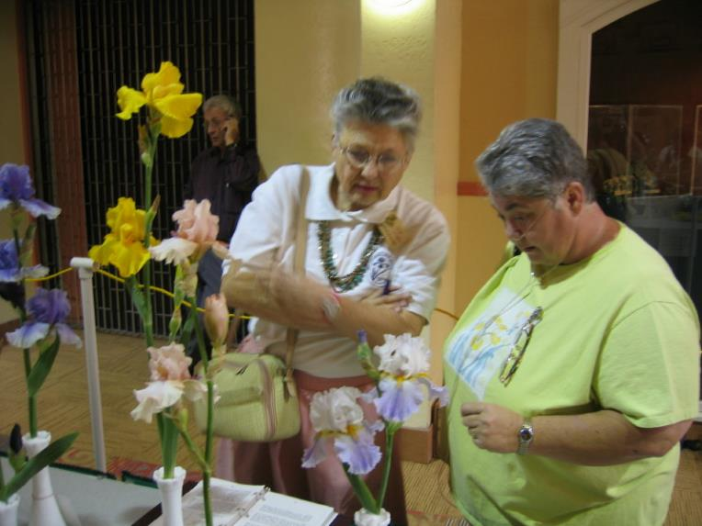
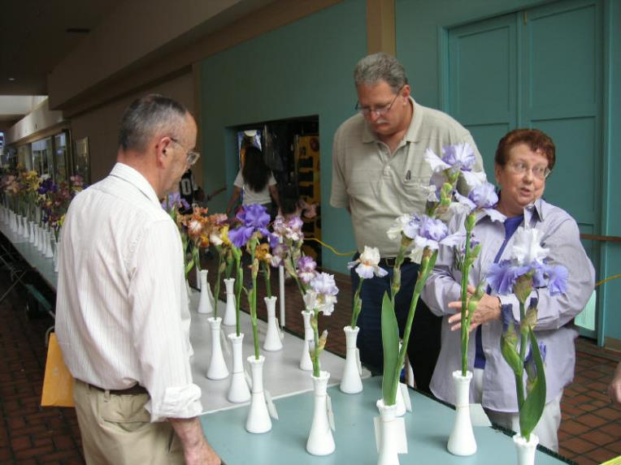
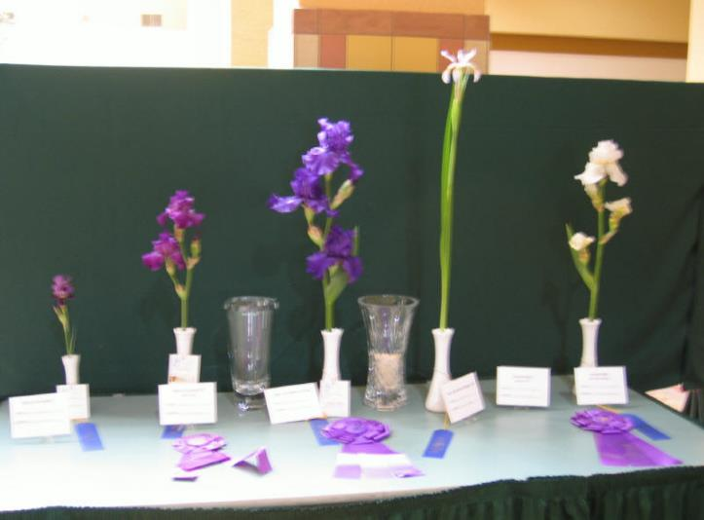
Purpose
This presentation describes the events, sections and rules for the MVIS annual Iris Show.

Slide 3
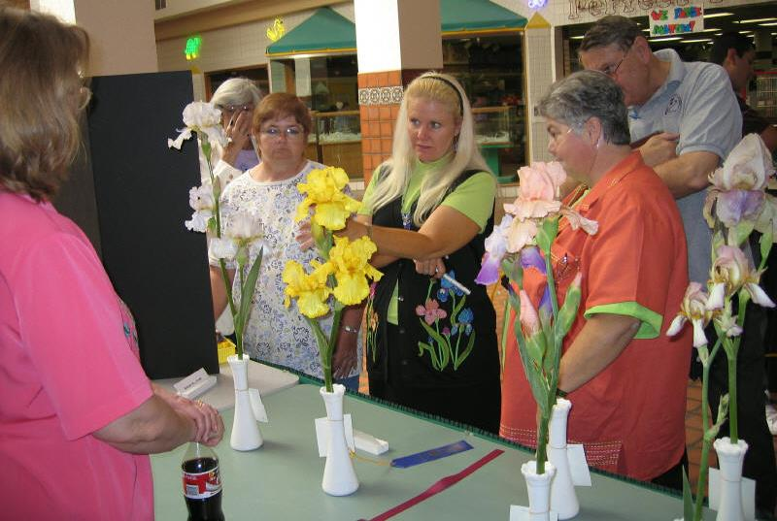
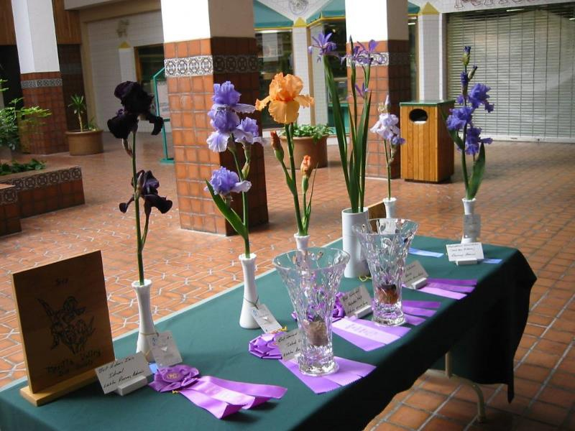
Outline
Each year the Mesilla Valley Iris Society has an Iris show.
This presentation:
  Explains why we have a show.
  The Events at the Show
  The Show Sections
  Filling Out Tags
  Rules

Slide 4
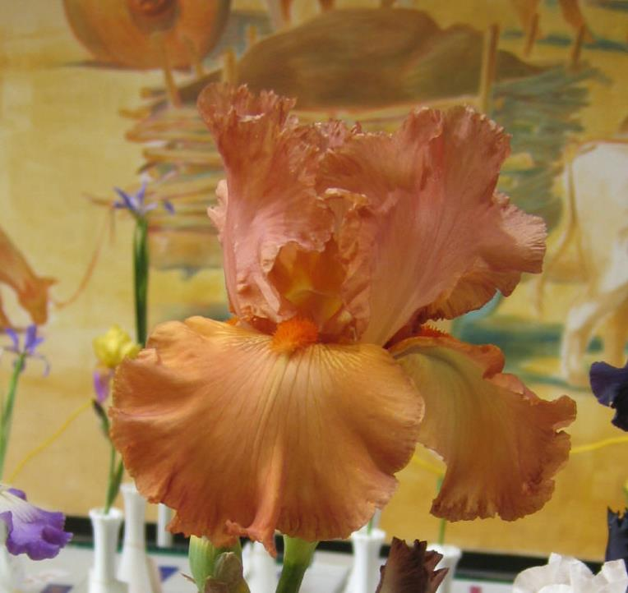
Acronyms
Copper Classic, TB
Tall Bearded TB
Standard Dwarf Bearded SDB
Miniature Dwarf Bearded MDB
Intermediated Bearded IB
Border Bearded BB
Mesilla Valley Iris Society MVIS
American Iris Society AIS
Spuria SP

Slide 5
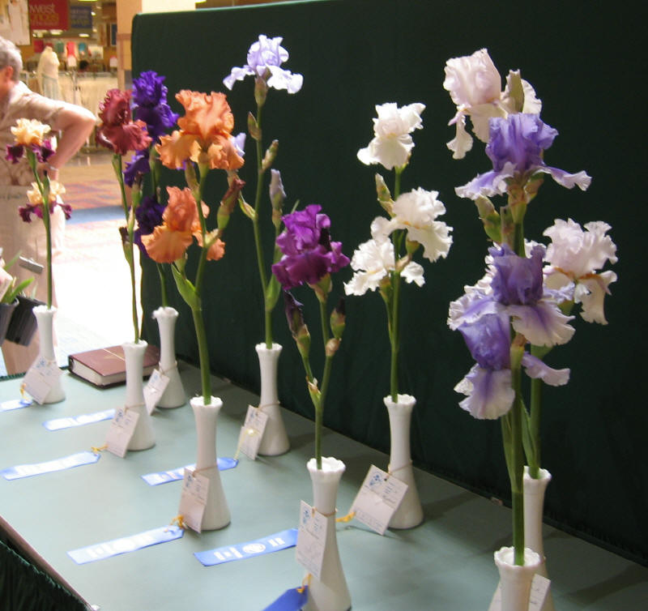
Purpose of Show
Promote Irises
Educate the public
Improve the Iris (hybridizers breed irises to win at shows)
Exchange of information among members.
Show each other what we have!
2006 Blue Ribbon Tall Bearded

Slide 6
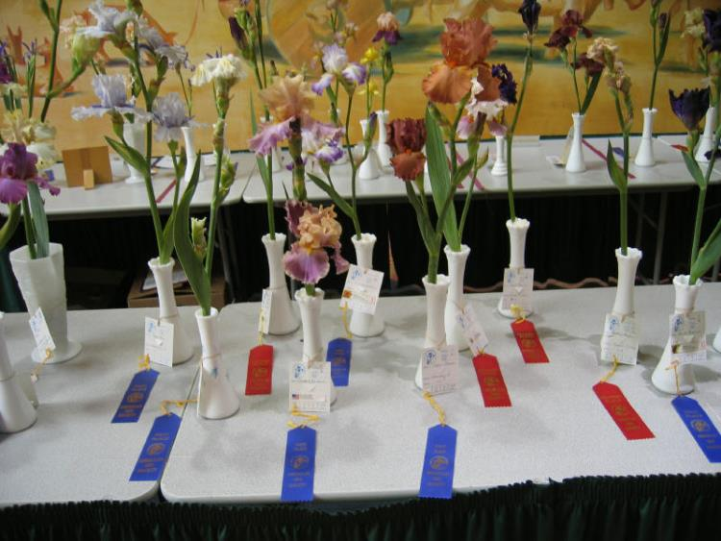
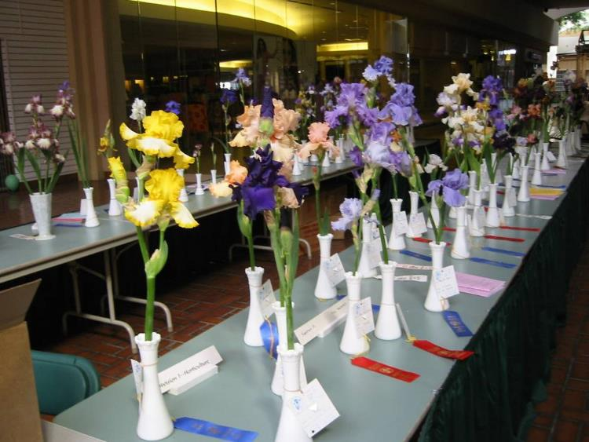
General Rules
Anyone who grows irises can exhibit.
Entries must be received in Classification from 8 to 10:30 AM.
MVIS assumes no responsibility for loss or damage.
Anyone may enter the Show without charge.

Slide 7
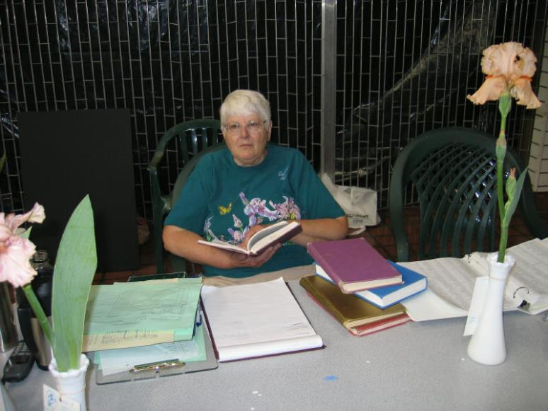
AIS Rules
Judging will be by American Iris Society rule.
All decisions of the judges are final.

Slide 8
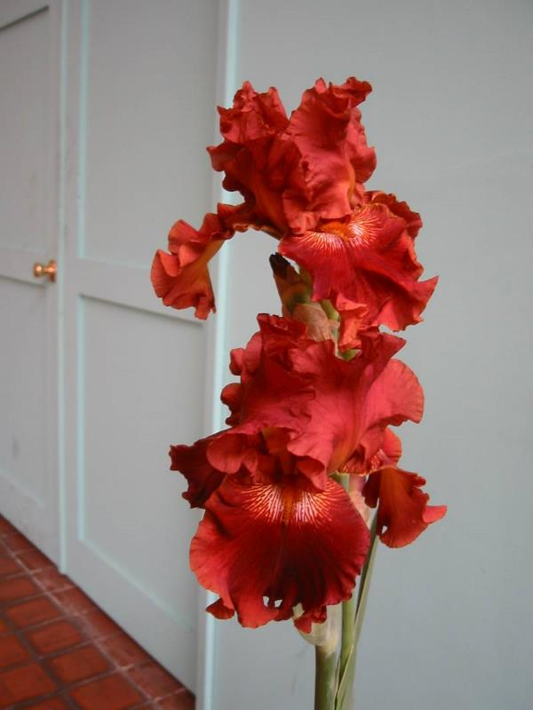
Named Cultivars
Except for seedlings and bulbous irises, each entry should be an iris registered with the AIS.
You must know the name and type (i.e. TB, BB, SDB, etc) if it is to be judged
Play With Fire, TB

Slide 9
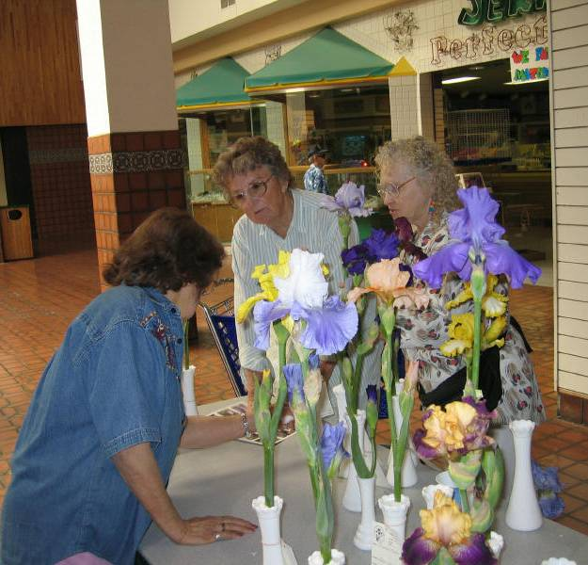
UFOs
Unnamed or incorrectly named specimens will be placed in the Section I: Unidentified Flowering Object (UFO) and may not be considered for AIS awards.
The Roswell club is rumored to have lots of UFOs ;-)

Slide 10
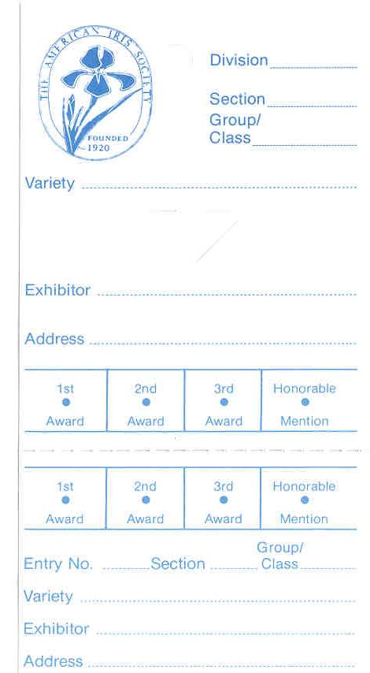

Entry Tags
1
Horticulture
B
Space Age
Each entry should have an entry tag with division, section, group, cultivar name and exhibitor name and address.
Each tag has a top and bottom section that must be filled out.
Mesmerizer
Jane Doe
5316 Main Street
Las Cruces, NM 88011
Do Not Fold
Entry No. is provided by the club.
Make sure you get one.
11
B
Mesmerizer
Hint:
Use your mailing address labels to save time.
Jane Doe
5316 Main Street
Las Cruces, NM 88011

Slide 11
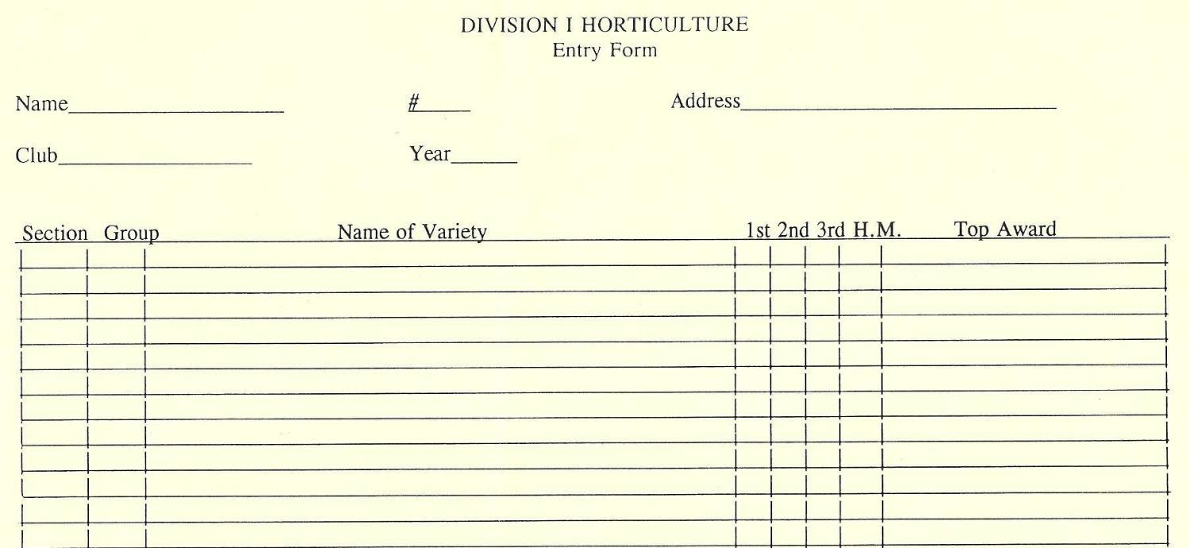
Entry Form
If for some reason you do not exhibit an iris listed on your form, then make sure you cross it off the form! Otherwise the tally clerk at the end of the judging will go nuts when she can’t find your iris.
Jane Doe
5316 Main Street
Las Cruces, NM 88011
Jane Doe
11
MVIS
2009
Tall Bearded
A Dusky Challenger
B Mesmerizer
C Persian Padishaw
D Vavoom
E Chickasaw Sue
F I Bless
G Lady Emma
N Apricot Frosty
P English Box (Plicatas)
Space Ager
Arils and Arilbreds
Medians
Collection
English Box

Slide 12
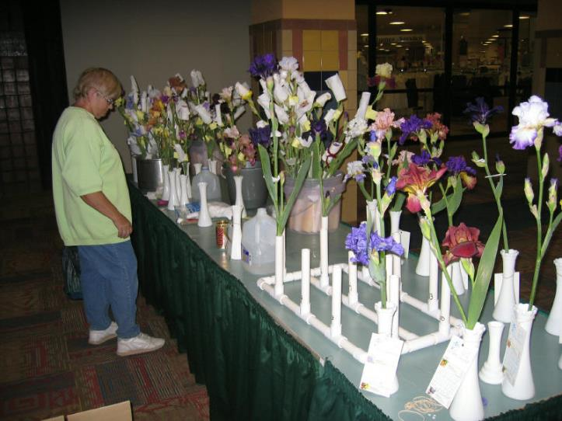
Division 1 Horticulture
Enter as many different varieties as you like
However, other than Collections, you can only enter one specimen stalk of a variety within each appropriate Section or Group.

Slide 13
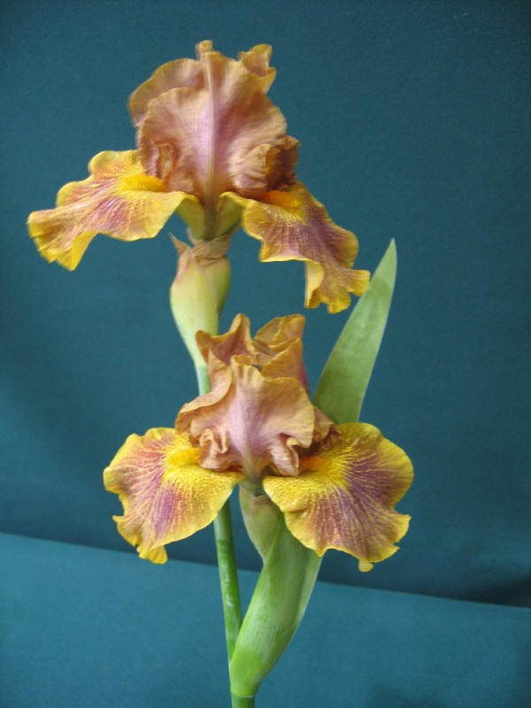
Horticultural
Special Rules
At least one fully opened flower must be present
Entries must have been grown and groomed by the exhibitor whose name is on the entry tag.
All entries (except for bulbous iris) must have been registered with the AIS and introduced into commerce. Otherwise it is entered in the seedling division
Dude, TB

Slide 14
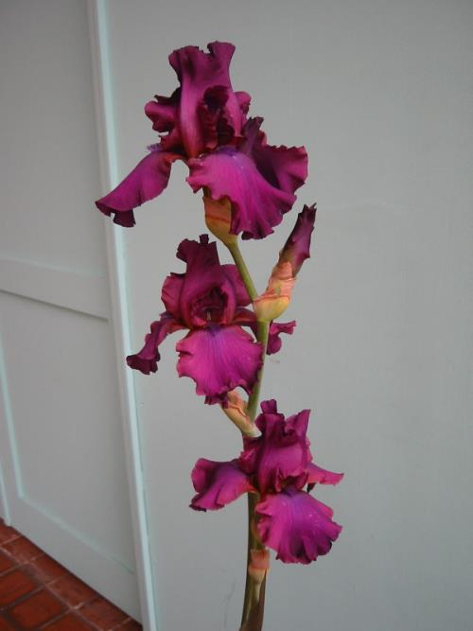
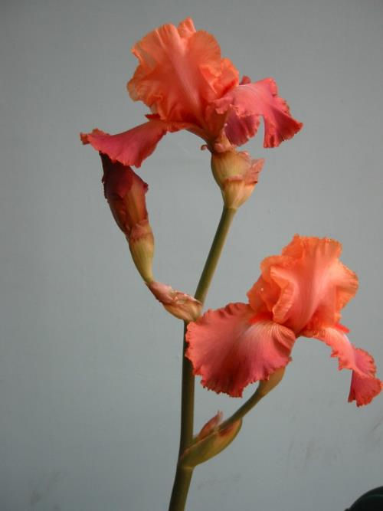
Division 1
Section A -Tall Bearded
MVIS shows typically have over 100 TB stalks on display
Surprisingly enough, very few cultivars have more than one stalk entered.
Sultry Mood, TB
Life Of Riley, IB

Slide 15
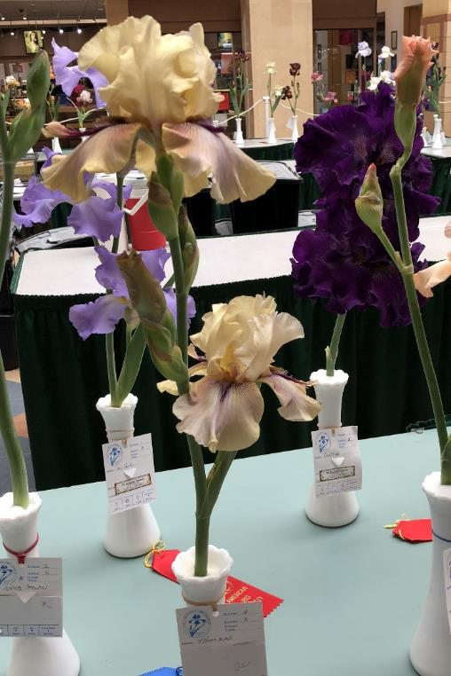
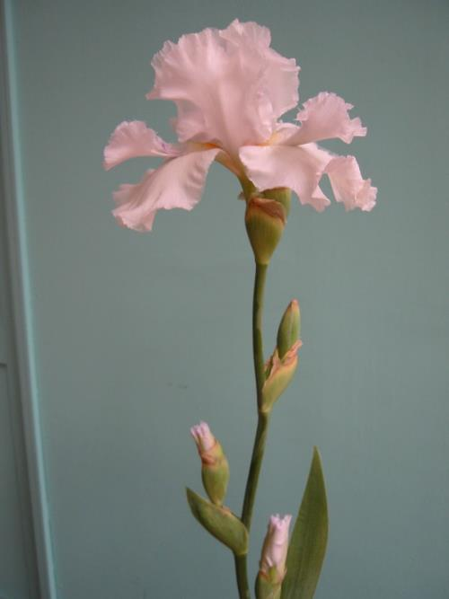
Division 1
Section B – Space Agers
Mesmerizer, SA
Thornbird, SA

Slide 16
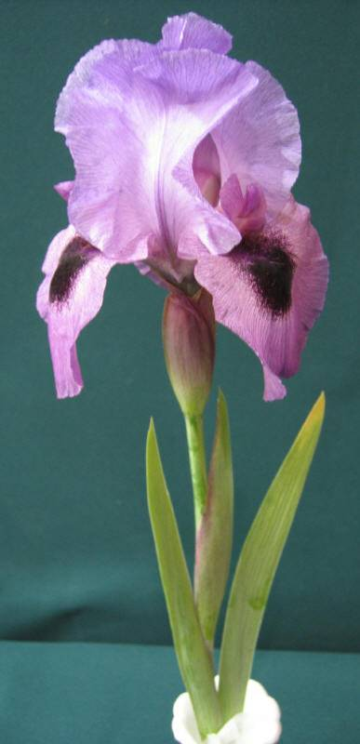
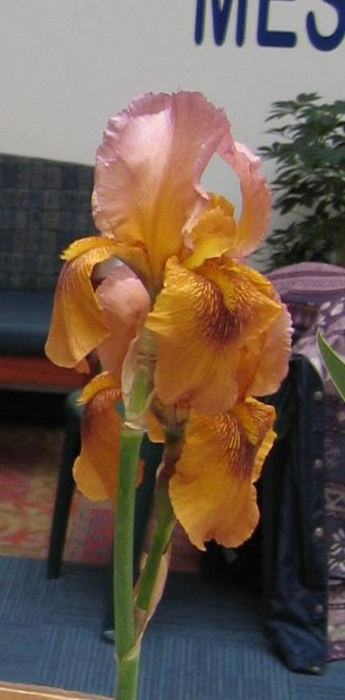
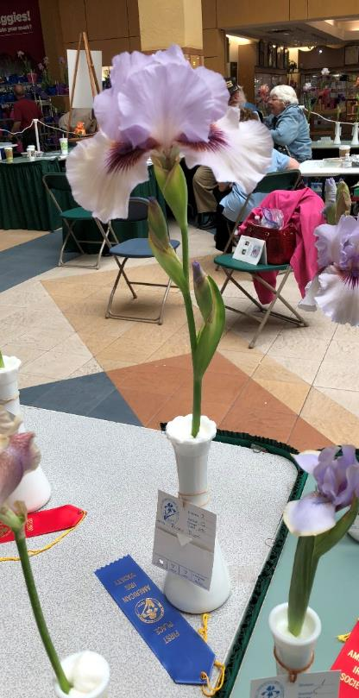
Division 1
Section C
Arils and Arilbreds
Persian
Padishaw, AB
Kaza Nama, AB
Perry Dyer, AB

Slide 17
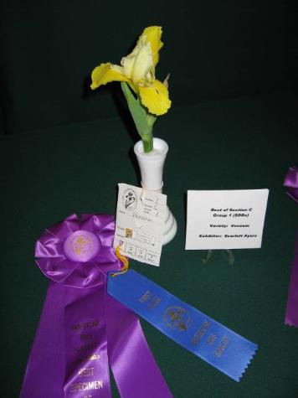
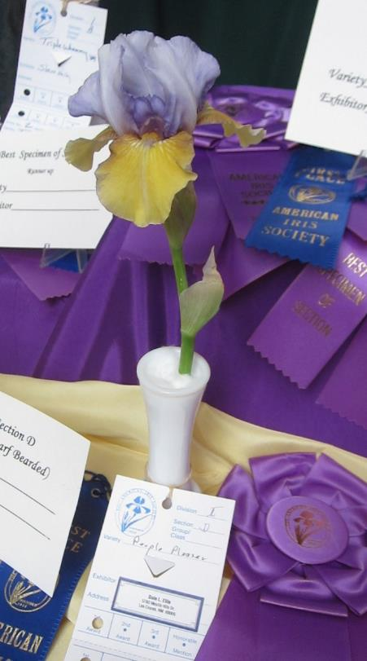
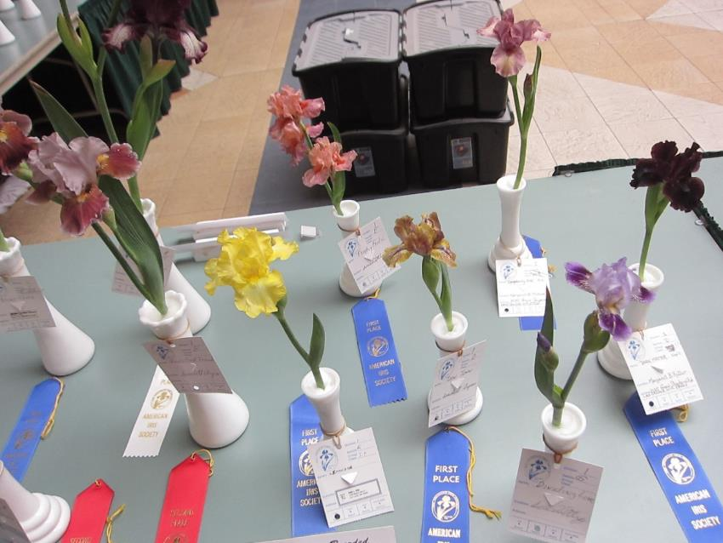
Division 1
Section D
Standard Dwarf Bearded
Vavoom, SDB

Slide 18
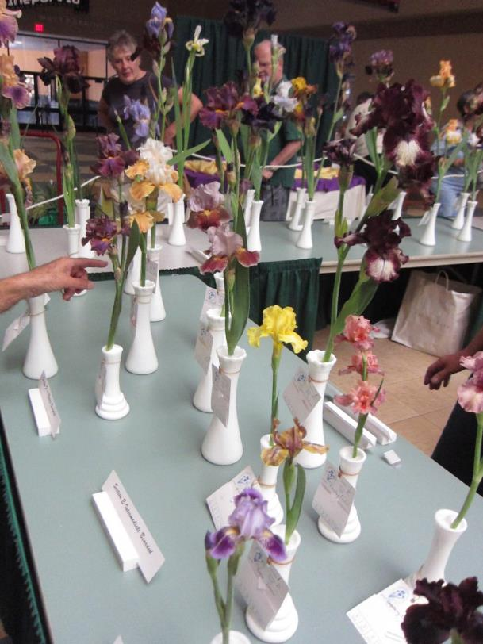
Division 1
Section E
Intermediate Bearded

Slide 19
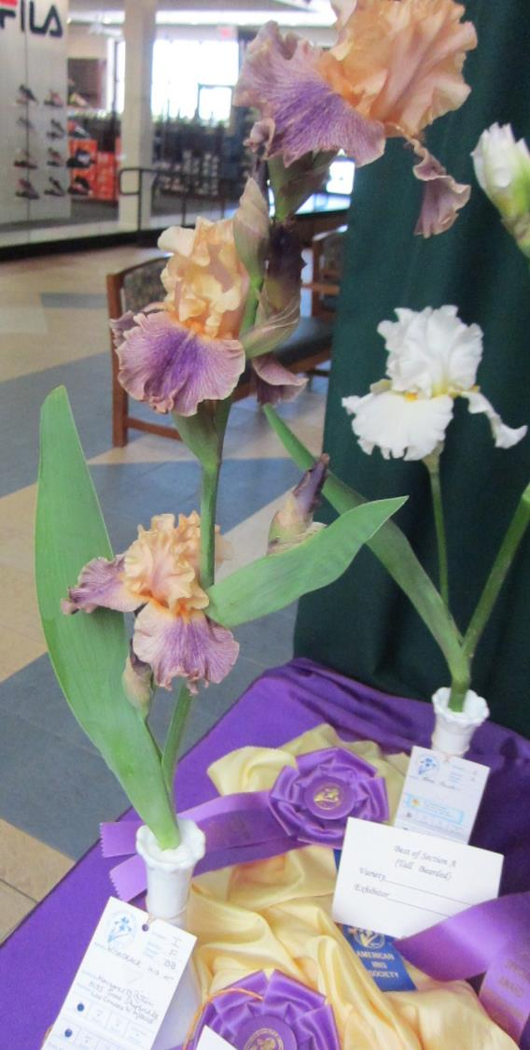
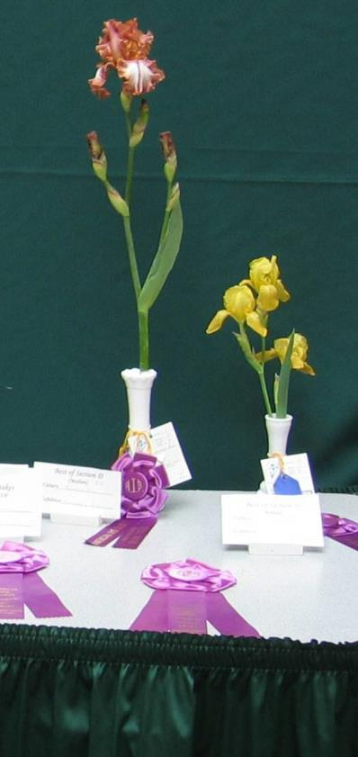
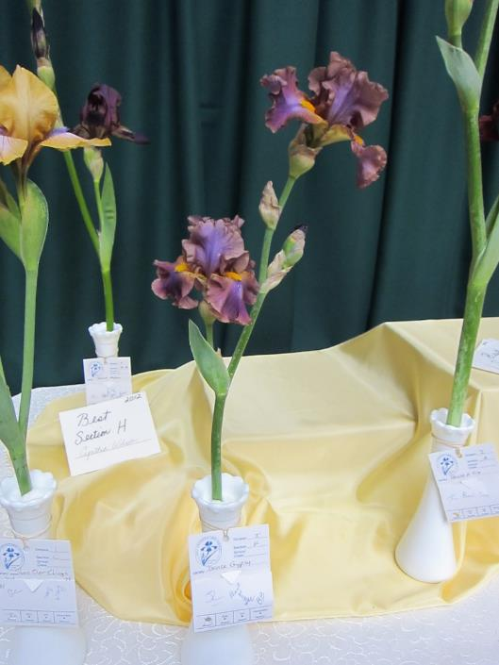
Division 1
Section F
Border Bearded
Wisecrack, Best
In Section 2015
BB
Chickasaw Sue, BB
Lady Emma, MTB
Dance Gypsy, BB

Slide 20

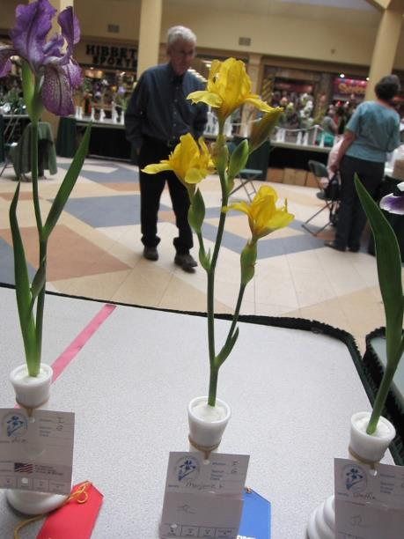
Division 1
Section G
Miniature Tall Bearded
Marjorie, MTB

Slide 21
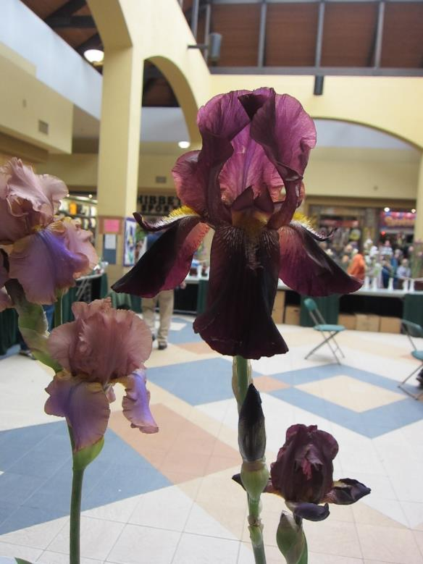
Division 1 – Section H
Section H Historic (over 30 years old)
1. Collectables….1950 through 1988
2. Golden Oldies…. Prior to 1950
Black Hope can be entered as a TB, SA or Historic. Which section should it be entered?
Black Hope, 1963,
Lloyd Austin, SA
Best Historic

Slide 22
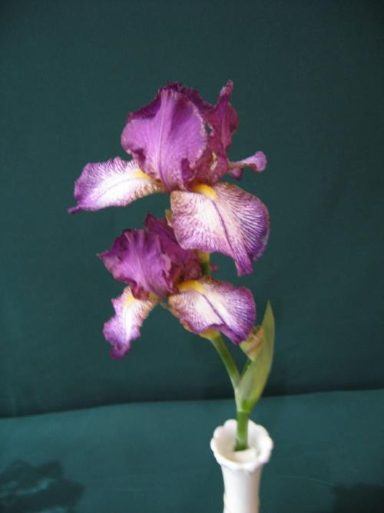
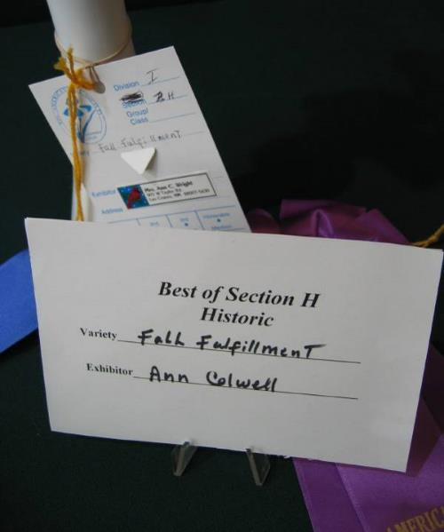
Division 1
Historic Section H
Any Iris introduced before 1988 (30 years before the current year) must be entered in the Historic Section (Section H)

Slide 23
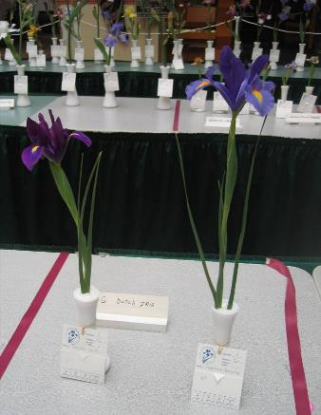
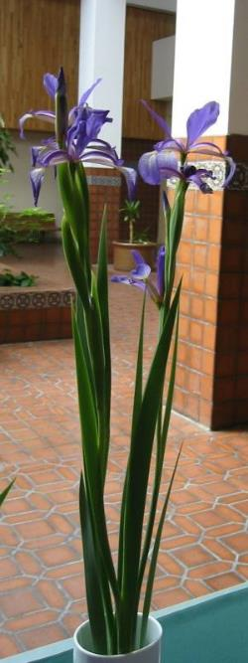
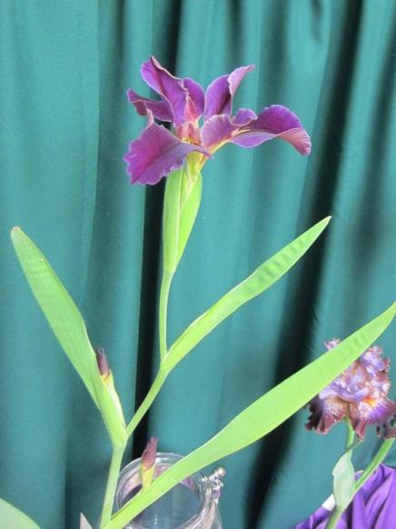
Division 1 –Horticulture (cont)
Dutch
Section I Spuria
Section J Louisiana
Section K Siberian
Section L Dutch/ bulbous
Section M Other
Section N Collection
Section P English boxes
Atchfalya, LO
Best in Show, 2015
Belise, SP

Slide 24
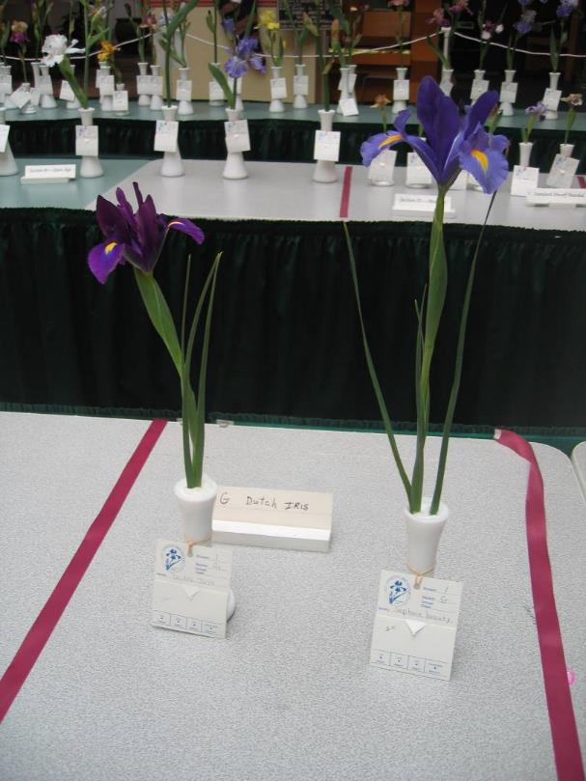
Division 1
Dutch Section L
Dutch Iris and other bulbous iris are not eligible for the “Best Specimen in Shown”

Slide 25
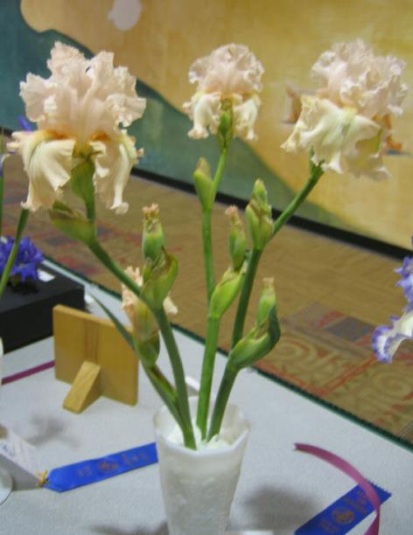
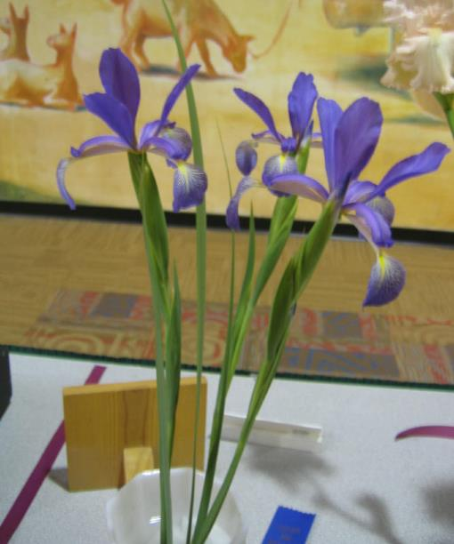
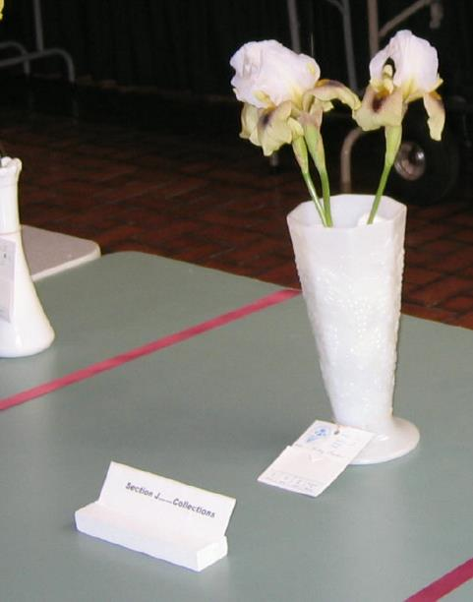
Division 1
Collections Section N
A “collection” is three stalks of the same cultivar of iris or three stalks of different cultivars. The collection may be of any type, but all three irises must be of the same type (i.e. all TBs or all BBs) and should be as uniform as possible

Slide 26
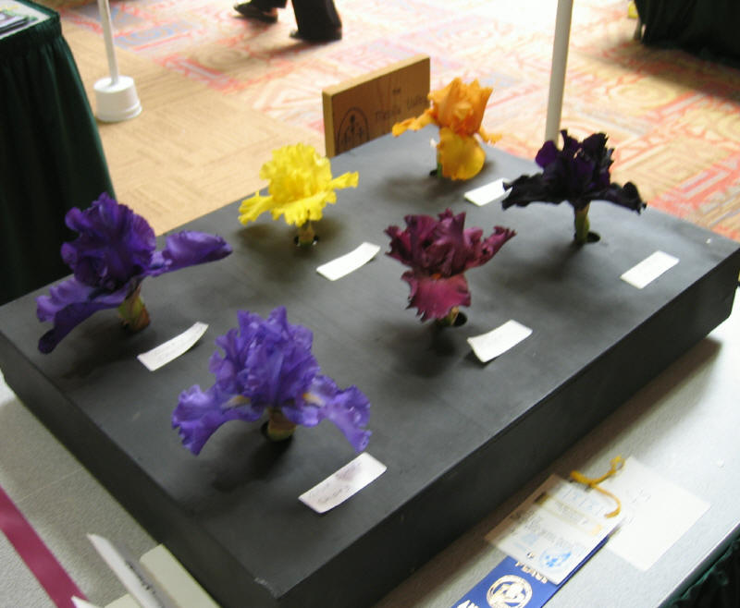
Division 1
English Boxes Section P
A themed entry (all plicatas, all amoenas, all selfs etc.)
Arrangement must be made with show chairman to furnish the English Boxes prior to the show.
Ribbon counts towards Sweepstakes award
Not eligible for “Best in Show”
Members Only
Selfs

Slide 27
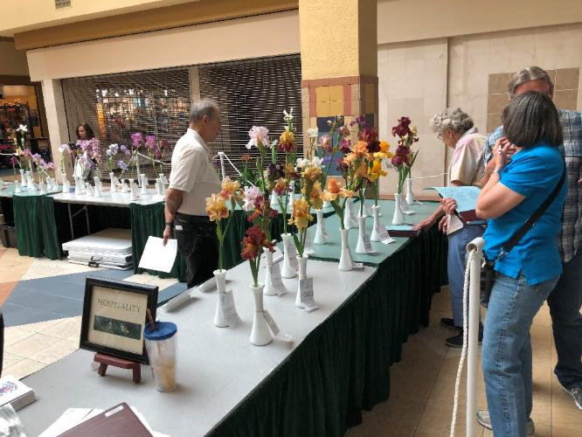
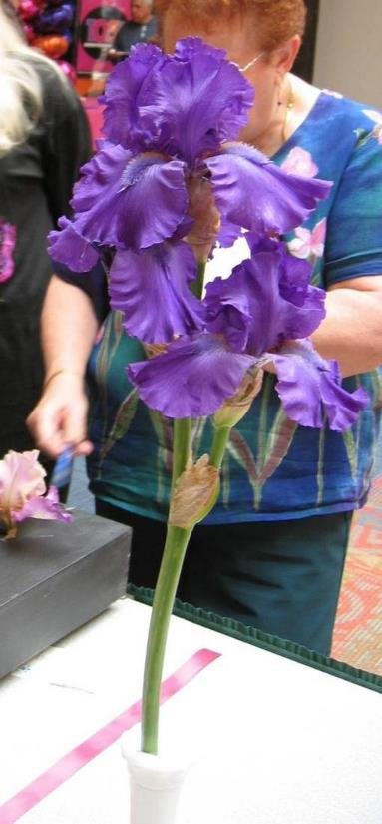
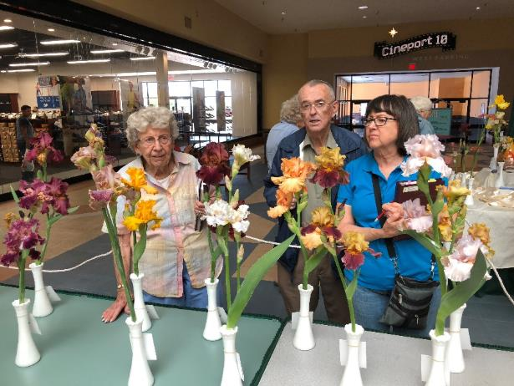
Division II Seedlings
Tall Bearded
Other
At the judges discretion, a “Best Seedling” Rosette maybe awarded. Then it automatically receives an Exhibition Certificate (EC)

Slide 28
Division III
Youth (Under 19)
All Exhibits must be grown and entered by the person whose name appears on the entry tag.
Youth exhibitors may enter in either Youth section or the regular Horticultural division, but not both at the same show.
All exhibitions except bulbous irises and collections are eligible for “Best Specimen of Show”
Notes:
A youth can’t exhibit the same iris in both Division I and III at the same time.

Slide 29
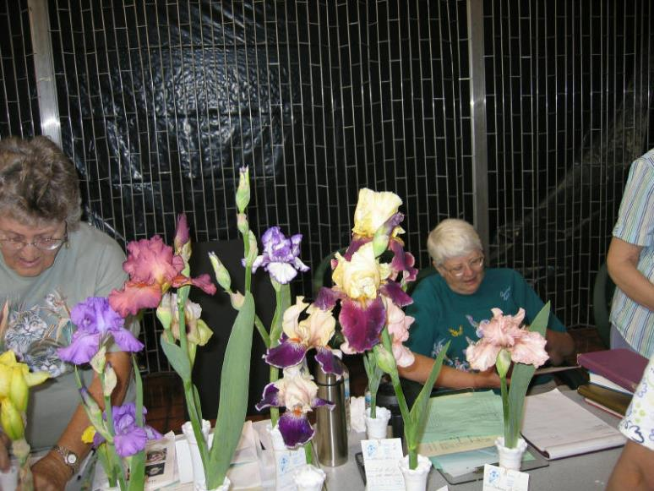
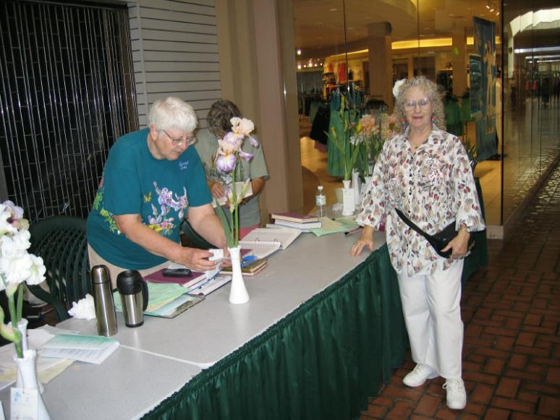
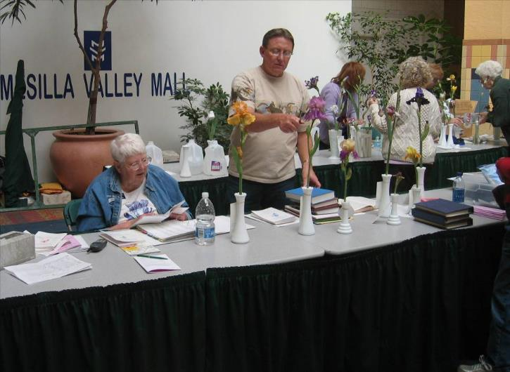
Classification
MVIS classification clerks will examine each entry and compare it to a written description for that cultivar. If the iris does not match the description, then it is rejected. The judges may also challenge a cultivar.
This happens at least once per show.

Slide 30
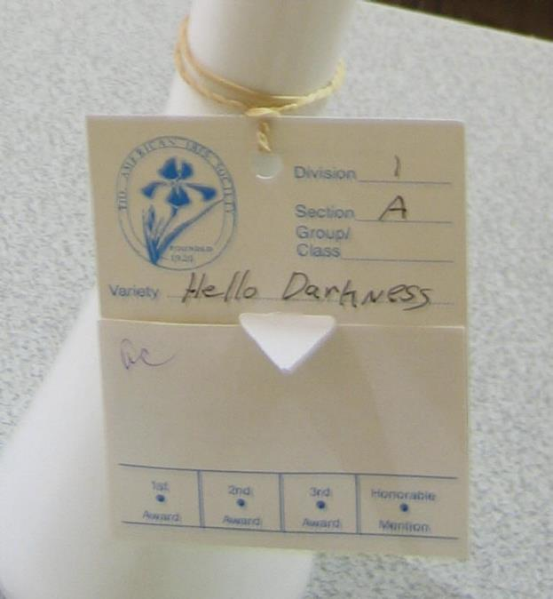
Entry Tags (cont)
Once the iris is verified by the classification clerks, the clerk will fold the tag so the name of the exhibitor is hidden from view. The clerk will initial the tag.
The judges won’t know who is the exhibitor until after judging.

Slide 31
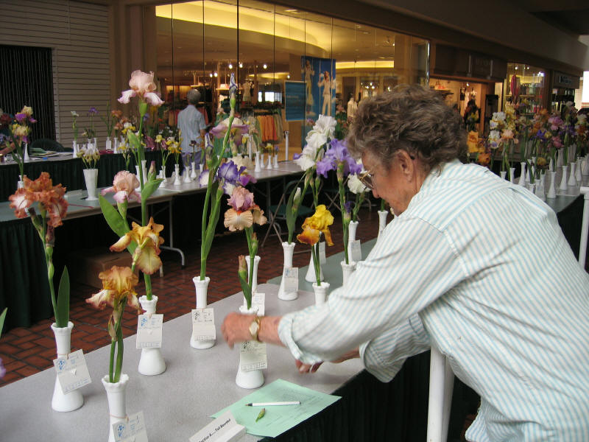
After classification
Irises are placed on the table in alphabetical order.
They are grouped into tall bearded, median, beardless, species, seedlings, collections etc.

Slide 32

Classification is Closed
Judging starts at 11:30 AM.
Classification closes at 10:30 AM sharp.
Make sure you give your irises to the classifications clerks well ahead of 10:30 AM.

Slide 33

The Judges
The judges are not from the local club but from other iris clubs (usually in NM).
Usually, there are two teams of 2-3 judges each.
Each team judges a set of irises.
However, the Best in Sections and Best in Show are chosen by all judges.

Slide 34


How the Iris is Initially Judged
Each named variety is judged on its own merits. Judging is based on culture, condition and grooming.
At this stage the iris is not compared with other irises unless more than one of a variety is shown.
Judges may not touch entries

Slide 35

Judging Clerks
Volunteer judging clerks are assigned to help each judging team.
The clerks place the ribbons string underneath the vases.
The Clerks may turn the vases if directed to do so by the judges. The judges may want to see all sides of the iris.
Clerks do not speak unless asked.

Slide 36

Ribbons
Blue, Red, White and Pink Ribbons are awarded to 1st, 2nd, and 3rd places and honorable mention.

Slide 37



Awarding Ribbons
Once a ribbon is awarded, a hole is punched in the appropriate location on the tag and the ribbon is placed on the vase by the clerk.
If the ribbon is not blue, then the clerks tear off the bottom portion of the tag and hand it to the tally clerk.
The bottom portion of blue ribbon winners are torn off and handed to the tally clerk after the Best in Sections and Best Specimen have been chosen.

Slide 38

Only one Color Ribbon per Named Cultivar
Any number of blue ribbons may be awarded in a show but only one blue, red and white ribbon per named cultivar.
Tact, IB

Slide 39

Ribbon
The judges are not going to give a blue ribbon to something just because it is the only one of its kind entered. It must earn that ribbon.

Slide 40



Best in Section (TB)
Rosette Ribbon
First the best of the blue-ribboned TBs are brought to the front table.
The judges may ask the clerks to eliminate some from the table.
The judges vote on the remaining TBs.
Finally, the Best of the TBs and the first runner-up are chosen.

Slide 41

Best Section
Rosette Ribbon
The other Best In Sections for Medians, Spurias, Collections, etc are judged in place on the tables.

Slide 42


At Least Five
At least five Irises must be entered in a section from three different exhibitors in order to get a Best In Section.
However, the show chairman may combine some sections like the medians to get enough irises and exhibitors
Exhibitors are encouraged to bring arils and medians so the show has enough entries for Best in Section even if they are not the best quality.

Slide 43


Best in Show
Vase and Certificate
The clerks bring the irises that won Best in Section to the front table.
The judges select the Best in Show
Bulbous Iris, Collections, English Boxes and Seedlings may not be considered for "Best Specimen of Show”

Slide 44

Winners Table

Slide 45


The Vases are Awarded
The vases are awarded to the top two Irises in the show.
That’s All Folks, Best TB
Deja Blue, Best SA
and Best in Show 2007
That’s All Folks, Best Specimen
and Best in Show 2018

Slide 46

Sweepstakes Award
Silver Medal and Certificate
The tally clerk tallies the blue ribbons in the Horticultural Divisions.
The person with the most blue ribbon wins the Sweepstakes Award and the silver medal.
The AIS believes this is the most important award.

Slide 47

Sweepstakes Runner-Up
Bronze Medal and Certificate
Bronze Medal and Certificate is awarded to second most first places in Horticultural Division

Slide 48


Division IV – Educational Exhibit
Only open to members of MVIS or AIS
Exhibits must be related to iris, iris culture or the American Iris Society and need not include fresh plant material.
An exceptional exhibit may be awarded a bronze medal.
Notes:
Educational Value 25 pts
Effectiveness and Presentation 50 pts
Originality and Distinction 25 pts

Slide 49



Peoples Choice
This is an award that is chosen by the public for their favorite iris.
It is not an AIS award
Freedom’s Song, TB

Slide 50


Presentation of Awards at 4PM

Slide 51
Awards Summary
Best Specimen of Show Rosette, Award
Best Specimen Runner Up Rosette, Award
Sweepstakes Rosette, Silver Medal
Sweepstakes Runner Up Rosette, Bronze Medal
Best Collection Rosette
Best English Box Rosette
Ribbons will be awarded as follows
First place Blue
Second Place Red
Third place White
Honorable Mention Pink

Slide 52

End of Show
No entries may be removed until closing time and if not claimed, will be disposed of in a suitable fashion.
Flower stalks not claimed by show close will become the property of MVIS and distributed as complementary bouquets to assisted living facilities.

Slide 53


The End
End This Presentation

