Slide 1
Mesilla Valley Iris Society
Growing Irises
In The Desert
Tips and Tricks for Growing Our Favorite Flower
Note: 95% of all pictures are from irises grown in NM.

Slide 2
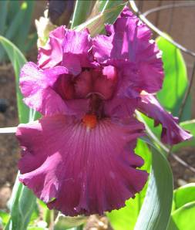
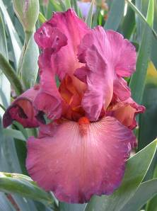
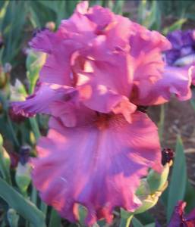
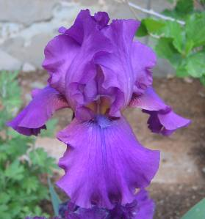
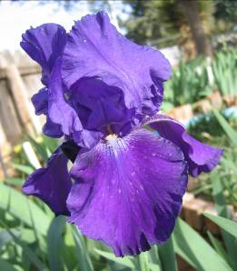
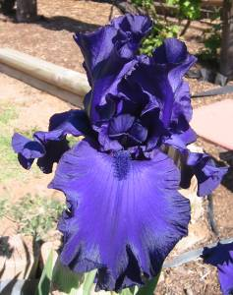
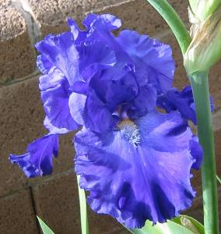
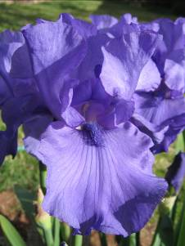
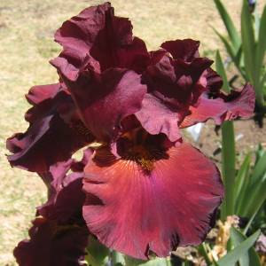
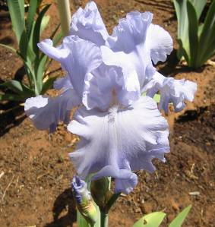
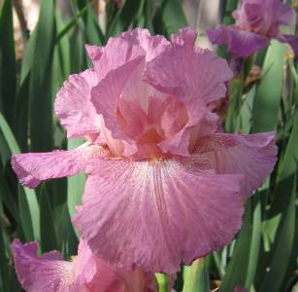
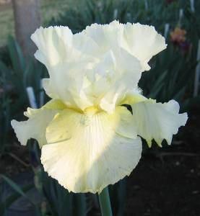
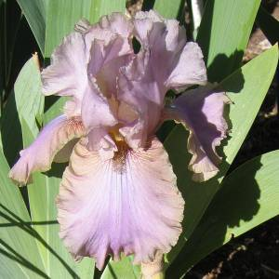
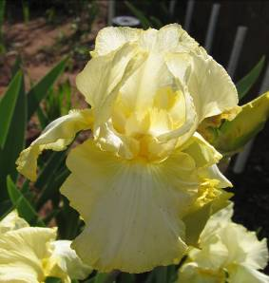
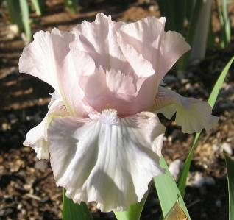
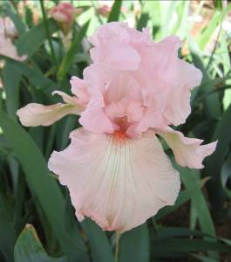
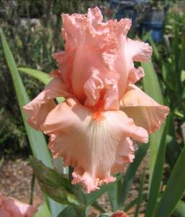
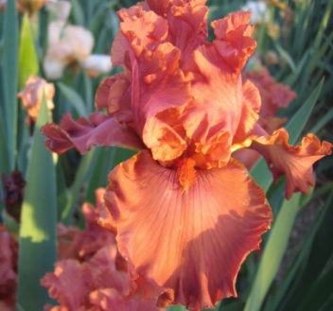
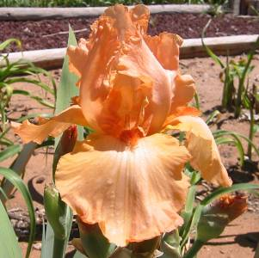
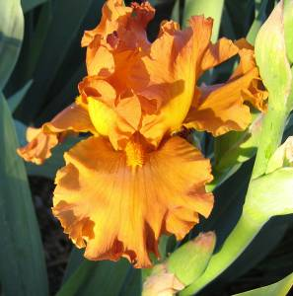
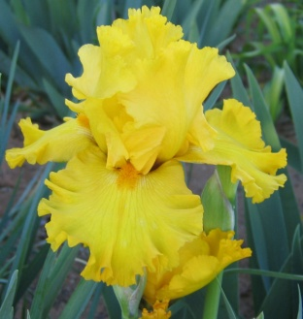
Iris – The Rainbow Flower
In mythology, Iris was the Greek goddess of the rainbow. As the rainbow unites Earth and heaven, Iris was the messenger of the gods to men who, instead of riding in a chariot, would ride on the rainbow to and from Olympus in her beautiful robe of many colors. She was the bridge between the world of the mundane and the world of the spirit.
Can you think of why the Iris was named after her?
Notes:
The names of the irises are
Vizier
Lady Friend
Aplomb
Gypsy Romance
Dusky Challenger
Autumn Bugler
Blue Suede Shoes
Blue
Abigua
Yaquina Falls
Unknown White
Total Recall
Pure As Gold
Golden Panther
Orange Harvest
Rustle Of Spring
Heidi Alana
Vanity
Bally Castle
Margarita Time
Foolish Fancy
Dynamite

Slide 3
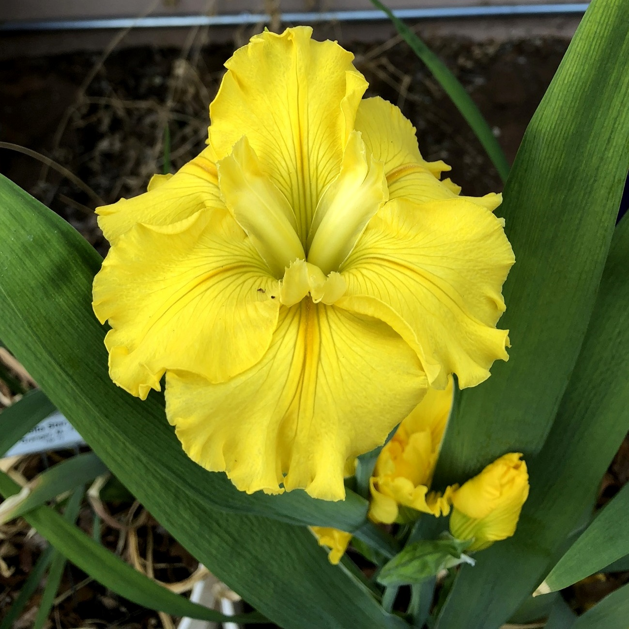
Outline
Types of bearded irises
Arilbreds
Louisianas
Spuria
Care

Slide 4
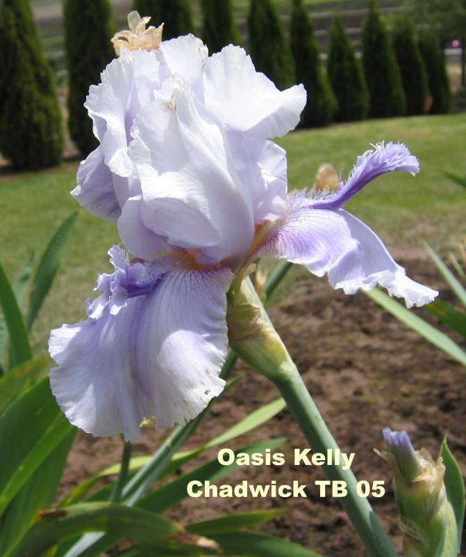
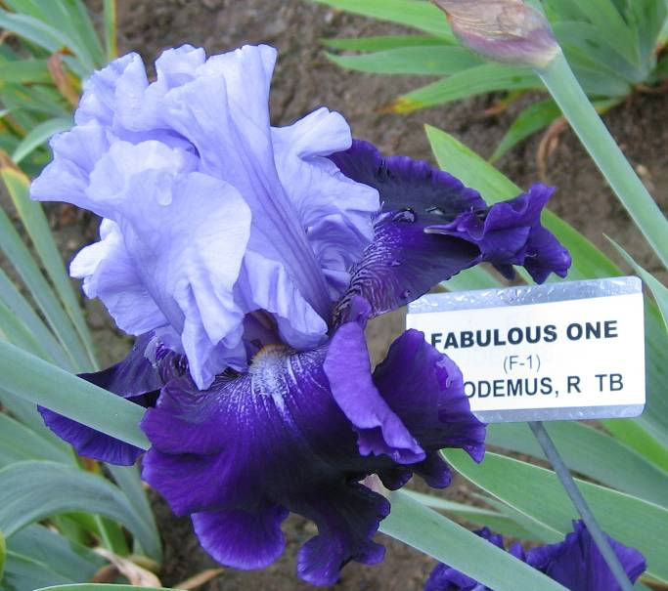
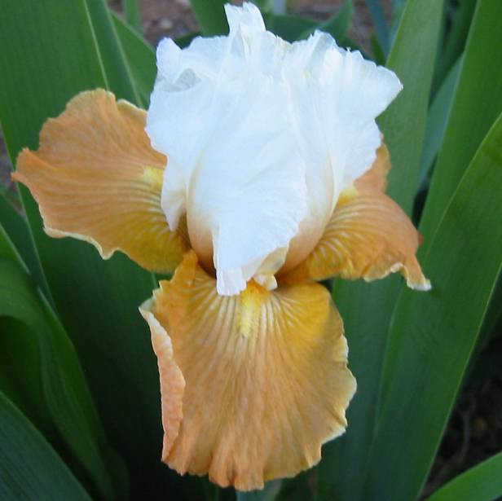
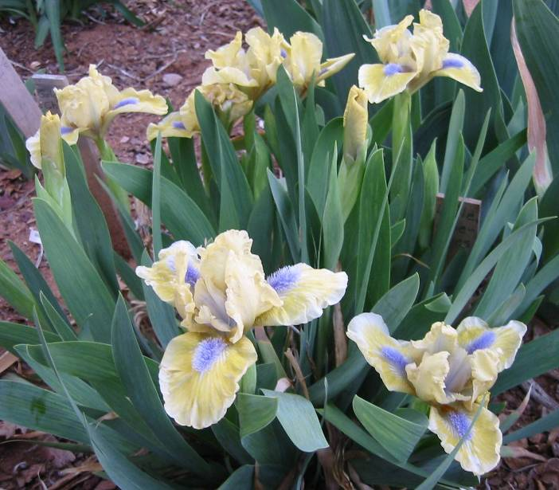
Types of Bearded Irises
Tall Bearded
Miniature Dwarf Bearded
Standard Dwarf Bearded
Intermediate Bearded
Border Bearded
Miniature Tall Bearded
Space Age
Historic
Arilbred
SA
Apricot Frosty
BB
Little Blue
Eyes, SDB

Slide 5
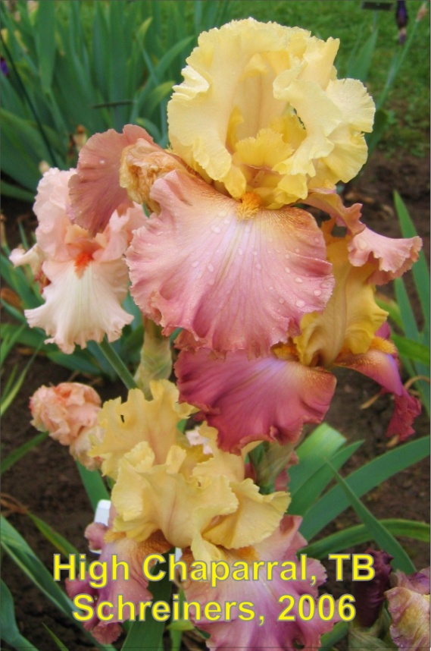
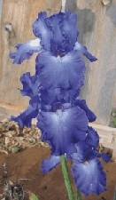
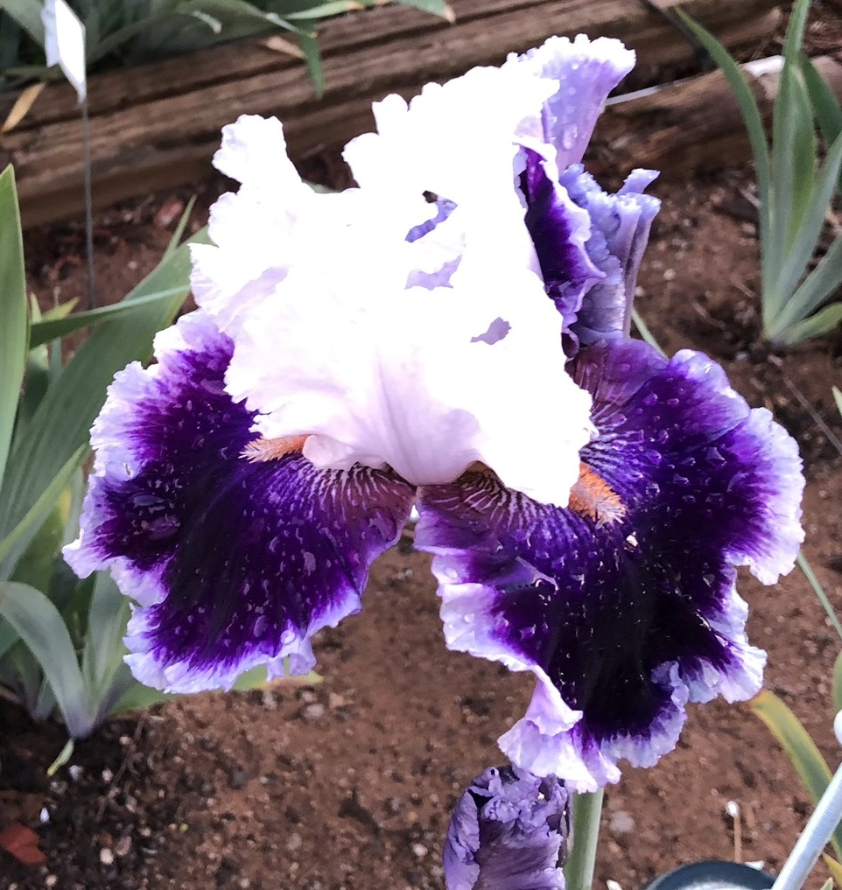
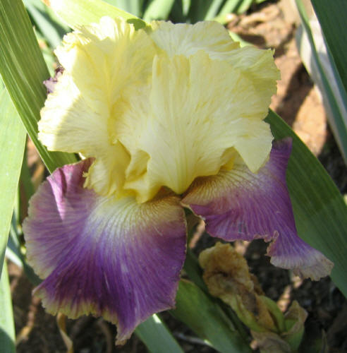
Tall Bearded (TB)
The queens of the iris world.
TB have stalks > 27 1/2 inches in height, with branching and many buds.
Bud count on a stalk ranges from 4-13 buds.
Flowers can exceed 7 inches in length
Some buds are double socketed and triple socketed
Stellar Lights. TB
Aitken, 1986
Sunnyside Delight, TB
Schreiner, 2002
Merry Amigo. TB
Notes:
In addition to a wide variety of colors and patterns, the TBs display other qualities (such as ruffling and lacing) more frequently than do the other classes

Slide 6
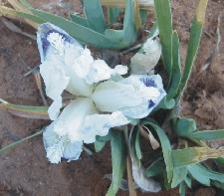
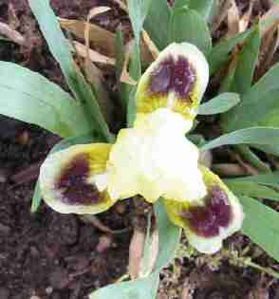
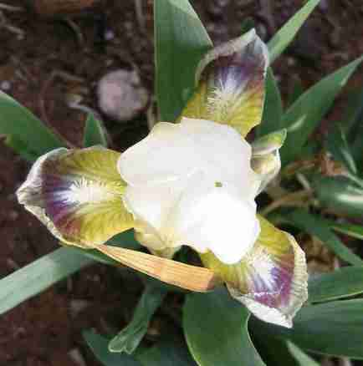
Miniature Dwarf Bearded (MDB)
Tiniest of bearded irises, with height of up to 8 inches.
Earliest to bloom.
Most MDBs do not grow well here. They require a colder winter.
Little Drummer Boy, MDB, Willott
Ditto, MDB, Hager, 1982
Bantan, MDB, Varner, 1985
Notes:
The MDBs will bloom but usually will not be the mound of flowers that they will be up north. Note that MDBs usually do not display lacing and ruffles like the TBs. However, they have color patterns that are not usually seen on the TBs. This is changing as TBs are being bred down and MDBs are being bred up.
Stems usually carry two flowers, but many more modern varieties now have three buds, which all goes to prolonging the flowering time.

Slide 7
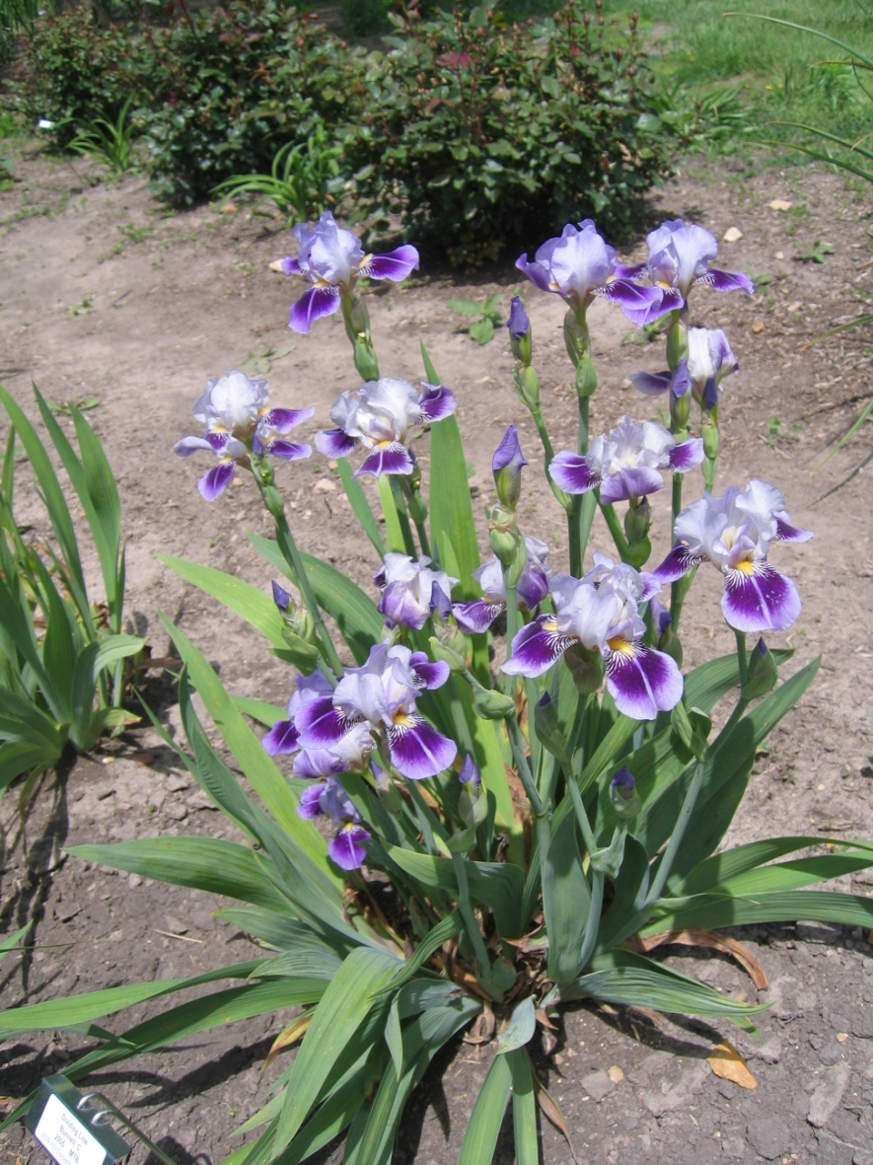
Medians
Medians is a term that refers to several classes:
  Standard Dwarf Bearded (SDB)
  Intermediate Bearded (IB)
  Border Bearded (BB)
  Miniature Tall Bearded (MTB)
Dividing Line, MTB
Notes:
For all medians, it can be said that the smaller the iris, the more important color is.
Strictly speaking a dwarf refers to a Miniature Dwarf Bearded and not a Standard Dwarf Bearded

Slide 8
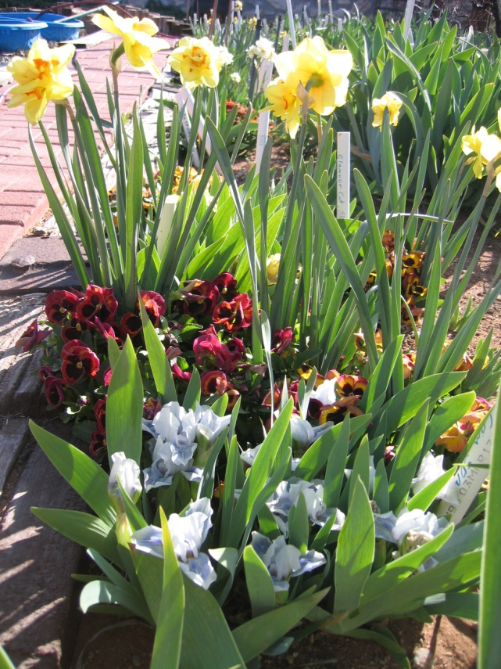
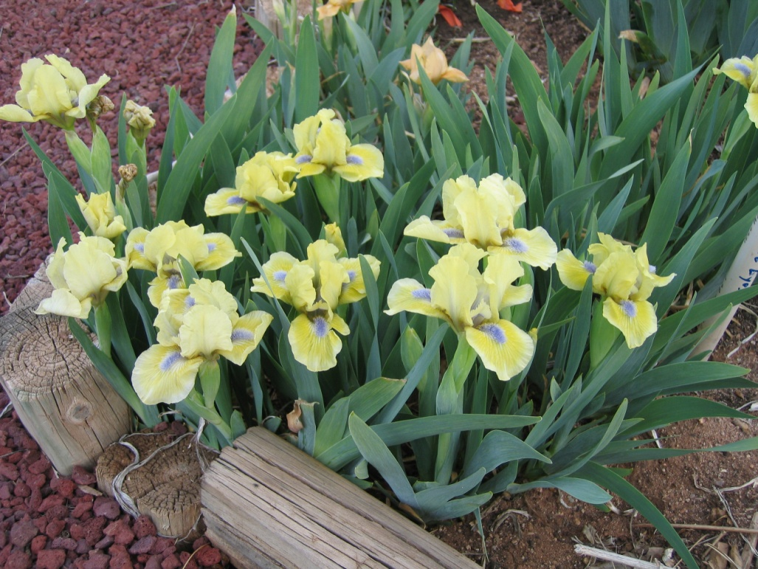
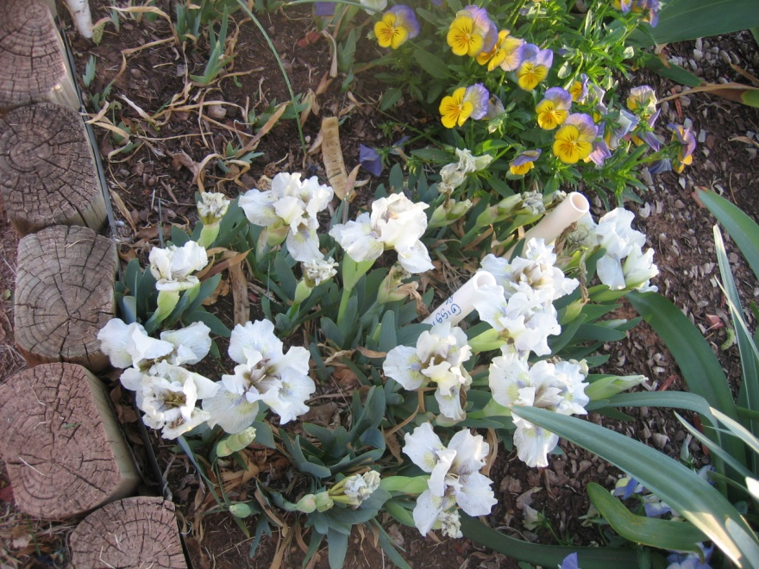
Standard Dwarf Bearded (SDB)
Range in height from 8 -16 inches.
Blooms after the MDB but before the TBs.
SDBs do quite well here
Dot Com, SDB, Jones, 2003
Little Blue
Eyes
Weiler, 1993
Giggler. Spoon, 2001
Notes:
Ideally the flower should not be in the foliage but should be above the plant.
The Cook Douglas medal is awarded to a SDB
Normally, the SDB iris has only 2 buds per bloomstalk

Slide 9
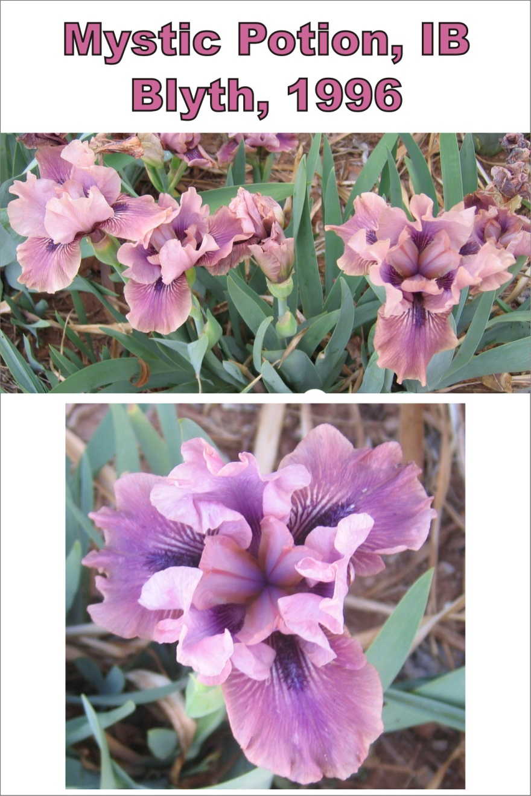
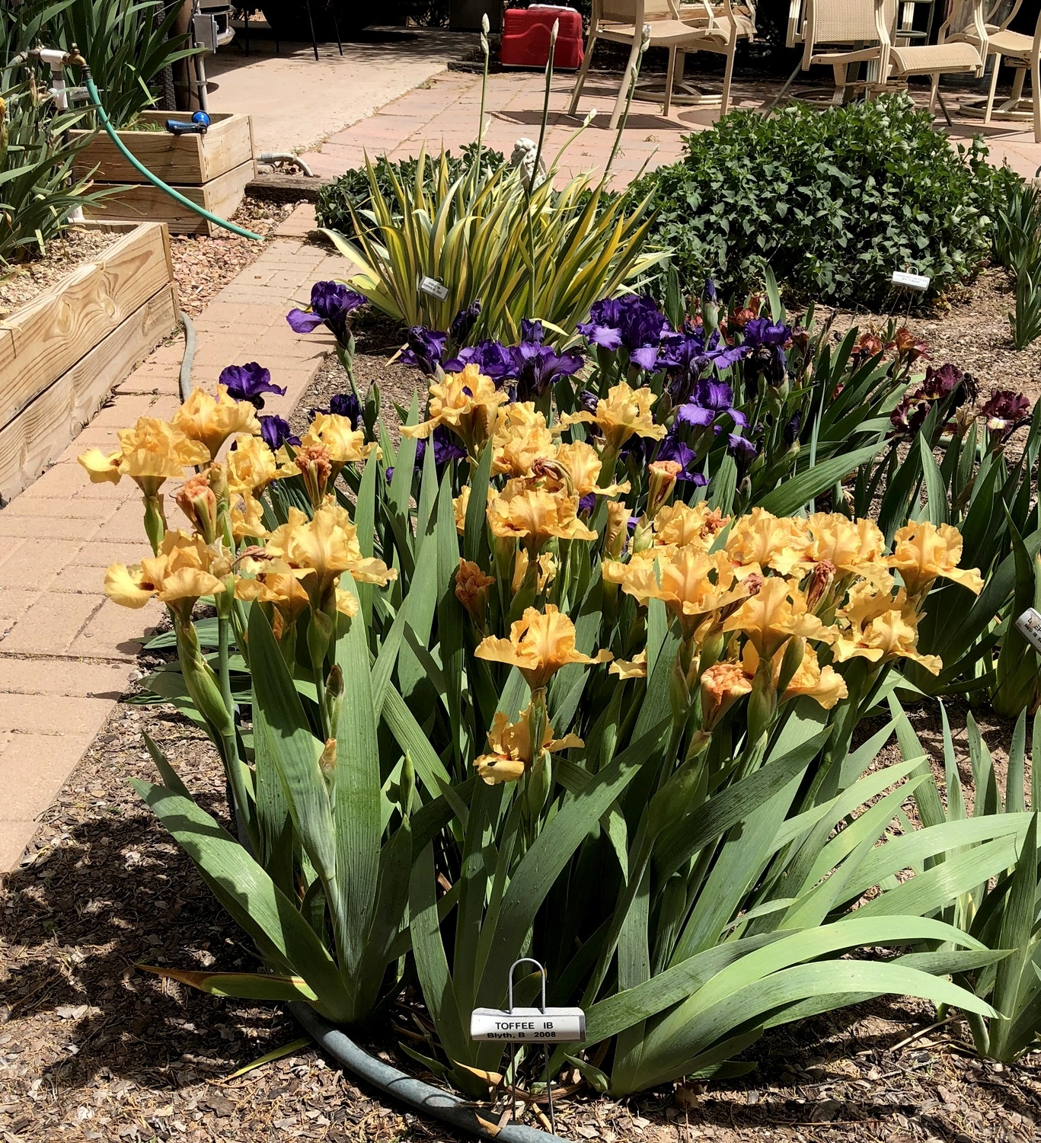
Intermediate
Bearded (IB)
Stand from 16 to 27 1/2 inches high
Bloom season overlaps the SDBs and the TBs.
Toffee, IB
Notes:
The Hans and Jacob Medal is awarded to an IB
Because modern Intermediates irises incorporate many different species in their background, they exhibit a variety of plant, stalk and flower types

Slide 10
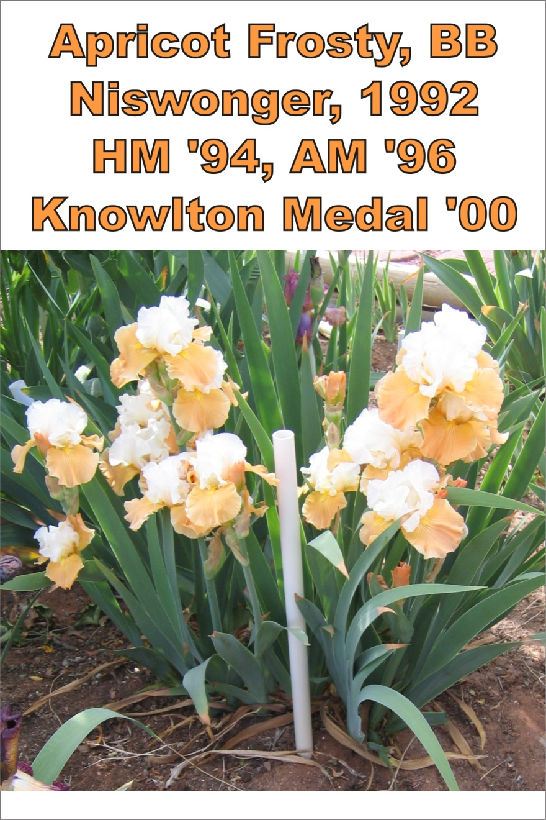
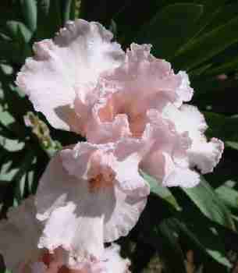
Border Bearded
Essentially small versions of the TBs in the same height range and bloom size as the intermediates
BBs bloom with the TBs.
Pink Bubbles, BB
Hager, 1980
Notes:
Good BBs have round, ruffled petals that complement their small size.
The Knowlton Medal is awarded to a Border Bearded Iris

Slide 11
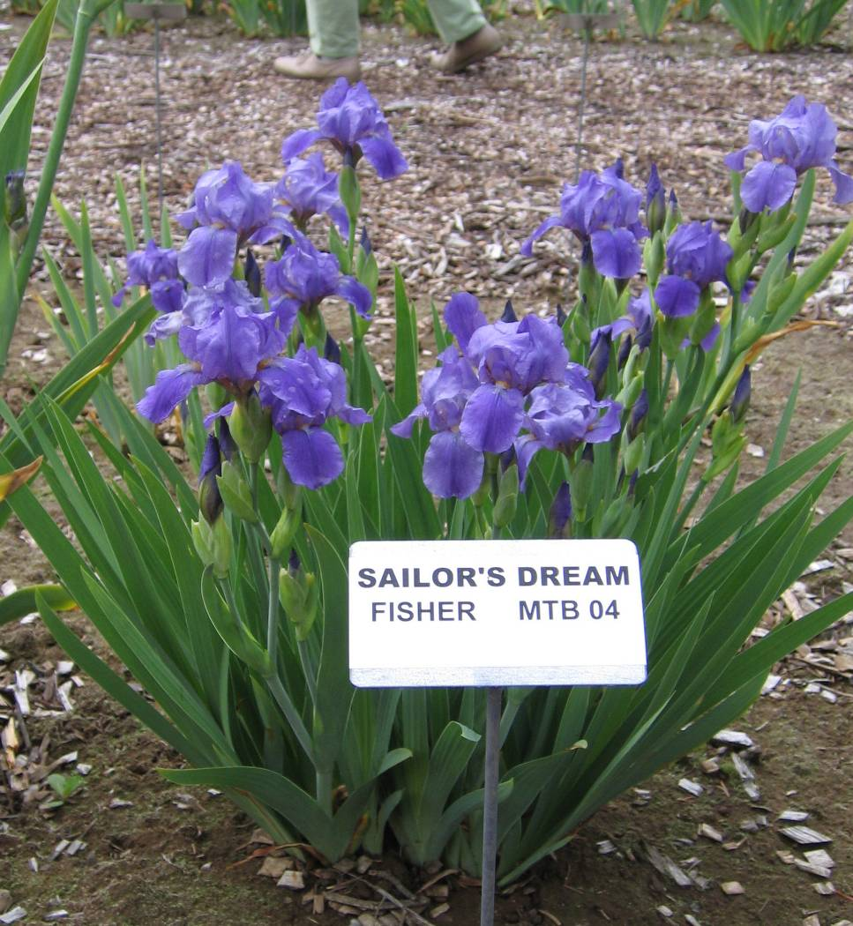
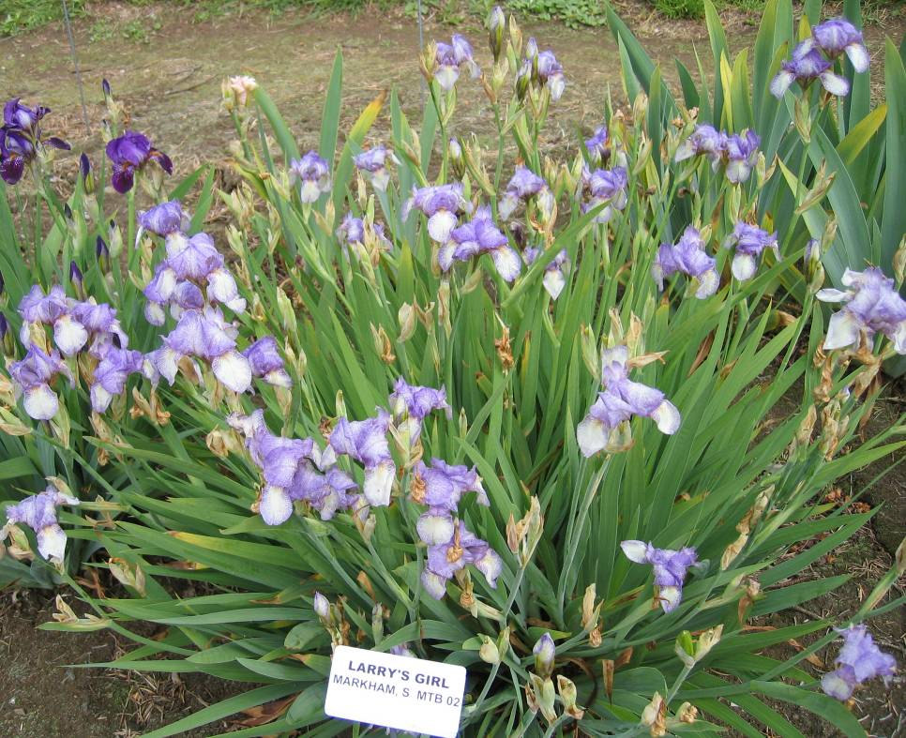
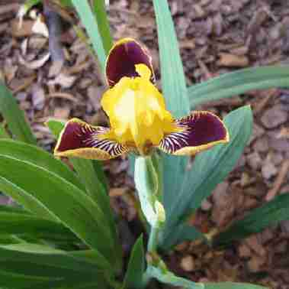
Miniature Tall Bearded (MTB)
  Height from 16 inches) to 27 1/2 inches.
  This class is distinguished by daintiness and delicacy.
  Favored as a cut flower and is often called the table iris.
Bumblebee Delight, MTB
Norrick, 1986
Notes:
Flaring and semi-flaring falls are preferred in MTB’s\The Williamson-White Medal is awarded annually to a Miniature Tall Bearded iris
New color and patterns in MTB rank high
this class of iris has long been neglected by plants breeders, but deservedly, they are now receiving much more of the hybridizers’ attention, and more new varieties are becoming available from specialist growers.

Slide 12
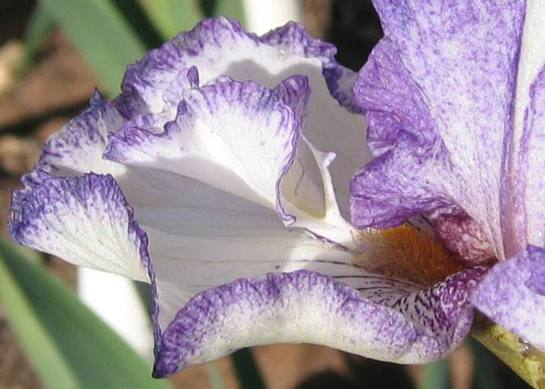
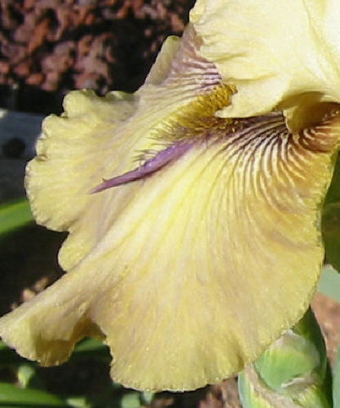
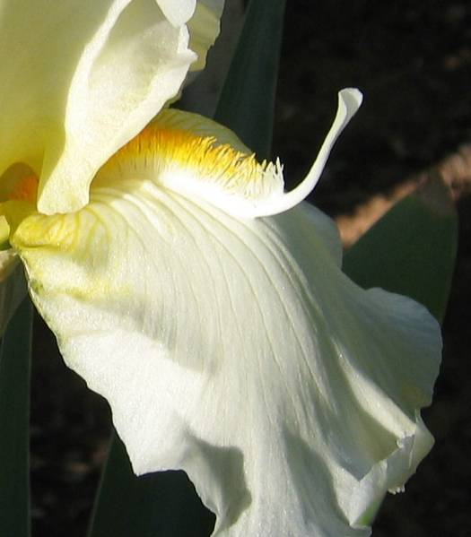
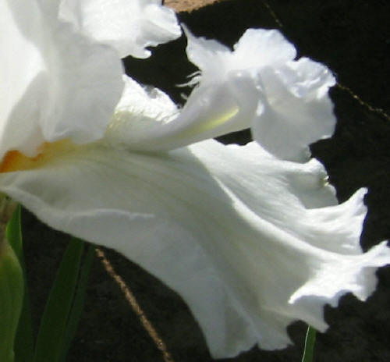
Space Age
This term refers to any iris (TB,BB,SDB, etc) where the beards have been modified to be flounces, horns, or spoons.
One day, it is expected that the flounce will be bred so large that we will truly have a double iris!
flounce
horn
spoon
Notes:
A quality space age flower will have all three flounces, spoons or horn. They will be of the same size.
Pictures are Momentus Occasion, Mesmerizier, Snow Spoon and Thornbird.
Space Agers are named as such, because they came to prominence during the Space Age (i.e. the late 1970’s) However, they really have been around much longer. What makes them so different from other iris is that the rib that extends from the end of the beard down the fall has lifted from its bed, curving up into a horn. Past hybridizers made crosses to enhance this characteristic, and initially managing to lengthen the horn, eventually succeeded in getting it to curve back on itself to form a hook, flattened the end to give a spoon, and even flattened the whole horn forming a flounce.
Many spageagers hybridizers long term goal is a true double iris where the flounce has been breed so lo large in that it can qualify as a petal. Recent breakthroughs make this goal a possibility within the next generation.

Slide 13
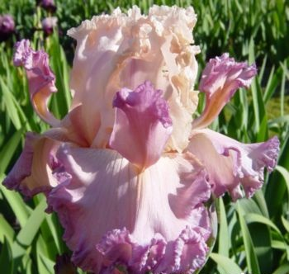
Big Flounces
Petal Pushers, TB
Painter, 2007

Slide 14
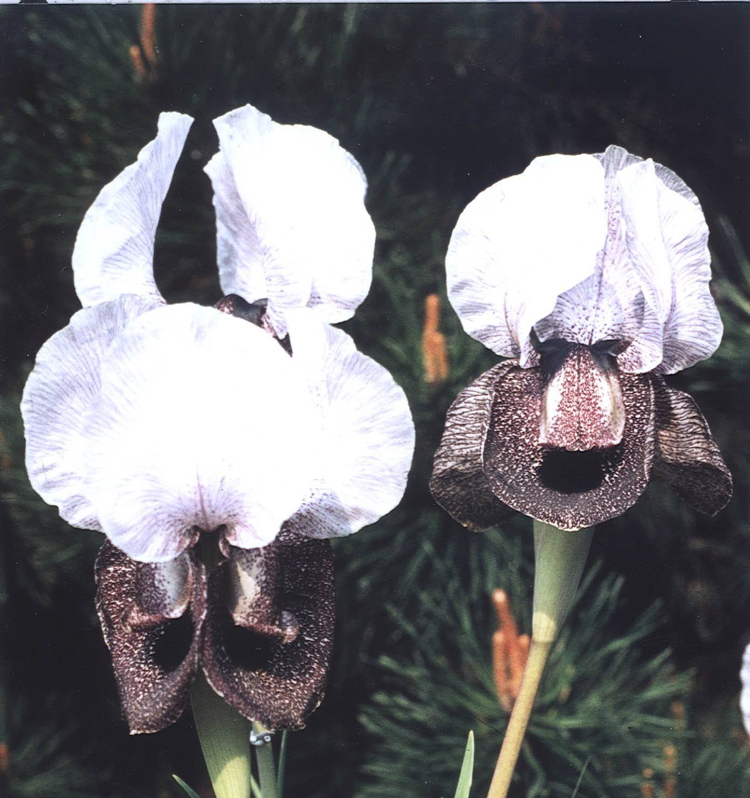
Arils and Arilbreds
Although, Arils have beards, they are not classified with the bearded irises because they are so different. Their beards are rather sparse.
Arils show dark signal spots below the beards with much veining and speckling in an unbelievable range of colors.
Arils are difficult to grow in all but the warmest and driest regions of the US.
I. iberica
Arils crossed with TB are called Arilbreds (AB). Arils crossed with medians are called arilbred-medians or arilmeds.
Notes:
Two very different types of irises are grouped together under the term "aril". These are the oncocyclus and regelia irises of the Near East. Actually, their beards are rather sparse, being long and straggly on the regelias, and nothing more than a wide "fuzzy" patch on the oncocyclus.
Most arilbreds are tall and have large blooms. They usually bloom earlier than the TBs, with the SDBs and the IBs.

Slide 15

Arilbreds
Pure Arils can rot with too much moisture. Adequate drainage is key!
Arilbreds are more hardy but still require adequate drainage.
http://www.arilsociety.org

Slide 16

Arilbred Can Go Dormant
Pure Arils go almost completely dormant. You will think they have died off. Have faith
Arilbreds don’t sell well because they too go almost completely dormant and are often leafless by the time of the MVIS sale.

Slide 17


Aril History
Aril irises are native to the Middle East and grow in Israel, Syria, Lebanon, Iraq, Iran, Afghanistan, Turkey
Aril irises get their name from the white collar (or "aril") on their seeds.
Persian Sapphire

Slide 18

Types
Two very different types of irises are grouped together under the term "aril". These are the oncocyclus and regelia irises of the Near East.
OGB+ 3/4 or 2/3 bred oncogelia hybrid
OB+ 3/4 or 2/3 bred oncocyclus hybrid
RB+ 3/4 or 2/3 bred regelia hybrid
OGB 1/2 bred oncogelia hybrid
OB 1/2 bred oncocyclus hybrid
RB 1/2 bred regelia hybrid
OGB- 1/4 or 1/3 bred oncogelia hybrid
OB- 1/4 or 1/3 bred oncocyclus hybrid
RB- 1/4 or 1/3 bred regelia hybrid
KEDESH
(James Whitely, R. 2001)
(OGB tet.),
Notes:
KEDESH
(James Whitely, R. 2001), (OGB tet.),

Slide 19

AFROSIAB
(Adolf Volfovich-Moler, R. 1998), RB
Regilia Arilbreds
The regelia irises are typically more tailored in form, with narrow petals and long, slender stems. Some are veined, others have smooth, solid coloring. Regelias usually have two flowers per stalk.

Slide 20


Oncogelia Arilbreds
Persian Paddahaw
(Howard Shockey
R. 1987), OGB
Most arilbreds have both the oncos and regilias as ancestors. They are known as Oncogelia or OGB.
TURKISH PENDANT
(Howard Shockey, R. 1989), OGB

Slide 21

Arilbreds Blooming Time
Most arilbreds are tall and have large blooms. They usually bloom earlier than the TBs, with the SDBs and the IBs.
DAMFINO
(Sharon McAllister, R. 1998), (OGB)
Notes:
DAMFINO
(Sharon McAllister, R. 1998), (OGB)

Slide 22

Nomenclature
Pluses or minus after the type indicates if it is mostly Aril (+) or not (-)
SILENT TEARS
(Les Peterson by Ardi Kary, R. 1991), (OGB-)
Notes:
SILENT TEARS
(Les Peterson by Ardi Kary, R. 1991), (OGB-)

Slide 23

Spuria
(not a bearded iris)
Spuria are beardless iris, originating from the Mediterranean area of Europe. Spuria iris are one of the tallest of iris, reaching a height of 5 feet or more. Experience has shown that spuria iris perform better in areas of the country where the summer months are dry. They like alkaline soil
Adriatic Blue
Niswonger, 1995

Slide 24
Spurias
Bloom after the TB in May
1’ to 5’
Leave in ground (10 year clumps are not uncommon)
Can mulch
Tougher flower
Florist uses them, landscapers uses them
They have only been bred for 3-4 generations
There are 50000+ TB but only 700 Spurias
Majority summer dormant. Can trim foliage in July for dormant types.
Likes alkaline soil (that’s us!)

Slide 25



Spurias

Slide 26


Planting Spurias
Spurias are shipped moist in a diaper in a plastic bag.
Plant immediately or store in your fridge in a bag with a wet towel. Plant within the next week. KEEP moist for two weeks
Hardy after established. Don’t water much in the summer. Water spring, winter, fall.
Cut off old bloom stocks to increase growth.
http://www.spuriairis.com

Slide 27


Louisiana Irises
Need swamp or bog conditions.
Keep moist
Can grow in ground with daily watering.
Can grow in buckets. Use quality soil.
Changing Shadows, LA
Little Ganster, LA

Slide 28





Don’t Grow
Japanese Irises
Siberian Irises
Pacific Coast Native Irises

Slide 29
Care

Slide 30

Too Many Increases
Each year new irises is grown from the old irises. Finally, the iris clump can get pretty crowed.
This clump yielded 20 rhizomes

Slide 31

Old Rhizomes
Old rhizomes don’t have any roots.
Notes:
This is the underside of the previous slide’s rhizome.

Slide 32



Rhizomes Selection
Choose the variety you want. Then look for the largest rhizome with multiple increases.
Annual MVIS rhizome sale
Mesilla Valley Mall

Slide 33


Rhizome Selection Continued
Note that some types of irises like the Standard Dwarf Bearded (SDB) irises naturally have smaller rhizomes than the Tall Bearded (TB).
    Note that some varieties of TBs have naturally smaller rhizomes than other varieties.
    Arils or Arilbreds may not have any leaves at all. People tend to pass these by at the fall sale because they think they are not a good selection. However, this is their natural form in the fall

Slide 34


Site Selection
The AIS recommends that the plants receive 6 hours a day of sunlight. Southern New Mexico has over 200 days of crystal blue sky each year. Our sunlight is quite intense. We recommend at least 4 hours of sunlight per day in the summer with at least 6 hours of sunlight spring and fall.
The site should be in a location where the rhizome will not sit in water. This can cause rot.
The site should have easy access to water. Remember it doesn’t rain most weeks or most months for that matter!
Edith Wolford

Slide 35


Site Selection
Shade
Our sunlight is so intense that some afternoon shade is beneficial. Deciduous trees with a high canopy can be ideal.
An iris may not bloom or increase under too much shade. In that case, just move them.
Irises will still do well in full sun.
Note that rebloomers may need more sunlight to rebloom
Some trees have shallow roots and will pull nutrients away from the irises(i.e. Mulberry Trees)
Notes:
Deciduous trees lose their leaves over the winter and usually don’t leaf out until after Iris blooming season.

Slide 36




Soil Improvement
      Irises are pretty forgiving and will grow in poor soil and tolerate some neglect.
You don’t have to amend the soil if you don’t want to.
However, improving the soil will improve the size and quantity of blooms and allow the plant to increase more rapidly.
Sierra Grande, TB
Stellar Lights, TB
Stairway To Heaven, TB

Slide 37

Soil Across
Las Cruces
The soil across the area is not the same. People living in the Mesilla Valley have heavier clay-like soil. This is the old river bottom of the Rio Grande.
People living on the East Mesa have sandier soil that is poor in organic matter. The soil is from the alluvial fan of the Organ mountains.
Most soil is alkaline. City water is also alkaline. Irises prefer neutral or slightly acidic soil but they tolerate our alkaline conditions very well.
Mariachi Music, TB

Slide 38
Alkaline Soil
Alkaline soils have pH readings above pH7.4 and contain relatively more lime.
When soils have a high pH of greater than 7.2, the amount of available manganese, iron, boron, zinc and copper in the soil becomes limited. A major problem in alkaline soils is reduced nutrient and especially micro-nutrient availability.
The common amendments added to improve these soils are: peat moss, ground-up bark and wood, and sulfur.
A pH of 6.5 to 7.2 is optimal for irises and many garden plants.
The mountain communities probably will not have alkaline soil.
Spurias loves alkaline soil
Notes:
Refer to http://extension.usu.edu/files/publications/soils2n.pdf
http://www.gardeningfromthegroundup.us//
Soils in the southern NM typically have a pH of 7.5 to 8.5 creating a basic/alkaline condition. Since city water is also alkaline, the possibility of reducing pH in gardens and lawns is highly unlikely.
Soil Reaction (pH)
Soil reaction or pH is a measure of the `active' hydrogen ions in the soil water (solution). Changing the pH of the soils in our area is extremely difficult if not impossible.

Slide 39


Soil Improvement Tip #1
Cotton Burr
To improve the soil, first wet it thoroughly two days before you dig. Otherwise be prepared to use a pick-axe!
Mix in well composted organic matter (manure, cotton burr, kitchen waste, garden waste, etc) to a depth of 10”.
You can add a balanced 10-10-10 fertilizer a few weeks before planting if so desired.
Notes:
If you do not use well-composted organic matter, then you will need to wait a few months before planting. I.e prepare the bed in the spring for fall planting.

Slide 40

Soil Improvement
Tip #2
Several club members work pecan shells into the soil to make it less hard ( more friable). This makes it much easier to pull weeds. Adding organic matter will also help. This also helps with the alkalinity.
Don’t do this next to the house as it will may attract roaches.
Notes:
Only pecan shells. DON’T use the pods that cover the shells. It has an growth inhibitor.
Note that as the shells decompose, they will put nitrogen out of the soil. However, it will be returned to the soil, once the process is finished.

Slide 41

Soil Improvement
Tip #3
Trench Composting.
This is especially useful for preparing new iris beds for fall planting.
In the winter or spring, simply dig a trench or hole 8-12 inches deep in the garden area, fill with 4-6" of kitchen scraps or yard debris and backfill with soil. Water occasionally.
Plant rhizome in the dirt above the composted material in the fall.
Notes:
Trench Composting is a relatively straight-forward method of composting directly in the soil. This method does not require a bin. Simply dig a trench 8 inches deep in the garden area, fill with 4" of kitchen scraps and backfill with soil.
After a few months, the material will have decomposed sufficiently for planting above the compost trench or hole.
The advantages of trench composting include ease of implementation and its ability to handle kitchen scraps without attracting pests as readily as in sheet composting. To optimize this method, you need to balance carbon and nitrogen as well as wet and dry materials as you go.
Advantages
One of the simplest forms of composting.
Can rapidly improve poor soils, especially sandy ones.
Allows you to add materials a little at a time.
Can encourage earthworm activity.
The disadvantages of trench composting include slow rate of decomposition and potential for pests to excavate trenches. Additionally, if the raw materials contain weed seed or plant pathogens, these undesirables will not be destroyed in the trench composting process.
A variant of trench composting was taught to the pilgrims by the Native Americans. You may have heard the story of how Squanto showed the pilgrims how to fertilize their corn crops by burying fish scraps underneath the corn. As the fish composted, nutrients were released for the crop.

Slide 42
#4 Add Bio-Solids
The Wastewater Treatment Facility Plant at 2851 W Amador (528-3515 M-F 9-3:30) will give you 10 buckets of bio-solids free. Bring back the buckets and get 10 more buckets free.

Slide 43
Watering
Keep newly planted rhizomes damp not soggy.
Otherwise, the equivalent of 1 inch water per week in the spring and summer is adequate if the temperature is less than 95 degrees. Very hot dry days may require more frequent watering.
One inch per month is fine for the winter. Start to increase the water when you see new spring growth.
Be aware that rebloomers need more TLC. You may want to increase watering during those 100+ degree, 10% humidity days.
Non-rebloomers are semi-dormant during our hot summers.

Slide 44


Fertilization
Use a balanced fertilizer like 6-10-10 in the spring when growth begins.
Avoid fertilizers high in nitrogen (the first number).
Club members like fertilizer high in the middle number.
A second round of fertilizer in August will help the rebloomers
Fertilize late in September for all irises.
Add trace minerals like iron if you have been growing irises for awhile
Notes:
Sometimes yellow leaves indicates a shortage of iron and/or trace minerals.

Slide 45
Fertilizer Tip #1
Bone Meal is not needed in our alkaline soil. Our soil has enough potassium.
Fertilizer Tip #2
Don’t let the rhizomes come in contact with granular fertilizer. It is an invitation to rot. Let the roots grow into the fertilizer.
Fertilizer Tip #3
Several members likes to put alfalfa pellets under a new rhizome. Alfalfa pellets contain a growth hormone. She digs a hole, drops in the pellets, adds more dirt on top. Then she plants the rhizome.

Slide 46

Fertilizer Tip #4
Many club members like to use a water soluble fertilizer fed to the plants through a hose end sprayer attached to a sprinkler.

Slide 47



Spacing
Space Tall Bearded irises 18” or more apart if growing different name cultivars.
Space the smaller medians 8-12 inches apart
You can space irises of the same name closer.
You can
  Face the rhizomes the same way.
  Place 3 irises of the same cultivar “toe-to-toe”. This will create a big clump quickly.
Direction of growth

Slide 48

Planting Depth
We recommend planting a new rhizome so that the top of the rhizome is 1/2 to 1-inch below the surface. This is due to our hot dry weather.
Most of the rest of the country plant irises so that the top of the rhizomes is even with the surface.

Slide 49
Mulching
Do not let mulch cover rhizomes in the spring and summer. This may lead to root rot.
Though other portions of the country mulch in the winter, our winters are fairly mild. Usually, the dead iris leaves provide sufficient protection for the winter.
You can mulch in the winter as long as the mulch doesn’t pack tightly around the rhizomes. If you feel you must mulch then remember to the rhizomes will need air circulation so use “fluffy” mulch.
Pecan leaves can be “fluffy”. However, a heavy snow fall will compact them around the rhizome.
Notes:
Ex of a “fluffy mulch” would be pecan leaves. However, they will start to pack down and rot in place once it becomes warmer.

Slide 50

Mulch Removal
A good time to remove your winter mulch or dead iris leaves is the first warm 70 degree day in February.
It is harder to remove mulch and leaves when the plant has buds. SDBs can start to bloom in early March with TBs starting in about early April.
Notes:
Ex of a “fluffy mulch” would be pecan leaves. However, they will start to pack down and rot in place once it becomes warmer.

Slide 51

Mulch Tip #1
Pine needles make a good mulch. They break down slowly and they don’t pack down on top of the rhizome like tree leaves.
Mulch Tip #2
Pine bark and wood type mulches will absorb nitrogen from the soil as they decompose. They will return the nitrogen to the soil once finished decomposing.
Mulch Tip #2
Shredded paper makes a good mulch.

Slide 52

Why Divide Irises
New Increases
Most bearded irises need to be divided every 3-5 years because the clump gets crowded and the rhizomes compete for nutrients.
Divide when you see few blooms or blooms of poor quality
Divide when your best friend mentions for the fifth time how pretty the irises are!
This clump is fine for this year. However, the new increases will start to make the clump crowded next year.

Slide 53

When to Divide and Plant
You can divide and re-plant any time in the Mesilla
except the winter months
Planting in our hot
dry summer is hard
on the plant but they
can survive with care
The best time in the
Mesilla Valley is Sept. with a
rainy August a close second
Planting in the spring time will interfere with the bloom
Fast Forward,
IB, Aitken, 2002

Slide 54

Planting Tip #1
One member prefers to plant in July in pots. He uses Miracle Grow potting soil. He shelters the pots in a semi-shaded location and provide adequate water. The irises are then transplanted into the ground in September. This gives them a good head-start.

Slide 55

How close to frost date can I plant?
It is recommended by the AIS that you plant irises 6 weeks before frost date.
That would mean sometime in late September in the Mesilla Valley.
However, MVIS members have reported planting irises in early December with no problems. These Irises may or may not bloom.
We frequently plant in October

Slide 56

How long between dividing and planting?
People have waited a year between when the time they dug up the iris and the time they plant the iris and the plants still survived. Of course, the chances of survival diminish with time.
MVIS recommends planting the rhizome within a month of being dug.

Slide 57

How to Divide
Place shovel blade under clump and heave! Take care not to cut through rhizomes. Don’t worry about the roots. They will die anyway.
If soil does not shake loose easily, then take iris root ball and drop to ground from height of about 5 feet. Repeat until most soil is gone. Otherwise you can use a waterhose at high pressure.

Slide 58


Breaking up isn’t hard to do
New Rhizome
Identify the old rhizome and the new rhizomes or increases.
Break apart with bare hands or use a knife.
Let the rhizome sit for a day before planting.
Throw away the old rhizome.
Old Rhizome

Slide 59

But wait...!
Scar
This old rhizome still has some life.
Be careful where you throw the old rhizome. The little increase will grow.
An increase
Old Rhizome
Note that this little increase will still grow even though there are no leaves

Slide 60


If increases are small..
Don’t try and break the increases off. Just plant the entire rhizome.

Slide 61

Do I need to trim the leaves and roots?
It is recommended to trim the leaves to 8” long after dividing the clump. These leaves will not grow anymore and you want the irises to put its energy into new leaves.
MVIS trims iris roots for the sale at the mall. This allows us to wash the dirt off the roots more easily. Plus it allows us to inspect for rot and fusarium.
The existing roots will die anyway. However, they are useful to anchor the plant to the soil! Leave the roots on unless you suspect you have rot or fusarium.

Slide 62

Removing Iris
Leaves and Stalks
The only time green leaves should be cut is when the rhizomes are being transplanted.
You can remove brown or withered leaves anytime and cut the bloom stalks at the base after bloom. However, dead iris leaves provide some protection over the winter.
Note, the same dead leaves can shelter aphids and other destructive critters.
Removing leaves improve air circulation that help prevents rot
Notes:
A lot of people like to trim the irise leaves at the end of the summer. It doesn’t seem to hurt the irises.

Slide 63


Insects
We are pretty lucky in New Mexico. Aphids seem to be our biggest pest.
Though rarely fatal, the little critters can drain energy from the plant.
Spray with soapy water, dormant oil
Don’t use lady bugs to control aphids. They fly away. Use Green Lacewings
Yippy Skippy,
SDB
Notes:
Ladybugs winter over in the Sacremento mountains. When they wake up, they spread through out the Tularosa Basin. People collect them in the mountains and sell at the local nurseries

Slide 64
Weeding
Iris roots can be 18” long and just below the surface. Use shallow cultivation to avoid damaging the roots.
Irises have been seen all over New Mexico growing amidst the weeds and still blooming in the spring. Just ask any MVIS member ;-)
However, it is still best to keep the iris bed free of weeds and neighboring plants, so sunlight and air circulation can keep rhizomes dry and free of rot.

Slide 65

Weeding Tip #1
In the summertime, wet the ground thoroughly and then cover with cheap clear plastic (2-6mil).
Seal the edges with dirt. When the plastic starts to disintegrate (~6 weeks), remove.
Many seeds will have sprouted and then be cooked by the heat.
Be careful not to position the plastic over the roots of trees or other desirable plants.
Temps can rise up to 160 degrees.

Slide 66


Weeding Tip #2
One member with a Bermuda grass lawn uses 10” aluminum flashing to line the sides of the flower beds. This helps to prevents the roots from running underground. She then keeps the grass 1 foot away from the beds using a shovel and occasional use of Round-Up.

Slide 67

Mesilla Valley Iris Society
The Mesilla Valley Iris Society of Las Cruces, NM was established in 1971 as an affiliate of the American Iris Society (AIS).
The goal was to share our mutual interest in these wonderful flowers and to promote public interest. The Society is sponsored through Region 23 of the AIS.
Visit our web site at aisregion23.com

Slide 68



Annual Rhizome Sale
Usually held the weekend after Labor Day weekend in the Mesilla Valley Mall
Over 100 named cultivars.
Notes:
Setting up for the 2006 Annual Sale on Friday between 8:30 and 10:00 PM

Slide 69




MVIS Yearly Events
Annual Spring Show
Big Dig
Annual rhizome sale
Sharing irises
Discussion
Slide show programs
Garden Tours

Slide 70
You Too Can Join
Contact Ann Colwell Membership chairman at 523-6612 or email her at gozaimus@aol.com
Dues are $10 per year. Membership forms are available from Members here at the sale.
We have one more meeting in May before we take our summer break. Then we start meeting again in August.

Slide 71

The End

Slide 72



Veins
Veins - Lines that are a contrasting color or darker color than the petal.
Bottle Rocket, TB
Sutton, 2010
Serendipity Elf, SDB
Bengal Tiger, TB, Maryott, 1981
Expose

Slide 73




Bicolor
A lighter colored standard with falls of a different, deeper contrasting color.
Poem of Ecstasy, TB
Hager, 1997
Mariachi Music, TB
Maryott, 1988
Broad Shoulders, TB
Keppel, 2001
Dante Inferno, TB
Moores, 1979

Slide 74

Peppering, Rings

Slide 75


Plicatas
Stitched margins of color on the rim of the petals. Usually having a white or yellow ground color.
Inside Track, TB
Keppel, 2002
Autumn Echo, TB, Re
Gibson, 1975
Footloose, TB
Schreiner, 1993
Notes:
Peppering: found on plicatas -- as if you shook a pepper shaker of contrasting color over an iris with a yellow or white background color.
Stitching: may go with "peppering", as if one had button-hole stitched around the edges of the falls or all of the petals. "Stitches" may be so close together as to look like a thin or thick solid rim around the petals.

Slide 76



Variegatas
A bicolor with yellow or near yellow standards and deeper maroon, brown or purple falls. Reverse is the opposite.
Jurassic Park, TB
Lauer, 1995
Devils Riot, TB
Blyth, 1993
Edith Wolford, TB
Hager, 1986

Slide 77



Amoenas
A bicolor with white standards and colored falls. A reverse amoena has white falls and a different color in its standards.
Gay Parasol, TB
Schreiner, 1974
Sierra Grande, TB
Schreiner, 1992
Imprimus, TB, AU
Blyth, 1993
Notes:
Note that Imprimus is an attempt to create a bluer pink rather than a peach pink

Slide 78


Luminatas
The reverse pattern of a plicata, with white background color and white edges, veins and around beards
Foolish Fancy, TB, re
Hager, 1985
Fancy Woman, TB
Keppel, 1995
Notes:
Note how the dark violet falls are overlaid with paler veining and margins, typical of the luminata color pattern.

Slide 79




Blend
A combination of two or more colors "blending" together. One is usually yellow.
Trillion, TB
Fundamental, TB
Johnson, 2002
Megabucks, TB
Tompkins, 1990
Lightshine, TB
Schreiner, 2000

Slide 80


Glaciatas
Flower has no purple or red pigment and is a very clean white, pink or yellow.
photo by
Vincent Christopherson
Photo by Christopherson
Seedling, Christopherson
Notes:
these lack all anthocyanin pigments and are pure whites, yellows, pinks, or oranges, formerly called ices.

Slide 81



Neglectas
A blue or violet bitone.
Moonba, TB, AU
Blyth 1986
Romantic Evening, TB, re
Ghio, 1996
Alaskan Seas, TB
McWhirter, 1992

Slide 82



Self
The same uniform color in both the standards and the falls.
Heidi Alana, TB
Wood, 2003
Blue Suede Shoes, TB,
Schreiner, 1996
Dark Passion, TB
Schreiner, 1998

Slide 83




Broken Color
Random streaking of two different colors
Tiger Honey, TB
Gnus Flash TB, Kasperek, 1996
Spiced Tiger, Kasperek, 1996
Marai Tormei, TB, Ensminger, 1987

