Slide 1
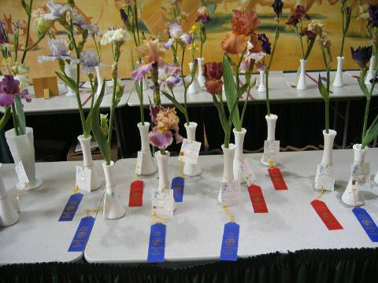
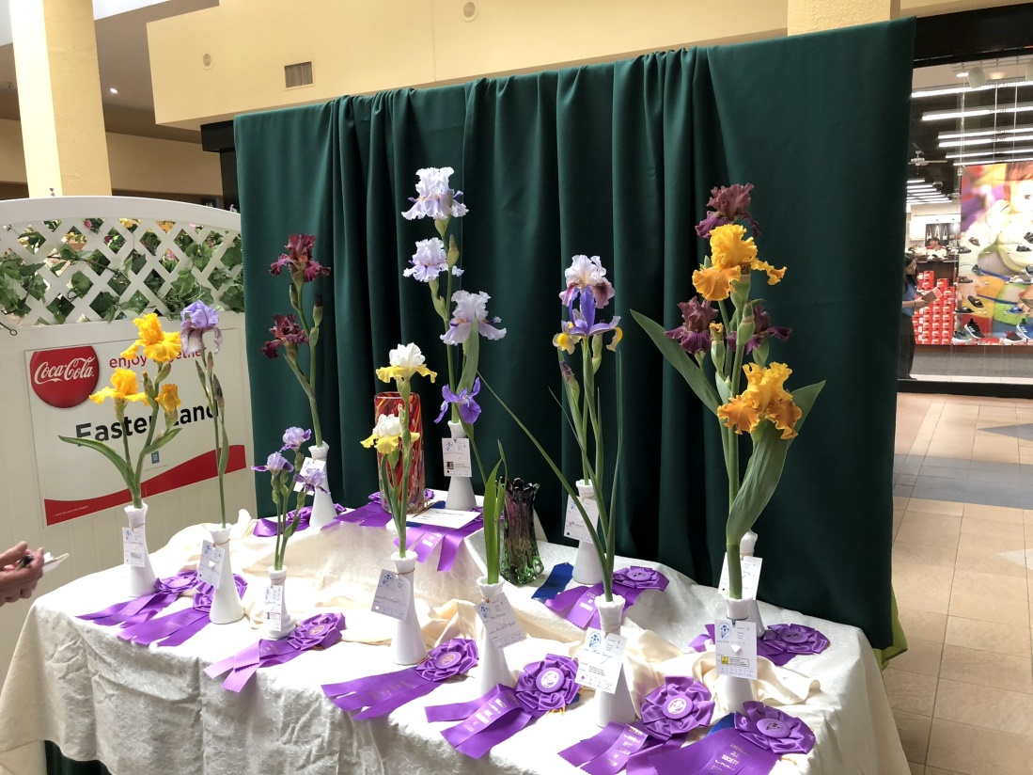
Mesilla Valley Iris Society Showing Irises
Tips and Tricks for Presenting Irises at Shows
Note: All pictures are taken during the MVIS annual Iris shows.

Slide 2
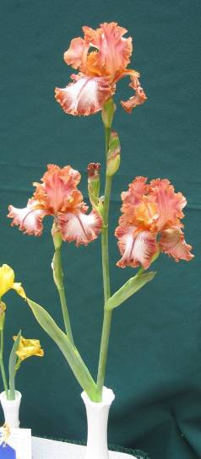
Purpose
Each year the Mesilla Valley Iris Society has an Iris show.
This presentation is a follow-on to the presentation “Show Rules and Regulations”. The topic is:
How to groom irises for the show

Slide 3
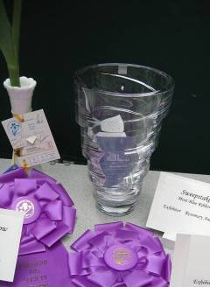
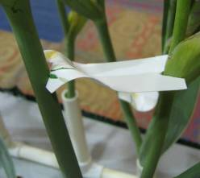
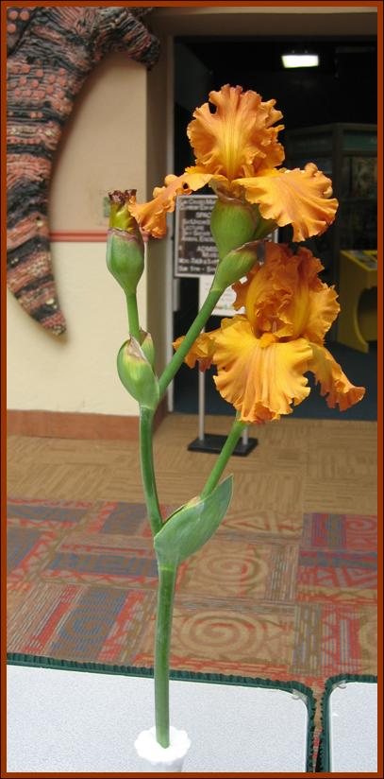
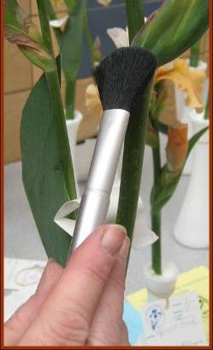
Outline
What the judges want/don’t want
Selecting Irises
Grooming Irises in the Garden
Transporting Irises
Equipment
Grooming Irises at the show
Specific grooming methods for the different sections.
Golden Panther,
TB

Slide 4
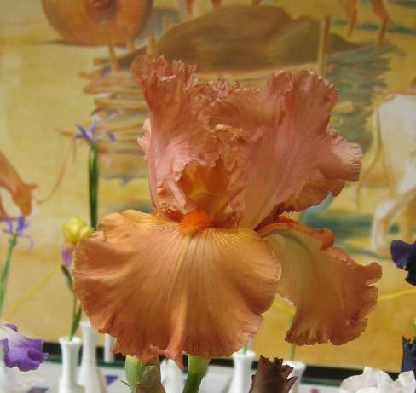
Acronyms
Tall Bearded TB
Standard Dwarf Bearded SDB
Miniature Dwarf Bearded MDB
Intermediated Bearded IB
Border Bearded BB
Spurias SP
Mesilla Valley Iris Society MVIS
American Iris Society AIS
Copper Classic, TB

Slide 5
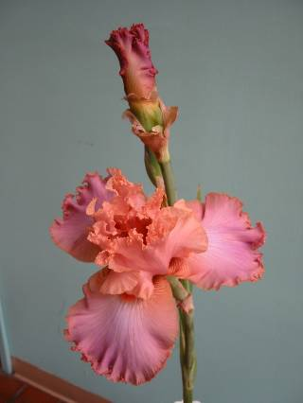
Disclaimer
Don’t worry. An iris doesn’t have to be perfect to be entered in the show.
Part of the reason for having a show is educate the public.
Many members bring irises that will be available at the annual MVIS sale in September.
Many members bring irises just to show to other members!

Slide 6
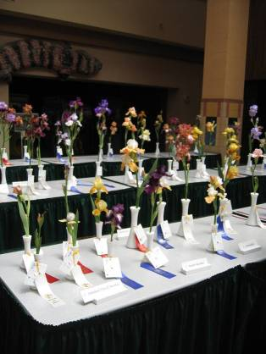
Disclaimer (cont)
It is almost impossible to obtain a “perfect” iris due to our high spring winds.
The judges are aware of this and make allowances (especially if they are from NM).
The winds affect everyone anyway.
Many an iris with a small tear have won a blue ribbon. However, it is much more difficult to win best in show.

Slide 7
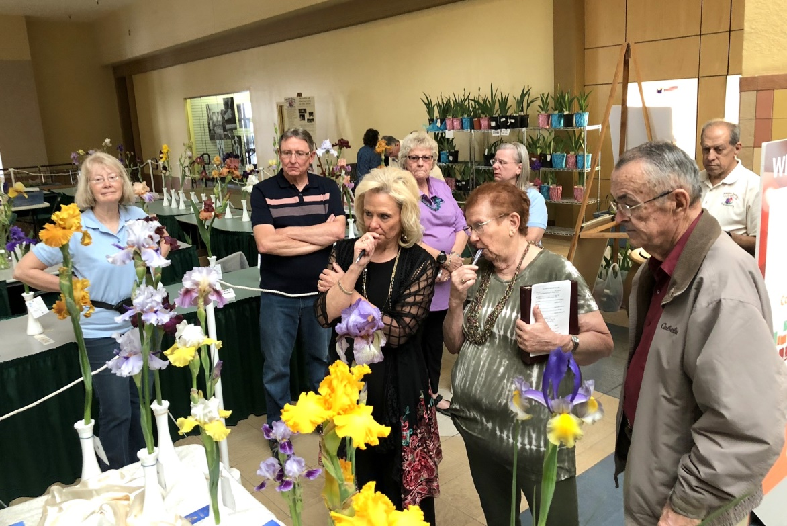
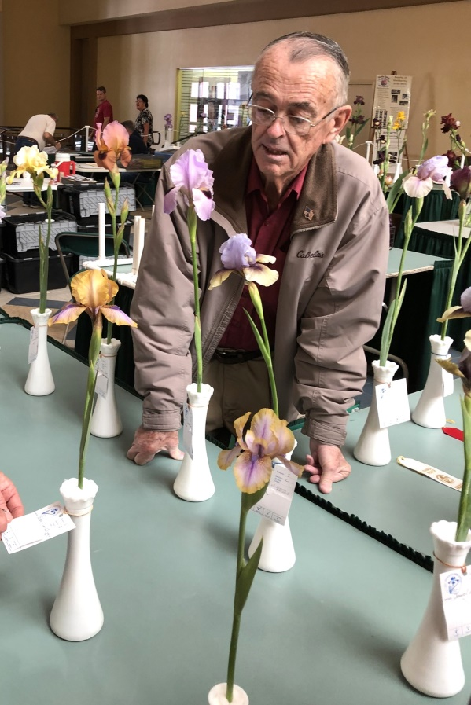
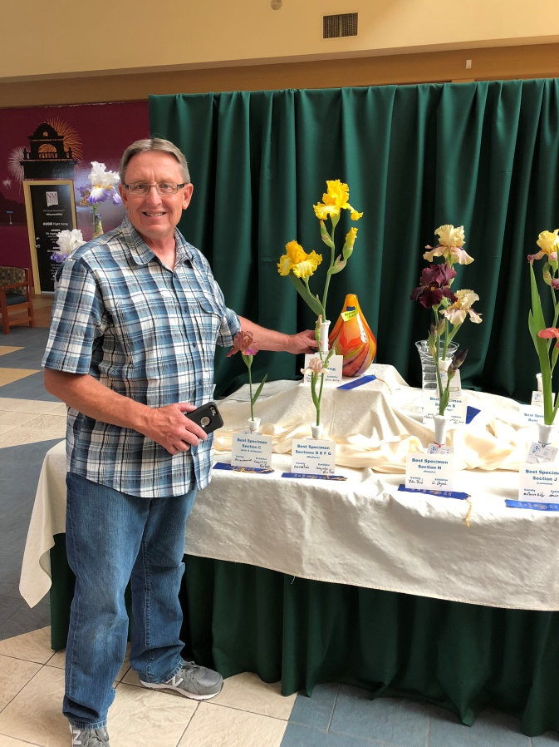
What the Judges Want
At least one bloom
A well presented iris
A candelabra stalk for the taller bearded varieties
A sexy “S-curve” for the TB, IB, and BB varieties
Many varieties
Older and new varieties.

Slide 8
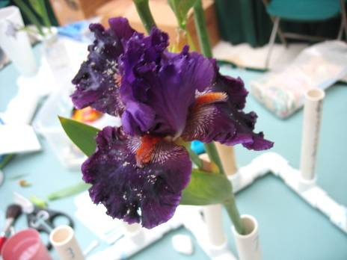
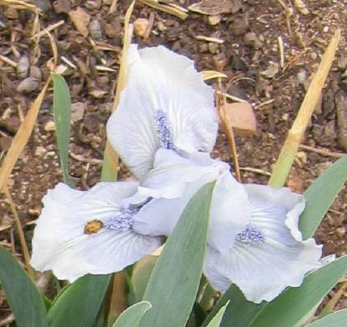
What the Judges Don’t Want
Bugs
Tears and blemishes
Missing flower parts
Dead or closing blooms
Fingerprints on the stalks
Petals touching stalks
Flowers touching each other
Poor presentation
Bedford Lilac

Slide 9
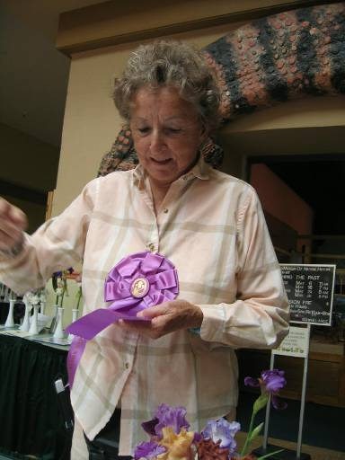
Remember
The judges are judging your presentation of the iris as much as they are judging the iris themselves.

Slide 10
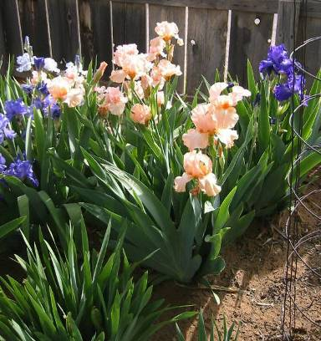
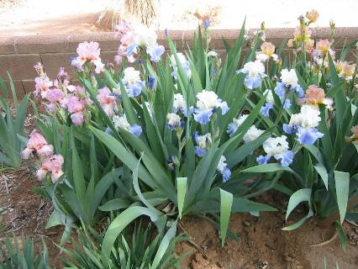
In the Garden
Handling
Selecting
Grooming
Coral Sunset, Breakers TB
Beautiful Vision, Stairway to Heaven
Afternoon Delight, TB

Slide 11
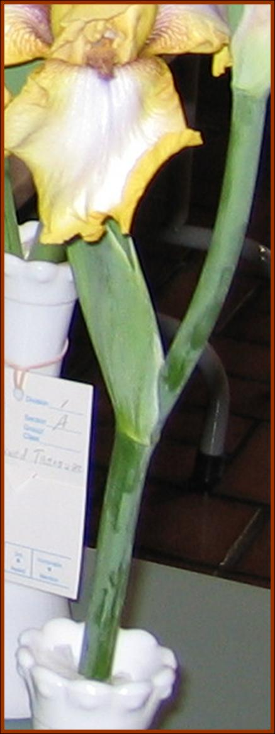
Handling An Iris
Avoid Fingerprints or Marks on the Stalk
Only handle the iris at the conjunction of the leaf and stalk or at the very bottom. Otherwise you will disturb the powder like substance (called the bloom) on the stalk.
This is important. More about correcting a misplaced fingerprint later.

Slide 12
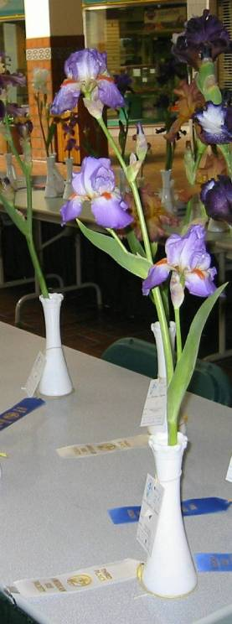
Stalk Length
Cut all the stalk. You may be trimming it later when you put it in the vase.
However, it is much more difficult to “add” a stalk if the iris is too short for the vase!
More about correcting stalk lengths later.

Slide 13
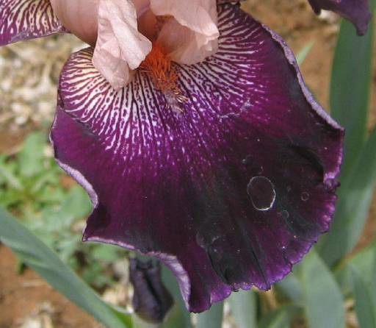
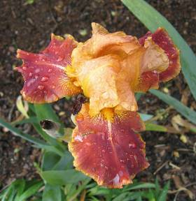
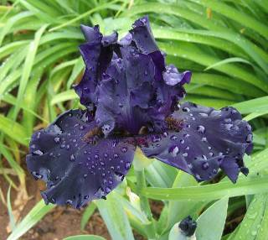
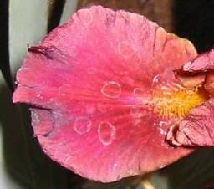
Avoid Watering Overhead
Overhead watering can leave water spots on your darker irises.
Water from below within a few days from the show.

Slide 14
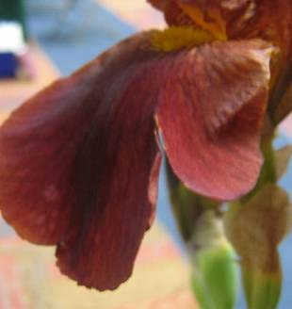
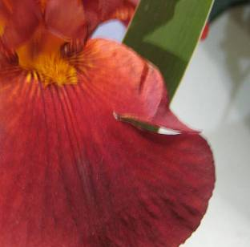
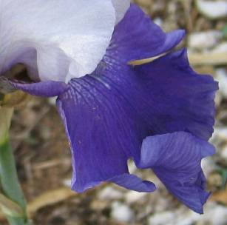
Small Tears
The judges don’t count off too much for small tears. Blue ribbons are still possible.
Larger tears should be avoided

Slide 15
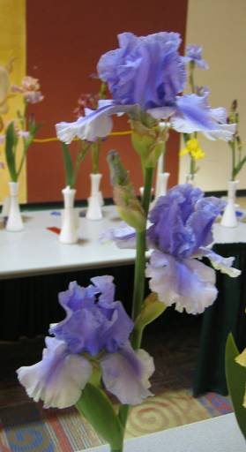
Candelabras
The TBs should have a candelabra like stalk. The flowers should not be crowding the stems or each other.
Select an iris that holds the flowers well away from the stem.
Note: The queen of show will most assuredly have a candelabra stalk if it is a TB.
Guadalajara
Island Surf, TB

Slide 16
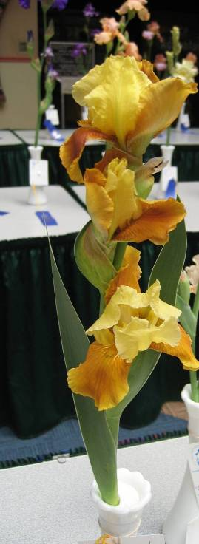
Irises Have Sides
Branches or Spurs should appear out the left and right side of the stalk. Stalks with branches coming out of one side probably grew at an angle and the branches rotated sunwards.
Honey
Mustard

Slide 17
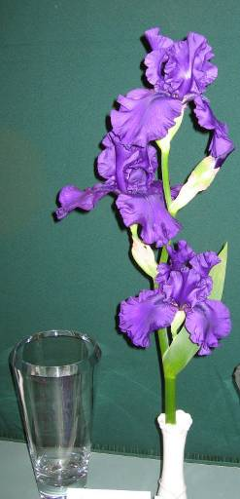
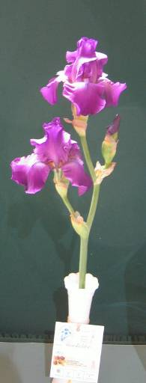
S-Curves Are Sexy
2006 Best In Show Dusky Challenger
Judges prefer a TB, BB and IB that has its center stalk in a gentle S-shape.
This is not critical. When you have a choice (all things being equal) select a stalk with a gentle S-shape.
Note: Many blue ribbons have been won by irises with straight stalks.
2006 Best
Historic Gondolier

Slide 18
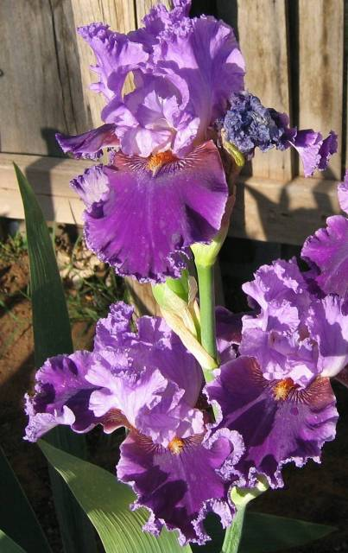
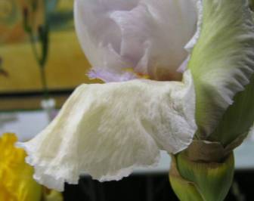
Dead Blooms
Select an iris that won’t have any dead or closing blooms at the time of judging.
If a blooms dies the morning of a show, cut off the bloom.
Try and cut it so that the judges can’t “see” the cut.
Closing
About Town
You will need to observe your irises in your garden to be able to judge when blooming will occur

Slide 19
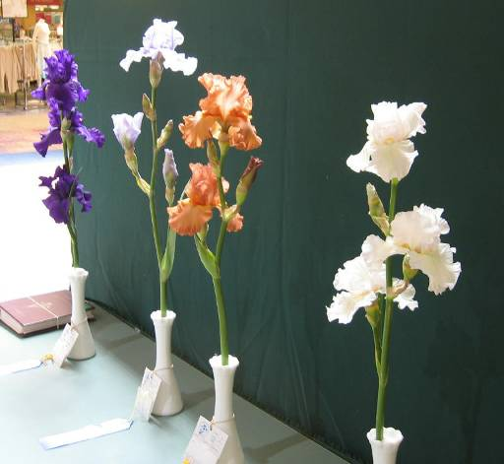
Spacing
The irises should be well spaced on the stalk. The spur should not be too close to the bottom or too close to the top.
Generally the 2/3 rule applies (top 2/3 of the stalk has flowers)

Slide 20
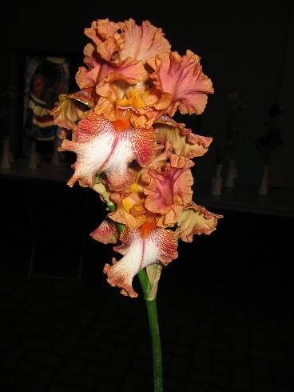
Too Crowded
This stalk is spaced poorly. It has all its blooms crowded towards the top. It is hard to see what an individual blossom looks like

Slide 21
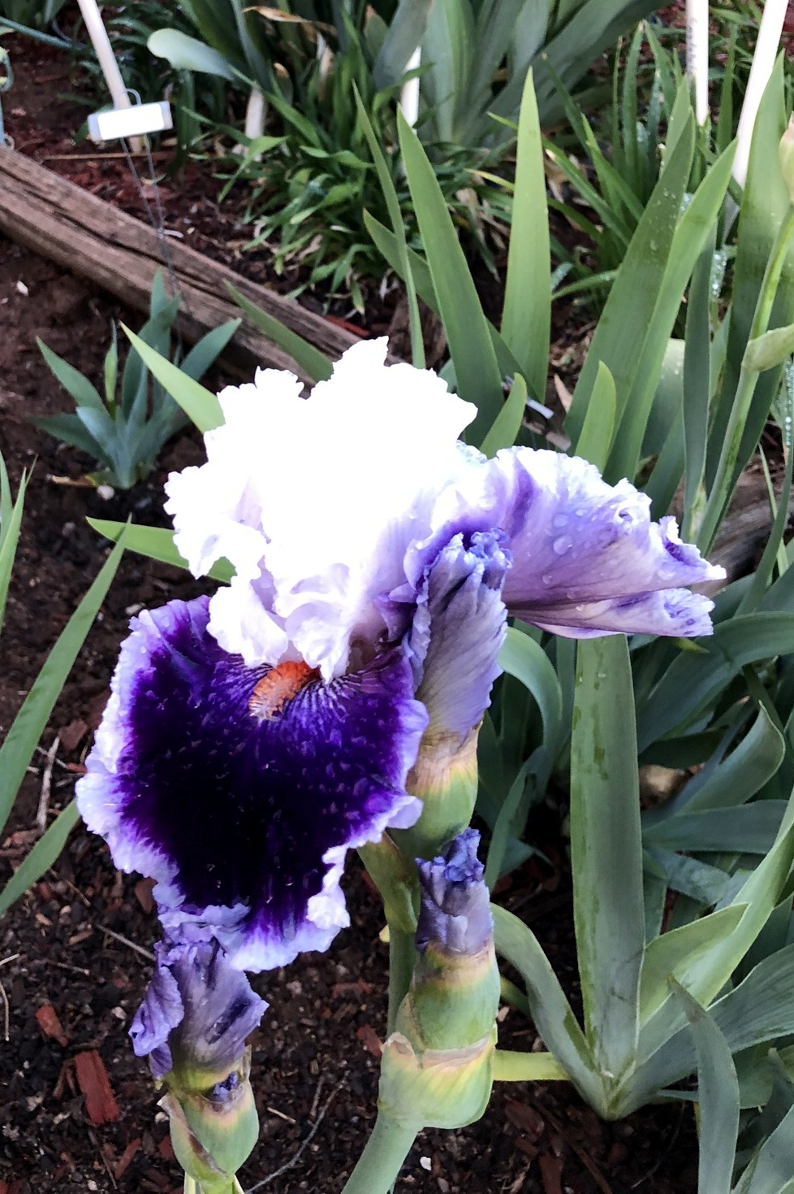
Too Crowded
This iris has a terminal bud interfering with the flower. The judges will fault this. The second bud can be removed. However, wait until the morning of the show because the main flower might close first and will need to be removed.
Merry Amigo

Slide 22
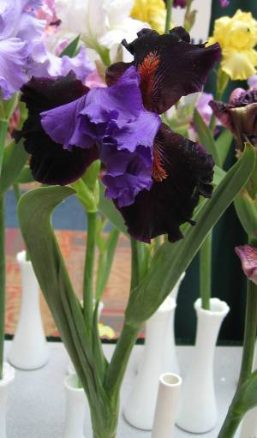
Balance
Choose a stalk in the garden that has its main stalk vertical.
A stalk that is leaning may not have balanced placement of its flowers.
Notes:
When the main stem leans away from the vertical, the branches on the lower side have a tendency to curve up toward the light thus jamming their buds against the main stem while the branches on the upper side curve up and farther away from the main stem than normal. This gives the whole stalk a lopsided appearance that prevents it from winning.
From Its' about time to win...

Slide 23
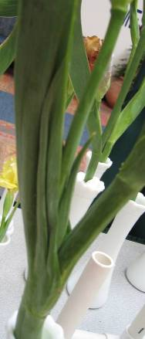
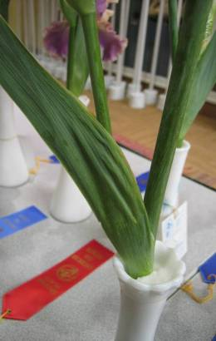
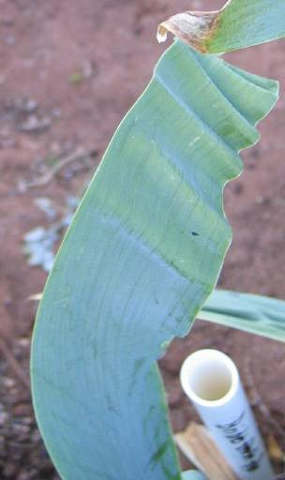
Leaf Wrinkles
Leaf Wrinkles are caused by repeated freezing and thawing. Don’t worry about them.

Slide 24
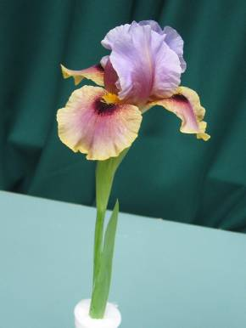
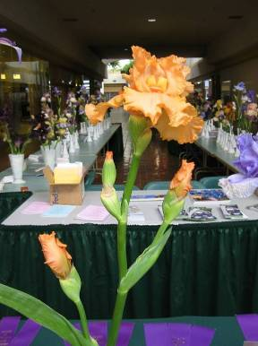
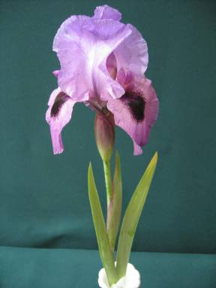
Single Blossoms
Multiple blossoms will not necessarily win blue ribbons or best in show. However, all things being equal, a multiple bloom stalk has a better chance for Best in Show
2010 Best In Show
Eye to Eye AB
2004 Best In Show
Forbidden Fruit, TB
2005 Best In Show
Persian Padisha, AB

Slide 25
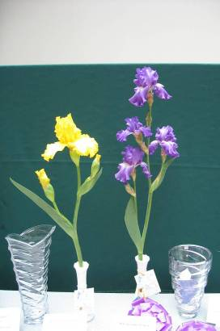
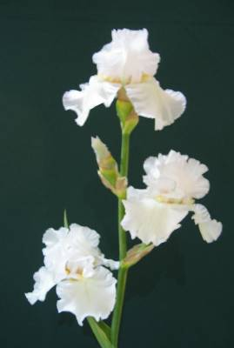
Single Blossoms (cont)
Deja Blue
2007 Best SA and
Best in Show
It is hard to have multiple flowers in perfect condition at the same time.
It is hard to transport open flowers successfully without a great deal of care.
White Elephant, TB
2006 TB Runner-Up
That’s All Folks
2007 Best TB

Slide 26
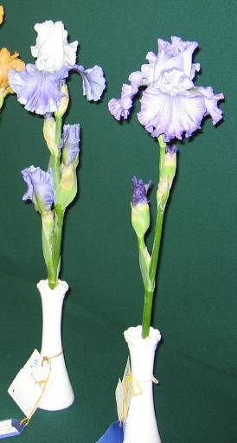
Single Blossoms (cont)
Many members choose a stalk with no open blossom.
They select a stalk that will have at least one blossom that will open during the night before the show.
The iris is transported the night before the show to the show location while it is still closed.
When the flower opens that night, it will be in perfect condition the morning of the show with little possibility of being damaged.

Slide 27
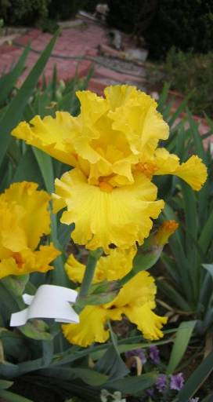
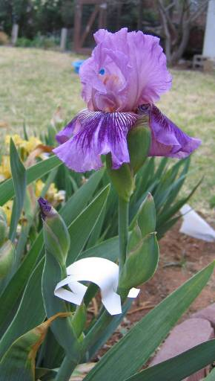
In Garden Grooming
You can “push” a crowded flower away from the stem by using spacers between the stalk.
A good spacer is a piece of Styrofoam plate with a “V” cut out each end.
Put the spacer on 5-days in advance and slide it down daily to increase separation.
My Kyala, TB
Pure As Gold, TB
Notes:
Ultimately, it boils down to how well an exhibitor has expertly grown and cultivated the show specimens. Irises must be kept watered while their stalks are emerging from the plant rhizomes. One must learn how to manipulate the developing stalk if it appears that branches will be too close to the stalk itself. Cutouts from paper plates or medicine bottles can act as wedges to force branches away from the main stem of the stalk. One may have to attend daily to the "wedges" to be sure that they have not slipped out of place and allowed the developing branch to return to its normal growth habits.

Slide 28
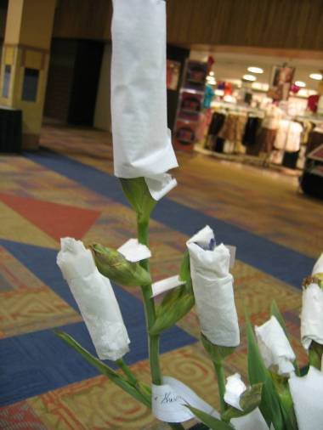
How to Hold a Bloom Back
You can pin a paper towel around a closed (but almost opened) blossom to delay opening.
Transport the iris to the show the night before and then remove the paper towel.

Slide 29
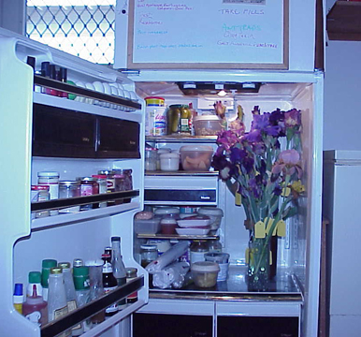
Refrigerator
Who needs a fridge nowadays with take out?
Just clean out the food and put in the flowers to delay blooming.
You will have to judge carefully when to remove the flowers so they can open by show time.

Slide 30
How To Push A Bloom Forward
Sometimes watering will spur irises to bloom earlier (especially if it has been dry).
Some varieties with color showing can be forced to bloom a few days earlier by cutting the stalk and placing in a warm and humid area.

Slide 31
How to Push a Bloom Forward
Two of three blooms seen here in this collection will probably not be opened by tomorrows judging. The irises are placed on top of a water heater under lights and Presto!
Note the light will make the iris turn towards it. Since this is a collection all three irises should be angled the same way.
Warmth and bright lights

Slide 32
High Winds
Consider cutting flowers a few days early if you know high winds will be a problem.
Notes:
Try to leave every stalk you plan to exhibit out in the garden on the plant until the very last moment. Irises look much better if they are allowed to naturally open in the garden. Sometimes they just don't open right once they have been cut and taken inside and put under air conditioning or forced heat air circulation.

Slide 33
Transportation
Many a possible queen of show have been ruined during transportation.
The goal is transport the irises so that the stalks and blossoms are not hitting and damaging each other.
The next several slides show methods that members have used to transport irises to the show.
Don’t Do This
Vienna Waltz
Notes:
Picture was taken at Schreiners in Oregon who sell cut Irises by the bucket!

Slide 34
Buckets
Use something in the bucket to space the stalks apart and keep them from sliding around in your car.
PVC is light and easy to cut and make good containers for holding the irises upright.
You want the Iris so it will not sway around and hit against another iris.

Slide 35
Handmade
Make your own with a basket and glue cheap vases to the bottom separated by about 5-6 inches

Slide 36
Carrying Louisianas or Spurias
Notes:
Seen at the Greater New Orleans Iris Society LA show at the 2018 national AIS convention

Slide 37
PVC Pipe
PVC pipe can be glued together with PVC pipe glue to make a watertight carrier for the irises that is light to carry. Make a handle!
Number each pipe and keep a paper with the pipe number and name of variety being transported.

Slide 38
The Night Before
If you intend to enter a lots of stalks, it is recommended that you take them to the show the night before (after 5:00 PM) and complete preliminary grooming while the mall is relatively uncrowded.

Slide 39
Equipment
A sharp knife
A "lot" of Q-Tips
Water, cup
Sharp manicure scissors
Rubber bands
Entry tags
Cosmetic brush
Loose facial powder.
The show book

Slide 40
Vase
You must use the vases supplied by MVIS
There are three sizes; small, medium and large
Use the appropriate vase for the size of the stalk. Most TBs are in the mid size vases. The SDBs are in the small vases. Collections are in the large vases.

Slide 41
Height
Ideally the branches should be placed on the upper 2/3 of the stalk).
You can cut off part of the stalk if the branches are too high to reach this ideal.
Be careful not to cut it too short, judges may be aware of its normal height.

Slide 42
Propping Up A Stalk
If a stalk is too short, you can cut a short piece of stalk and use it to prop up the exhibited stalk. Wedge tightly with cotton so it won’t lean.
This added stalk should be completely in the vase and not visible to the judges.
You will need to add enough water to reach the exhibited stalk.
Too Short

Slide 43
Center the Stalk
The main stalk should be centered over the vase.

Slide 44
Cotton
Cotton is used to center the stalk in the vase.
It should not be higher than the rim of the vase.
Too Much
Just Right

Slide 45
Raggedy Spathes
Dry brown spathes are due to our dry high winds.
Just smooth the spathes back in place.
Trim if very raggedy.
Trim
Trim

Slide 46
Trim Doohickeys
Trim if very raggedy or pronounced.
Trim
Smooth Down
Trim
Trim

Slide 47
Only a single stalk In The Vase
The judges didn’t like this stalk because it looked like 2 stalks was in the vase, when there was really only one.
They felt the groomer should have removed the second smaller stalk.
A middle bud was also touching the center stalk.

Slide 48
However…
Cutting the second branch off this iris would have removed it from the competition.
Strange Brew, TB

Slide 49
Avoid Broken Petals
Petals can be broken quite easily during transport.
If you find you arrived at the show with a broken petal, position it to the rear and hope the judges don’t notice.

Slide 50
Avoid Holes in Petals
The presenter found after she arrived at the show locale that the lower petal was missing a big piece.
She positioned this side so it was to the rear. It won a blue ribbon!
First Interstate

Slide 51
Covering Up Fingerprints
Lightly brush the stalk with a cosmetic brush to blend away the finger print … or…

Slide 52
Adding Talcum Powder
Or “Replace" the natural bloom on the stalk with a cosmetic brush and a “gentle" touch with talcum powder.

Slide 53
Q-Tips
Remove Dust
The Q-Tips are dipped in the water to aid in the removal of foreign matter from the open flowers. Remove bugs such as aphids, spiders, dirt, spider webs, and pollen.
A judge will remove an iris from the
display tables if it has too many
bugs.

Slide 54
Manicure Scissors
The manicure scissors can remove up to 1/4" foliage which has been damaged by leaf spot or insect grazing.
Trimming should follow the natural contour of the leaf.
The spent terminal blooms and brown sheaths at the base of the flowers can be neatly trimmed away if necessary.
2007 Best In Show
Note the trimmed foliage

Slide 55
Improper Leaf Cutting
If you must trim a leaf, follow the natural contours
This leaf was trimmed. However, the cuts had angles.
The judges also thought the tag didn’t represent the best side.
Notes:
Blue Ribbon

Slide 56
Loose Rubberbands
Too Loose
The judges will judge the side with the tag as the front.
They will mark off if the front is not the prettiest view of the flower.
It is easy for a loose rubber band to shift to some other side.
Double loop the rubber band for security
Just Right

Slide 57
Present Best Side Forward
The front is defined by the location of the tag. It is up to the presenter to properly position the tag.
This iris was presented as if this was the best side.
The lower flower is partially obscured by the leaf.
This is a very common error.

Slide 58
Only One Bloom in Socket
The judges felt that the second older bloom should be cut off.
It looks too crowded.

Slide 59
Too Crowded
The bud is crowding the flower.

Slide 60
Leaf Inside Vase
The leaf of this stalk is inside the vase. Maybe it should be removed or the stalk should be lifted higher.
The stalk is not well centered.

Slide 61
Flower Touching Stalk
The flower petal is actually being split by the talk.
This could have been eliminated in the garden by the addition of spacers

Slide 62
One Last Check
Before entries close, take a walk through and double check each specimen you entered and repair any damage caused by the placement committee.
Make sure best-side is facing forward along with tag.

Slide 63
Courtesy
Be out of the exhibition area before the show entry deadline. You can relax with the exhausted classification clerks who had to classify 100-200 irises in less than 4 hours. Wish them a job well done!

Slide 64
Once the Judging Starts
You can’t touch the exhibits once the judges arrive.
Judging may take 1-2 hours.
You can listen to but not talk to the judges while they are judging.
No arguments!

Slide 65
Division 1 Collections Section N
Collections are judged on how identical are the stalks including:
Position of branches
The number blooming
Shape of stalk
Doesn’t have to be the same cultivar
Belise
Tantara, SDB

Slide 66
Division 1 English Boxes Section P
A themed entry (all plicatas, all amoenas, all selfs etc.)
Six single Irises placed in baby jars filled with sand and water.
Names of Irises on box.
Name of theme in front of box.
Selfs

Slide 67
English Box Scale of Points
Scale of Points English Box
Overall Beauty 15
Color and Pattern Combination 20
Cultural Perfection 45
Condition and Grooming 20
Total 100

Slide 68
English Boxes What the Judges Want
Flowers should be straight and not tilted.
Falls should barely clear the box and not touch the box.
¼-inch clearance between Falls and box
Plicatas

Slide 69
Seedlings
Seedlings require minimum grooming.
Judges want to see the spent blossoms. They want to count how many flowers the seedling will have.
Don’t pull off dead blossoms

Slide 70
Now You Judge
Off balance
A little crowded on top
Ah Chihuahua
About Town

Slide 71
Now You Judge
Too tall. Suggestion: Remove leaf and cut stalk to represent 2/3 rule
Spacer seen by judge!
Captain
Thunderbolt
Notes:
The judges had the clerks remove the spacer and gave it a blue ribbon.

Slide 72
Now You Judge
Low blue
Crowded at the top, fall split
Too tall, damage on stalk
Carry a Torch
Color Strokes
Cold Fusion
Notes:
\

Slide 73
Now You Judge
Copper Angel
Cow Patty
Leaf touching, tag not centered
Bud touching top flower

Slide 74
Now You Judge
Leaf touching
Frost damage
Easy Being Green
Crazy for You

Slide 75
Now You Judge
Good job on taking terminal bud. Second stalk in vase
Leaf in vase, leaning forward, stalk too clean at bottom, flower touching leaf
Glimmer of Hope
Greatest Show on Earth

Slide 76
Now You Judge
In Living Color
Closing terminal flower, crowded top, fingerprints on stalk, bottom flower. Suggestion: Using a soft makeup brush, gently blend away fingerprints.
Haunting
Leaf in vase (If in doubt, take out), tag not centered

Slide 77
Now You Judge
Irresistible Charm
Not judged (at least one flower must be opened). You can open it by hand or place it in a warm, humid environment the night before
Leaf touching flower
Magic Beth

Slide 78
Now You Judge
Pin-wheeled top flower
Blue Red
Orinoco Flow
Perry Dyer

Slide 79
Now You Judge
Refiner’s Fire, AB
Revved Up Rose
Bunchy, leaf touching flower
Red. Lose the leaf and cut the stalk so the stalk fits lower and follows the 2/3 rule
Notes:
Sultry Mood – Could use a better Candelabra effect, however, looks good

Slide 80
Now You Judge
Torn fall.
Leaf in vase
It’s a flattie, but not all flowers are flat
Soaring Falcon,
AB
Six Pack
Notes:
Amain has fingerprints

Slide 81
Choose Red, White, Blue and Honorable Mention
4
Idols
Apricot
Frosty

Slide 82
Now You Judge
Proportion doesn’t follow 2/3 rule, Tag on wrong side. Still won blue
Suggestion: Lose the leaf and trim the stalk for better proportion.
Place tag on best side.
Some smudging on the stalk. Brown leaf tip. Stalk could be more vertical. Still won blue.
Safari Sunset
And Away We Go
Notes:
Safari Sunset. Brush stalks with talcom powder. Trim brown tip on leaf.

Slide 83
Now You Judge
There is a bud interfering with the top flower. Leaf cut is not natural. Suggestion: Either remove the bud or twist the flower slightly so the bud falls between the flower petals. The question to ask is does the 2nd bud interfere with the open flower?
Standards look twisted. Leaf in vase.
White ribbon
Crowned Heads
Galilee Dawn AB
Notes:
Crowned Heads - There is a bud interfering with the top flower. Leaf cut is not natural
Suggestion: Either remove the bud or twist the flower slightly so the bud falls between the flower petals. The question to ask is does the 2nd bud interfere with the open flower?

Slide 84
Now You Judge
Red. Mutant Flower! Best side not presented.
Odd shaped stalk. Some smudging on stalk. Won Red
Suggestion: Take a facial powder brush and lightly brush the smudges. Do not remove the powdery substance on the stalk.
Glitter Gulch SA
Barbara My Love
Notes:
Barbara My Love - Odd shaped stalk. Some smudging on stalk. Won Red
Suggestion: Take a facial powder brush and lightly brush the smudges. Do not remove the powdery substance on the stalk.
Chickasaw Sue – Won blue

Slide 85
Now You Judge
Flower not opened enough for judging. Suggestion: Prior to show, place stalk in a warm environment under lights.
Or try to open flower by hand.
Bud touching flower. Suggestion: Add spacers in garden. Won Red
Chocolate & Silk
Coral Point
Notes:
Chocolate & Silk- Bud touching flower. Suggestion: Add spacers in garden. Won Red
Coral Point – Flower not opened enough for judging. Suggestion: Prior to show, place stalk in a warm environment under lights.
Or try to open flower by hand.

Slide 86
Now You Judge
Standards are twisted. Leaf should be taken off and stalk lowered in vase for the 2/3 rule. Terminal bud interfering with open bloom.
Leaf in Vase, Flower crepey (closing)
Roper’s Revenge SA
Scented Bubbles

Slide 87
Eye For Style
Petal touching stalk
Suggestion: Add spacers while still in garden
Won Blue Ribbon
Eye For Style

Slide 88
Fringe Benefits
Tag not facing best side
Fringe Benefits
Fringe Benefits 2010_04_17

Slide 89
Fancy A Flutter
Doesn’t follow 2/3 rule
Suggestion: Trim the stalk
Red Ribbon
Fancy a Flutter

Slide 90
Freppe
Doesn’t follow 2/3 rule. Lower flower touching leaf and stalk.
Suggestion:
Add spacers to correct touching.
Cut more of the stalk. Try to position stalk higher.
Freppe
Notes:
Judges said that the leaf was okay.

Slide 91
Now You Judge
Minor touching of flower buds. Suggestion: Add spacers the night before to separate the two branches.
Bud at terminal is okay since it is not interfering with flower. Out of Proportion. Could tell leaf had been cut off at lower branch.
Could tell there use to be a bloom at second branch. Honorable Mention
Suggestion: Lose lower branch and adjust stalk height for proportion
First Wave
Friendly Fire
Notes:
Friendly Fire - Bud at terminal is okay since it is not interfering with flower. Out of Proportion. Could tell leaf had been cut off at lower branch.
Could tell there use to be a bloom at second branch. Honorable Mention
Suggestion: Lose lower branch and adjust stalk height for proportion
First Wave – minor touching of flower buds. Suggestion: Add spacers the night before to separate the two branches.

Slide 92
Now You Judge
Golden Panther
Doesn’t follow 2/3 rule. Lower flower touching leaf and stalk.
Suggestion: Add spacers to correct touching. Cut more of the talk. Try to position stalk higher.
Stalk not centered. Powdery bloom on stalk has been completely brushed off. Stalk is too shiny! Red ribbon.
Suggestion: Center stalk over vase. Blend away fingerprints on the stalks. Do not remove all the powdery bloom on stalk. You can use talcum powder to add the powdery bloom back to the stalk.
Freppe
Notes:
Golden Panther - Stalk not centered. Powdery bloom on stalk has been completely brushed off. Stalk is too shiny! Red ribbon
Suggestion: Center stalk over vase. Blend away fingerprints on the stalks. Do not remove all the powdery bloom on stalk. You can use talcum powder to add the powdery bloom back to the stalk.
Freppe - Doesn’t follow 2/3 rule. Lower flower touching leaf and stalk.
Suggestion: Add spacers to correct touching. Cut more of the talk. Try to position stalk higher.

Slide 93
Now You Judge
Main stalk leaning backwards. Suggestion: straighten stalk.
Grand Classic
Crowding, top heavy. Lower blossom has back petal up on the stalk. Missing flower. The judges loved this one and plan to order it. However… only Honorable Mention
I’m Back
Notes:
Grand Classic - Crowding, top heavy. Lower blossom has back petal up on the stalk. Missing flower. The judges loved this one and plan to order it. However… only Honorable Mention
Suggestion: Rotate lower blossom so back petal falls down instead of falls up.
I’m Back – Main stalk leaning backwards. Suggestion: straighten stalk.

Slide 94
Now You Judge
Looks good but could be taller for better proportion, Blue ribbon
Lower blossom touching stalk. Some brown. Suggestion: Add spacers a few days before show. Or after you first pick the stalk (while it is still warm) gently rotate the blossom so the stalk falls between the petals. Trim away brown. Red Ribbon
Heart of Glass
Honeycomb
Notes:
Heart of Glass - Lower blossom touching stalk. Some brown. Suggestion: Add spacers a few days before show. Or after you first pick the stalk (while it is still warm) gently rotate the blossom so the stalk falls between the petals. Trim away brown. Red Ribbon
Honeycomb - Looks good but could be taller for better proportion, Blue ribbon

Slide 95
Now You Judge
A bloom is obviously gone. Proportion bad. Suggestion: Trim stalk and lose lower leaf. When you remove the spent bloom, remove it so the judges are not aware it is gone (wiggle spent bud and snap off). Red Ribbon
Stalk not centered. Suggestion: Center main stalk over vase (may not be possible). Red Ribbon
Luscious Lace
Let’s Romp
Notes:
Luscious Lace - Stalk not centered. Suggestion: Center main stalk over vase (may not be possible). Red Ribbon
Let’s Romp - A bloom is obviously gone. Proportion bad. Suggestion: Trim stalk and lose lower leaf. When you remove the spent bloom, remove it so the judges are not aware it is gone (wiggle spent bud and snap off). Red Ribbon

Slide 96
Now You Judge
Blue
Proportion incorrect. Tilted. Suggestion: Lose the leaf. Trim and straighten the stalk. Honorable Mention
Mariposa
Skies
Marv
Notes:
Marv - Proportion incorrect. Tilted. Suggestion: Lose the leaf. Trim and straighten the stalk. Honorable Mention
Mariposa Skies – Blue Ribbon

Slide 97
Not So Easy, Isn’t It?

Slide 98
At the End of the Show
Either take your iris home
Or
Add it to a vase to be taken to a Senior Citizen/ Retirement home

Slide 99
The End
End This Presentation

