Slide 1
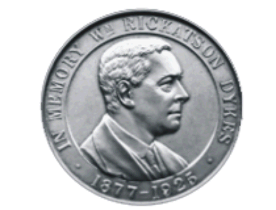
Dykes Medal Winners
American Iris Society
Presentation and Bingo Game

Slide 2

How to Play Bingo
Method: Print out the Dykes list on slide 7 and cut it up into individual Dykes winner. Place in a bowl and pull randomly. Print the Dykes bingo cards (a separate pdf file) .
Go to slide 7. This pages has links to the individual winners. Click on the Dykes medal winner you just pulled. This takes you the winner. To get back to slide 7, click on the Dykes list at bottom right. . Repeat until someone yells Bingo. Keep track of the irises that have been pulled and verify the winner.
Dykes List

Slide 3
Dykes Description
First awarded in 1927, the American Dykes Medal is the highest award of the AIS. Awarded to no more than one iris per year. Irises are eligible as a Dykes Medal candidate for three years following the winning of a classification medal. Only AIS registered judges may vote.
It is awarded by the British Iris Society in honor of William R. Dykes to the best Iris developed by an American hybridizer. The candidates are chosen from the AIS Medal winners that have been bred by American (US & Canadian) Hybridizers. The Medal winners are the best irises in their class. So this is the best of the best. The British Iris Society also presents Dykes Medals to Great Britain, Australia, New Zealand and previously France.

Slide 4
Story
The Dykes medal winners reads like a story about the revolution caused by the inclusion of the tetraploids (4 sets of chromosomes) into hybridizing programs. Most of the original hybridizers did not know about genetics. They just followed their tuition and used a great deal of luck. The story of the Dykes is a story about the development of pure whites, pinks and tall yellows. It’s a story about the quest for the blackest black, a true rose red and unusual patterns. Finally it is a story about developing a plant that can be grown throughout the country.

Slide 5
Missing Years
1930
1931
1934
1946
1960
1969
1987
1989
2020
An iris needs 15% of the votes to achieve the DM.
No Dykes was awarded during 2020 because of the CoVid-19 pandemic.

Slide 6
Type of Games
Choose your game, typically the first 3 are played

Slide 7
Dykes Medal Winner List
2004 -2021
Daring Deception 2021
Bottle Rocket 2019
Haunted Heart 2018
Montmartre 2017
Swans In Flight 2016
Gypsy Lord 2015
Dividing Line 2014
That’ All Folks 2013
Florentine Silk 2012
Drama Queen 2011
Paul Black 2010
Golden Panther 2009
Starwoman 2008
Queens Circle 2007
Sea Power 2006
Splashacata 2005
Crowned Heads 2004
1985-2003
Celebration Song 2003
Mesmerizer 2002
Yaquina Blue 2001
Stairway to Heaven 2000
Hello Darkness 1999
Conjuration 1998
Thornbird 1997
Before the Storm 1996
Honky Tonk Blues 1995
Silverado 1994
Edith Wolford 1993
Dusky Challenger 1992
Everything Plus 1991
Jesse's Song 1990
Titan's Glory 1988
Song of Norway 1986
Beverly Sills 1985
1967-1984
Victoria Falls 1984
Ruffled Ballet 1983
Vanity 1982
Brown Lasso 1981
Mystique 1980
Mary Frances 1979
Bride's Halo 1978
Dream Lover 1977
Kilt Lilt 1976
Pink Taffeeta 1975
Shipshape 1974
New Moon 1973
Babbling Brook 1972
Debby Rairdon 1971
Skywatch 1970
Stepping Out 1968
Winter Olympics 1967
1949-1966
Rippling Waters 1966
Pacific Panorama 1965
Allegiance 1964
Amethyst Flame 1963
Whole Cloth 1962
Eleanors Pride 1961
Swan Ballet 1959
Blue Sapphire 1958
Violet Harmony 1957
First Violet 1956
Sable Night 1955
Mary Randall 1954
Truly Yours 1953
Argus Pheasant 1952
Cherie 1951
Blue Rhythm 1950
Helen McGregor 1949
1927-1948
Ola Kala 1948
Chivalry 1947
Elmohr 1945
Spun Gold 1944
Prairie Sunset 1943
Great Lakes 1942
The Red Douglas 1941
Wabash 1940
Rosy Wings 1939
Copper Lustre 1938
Missouri 1937
Mary Geddes 1936
Sierra Blue 1935
Coralie 1933
Rameses 1932
Dauntless 1929
San Francisco 1927

Slide 8
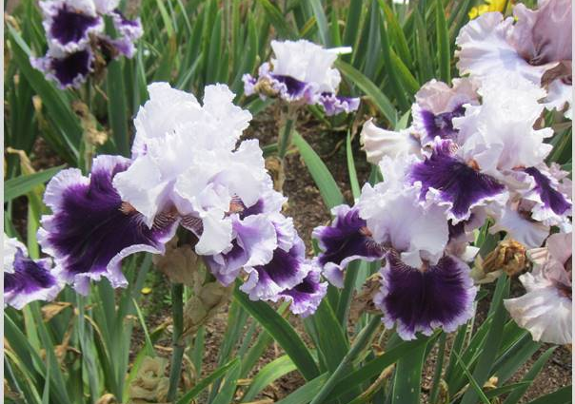
Daring Deception 2021
Hybridizer: Thomas Johnson
TB; 2012
This Iris resulted from crosses made in Australia. Many hybridizers around the world travel to each other’s garden and make crosses in the garden. The seeds are then shipped to the hybridizer. This is faster than shipping a rhizome which may have to adapt to the flipped spring and fall.
Dykes List

Slide 9
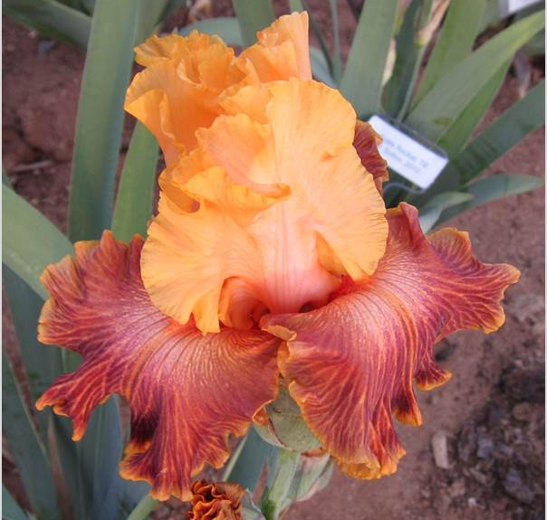
Bottle Rocket 2019
Hybridizer: Michael Sutton
TB; 2010
High Commendation (HC) awards are reserved for seedling irises, viewed in the garden by AIS judges, under seedling number or registered name, which have not been introduced into commerce yet. Any seedling of any established classification that receives five votes is granted an HC award. Only AIS registered judges may vote.
Dykes List
Notes:
this tall bearded iris also captured the Wister Medal in 2018, an Award of Merit in 2014, and an Honorable Mention in 2012. This becomes the first Dykes Medal winning iris from an Idaho hybridizer.

Slide 10
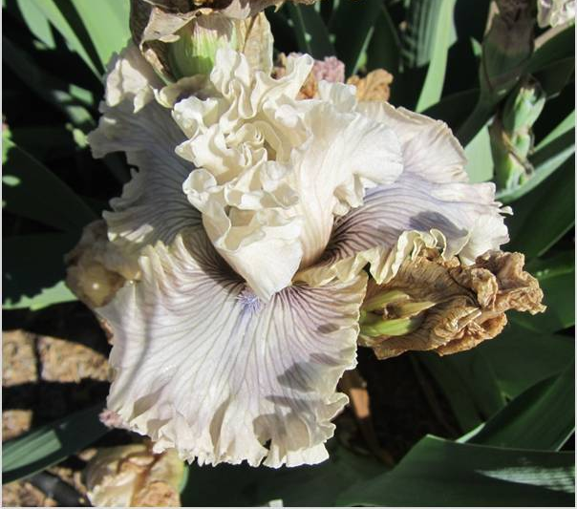
Haunted Heart 2018
Hybridizer: Keith Keppel
TB; 2010
Award of Merit (AM) awards are given to irises from each classification each year. Any iris is eligible the second year after previously winning an Honorable Mention (HM). Only AIS registered judges may vote.
Dykes List

Slide 11
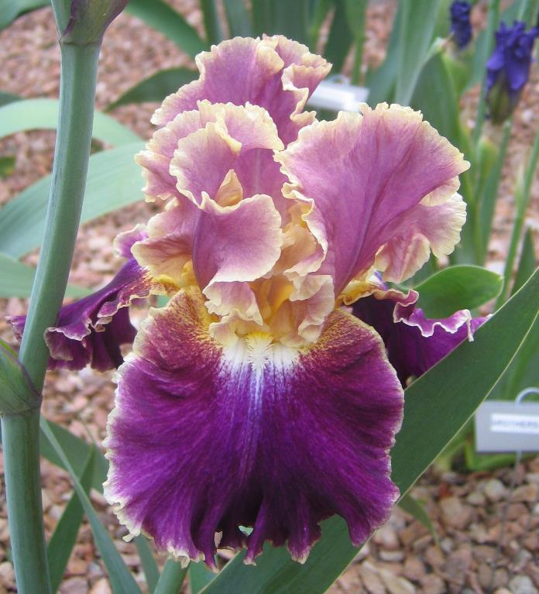
Montmartre 2017
Hybridizer: Keith Keppel
TB; R 2008
The Tall Bearded Iris Society sponsors a popularity contest to determine the 100 most popular TBs. Montmartre was ranked #57 in 2011 but moved up to #21 in 2015. This ballot is not just limited to judges but is open to every member of The American Iris Society. Each member may vote up to 25 times. The TB Symposium ballot therefore gives a good idea of which irises grow well in all parts of the country.
Dykes List
Notes:
Honorable Mention 2010, Award of Merit 2012, Wister Medal 2014, American Dykes Medal 2017

Slide 12
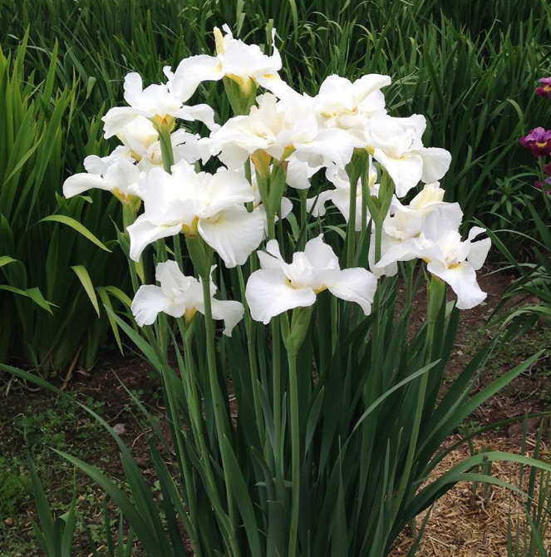
Swans in Flight 2016
Hybridizer: Robert Hollingworth
SIB; R 2006
Siberians perform best with cooler conditions, regular moisture and a slightly acid soil.
Swans in Flight is the first Siberian Iris to win the Dykes medal. It has to first win the Morgan-Wood medal. It is named in honor of F. Cleveland Morgan and Ira E. Wood. Morgan was a pioneer Canadian breeder of Siberian irises and a founding member of AIS. Wood and his wife Betty were both scientists who worked for Bell Telephone Laboratories in New Jersey and active in the Society for Siberian Irises.
Dykes List
Notes:
Honorable Mention 2009, Award of Merit 2011; Morgan-Wood Medal 2013; Franklin Cook Cup 2015; American Dykes Medal 2016.

Slide 13
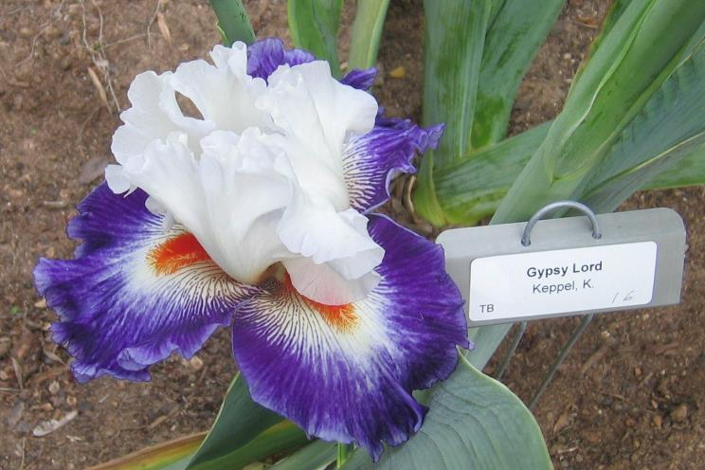
Gypsy Lord 2015
Hybridizer: Keith Keppel
TB; R 2006
Gypsy Lord is a bi-color iris known as an amoena (white standards, colored falls). Historically, bicolors, bitones and amoenas were among the first recorded irises and are seen in catalogs as early as the 1840s. The French were among the first to place diploid irises on the market. As tetraploids developed, bicolors, bitones and amoenas improved in color, form, size and plant habits.
Dykes List
Notes:
Honorable Mention 2008; Franklin Cook Cup 2008; Award of Merit 2010; Wister Medal 2012, America

Slide 14
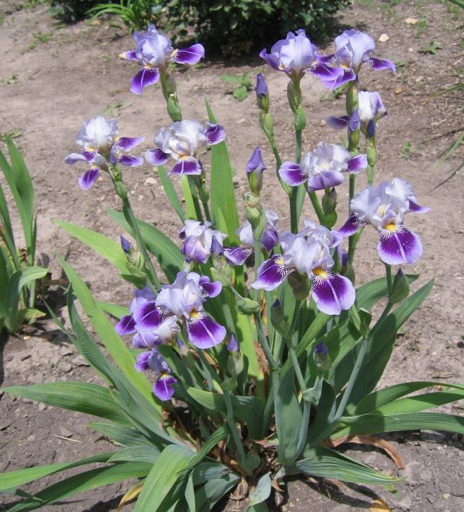
Dividing Line 2014
Hybridizer: Charles Bunnell
MTB; R 2004
Dividing Line is the first Miniature Tall Bearded to win the Dykes. MTBs are dainty and a clump looks like a cloud of butterflies. They are called "Table Irises" because they are so well suited for arrangements. Height 16” to 27.5”.
Dividing Line also won the Ben Hager Cup in 2007 and 2009. The Ben Hager Cup is awarded annually during the American Iris Society's annual convention to median irises (SDB, IB, MTB and BB) seen in bloom in the official tour gardens. Each registrant may vote for one median iris.
Dykes List
Notes:
Honorable Mention 2007; Ben Hager Cup 2007; Award of Merit 2009; Ben Hager Cup 2009; Williamson-White Medal 2011, American Dykes Medal 2014.

Slide 15
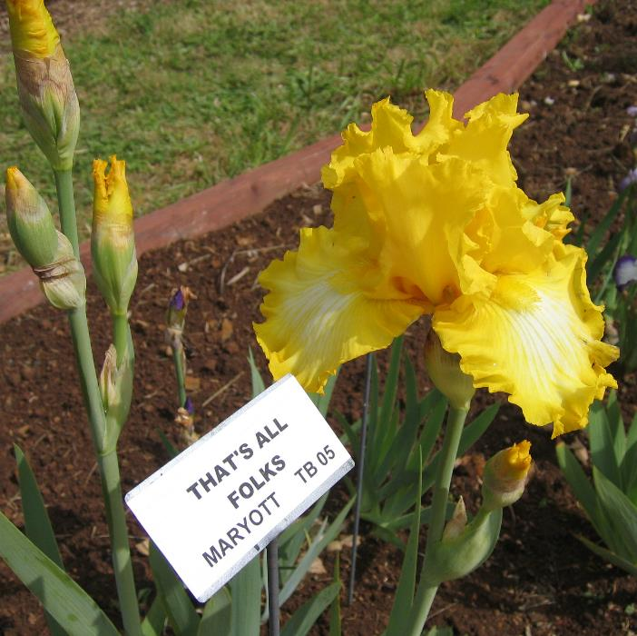
That's All Folks 2013
Hybridizer: William Maryott
TB; R 2005
Maryott also won the hybridizer award in 2013. The hybridizers award honors hybridizers who have made significant advancements in Iris. "The Hybridizer's Medal is awarded to persons who have produced new iris varieties of exceptional merit deserving of special recognition."--Garden Irises 1959.
Dykes List
Notes:
Honorable Mention 2007; Award of Merit 2009; Wister Medal 2011; American Dykes Medal 2013.

Slide 16
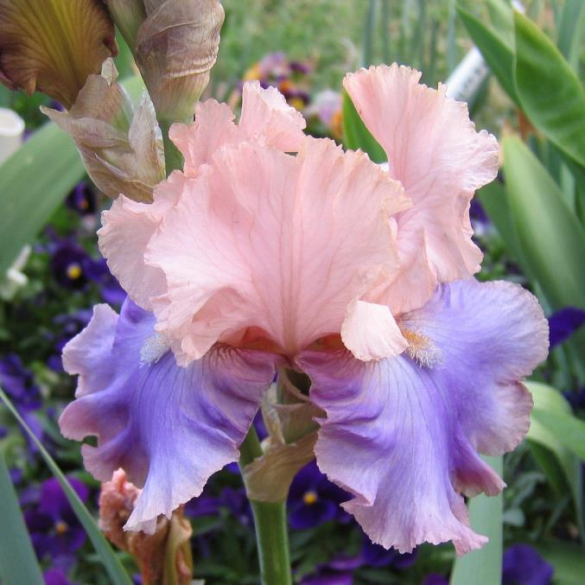
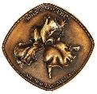
Florentine Silk 2012
Hybridizer: Keith Keppel
TB; R 2005
Florentine Silk first had to win the Wister Medal before it could win the Dykes. The Wister medal is the highest award given by AIS to a TB. John C. Wister, a landscape architect, led the organizing meeting that created the American Iris Society and became its first president. All the other iris categories award only one medal each year. The exception is this category which awards three Wister medals for the popular TBs. Only AIS registered judges may vote.
Dykes List
Notes:
Honorable Mention 2007; Franklin Cook Cup 2007; Award of Merit 2009; Wister Medal 2011, American Dykes Medal 2012.

Slide 17
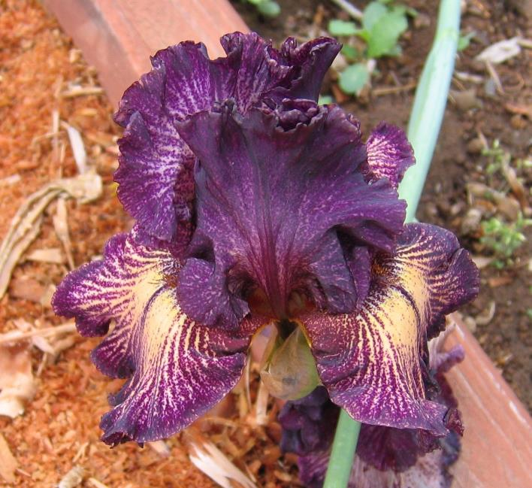
Drama Queen 2011
Hybridizer: Keith Keppel
TB; R 2003
Emphasis in the Dykes Medal has been placed on branching and the top-heavy stalks of yesteryear are no longer acceptable. By today's standards the branches should be evenly distributed over the upper two-thirds of the stalk. A graceful S curve will show off the blossoms to their best advantage.
Dykes List
Notes:
Honorable Mention 2005; Award of Merit 2007; Wister Medal 2009; American Dykes Medal 2011.

Slide 18
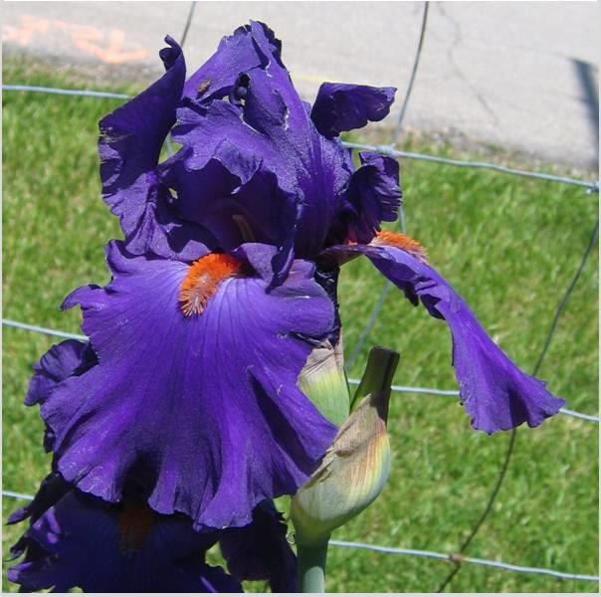
Paul Black 2010
Hybridizer: Tom Johnson
TB; R 2003
Paul Black won the Franklin Cook Cup in 2004 in Fresno, CA. The Franklin Cook Memorial Cup is awarded annually during The American Iris Society's national meeting. All introduced irises seen growing and in bloom in the official tour gardens of the meeting are eligible to be voted by attendees for the Cook Cup, except irises originated within the host region for that year's national meeting.
Dykes List
Notes:
Franklin Cook Cup 2004; Honorable Mention 2005; Award of Merit 2007; Wister Medal 2009; American Dykes Medal 2010.

Slide 19
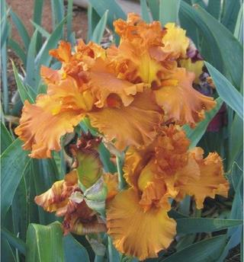
Golden Panther 2009
Hybridizer: Richard Tasco
TB; R 2000
Golden Panther also won the President’s cup in 2004. The President's Cup is awarded annually during The American Iris Society's national meeting. Eligibility is restricted to introduced irises originated within the host region for that year's national meeting or originated by a hybridizer whose garden is included on the meeting's official convention tour, regardless of its location.
Dykes List
Notes:
Honorable Mention 2002; Award of Merit 2004; President's Cup 2004; Wister Medal 2006; American Dykes Medal 2009.
See below:

Slide 20
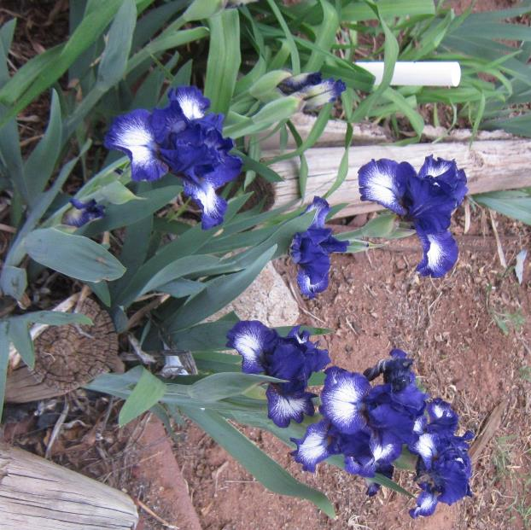
Starwoman 2008
Hybridizer: Marky Smith
IB; R 1998
Starwoman is the first Intermediate Bearded (IB) iris to win the coveted medal. It had to first win the Hans and Jacob Sass Medal (for IBs). It is named in honor of 2 brothers Hans and Jacob Sass.
Their fame came for their work producing IBs. Crossing dwarf irises with TBs, they were the first American breeders to develop many new colors and forms in the intermediate class. They saw the great advantage of IBs in windy areas, and desired an iris that filled out the bloom season between the early dwarf irises and the later TBs.
Dykes List
Notes:
Honorable Mention 2001; Award of Merit 2003; Sass Medal 2005; American Dykes Medal 2008.

Slide 21
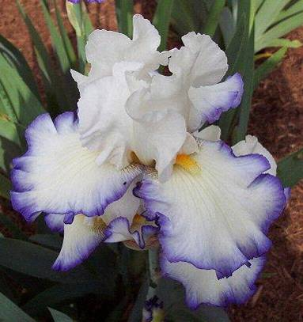
Queen’s Circle 2007
Hybridizer: Frederick Kerr
TB; R 2000
At the turn of the century, most garden irises were the diploids. Animals (including humans) and many plants are ‘diploid’ with two copies of each gene, one inherited from each parent. Today’s many irises are tetraploids ( 4 sets of each gene).
Dykes List
Notes:
Awards: HM '02, AM '04, Wister Medal '06

Slide 22
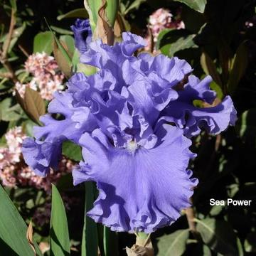
Sea Power 2006
Hybridizer: Keith Keppel, Oregon
TB-38”; R 1999
Sea Power has incredible ruffling. This iris and all modern irises owe their ruffly existence to Snow Flurry. One of the great iris stories, Clara Rees, a hybridizing novice, crossed Purissima with the diploid Thais and produced a seed pod with just two seeds. Only one seed sprouted and that was Snow Flurry. Some mutant variation caused it to have ruffles (unknown at that time). A noted hybridizer brought Clara’s entire clump and the rest as they say, is history. Clara won the first ever AIS Board of Directors award in 1974 Talk about beginners luck! The importance of Snow Flurry can not be overestimated.
Dykes List
Notes:
Dykes Medal winner 2006, Wister Medal 2005, AM 2003, HM 2001. Second place for the Cook Cup at the AIS 2004 Convention held in Fresno, California, April 2004.

Slide 23
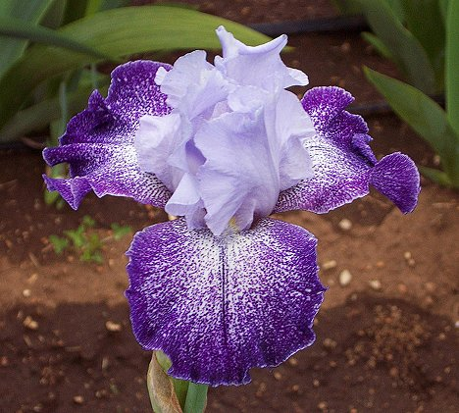
Splashacata 2005
Hybridizer: Rick Tasco California
TB; 1998
Plicata pattern is recessive so it is best to start with two plicata parents when trying to produce another plicata. In "recessive" traits, the factor(s) that causes the traits is weak in some way, so that it loses out when paired with a dominant factor and reproduces only when paired with a factor like itself.
Dykes List
Notes:
Also voted the 2003 Franklin Cook Cup winner by the attendees at the 2003 AIS Convention, Falls Church, Virginia.
The Cook Cup is presented each year at the AIS Convention to the best out of region convention iris.

Slide 24
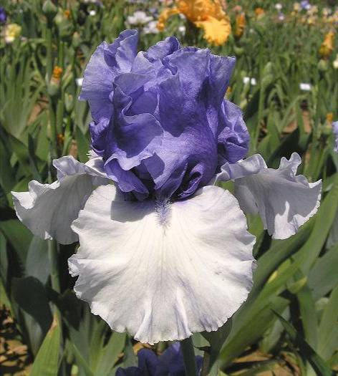
Crowned Heads 2004
Hybridizer: Keith Keppel, Oregon
TB-38”; R 1997
By 2004, Keith has been working on creating a true blue reverse amoena for a decade. He crossed the reverse amoena In Reverse with Schreiners Honky Tonk Blues to create this spectacular new reverse blue amoena. Crowned Heads falls are tinted slightly blue, so he crossed it with Fogbound (Keppel, 97) to finally achieve Alpenview, with true blue standards and clean white falls.
Dykes List
Notes:
From the Bulletin of the American Iris Society, April 2005, “The Fogbound Effect” by Sylvain Ruaud

Slide 25
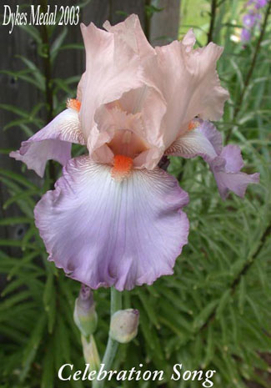
Celebration Song 2003
Hybridizer: Schreiner, Oregon
TB; I 1993.
One of the goals of hybridizers throughout the years have been increasing bud count. Many buds are double or triple socketed. Celebration Song produces strong stems with three to four branches and 9-12 buds. A hundred years ago, a bud count of 7 was considered good.
Dykes List

Slide 26
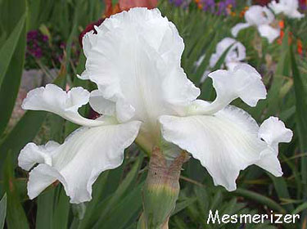
Mesmerizer 2002
Hybridizer: Monty Byers, California
SA-M-36”;
Who could have foreseen a time that space-agers would win 3 of the last 6 DMs. More and more irises introduced are space-agers and Monty space-agers such as Mesmerizer are appearing in the backgrounds of modern irises.
Dykes List
Notes:
Awards: HM '93, AM '96, Wister Medal '00, Dykes Medal '02.

Slide 27
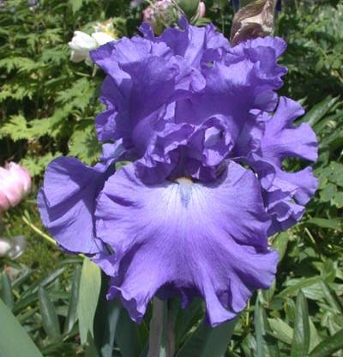
Yaquina Blue 2001
Hybridizer: Schreiner, Oregon
TB-M; R. 1992
There are about a dozen blue irises that have won the Dykes Medal. This makes blue the most popular color for Dykes. The colors range from pale blue to dark navy blue.
Dykes List
Notes:
N59-A: (J78-3: ((Cup Race x Tufted Cloud) x Sailor's Dance) x I 38-A: (Sapphire Hills x (Parisian Blue x ((Blue Linen sib x (J 274-A x Violet Harmony)) x (Swan Ballet x Snowy Heron))))) X L 100-A: (I 144-G: (((((Black Onyx x N 371-1) x Grand Ball) x (Sterling Silver x (((Pierre Menard x (Blue Rhythm x Chivalry)) x Harbor Blue) x (Blue Sapphire x Harbor Blue)))) x unknown) x Neptune's Pool) x G 119-H, Royal Regency sib). Schreiner 1992.

Slide 28
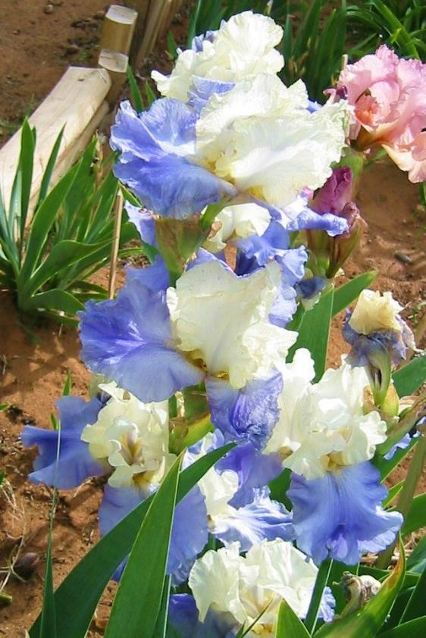
Stairway To Heaven 2000
Hybridizer: Larry Lauer
TB-EM-40”; R. 1992
The following table show probabilities in trying to obtain a recessive trait aaaa. The actual table is much more complex and varied.
AAAa X AAAa 0
AAAa X AAaa 0
AAAa X Aaaa 0
AAAa X aaaa 0
AAaa X AAaa 1/36
AAaa X Aaaa 1/12
AAaa X aaaa 1/6
Aaaa X Aaaa 1/4
Aaaa X aaaa 1/2
Dykes List
Notes:
Sdlg. L87-48-3. Edith Wolford X Breakers. Cottage Gardens 1993.
From Bulletin of the AIS, July 2004

Slide 29
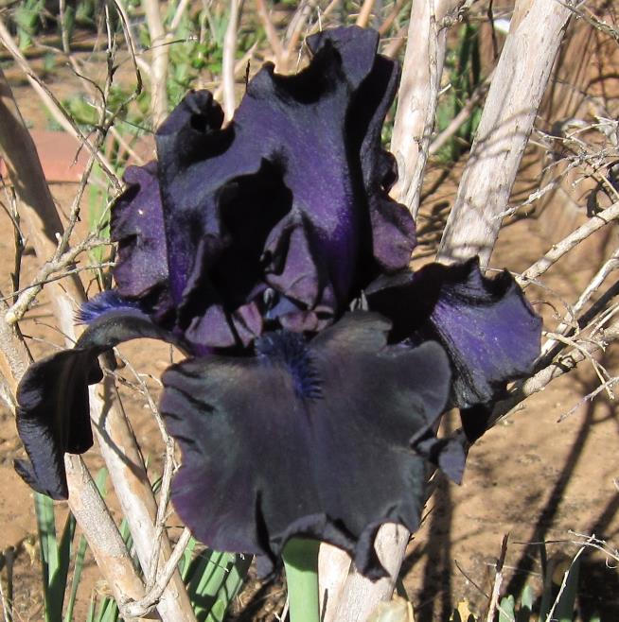
Hello Darkness 1999
Hybridizer: Schreiner, Oregon
TB-EM-37; R. 1992
Black comes about through equal parts of red, blue and yellow pigment. The problem with irises is that there is no red pigment.
Irisarians have to play tricks to approach black. Hybridizers have started with blue, bred to indigo or violet and kept saturating the color until they approach a very realistic looking black.
Dykes List
Notes:
Sdlg. Y882-1.
From the Bulletin of the American Iris Society, Oct 1999; Article “Black is Black” by Sylvain Ruaud

Slide 30
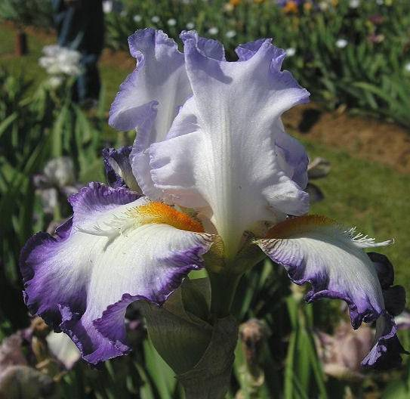
Conjuration 1998
Hybridizer: Monty Byers, California
SA-ML-36”; R. 1988
Monty breeding interests centered around Space-Agers such as Conjuration. He is known for taking this class of iris, once considered just a novelty class, and mainstreaming it. Conjuration won the Wister Medal and the DM both in 1998, a unique occurrence!
Dykes List
Notes:
(Sky Hooks x Condottiere) X Alpine Castle. Moonshine Gardens 1989

Slide 31
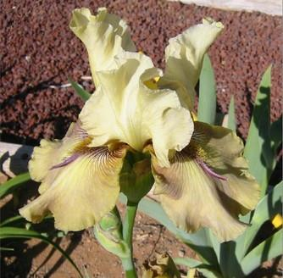
Thornbird 1997
Hybridizer: Monty Byers, California
SA-M-35”; R. 1988
Hybridizers don’t clearly understand space age genetics. The Space Age Genetic Endeavor project is trying to generate tests in which genetic patterns and traits can be studied.
For examples what traits governs the horns as seen in Thornbird or the flounces seen in Mesmerizer? What traits enhance or suppress space-ageness?
Dykes List
Notes:
Sdlg. D156-1-B.
Bulletin of the American Iris Society, April, 2005, “Getting Serious About Space Age Genetics” by Neil Mogensen

Slide 32
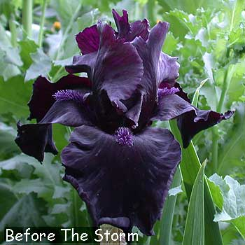
Before The Storm 1996
Hybridizer: Stirling Innerst, Pennsylvania
TB-M-36“; R. 1988
There is something about black. Throughout history mankind has always tried to breed a black flower whether it be a tulip, rose or iris. Many a hybridizer has called a dark purple “black” as a marketing ploy. One hybridizer sent out a strand of faux pearls if you purchase his black iris. Now there is so much saturation of the dark purple color, that they do look black and deserve the name.
Dykes List
Notes:
Superstition X Raven's Roost.
From the Bulletin of the American Iris Society, Oct 1999; Article “Black is Black” by Sylvain Ruaud

Slide 33
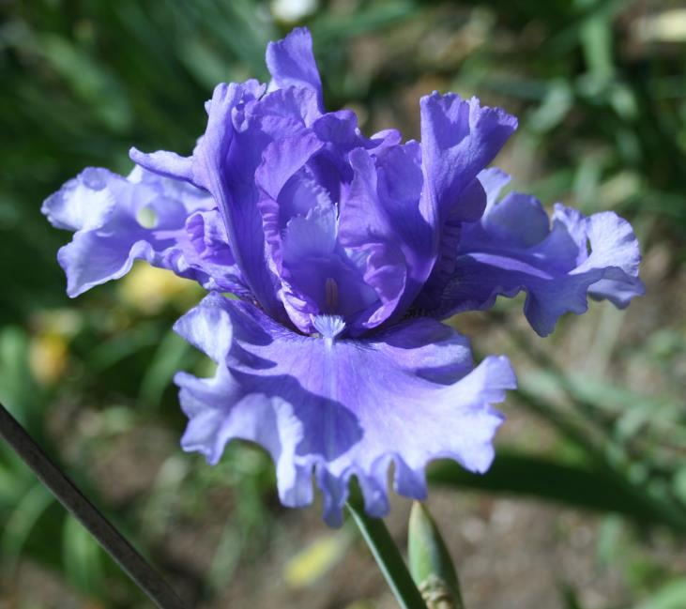
Honky Tonk Blues 1995
Hybridizer: R. Schreiner, Oregon
TB-M-37"; R. 1988.
Honky Tonk Blues has standards that are a deeper blue than the falls. This iris is often used in the quest of reverse amoenas such as the 2004 DM winner Crowned Heads.
Dykes List
Notes:
Sdlg. T 280-1. J 59-A: (Admiral Blue x Sailor's Dance) X L 100-A: ((G 1517-B x Neptune's Pool) x G 119-H, Royal Regency sib).
From the Bulletin of the American Iris Society, April 2005, “The Fogbound Effect” by Sylvain Ruaud

Slide 34
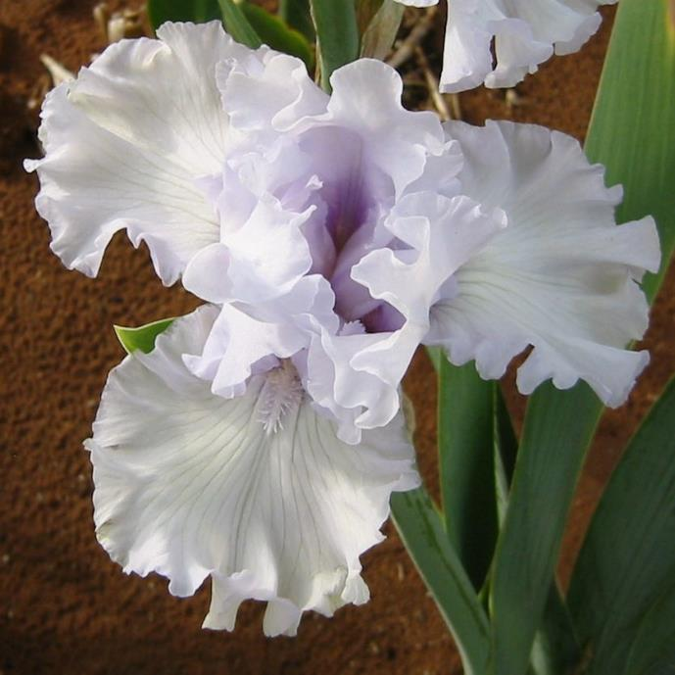
Silverado 1994
Hybridizer: Schreiner's, Oregon
TB-M-38“; R. 1987
Schreiners is the largest national retail grower of Iris with 200 acres of growing fields and 10 viewing acres open to the public. Schreiner's Iris Gardens sells over 3.5 million rhizomes annually, primarily from national and international catalog mail orders, and employs a crew of 150 during the shipping and planting season.
Dykes List
Notes:
Sdlg. 592-D. K 440-S: Starina x Navy Strut) X Carriage Trade. Schreiner's 1987.

Slide 35
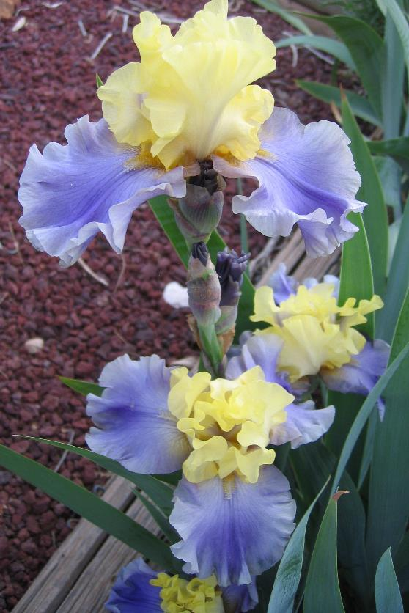
Edith Wolford 1993
Hybridizer: Ben Hagar; California
TB-M;
Ben was an all-around irisarian and worked on other types of irises other than TBs. Ben has won about every medal the AIS has to offer including this 3rd Dykes medal for Edith Wolford. A listing of all his awards would probably take several slides. By his death in 1999, he had made more than 6700 crosses. He had a saying, half in jest, that if it stood still long enough, he would pollinate it!
Dykes List
Notes:
From the bulletin of the AIS, October 1999; article “Ben Hagar, 1915-1999”

Slide 36
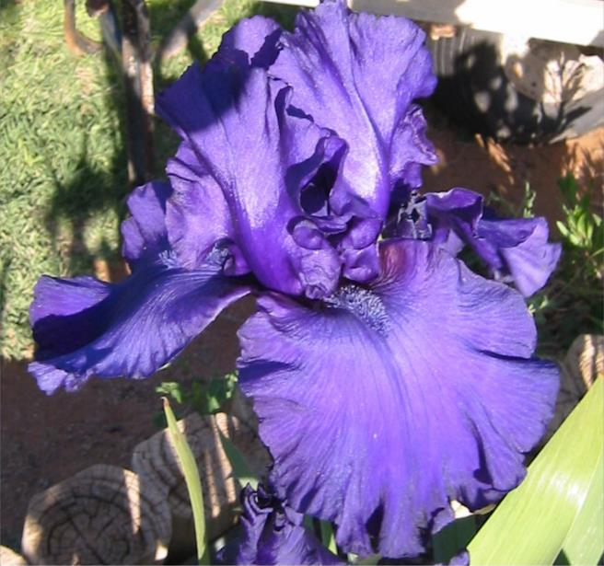
Dusky Challenger 1992
Hybridizer: Schreiner's
TB-ML-39”; R. 1986
Dusky Challenger is probably the most popular iris of modern times. It has led the AIS popularity poll for over 20 years. Dusky Challenger’s large 7 inch flowers are the results of hybridizers breeding for larger flowers for the past 100 years. Flowers were typically 4-inches long at the turn of the last century. How big will the flowers be in another 100 years?
Dykes List

Slide 37
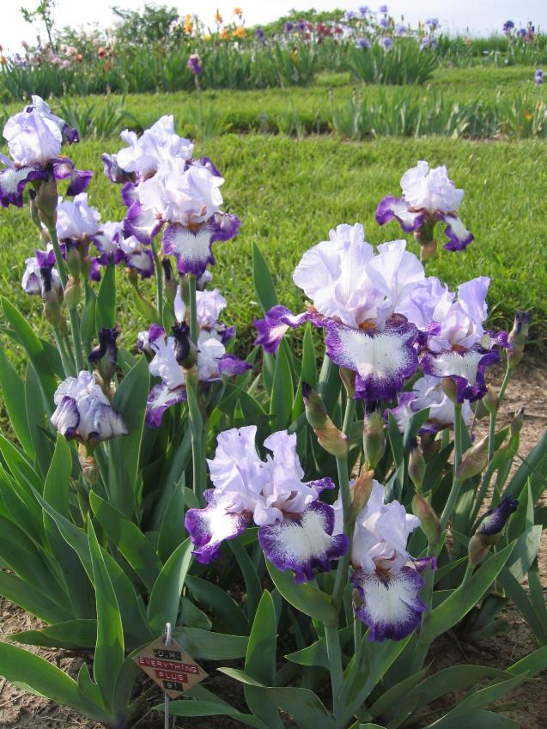
Everything Plus 1991
Hybridizer: Niswonger
TB-M-
Almost all of our modem bearded hybrids are tetraploid, only the MTB's are still largely diploid. An iris that is tetraploid has thicker wider heavier leaves, the flower parts are thicker and larger and because the petals are thicker the color is often deeper and brighter. The plant is not usually much taller but is stiffer and wider.
Dykes List

Slide 38
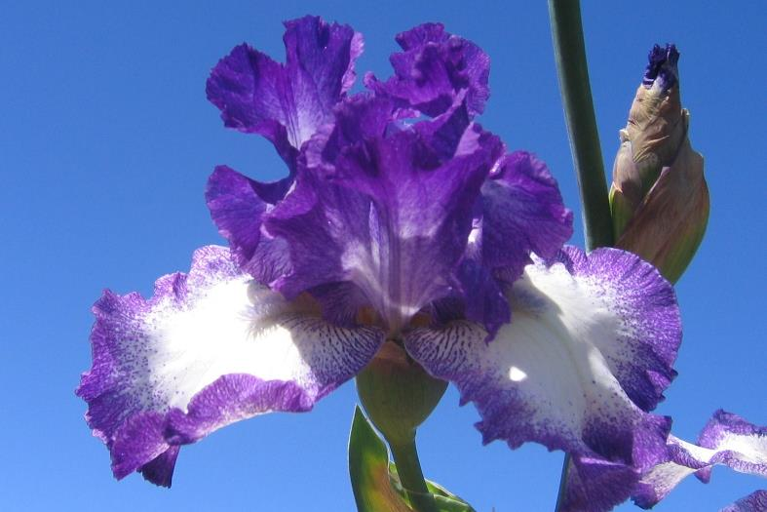
Jesse's Song 1990
Hybridizer: B. Williamson
TB-M-36; R. 1979
Many of the garden irises at the turn of the century was diploids. The diploids evolved in northern Europe where the conditions were cold and wet. While the tetraploids was found in eastern Mediterranean climate which is hotter and drier. Early hybridizers crossed the diploids with tetraploids and occasionally came up with a hybrid that was fertile. All modern irises including Jesse’s Song are descended from these hybrids.
Dykes List
Notes:
(Charmed Circle x Kiss) X Iris Nelson 34-74A: (Smoke Rings x Decolletage). Pacific Coast Hybridizers 1983.
From Bulletin of the American Iris Society, October 20056; Article “A Second Helping, More Food for Thought” by Terry Aitkens

Slide 39
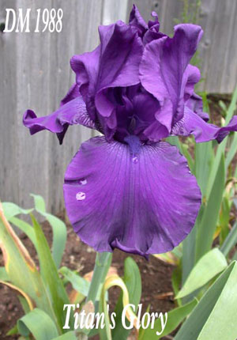
Titan's Glory 1988
Hybridizer: Schreiner's, Oregon
TB-EM-37; R. 1981
The post war years after World War II saw the migration of iris growers towards the hospitable climate of the Pacific Coast. Fertile land was cheap (way back then) and cheap land meant that irisarians could now grow seedlings in the thousands. Plus, the short mild winters meant that seedlings could be brought into bloom in 2 years instead of 3-4 years in Midwest gardens. There also wasn’t as much frost damage.
Dykes List
Notes:
Navy Strut X H 201-2: ((Y 54-A x Y 240-B) x (Rococo x Prince Indigo)). Schreiner's 1981.
From Bulletin of the American Iris Society, October 2005; Article “50 Years of Hybridizing” by Ghio, Keppel and Waters

Slide 40
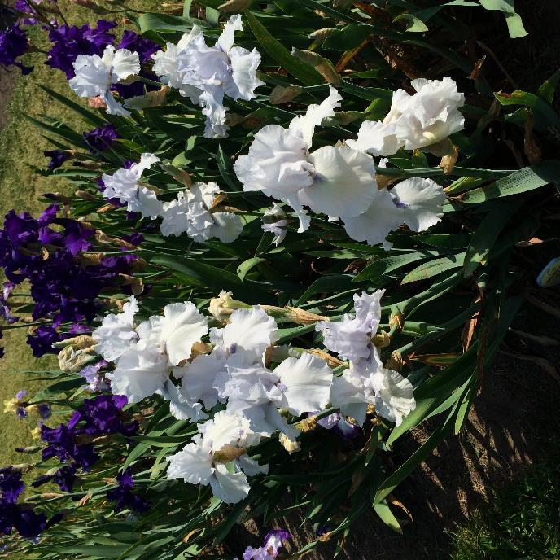
Song of Norway 1986
Hybridizer: W. Luihn
TB-EML-38; R. 1977
Say you (as a 2-chromozome set diploid) have a blue-eyed mom and brown eyed dad. Your eyes will be either one of three colors; blue, brown or hazel. Now suppose you were a tetraploid with 4-sets of chromosomes. There could be 15 possible combinations leading to your eye color. Sometimes the highest dosage of a trait is expressed. Other times all 4 chromosomes must have the trait. This is true for pink irises. Three just won’t make the pink.
Dykes List
Notes:
Nobleman X Blue Luster. Luihn 1979.
From “The World of Irises”, 1978, American Iris Society, ISBN-09601242-1-7,pg 394

Slide 41
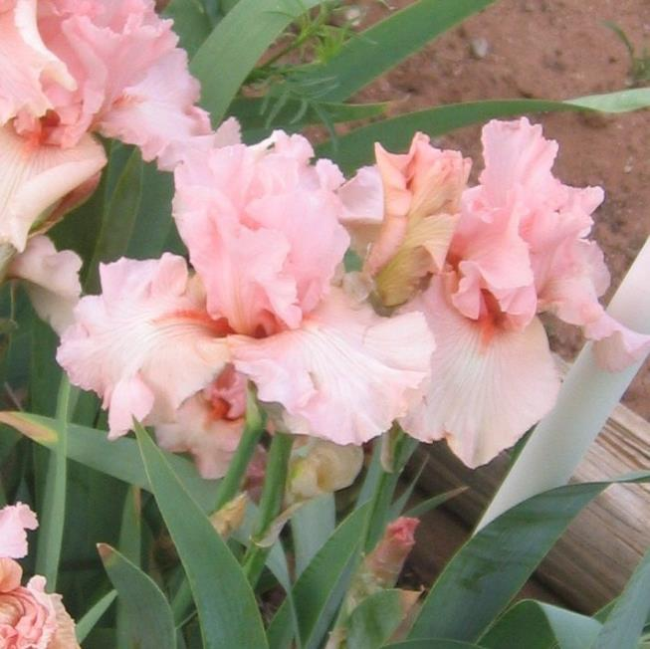
Beverly Sills 1985
Hybridizer: Ben Hager
TB-M-36; R. 1978
Tangerine-bearded pinks and pink blends have won 5 DM over the years. Beverly Sills has the other 4 pink DM in its inheritance. We now know that it takes the presence of four sets of chromosomes, each with a pink “trait” to generate the recessive pink color. This is why it never appeared until hybridizers started using tetraploids.
Dykes List
Notes:
Pink Pirouette X Vanity. Melrose Gardens 1979.
AIS 75th anniversary, 1995; Article Pink Color in Irises: A Parallel History” by Ben Hagar

Slide 42
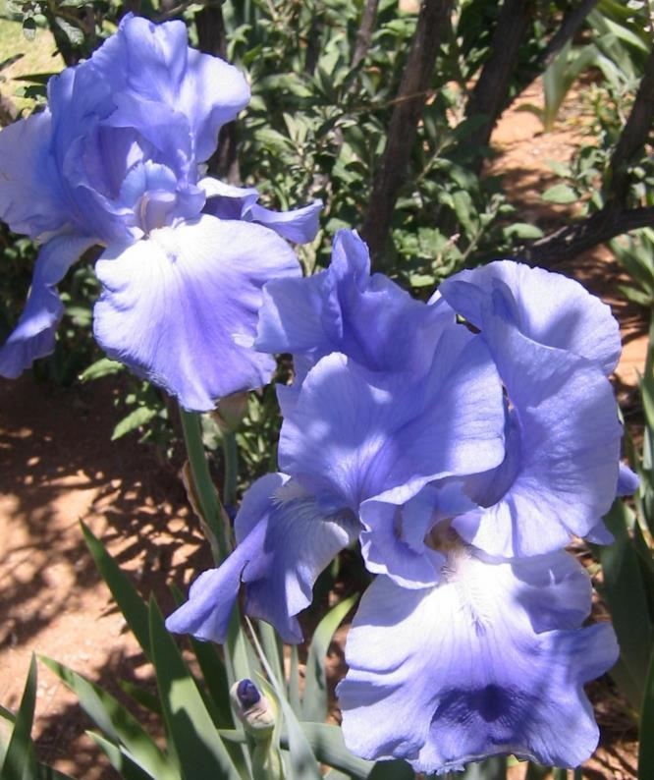
Victoria Falls 1984
Hybridizer: Schreiner, Oregon
TB-EML-40; R. 1977
The Schreiner family have about 11 Dykes to their credit. Schreiner's Iris Gardens began as a hobby during World War I when Francis Xavier Schreiner started growing Irises in St. Paul, Minnesota; a testament to the fact that bearded Iris will grow in a variety of climates. Upon his death in 1931, Francis' children continued the business and after much searching, chose to move the gardens to Oregon.
Dykes List
Notes:
(White Pride x Y163-B) X Violet Favor. Schreiner's 1977.

Slide 43
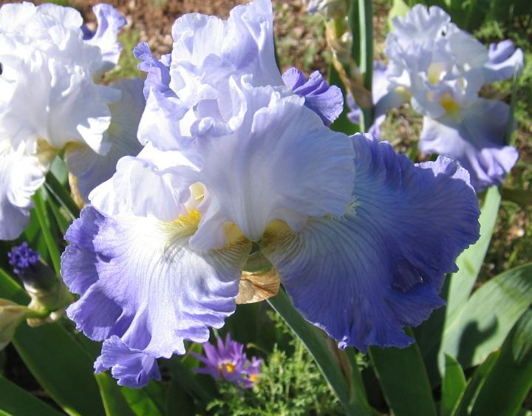
Ruffled Ballet 1983
Hybridizer: Elvan Roderick
TB-ML-30; R. 1973
Earlier tetraploid/diploid hybrids often retained the Near East tetraploid preference for hotter and drier climates. They tended to rot in many parts of the country. However, they were so pretty and big that hybridizers persevered and hybrids started to emerge that like their diploid ancestors could hand cold and rainy weather.
Dykes List
Notes:
Favorite Topic X Tempo. Roderick 1975.

Slide 44
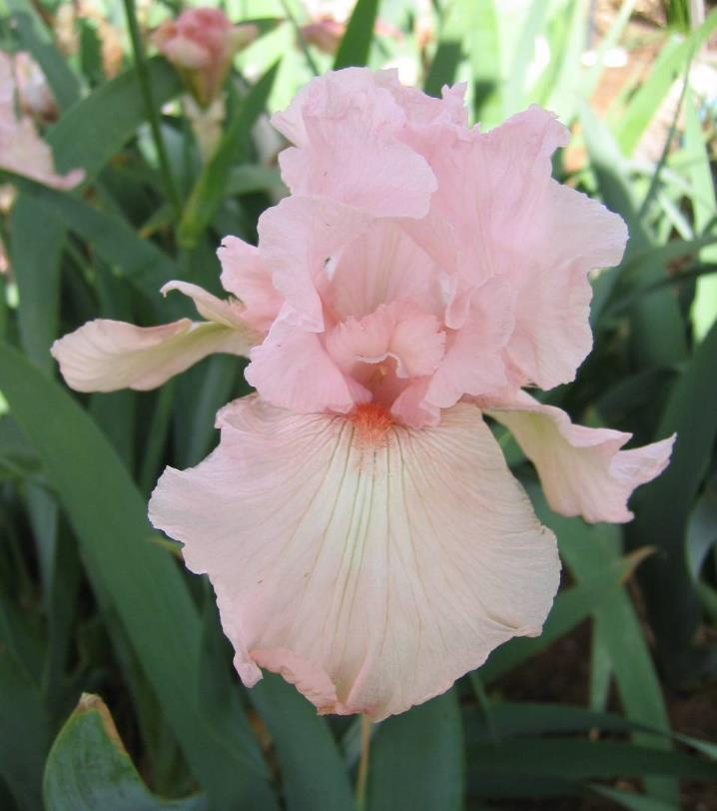
Vanity 1982
Hybridizer: Ben Hager
TB-EML-36; R. 1974
One of the most popular of irises.
When true-pink (no violet undertones) finally appeared in the iris world in the 30’s, it appeared in several places throughout the nation almost simultaneously and accompanied by tangerine beards. These were known as the tangerine pinks.
Dykes List
Notes:
Cherub Choir X Pink Taffeta. Melrose Gardens 1975

Slide 45
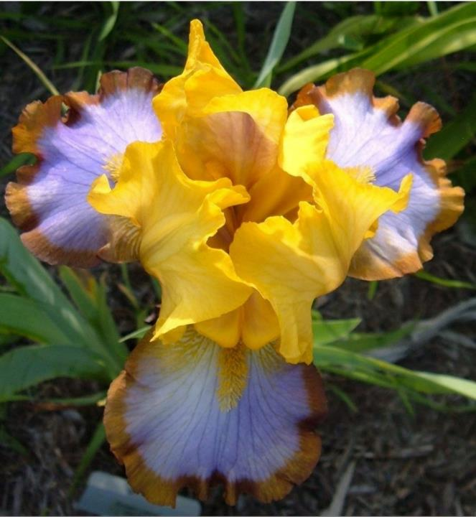
Brown Lasso 1981
Hybridizer: Eugene Buckles by D. Niswonger
BB-EM-22; R. 1972
Brown Lasso created by Buckles of Sikeston, MO. It is the first median to ever win a DM. Unfortunately, Buckles died while Brown Lasso was still a seedling. His good friend Dave Niswonger from Cape Giradeau, MO, evaluated his seedlings and introduced Brown Lasso in 1975.
Dykes List
Notes:
Punchline X B69-29: (Wild Mustang x Milestone). Cape Iris 1975.
From the Medianite, 2007, Official Publication of the American Median Society, Volume 48, Number, 1 pg 111

Slide 46
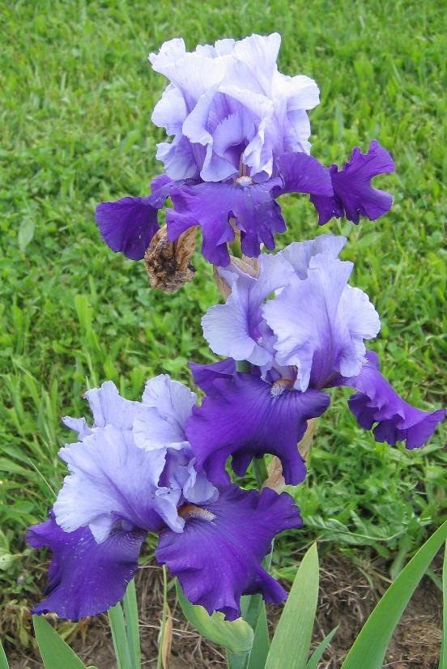
Mystique 1980
Hybridizer: Joe Ghio, California
TB-EML-36; R. 1972
When a kid in 1954, Joe earned money from cutting lawns to buy a $5 collection of irises from Schreiners. During that first bloom season, he crossed everything with everything. He wasn’t even out of high school!
Joe won the DM for Mystique after 27 years of hybridizing and over 400 crosses.
Dykes List
Notes:
((((Frosted Starlight x (Spanish Peaks x Black Satin)) x ((Cahokia x Pierre Menard) x (Black Forest x Chivalry))) x Penthouse) x (Mahalo x Diplomacy)) X Veneration. Bay View Gardens 1975.
From Bulletin of the AIS, No 239, October 1980. Article “A Salute to Joseph Ghio”

Slide 47
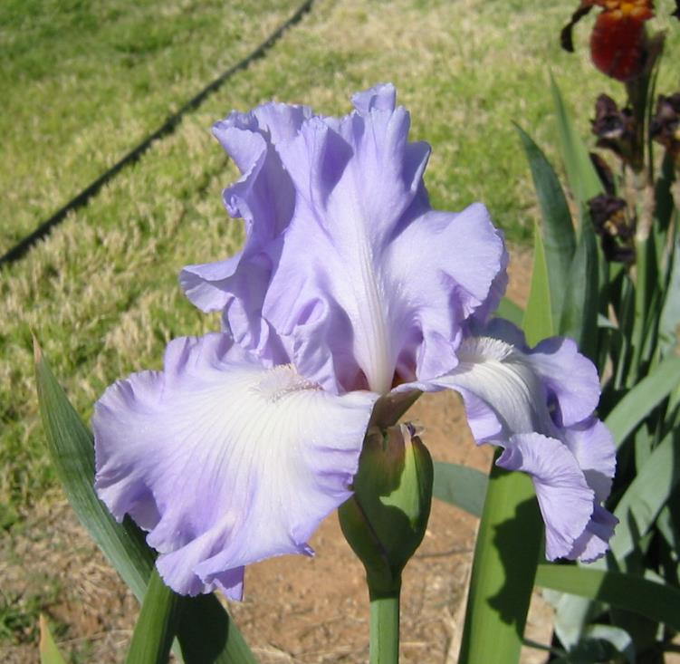
Mary Frances 1979
Hybridizer: Larry Gaulter, California
TB-M-38; R. 1971
Larry was know for his orchid beauties such Mary Frances.
After Larry was discharged from the navy after World War II, he used his mustering-out pay to purchase several hundred dollars of new irises.
He bought more expensive varieties for Mothers Day or some other special occasion for his wife and daughters. They were thrilled!
Dykes List
Notes:
Town and Country X (Marie Phillips x Sterling Silver, F2). Cooley's Gardens 1973.
Bulletin of the AIS, No 231, Fall 1978. Article “Hybridizers Medal to Larry Gaulter” by Jim McWhirter

Slide 48
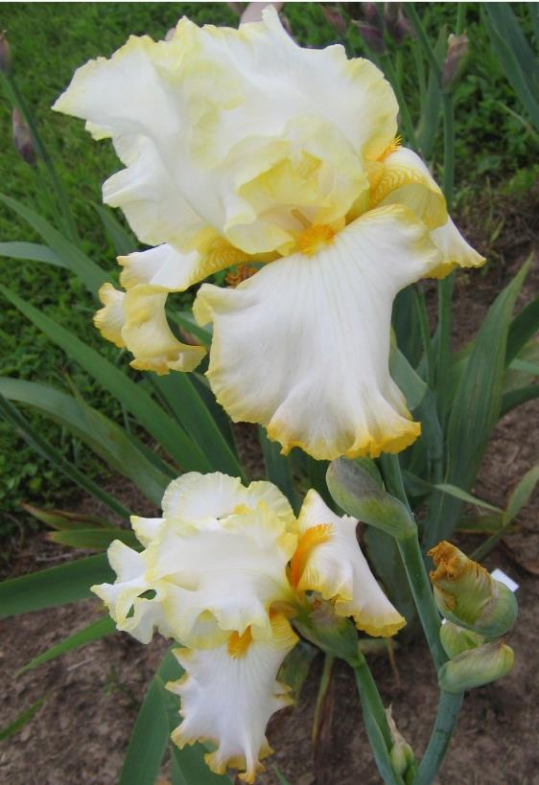
Bride's Halo 1978
Hybridizer: Herbert Mohr
TB-EML-36; R. 1971
One of several enchanting varieties with a striking most definite and precise yellow-gold margin on edging. This border is about 1/8 inch, like an applique of burnished gold on the satin-white main color of the flower.
Dykes List
Notes:
Rainbow Gold X Denver Mint. Mohr Gardens 1973

Slide 49
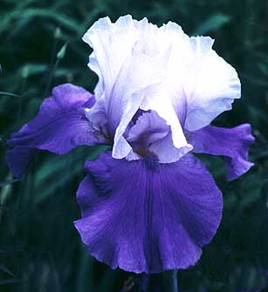
Dream Lover 1977
Hybridizer: E. Tams
TB-ML-38; R. 1970
Tams built off of the work of Paul Cook, who developed dominant amoenas of high quality. The 60’s and 70’s were to see many hybridizers created beautiful bi-color irises. 20 AM were given to bi-colors in the 60’s. All but 5 can be traced to Paul Cook’s dominant amoenas.
Dykes List
Notes:
Miss Indiana X (Melodrama x Rippling Waters). HM 1972, AM 1974, DM 1977. Tell 1971.
From “The World of Irises”, 1978, American Iris Society, ISBN-09601242-1-7,pg 115-116

Slide 50
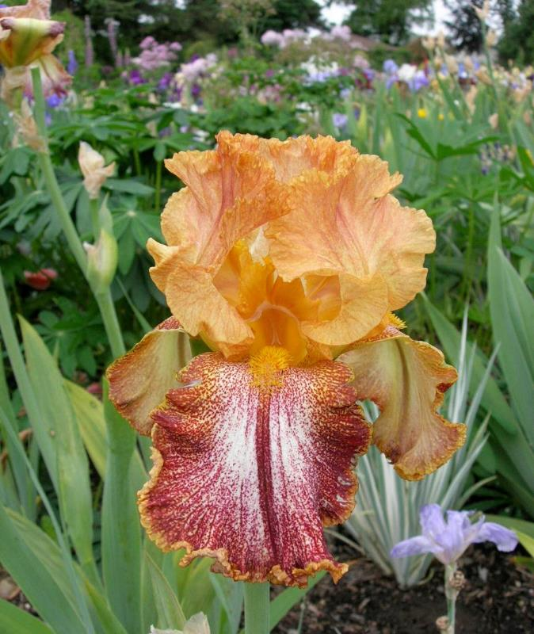
Kilt Lilt 1976
Hybridizer: Jim Gibson
TB-EM-40; R. 1969
Jim worked 26 years on developing plicatas and created a winner with this warm lacy bi-toned variegata plicata. Kilt Lilt is a result of a tangent in plicata breeding that creates a bicolored iris with clear standards but with the plicata pattern on the falls.
Note, Jim came up with the name first, and then worked to develop an iris that went with the name.
She had a smile like a kilt lilt.
Dykes List
Notes:
1-2 PLD X Golden Filigree. HC 1968, HM 1971, AM 1973, DM 1976. Cooley's 1970.
From “The World of Irises”, 1978, American Iris Society, ISBN-09601242-1-7,pg 106

Slide 51
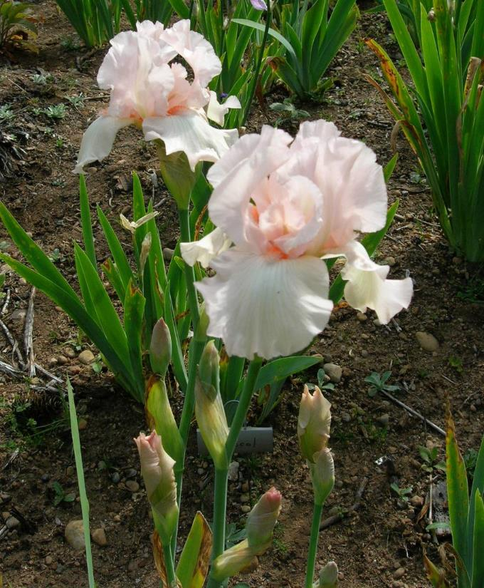
Pink Taffeta 1975
Hybridizer: N. Rudolph
TB-EM; R. 1965
Pink Taffeta is the first pink self to obtained a Dykes since Cherie in 1951
It is hard to believe that when early pinks were shown at the Chicago’s World Fair in 1933, horticultural experts said that the color was not possible in nature for irises and that dye must have been added to the soil!
Dykes List
Notes:
(Fay 56-06: sib to Arctic Flame x 59-31) X 61-42: (Pink Ice x 59-55). HM 1969, JC 1969, AM 1971, DM 1975. Moldovan 1968.
From “The World of Irises”, 1978, American Iris Society, ISBN-09601242-1-7,pg 92

Slide 52
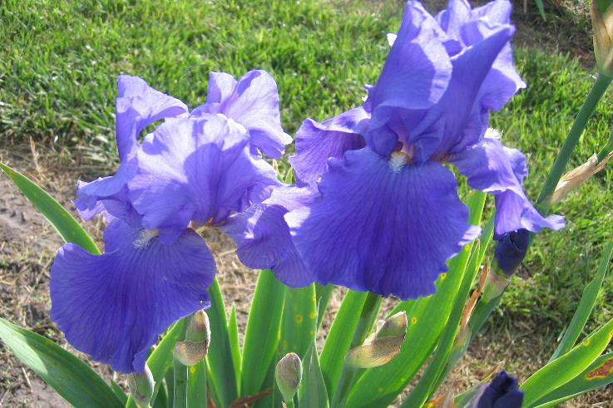
Shipshape 1974
Hybridizer: Babson
TB-M-38; R. 1968
Earlier irises had narrow falls that hung down. Selective breeding over the years produced wider falls that flared or arched.
Also of importance is balance. Irisarians believe that standards that measure less than the length of the falls is more esthetically pleasing.
No less importance is substance. An iris must retain its form for three days even in bad weather.
Dykes List
Notes:
Pacific Panorama X Epic. HC 1968, HM 1970, AM 1972, DM 1974. Melrose 1969.

Slide 53
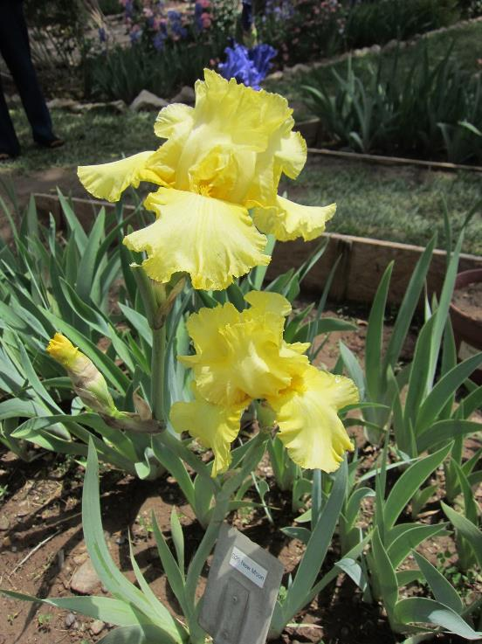
New Moon 1973
Hybridizer: Neva Sexton, California
TB-M-36; R. 1968
Neva was married at the age of 16 and was soon left with 3 small children. She moved to California to find work and where she married Harvey Sexton. When she decided to hybridize, she decided to use only the very best. She earned $1 an hour hoeing weeds in a cotton field. It took her 30 hours of work to purchase Toast An’ Honey and 20 hours of work to purchase Limelight. Neva is one out of a dozen women to win the DM.
Dykes List
Notes:
Moon River X New Frontier. HC 1966, JC 1969, HM = 1969, AM 1971, DM 1973. Sexton 1968
From Bulletin of the AIS, No 259, Oct, 1985; Article “Neva Sexton, 1906-1985”

Slide 54
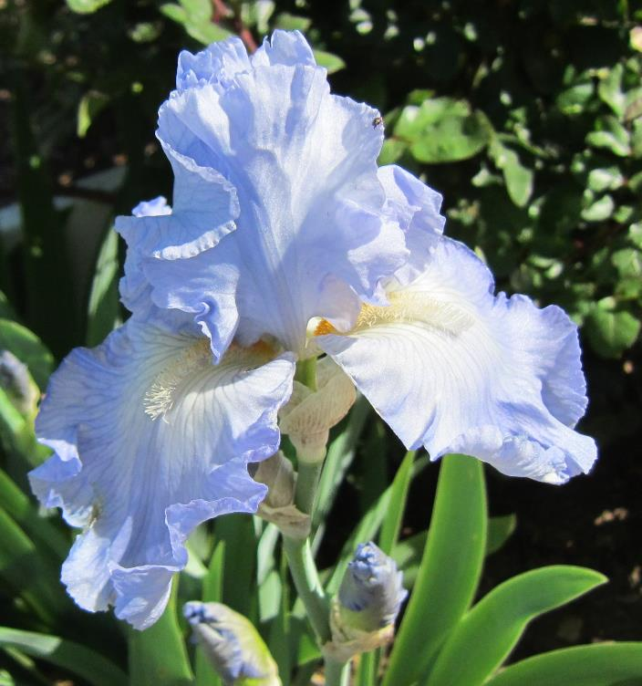
Babbling Brook 1972
Hybridizer: Keith Keppel; Oregon
TB-M-38; R. 1965
Irises such as Babbling Brook show the emphasis that hybridizers have placed on good branching to best display the irises. The top-heavy stalks of long ago are not acceptable for a medal winner. Today’s stalks obey the 2/3 rule. The flowers should be evenly distributed over the top 2/3 of the stalk which should display as a gentle S-curve.
Dykes List
Notes:
Light blue self. = Wilson 43/3 to 43/2). Galilee X Symphony. HC 1965, HM 1967, JC 1967 & 68, = AM 1969, NTG Award 1968, DM 1972. Keppel 1966

Slide 55
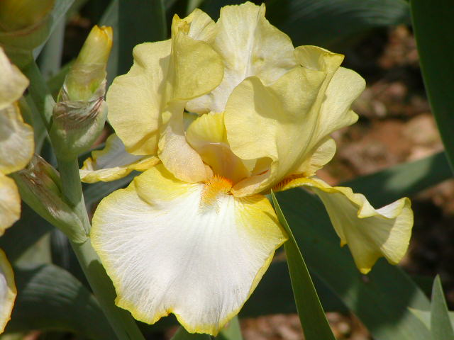
Debby Rairdon 1971
Hybridizer: Kuntz
TB-ML-36
Yellows were often an unexpected by-product of crossing tangerine bearded pinks (often called just tangerine-pinks). These yellows had sheen, brilliance and some laciness not often found in other yellow breeding lines. Debby Rairdon parentage is a tangerine pink crossed with an unknown.
This color pattern of white S with white F bordered yellow has been popular throughout the years.
Dykes List
Notes:
HM 1966, JC 1967, AM 1968, DM 1971. Noyd 1965

Slide 56

Skywatch 1970
Hybridizer: C. Benson
TB-M-37; R. 1963
Tetraploids create more variability for the hybridizers at the expense of predictable behavior. Trait probabilities depend not only the combination of the 4 chromosomes but also on the trait’s genetic position on the chromosome as well as the pairing relationship of the chromosomes. In diploids you only worry about the combination of the 2 chromosomes.
Dykes List
Notes:
((Spanish Peaks x Cloudless Sky) x Henry Shaw) X Van Cliburn. HC 1960, HM 1965, JC 1965 and 66, AM 1967, DM 1970. Benson 1964.
From “The World of Irises”, 1978, American Iris Society, ISBN-09601242-1-7,pg 395

Slide 57

Stepping Out 1968
Hybridizer: Robert Schreiner, Oregon TB-ML-38; R. 1964
Stepping Out became the first plicata to win the American Dykes medal since San Francisco in 1927. Parentage is unknown. Hybridizers, such as the Schreiners, worked on the contrast between the stitches and the ground color.
Dykes List
Notes:
HM 1965, Cook Cup 1966, JC 1965 & 66, AM 1967, Nelson Award 1968, DM 1968. Schreiner's 1964.

Slide 58

Winter Olympics 1967
Hybridizer: Opal Brown, Oregon
TB-37; R. 1961
The most important responsibility of an AIS judge is voting the annual AIS ballot for the AIS awards and medals including the DM.
To vote the ballot knowledgeably, a judge must grow a selection of newer varieties.
He/she must also tour gardens to observe as many irises as possible. This takes a commitment of time and money.
Dykes List
Notes:
HC 1961, HM 1964, JC 1964 & 66, AM 1966, Clara Rees Cup 1966, DM 1967, Nelson Award 1969. Brown's Sunnyhill Gardens 1963.
From “The World of Irises”, 1978, American Iris Society, ISBN-09601242-1-7,pg 62

Slide 59

Rippling Waters 1966
Hybridizer: Orville Fay, Illinois
TB-M-37”; R. 1961
During the 1930’s strange bumps and warts started to appear in the edges of the Sass brothers seedlings. These lace precursors indicate that the flowers carried the genetic factors for the production of “lace”. These Irises were at first looked on by the Sasses as freaks and considered the consequence of too-much in-breeding. People bought the precursor Irises as novelties for the “crimped”, lacinated”, “crinkled” effect. Eventually the term “lace” dominated.
Dykes List
Notes:
sib to Native Dancer x 51-50) X (51-43 x May Hall). HC 1960, HM 1962, JC 1962 & 1963, AM 1964, DM 1966. Fay 1961
From “The World of Irises”, 1978, American Iris Society, ISBN-09601242-1-7,pg 120

Slide 60

Pacific Panorama 1965
Hybridizer: Neva Sexton
TB-M-40; R. 1960
Neva Sexton is the only woman to have won 2 DMs. She definitely was a poster child for the American Work Ethic. The soil in Wasco was sandy, so she would pick up leaves and bollie hulls to compost. She would go to the local cotton gin to pick up spilt cottonseed meal. She would go out in the country for “sheep sugar”. Eventually, she used money from the sale of her irises to buy two city lots to grow more irises!
Dykes List
Notes:
Swan Ballet X South Pacific. HC 1960, HM 1961, JC 1961, 62, AM 1963, DM 1965. Melrose 1960.
From Bulletin of the AIS, No 259, Oct, 1985; Article “Neva Sexton, 1906-1985”
Sheep sugar is sheep manure.

Slide 61

Allegiance 1964
Hybridizer: Paul Cook, Indiana
TB-M-38; R. 1957
The clearest, truest blues usually involve whites in their breeding. However, dark blues such as Allegiance involve blacks or dark purples such as Allegiance’s parent Dark Boatman. Dark blues are comparatively difficult to achieve, because as the blue deepens, the violet influence also increases. Paul Cook of Indiana is known for his deep blacks. He considered this iris the finest he ever raised.
Dykes List
Notes:
HM 1958; AM 1960; Dykes Medal 1964. Longfield 1958.
Dark Boatman X Cook 11752: ((Distance x blue sdlg.) x Pierre Menard.
From Tall Talk, September 2000, “Outstanding Hybridizers of the Twentieth Century”, Anne Lowe

Slide 62

Amethyst Flame 1963
Hybridizer: Robert Schreiner, Oregon
TB-M; R. 1957
Notice the thickened spine that extends beyond the beard in this Space-Ager precursor. This feature is called a beard spine extension (BSE). BSE is a new term coined by the group Space Age Genetic Endeavor (SAGE). SAGE was formed to try and understand the genetic inheritance patterns of space-agers. Their first task was to develop a common language to discuss this recent development in the iris world.
Dykes List
Notes:
Crispette X (Lavanesque x Pathfinder). Plant patent 1793. HM 1958, AM 1960, DM 1963. Schreiner's 1958.

Slide 63

Whole Cloth 1962
Hybridizer: Paul Cook, Indiana
TB-M-36; R. 1956
Paul originally though he could get a pure blue into the TBs by crossing with L reichenbachii. The pure blue eluded him but something about the introduction of the reichembachii suppressed the blue colors in the standards. Thus the dominant amoenas was created and was made famous by Whole Cloth, the first amoena to win the Dykes since Wabash. Most amoenas today can be traced back to this iris.
Dykes List
Notes:
Cahokia X 11253: (Blue Rhythm x ((blue sdlg. x progenitor) x (Distance x blue sdlg.))). HM 1958, AM 1960, DM 1962. Longfield 1958.

Slide 64

Eleanors Pride 1961
Hybridizer: E. Watkins
TB-M-41; R. 1952
The American Iris Society (AIS) is dedicated to improving the iris. The AIS encourages discussion on the merits of individual cultivars through the AIS bulletin.
One of the AIS most important tasks is to develop guidelines (Judges Handbook) for what constitutes a good iris form. Yet, allow flexibility in the interpretation of form. Medals such as the DM awards the hybridizers for improving the iris.
Dykes List
Notes:
Jane Phillips X Blue Rhythm. HM 1956, AM 1958, DM 1961. Fairmont 1956.

Slide 65

Swan Ballet 1959
Hybridizer: Tell Muhlestein, Utah
TB-M-40; R. 1953
Tell Muhlestein hybridized Irises for 40 years. He started in 1938 by placing pollen on the beards. He eventually figured out the correct way to pollinate Irises and was considered a prolific Iris breeder. He was generous with advice and included many tidbits in his catalogues.
Dykes List
Notes:
Spanish Peaks X (Tell 47-18: (Azure Skies x Tell 44-59: (Shining Waters x Buteo))). HM 1955, AM 1957, DM 1959. Tell 1955..
From the Medianite, 2007, Official Publication of the American Median Society, Volume 48, Number, 1 pg 96

Slide 66

Blue Sapphire 1958
Hybridizer: B. (Gus) Schreiner, Oregon
TB-E-40”; R. 1953
This iris prestigious parentage is a cross of Snow Flurry X and the 1947 DM Chivalry. Snow Flurry (1939), a prolific parent, is renowned throughout the Iris world and is probably the most famous white of the last century. Ruffles can be traced to this iris. Snow Flurry was the recipient of the first AIS Board of Directors Award in 1974.
Dykes List
Notes:
HM 1954, AM 1956, DM 1958.
From “The World of Irises”, 1978, American Iris Society, ISBN-09601242-1-7,pg 65, 119

Slide 67

Violet Harmony 1957
Hybridizer: Edith Lowry, Massachusetts
TB-M; R. 1948
Violet Harmony is another violet cross from blue-white breeding. It parents consists of the white Snow Flurry and the lavender blue Cloud Castle.
Dykes List
Notes:
Snow Flurry X Cloud Castle. HM 1952, AM 1954, Cook Cup 1953, DM 1957.

Slide 68

First Violet 1956
Hybridizer: Fred DeForest, Oregon
TB-M-38”; R. 1951
Violets and purples are “common” colors. Hybridizers tend to focus on unknown colors or patterns and neglect the more common colors like purple. Therefore, First Violet must be real special in order to win the DM. Note that many great violets were caused by accident in breeding for blues by using whites somewhere in the background. First Violet parents are the blue Chivalry and the white Spanish Peaks.
Dykes List
Notes:
Chivalry X Spanish Peaks. HM 1953; AM 1955; Dykes Medal 1956. Irisnoll 1952
From “The World of Irises”, 1978, American Iris Society, ISBN-09601242-1-7,pg 70

Slide 69

Sable Night 1955
Hybridizer: Paul Cook, Indiana
TB-EM-36”; R. 1950
The 40’s and 50’s saw improvements in the development of the black Iris. Sable Night is a famed early approach to the full black Irises of today
Dykes List
Notes:
(Captain Wells x Indianna Night) X ((Modoc x Black Wings) xSable). Hm 1952, AM 1954, DM 1955. Longfield 1952

Slide 70

Mary Randall 1954
Hybridizer: Orville Fay, Illinois
TB-M-36; R. 1950
Fay was a selective hybridizer. His yearly goal was only 1000 seedlings from 20 well-planned crosses.
Mary Randall was considered an important parent of tangerine-bearded irises. The tangerine beard is recessive.
The arrival of pink irises generated much interest in the public.
Dykes List
Notes:
Self of Bengal rose (Wilson), with red beard. New Horizion X Fay sdlg: Pink Cameo x Cherie. HM 1951, AM 1953, DM 1954. Fay 1951.
From “The World of Irises”, 1978, American Iris Society, ISBN-09601242-1-7,pg 96

Slide 71

Truly Yours 1953
Hybridizer: Orville Fay, Illinois
TB-L; R. 1948
Truly Yours has large ruffled flowers with a bright yellow heart. It was introduced in 1949. The 1940s would be considered the golden age of yellows. Three yellows became DM Winners, while several yellows introduced in that decade went on to fame.
Dykes List
Notes:
Sdlg. 46-35. TB, L. W5M. 44-43: (41-40 x Hall 42-45) X Zantha. Fay 1949.
From “The World of Irises”, 1978, American Iris Society, ISBN-09601242-1-7,pg 90

Slide 72

Argus Pheasant 1952
Hybridizer: Fred DeForest, Oregon
TB-M; R. 1947
By this point, there has been an involved breeding program for browns for decades.
All brown are blends, deriving their color from the visual mingling of two different pigments. Many are uniform in color but some will show graduations of other color.
Brown seems like an unusual color for a flower called the rainbow flower. However, hybridizers have always strived for colors beyond the rainbow.
Dykes List
Notes:
Casa Morena X Tobacco Road. HM AIS 1948, AM AIS 1950, DM 1952. Irisnoll 1948
From “The World of Irises”, 1978, American Iris Society, ISBN-09601242-1-7,pg 85

Slide 73

Cherie 1951
Hybridizer: David F. Hall, Illinois
TB-E; R. 1945
One of Hall’s primary breeding objectives was in eliminating lavender from the pinks during the 20’s and 30’s and creating a pure-pink. Easier said than done! Halls first tangerine-bearded pink bloomed in 1942 after 17 years of work and 20,000 seedlings!
His flamingo-pink irises received over 20 AM during the 20 years following his first flamingo-pink.
By the middle 70s, over 100 AMs can be traced back to tangerine-pink breeding.
Dykes List
Notes:
(Golden Eagle x 39-62) X Fantasy). HC AIS 1945, HM AIS 1947, AM AIS 1949, DM 1951. Cooley's Gardens 1948
The tangerine beard is a generally accompanied by a pure pale pink flowers. These are referred to as the tangerine-pinks. The tangerine beard is recessive.
From “The World of Irises”, 1978, American Iris Society, ISBN-09601242-1-7,pg 93, 95

Slide 74

Blue Rhythm 1950
Hybridizer: Agnes Whiting, Iowa
TB-M TB; R. 1945
The Historic Iris Preservation Society is trying to preserve our iris heritage. HIPS:
Sponsors a yearly historic iris sale with donated irises
Writes chronicles of past hybridizers or era.
Commercial Source Chairman advises potential buyers on iris location.
Maintains a database, voluntarily reported, of who grows what and who is willing to share
Dykes List
Notes:
HM AIS 1945, AM AIS 1947, President's Cup 1949, DM 1950.
Annabel X Blue Zenith
From “The World of Irises”, 1978, American Iris Society, ISBN-09601242-1-7,pg 395
These numbers are for random chromosome pairing when only bivalents are formed and when traits genetic position is tightly linked to the kinetochore. The kinetochore is the section of the chromosome that divides last and orients the dividing chromosome to opposite sides of the dividing cell.

Slide 75

Helen McGregor 1949
Hybridizer: Robert Graves, NH
TB-M; R 1946
At the turn of the century, there were no impressive whites. The first generation of white tetraploids/diploids hybrids that emerged disliked cold and rainy. The blossoms were unimpressive. That changed with Helen McGregor’s parent Purissima.
Purissima was considered to be a commanding white that unfortunately, still suffered from the drawbacks of its native tetraploid heritage. Dr. Graves, mated Purissima with winter-hardy stock establishing the basis for an outstanding lines of blues and whites.
Dykes List
Notes:
Purissima X Cloud Castle.
Purissima almost never existed. Purissima creator, William Mohr, died tragically in an auto accident. Following his death, Sydney Mitchell took on all un-flowered Mohr seedlings as well as seeds. Among the posthumous Mohr crop appeared Purissima. Purissima is considered one of the most important Irises of the 20th century.

Slide 76

Ola Kala 1948
Hybridizer: Jacob Sass, Nebraska
TB-36”; R 1943
Ola Kala achieved instant fame for its color and form. It topped the AIS popularity poll in 1947 and remained there until 1955. It became an important parent of bright yellows.
Hans and his brother Jacob won 4 of the 17 DMs awarded between 1927-1948, almost ¼ of the total!
Dykes List
Notes:
(Prairie Sunset x unknown) X Golden Age x unknown)H.C AIS 1942, HM AIS 1943, AM AIS 1945, DM AIS 1948.
From “The World of Irises”, 1978, American Iris Society, ISBN-09601242-1-7,pg 89

Slide 77

Chivalry 1947
Hybridizer: Jesse Wills, Tennessee
TB-M , R. 1943
Breeding will tell. This iris is a cross between two Dykes Missouri (1937) X Great Lakes (1942). Chivalry was also the parent of two later DM winners; First Violet and Blue Sapphire.
Dykes List
Notes:
HM AIS 1944, AM AIS 1946, DM 1947. Wills 1943.

Slide 78

Elmohr 1945
Hybridizer: Phillip Loomis, Colorado
TB-M; R. 1942
Elmohr is the only Arilbred to win the Dykes medal. An arilbred is a cross of an Aril iris with a TB iris. Note that arilbreds were not eligible for the Dykes a few years earlier.
Loomis contracted tuberculosis in medical school in Chicago. It was recommended that he move to Colorado. So bought a round trip ticket to Colorado (just in case). He carried the return half of that ticket for 66 years.
Dykes List
Notes:
William Mohr X R. seedling. HM 1942, AM 1944, DM 1945. Long 1942.

Slide 79

Spun Gold 1944
Hybridizer: Glutzbeck
TB; I 1940
Spun Gold was the first yellow to achieve falls of velvety texture.
It was hard to believe that tall yellow irises use to be rare. Conversion from diploidy to tetraploidy in the yellows were slower than in the other colors. The first yellow tetraploid appear in W. R. Dykes garden in 1926, the year following his death. The Iris was named for him and probably exists in the ancestry of most yellows hybridized today. Its parentage is unknown.
Dykes List
Notes:
From “The World of Irises”, 1978, American Iris Society, ISBN-09601242-1-7,pg 86

Slide 80

Prairie Sunset 1943
Hybridizer: Hans Peter Sass; Nebraska
TB-ML; R. 1936
Prairie Sunset was considered one of the finest blends at that time. One person bought one Prairie Sunset plant for $100 the year before it was introduced. Another person bought 3 stamens for $10 each.
Hans was only willing to part with 26 plants the year it was introduced. Legend says that Rholin Cooley offered Hans $1000 for the few remaining plants he had the second year after its introduction. He was turned down.
Dykes List
Notes:
HM AIS 1935; AM AIS 1937, Dykes Medal 1938. Kirkland 1934
From Bulletin of the AIS, No 239, October 1980, Article “Bloomin Rememberances” by Larry Gaulter
The Sass brothers were known for their blends including this peachy-brown blend.

Slide 81

Great Lakes 1942
Hybridizer: L.W. Cousins, Canada
TB-35-M; R. 1938
A blue that has been used as a parent with great success. However, its parentage is not precisely known. Great Lakes is a very important breeder of blues and has led to a flood of other great blues ;-). Lavender blues and blue purple existed at the beginning. However, the search for true blue has been a long slow process.
Dykes List
Notes:
(DOMINION sdlg X CONQUISTADOR sdlg)
From the World Iris Society and
From “The World of Irises”, 1978, American Iris Society, ISBN-09601242-1-7,pg 64

Slide 82

The Red Douglas 1941
Hybridizer: Jacob Sass, Nebraska
TB; R. 1934.
Red color in irises is due to the interaction of two types of pigmentation; purple anthocyanin and yellow carotine. There is no red pigment like that found in roses. Note that this iris has a purplish cast.
Many a hybridizer has tried their hands at creating a true red iris but with no success. Iris seeds have even been irradiated in the 60’s with no pure red success.
Dykes List
Notes:
H.C AIS 1942, HM AIS 1936, AM AIS 1939, DM AIS 1941.

Slide 83

Wabash 1940
Hybridizer: Mary Williamson, Indiana
TB-M-34”; R. 1936
Wabash is considered to be a landmark in the development of amoenas. Note that there was no dominant amoenas at this time. Wabash is a recessive amoena.
A debate following Wabash winning the DM arose concerning who should be listed as the originator. Mary registered and introduced Wabash after her father’s death. She has always claimed to have created it as well. Thus, Mary is the 2nd woman to win the DM.
Dykes List
Notes:
HM 1937, AM 1938, DM 1940. Longfield 1936 go to pedigree
From “The World of Irises”, 1978, American Iris Society, ISBN-09601242-1-7,pg 108

Slide 84

Rosy Wings 1939
Hybridizer: L. Gage, Massachusetts
TB-M-38; R. 1934
Tetraploids such as Rosy Wings show the benefits of four sets of chromosomes. However, tetraploids hybridizers have to accept that hybridizing for traits that are considered recessive may require bigger populations. For example, suppose you cross two diploids (Aa) X (Ba) with a desired but recessive trait “a”. Only 1 out of 4 seedlings (Aa, Ba, AB,aa) should express that recessive trait “aa”. Now think this through for quad inheritance (aaaa).
Dykes List
Notes:
Dauntless X mixed pollen. HM 1934, AM 1936, DM 1939. Gage 1935

Slide 85

Copper Lustre 1938
Hybridizer: James Kirkland, Tennessee
TB-M; R. 1934
Copper Luster did not have great form but was considered for its day an advance in color for its bright golden copper appearance. Unknown parentage.
Dykes List
Notes:
HM AIS 1935; AM AIS 1937, Dykes Medal 1938. Kirkland 1934. Hybridized in Tennessee

Slide 86

Missouri 1937
Hybridizer: J.H. Grinter, Missouri
TB-M-40”; R 1933
The original native tetraploids thrived in drier summers and tended to rot under wet conditions. The diploids had better color variation and were less fussy about the climate.
Many small-time growers and back-yard gardeners led the charge to improve the iris and created a plant that thrived under a variety of conditions and displayed tremendous colors and patterns.
Dykes List
Notes:
From Tall Talk, September 2000, “Irises that Shaped Twentieth Century Developments”, Phil Edinger
HM 1933, AM 1935, DM 1937.

Slide 87

Mary Geddes 1936
Hybridizer: Stahlman-Washington
TB-M; R. 1930
Recent evidence has shown that Mary Geddes was co-hybridized by two women making this the first DM won by women. Mrs. Edward C. Stahman’s name was Mary Geddes. Mrs. T.A. Washington (Elizabeth B.) may have been the co-breeder rather than her husband.. It was believed for years that this DM was won by men and proof that it was won by women only recently came to light. You must remember the times. Sixteen years after gaining the right to vote, women were known by their family name.
Dykes List
Notes:
AM AIS 1933, Dykes Medal 1935. Washington 1931
Dejazet X Sherbert
Dauntless, Copper Lustre, Mary Geddes, and Chivalry - and, in 1978, Bride's Halo was hybridized in region 7.
From AIS Region 7 web site.
AIS Bulletin Winter 2008 “Wonder Women, AIS Women Who Have Won the Dykes Medal”, pg 48

Slide 88

Sierra Blue 1935
Hybridizer: Edward Essig, California
TB-M; R. 1930
There is evidence that the clarity of blues is improved by the inclusion of pure whites in the breeding.
Sierra Blue grandparent was Kashmir White 1912. In Kashmir White an inhibitor factor against the normal blue-violet pigment for irises emerged. This produced the first very clean crisp white. It is sort of odd, that this will lead to a clear blue iris in two generations.
Dykes List
Notes:
AM AIS 1933, Dykes Medal 1935. Washington 1931
Dejazet X Sherbert
Dauntless, Copper Lustre, Mary Geddes, and Chivalry - and, in 1978, Bride's Halo was hybridized in region 7.
From AIS Region 7 web site.

Slide 89

Coralie 1933
Hybridizer: Dr, Wylie Ayres, Ohio
TB-M;. R. 1932
The native tetraploids collected from the Near-East were nearly all lavender and purple shades. The smaller flowered diploids were blue, purple, whitish with an occasional pink or lavender. The early hybridizers started playing “what if..?” with the more varied diploids and the larger flowered tetraploids.
Dykes List
Notes:
(Ayres red seedling x (Loute x I. mesopotamica)) X Dauntless. HM AIS 1932; Dykes Medal 1933. Ayres 1932.
From Tall Talk, September 2000, “Irises that Shaped Twentieth Century Developments”, Phil Edinger

Slide 90

Rameses 1932
Hybridizer: Hans P. Sass, Nebraska
TB-ML; R. 1928
Ramesis, a pinkish blend, was probably used during the 1930s’ and early 1940’s by more hybridizers than any other tetraploid. Many blends can be traced back to this iris. However, it is best known as a progenitor to the flamingo pinks.
Dykes List
Notes:
HM AIS 1931; Dykes Medal 1930. H. P. Sass 1929
From “The World of Irises”, 1978, American Iris Society, ISBN-09601242-1-7,pg 56

Slide 91

Dauntless 1929
Hybridizer: Clarence Connell, Tennessee
TB-M-36”; R. 1927
Many an attempt at a red iris can trace its lineage back to this iris. Parent of 1933 DM Coralie and 1939 DM Rosy Wings. Dauntless was as close to a red Iris that could be had at this time.
Dauntless parent was Cardinal. Though, not a true red despite its name, this English Iris had a better reddish cast than earlier tetraploids. Dauntless and Cardinal led the effort in the search for a true red.
Dykes List
Notes:
Cardinal X Rose Madder. Connell 1929.
From “The World of Irises”, 1978, American Iris Society, ISBN-09601242-1-7,pg 77
Many early DM were hybridized in Tennessee. This region was the center of hybridizing before the large commercial iris gardens on the west coast came into being. The iris is the state flower of Tennessee, although the Tennesseans aren’t in agreement as to which iris!

Slide 92

San Francisco 1927
Hybridizers: William Mohr-Sydney Mitchell
TB-M-40”; R. 1927
This first Dykes medal winner was registered, introduced and awarded the Dykes Medal all in the same year.
These Californian hybridizers were good friends. When Mohr died in 1923, Mitchell inherited his records and plants and produced a number of irises known as the Mohr-Mitchell seedlings
Dykes List
Notes:
From “The World of Irises”, 1978, American Iris Society, ISBN-09601242-1-7,pg 56

Slide 93
How to add new Irises
First you must have powerpoint installed on your PC. Then, the security level must be set to medium so you can run the macros that pulls the irises. From the powerpoint editor, go to either (depending upon the version of Powerpoint) a) to Tools →Options → Security → Macro Security. Set the security level to medium or b)File → Options → Trust Center → Trust Center Settings → Disable All Macros With Notification. This allows you the option of whether or not to run macros. Save → Close the presentation completely and then open the presentation back up. Click enable macros.
Note to allow this presentation to expand yearly without the presence of a programmer, The irises must be between the first six slides and the last three slides. So you can add irises anywhere between the first six slides and the last three slides. Slide 6 (the slide that starts the game) should remain slide 6. If you inserted a slide in-between slide 5 and slide 6, slide 6 will be renumbered slide 7 and the program will think it is a Dykes Medal Winner slide and all the Dykes list buttons will go to the new slide 6 which is the wrong slide. So don’t add new slides in the first six slides or the last three slides. Don’t delete those slides either. You can modify the first 6 slides or the last three slides..

Slide 94
How to Add New Irises (cont)
Go to slide 7. Click at the top Insert -> New Slide. Edit the new slide normally. To insert a new picture click a the top Insert -> Picture -> From File… Then browse and select the picture and resize to fit.
Important. You must name the shape holding the title (the name of the Dykes Medal Winner) of the slide “title”. First click the title of the slide. Then click at the top* Developer ->Macro -> SetObjectName -> Run. Type the word title and hit OK. This allows the title of the slide (the Dykes Medal Winner) to be added to slide 6 to the Pulled Iris List shape. This shape will appear when the slide show is run and allows people to check their cards. The shape is deleted and reformed any time a new game is run. You can check if the title shape on each iris slide has the correct name by first clicking the title and then going at the top Developer ->Macro -> GetObjectName -> Run. A message box should come back and tell you the shape’s name is title. If it says it is Rectangle 2 then try again and go back to Developer ->Macro -> SetObjectName -> Run.
Save the presentation. Then save the presentation as a show. I would call it DykesShow, but that is only a suggestion.
*The Developer tab isn't displayed by default, but you can add it to the ribbon.
On the File tab, go to Options > Customize Ribbon.
Under Customize the Ribbon and under Main Tabs, select the Developer check box.

Slide 95
That’s All Folks!
No, not the iris That’s All Folks. This is the end of the presentation.
Dykes List
Notes:
From http://en.wikipedia.org/wiki/Codominant#Simple_dominance_or_complete_dominance
An allele (pronounced /əˈliːl/ (US), /ˈæliːl/ (UK)) is a viable DNA (deoxyribonucleic acid) coding that occupies a given locus (position) on a chromosome. Usually alleles are sequences that code for a gene, but sometimes the term is used to refer to a non-gene sequence. An individual's genotype for that gene is the set of alleles it happens to possess. In a diploid organism, one that has two copies of each chromosome, two alleles make up the individual's genotype. The word came from Greek αλληλος = "each other".
An example is the gene for blossom colour in many species of flower — a single gene controls the colour of the petals, but there may be several different versions (or alleles) of the gene. One version might result in red petals, while another might result in white petals. The resulting colour of an individual flower will depend on which two alleles it possesses for the gene and how the two interact.

