Slide 1
Aril Trek
April 7, 2018
Mesilla Valley Iris Society
Arilbred Board Game

Slide 2
How to Play Game
Method:
Print out the Aril and Arilbred list on slide 4 and cut it up into individual irises. Place in a bowl and pull randomly. Print the Aril and Arilbred bingo cards (a separate pdf file) .
Go to slide 4. This pages has links to the individual irises. Click on the iris name you just pulled out of the bowl. Be careful, the names are close together and it is easy to accidently click on the one before it. The names are linked to the slide discussing that iris. To get back to slide 4, click on the Aril list button at bottom right. . Repeat until someone yells Bingo. Keep track of the irises that have been pulled and verify the winner.
Aril List

Slide 3
Type of Games
Choose your game, typically the first 3 are played

Slide 4
Aril and Arilbred List
Desert Fire
Desert Fury
Dreamkeeper
Dunshanbe
Ear Falas
Enchanter’s Spell
Fiesta Skirt
Frank Rice
Genetic Artist
Go Big Red
Golden Halo
Hakuna Matata
Hammurabi
Hannah's Prayer
Honey Not Tonight
Hoopla
Hot Ice
Hunt's Dorcom
I'm Still Here
Invention
Sky Signal
Silent Tears
Spirit of Caleb
Stars Over Lpaso
Stars Over Chicago
Stolen Heart
Sunflight
Surpassing Yellow
Sylphide
Tcha'Deetch
Thabor
Tuff Stuff
Turkish Pendant
Turkish Topaz
Vera
Vera-Anne
Werckmeister's Clone
Windrider
Zizah
Zwanenburg Beauty
I. barnumae
I. hayneii
I. iberica
I. paradoxa
I. stolonifera
Jacobs Well
Jonneye's Magic
Judean Magic
Kalifa's Cape
Kedesh
Khyber Pass
Kiosk
Kuza-Nama
Lancer
Little Brown Jug
Loudmouth
Masada's Glory
Mean Mr. Mustard
Mixed Messages
Old Fashion Girl
Omar's Eye
Omar's Gold
Omar's Stitchery
On Bended Knee
Patriot's Gem
Penninah's Provocation
Persian Lass
Persian Padishah
Persian Sapphire
Pink Marble
Prairie Thunder
Refiner's Fire
Rivers of Babylon
Sand Dancer
Scarlet Butterfly
She Devil
Sharina
Skies Always Blue
Afrosiab
Aladdin’s Gem
Andromache
Aril Reverie
Back in Fashion
Betty McPherson
Blue Arts
Bozrah
Bronze Age
Burnished Star
Buttered Berries
Butterflies Wings
Bysantine Art
Calypso Clown
Canasta
Child Song
Cup Runneth Over
Damfino
Desert Celebration

Slide 5
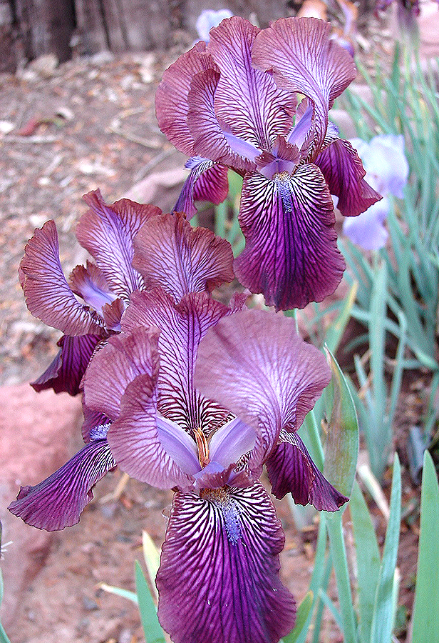

Afrosiab RB
RB Regeliabred. This is a regelia bred with a bearded eupogon iris. ½ aril heritage.
The regelia irises are typically more tailored in form, with narrow petals and long, slender stems. Some are veined, others have smooth, solid coloring. Regelias usually have two flowers per stalk. In Regelia, beards can occur on standards as well as falls.
Aril List
AFROSIAB
(Adolf Volfovich-Moler, R. 1998), RB
Notes:
AFROSIAB
(Adolf Volfovich-Moler, R. 1998), RB

Slide 6
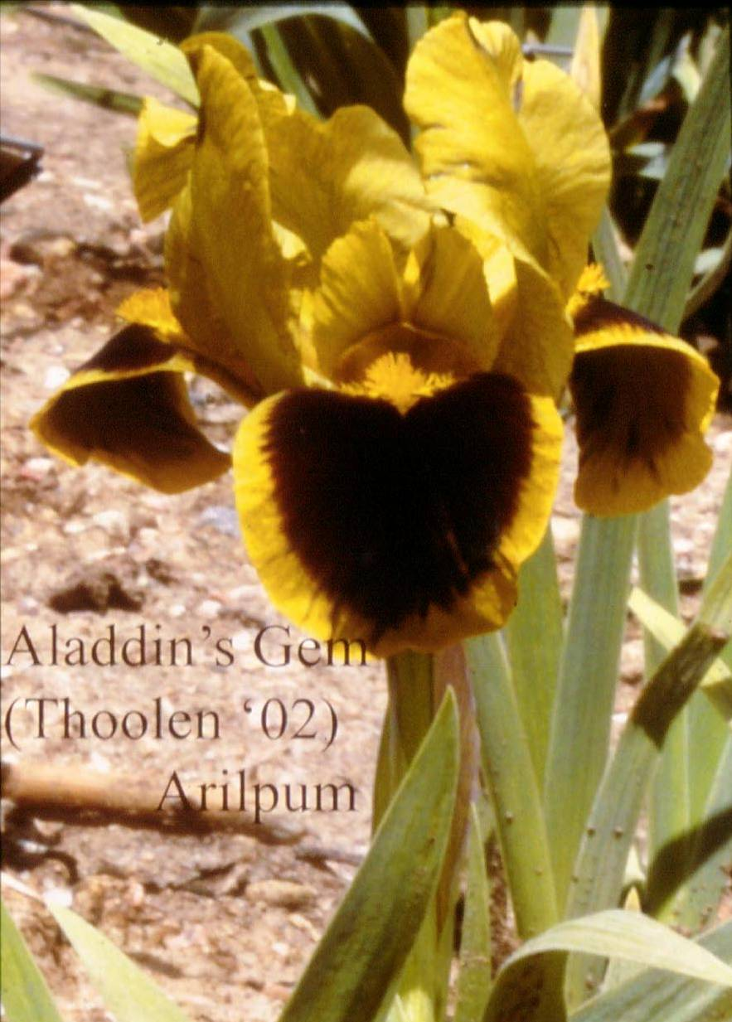
Aladdin’s Gem OGB Arilpum
This iris has an AAPP chromosome configuration.
A - set of 10 or 11 aril chromosomes (oncocyclus or regelia)
P - set of 8 dwarf bearded chromosomes (usually from I. pumila)
Aril List
ALADDIN'S GEM
(Francesca Thoolen, R. 2001), OGB
Notes:
ALADDIN'S GEM
(Francesca Thoolen, R. 2001), OGB

Slide 7
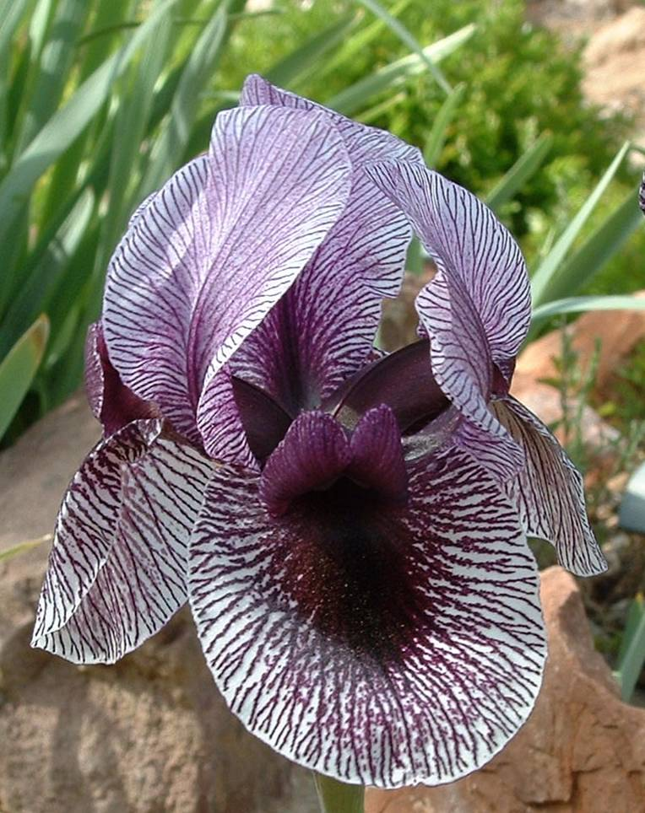
Andromache RC
RC is a Regeliocyclus It contains both Regelia and Oncocyclus in its heritage. Regelia is listed first which means that it more regelia in appearance or is the first-generation pod parent.
Aril List
Andromache
RC, Van Tubergen, BRS
Notes:
Andromache, RC, Van Tubergen, BRS

Slide 8
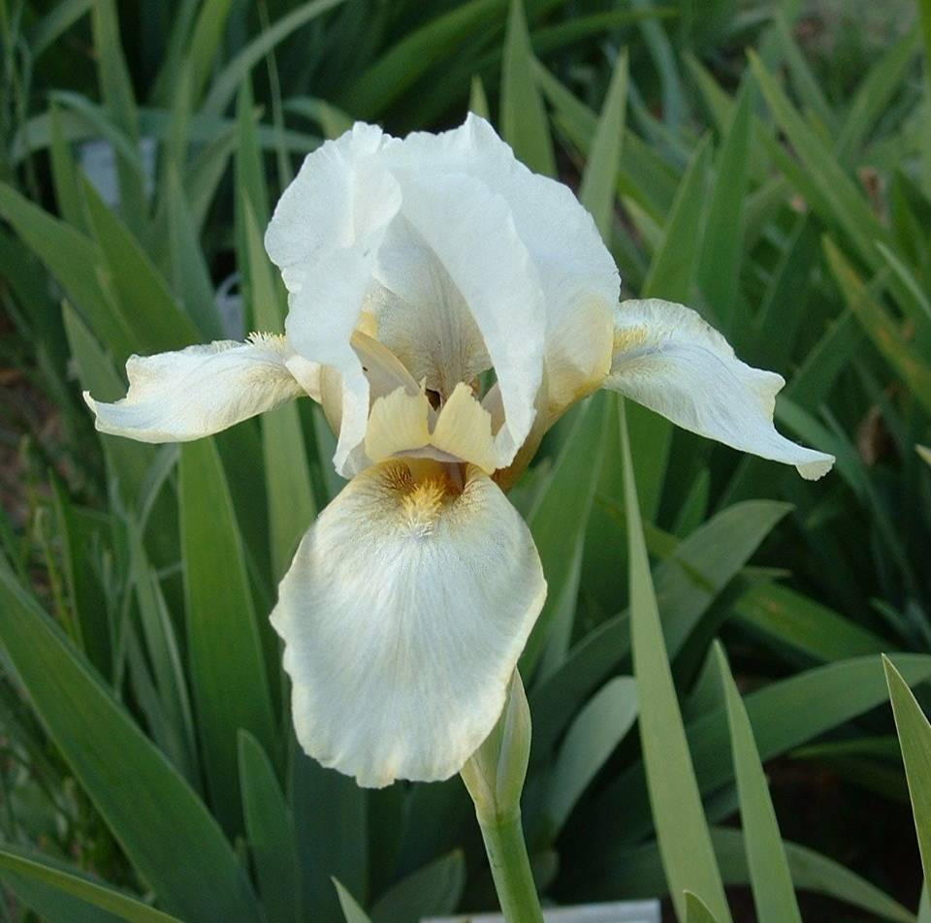
Aril Reverie OGB-
The minus “–” means that it has less than ½ Aril content and it can probably be grown with the TBs
Aril List
ARIL REVERIE
(Walter Moores, R. 1988), OGB-
Notes:
ARIL REVERIE
(Walter Moores, R. 1988), OGB-

Slide 9
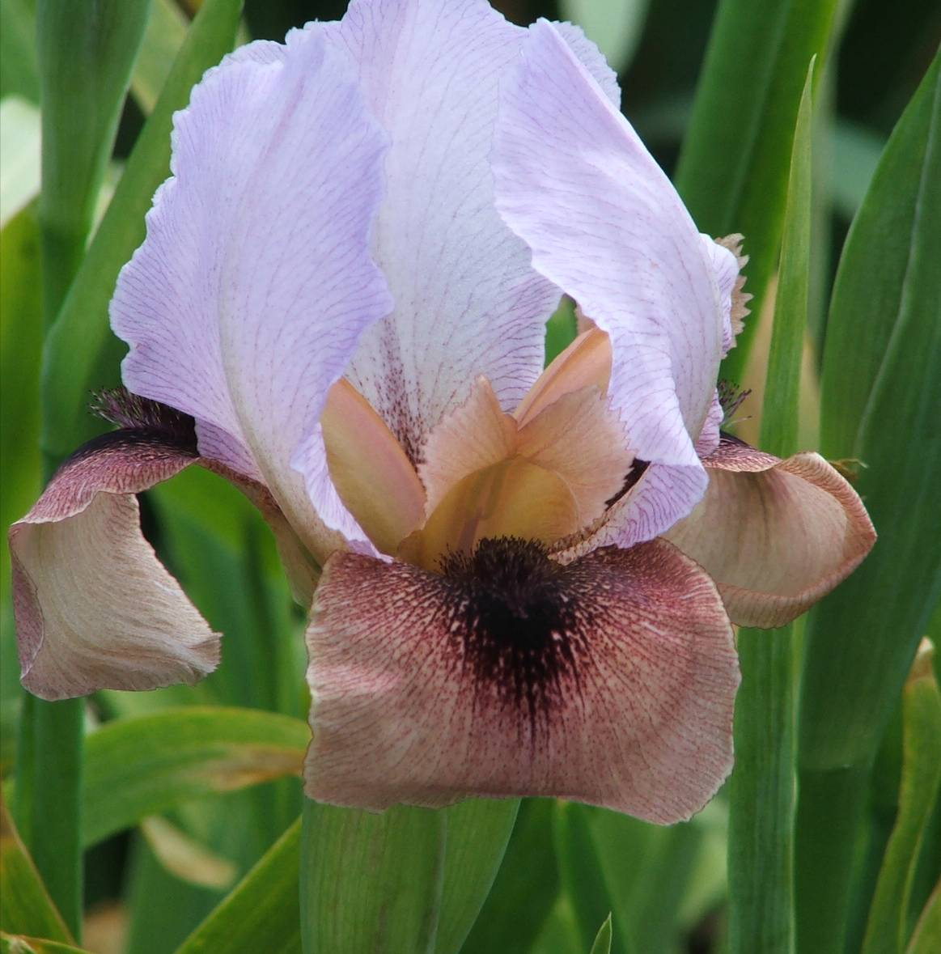
Back in Fashion OGB-
Less than ½ Aril
Requires two recognizable aril characteristics
Resembles their non-aril parentage more than the aril
Height varies from 3 to 28+ inches
Branching, height, bud count may be equal to its bearded parentage
Aril List
BACK IN FASHION
Sharon McAllister 2006 OGB-
Notes:
BACK IN FASHION
Sharon McAllister 2006 OGB-

Slide 10
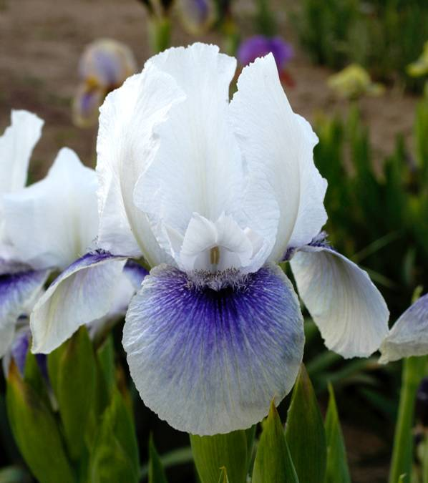
Betty McPherson OGB
No sign (either a “+” or “-”) means that the iris is ½ aril heritage.
Requires 3 recognizable aril characteristics
May produce more than one stem per rhizome
If it has TB parentage, height maybe over 30”, contain one branch, a spur and 3-5 buds.
Aril List
Betty McPherson
Frank Rice, R. 2001, OGB
Notes:
Betty McPherson
Frank Rice, R. 2001 OGB,

Slide 11
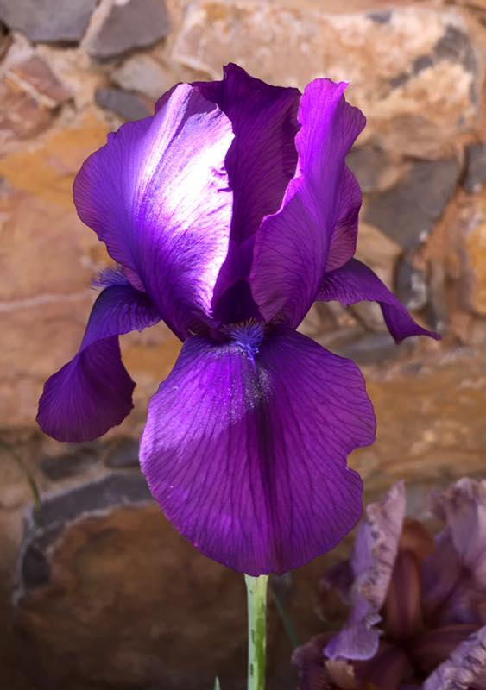
Blue Arts RB+
The plus “+” means that it contains more that ½ regelia content.
Requires three recognizable aril characteristics
Aril traits are strongly expressed.
Typically no branching with two buds
Aril List
BLUE ARTS
(L. Danielson, R. 1985), RB+
Notes:
BLUE ARTS
(L. Danielson, R. 1985), RB+
Photo by Howie Dash

Slide 12
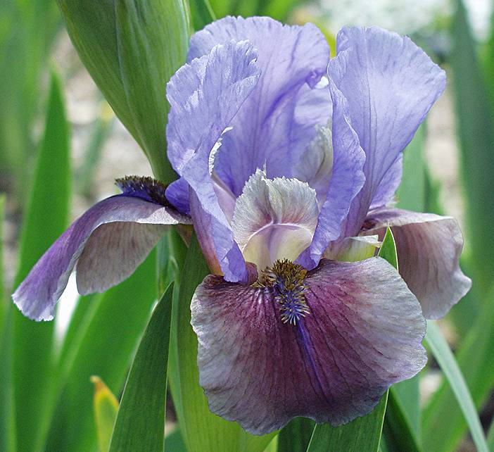
Bozrah OGB-
The American Iris Society is the worlds registration authority for all non-bulbuous irises. Go to http://www.irises.org/About_Irises/Iris_Registrations.html if you created a new cross and would like to register it.
Aril List
BOZRAH
(F. Gadd, R. 1988), OGB-
Notes:
BOZRAH
(F. Gadd, R. 1988), OGB-

Slide 13
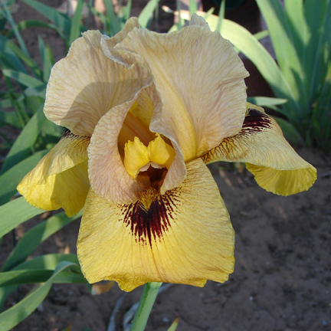
Bronze Age OGB
Arilbreds are the best of the Aril world and the bearded iris world.
Retains the exoticness of the arils but the ease of growth of the bearded irises.
Bud counts are often better than the Aril’s.
Extend color season earlier than the TBs
Aril List
Bronze Age
(Lois Rich by James Whitely, R. 1992) OGB

Slide 14
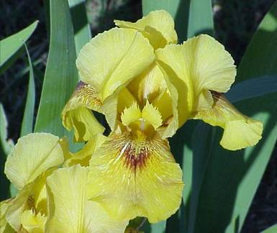
Burnished Star OGB
To be considered an Arilbred:*
Must be a hybrid of an Aril iris and other bearded (eupogon) iris.
Must exhibit at least 2 Aril characteristics
Must contain ¼ or more aril heritage
Aril List
BURNISHED STAR
(Vernon & Dana Brown, R. 2004), OGB
* Aril Society International 1995 resolution
Notes:
BURNISHED STAR
(Vernon & Dana Brown, R. 2004), OGB

Slide 15
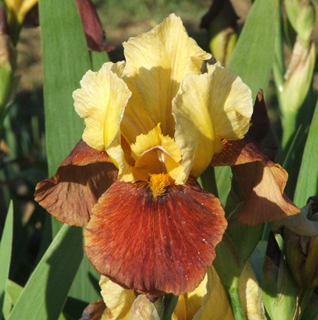
Buttered Berries OGB-
Aril irises are native to the Middle East and grow in Israel, Syria, Lebanon, Iraq, Iran, Afghanistan, Turkey
Aril List
Buttered Berries
Vernon & Dana Brown 2006, OGB-
Notes:
Buttered Berries
Vernon & Dana Brown 2006

Slide 16
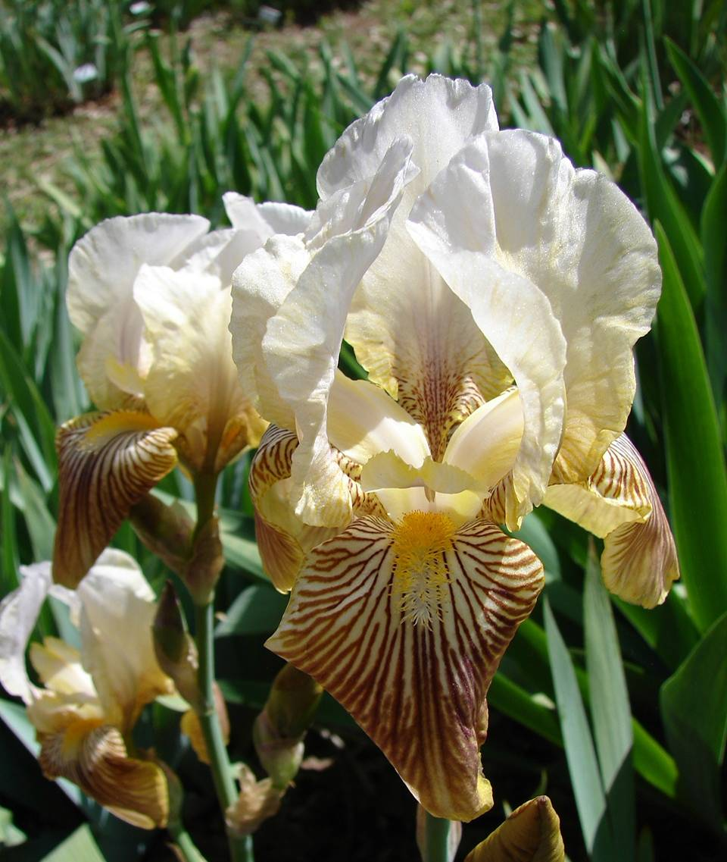
Butterfly Wings TMB
This iris introduced in in 1946 has the symbol “TMB” (Tall Miscellaneous Bearded Section). The symbols have evolved over time and in 1946 the term Arilbred was not yet coined.
Aril List
Butterfly Wings
C.G. White, 1945, TMB, Grandparent Susiana per Austin
Notes:
Butterfly Wings
C.G. White, 1945, TMB, Grandparent Susiana per Austin
The following is from the Iris Wikipedia
NOTE: This iris has not been accepted as an arilibred by the Aril Society International because it does not exhibit the aril characteristics necessary for ASI acceptance.
The entry in the A.I.S. Checklist reads: Note the rather confusing parentage with large X everywhere ! Theme (Lothrop, R., 1930) and Sacramento (Mohr-Mitchell, R., 1928) are TB. No information can be found on Incognito. One can assume it had some aril in it otherwise the Checklist entry would not indicate 'TMB'; (Tall Miscellaneous Bearded Section). The category 'arilbred' was not yet in use.
However the Historical Iris Preservation Society's entry for Butterfly Wings reads '1946 ; TB-OG 36" M #B2D'; and gives a different parentage : ( 'Pink Jadu' x I. susiana ) X 'Theme' x 'Sacramento'). 'Pink Jadu' (Sturtevant, R., 1931) is a TB pink plicata.
The HIPS-Roots web site also gives the following description from Lloyd Austin's Rainbow Gardens 1952 catalog. "Yes, an Oncobred as beautiful and as captivating as wings of a tropical butterfly, veinings that come from its grandparent, Susiana. So, I picture for you a whole cluster of 'Butterfly Wings', like a swarm of freshly alighted butterflies. Above, the coloring is translucent lilac blue - below, it is rich parchment, veined in golden russet and deep carmine. Thus, these iris have the exotic charm of true Oncos, but unlike them, are borne on yard-high, well-branched stalks. A real accomplishment for 'Clarence White', but this need not be the trails end. This rare hybrid is fertile and I have a wide array of promising new seedlings just coming into bloom from 'Butterfly Wings' X 'Rocket', 'Chivalry' and other favorites of mine. Now you try it!"
Further points to add to Austin's description is the narrow russet hairline edge not only around the falls but also around the standards. The leaves are lightly colored rosy red toward their base; the bud sheaves are also lightly pigmented. 'Butterfly Wings' is a strong grower and very pod fertile, each year practically all flowers are bee pollinated in my garden.
NOTE: This iris has not been accepted as an arilibred by the Aril Society International because it does not exhibit the aril characteristics necessary for ASI acceptance

Slide 17
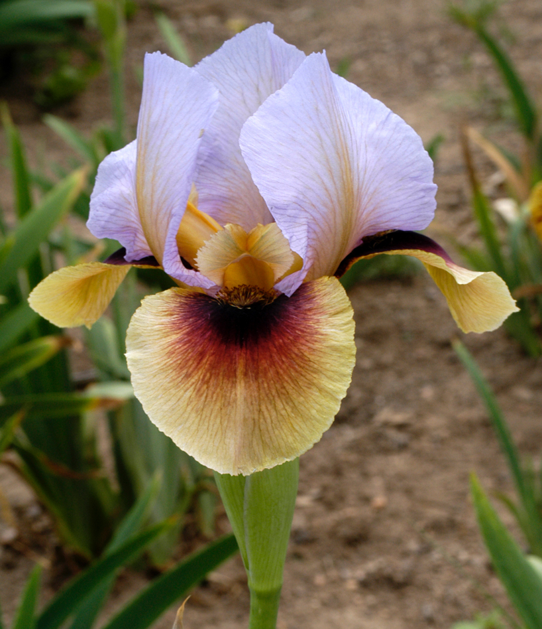
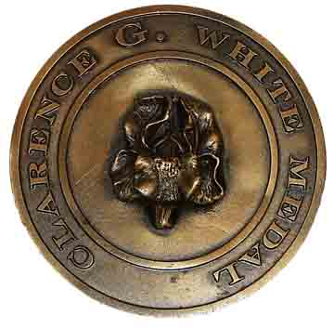
Byzantine Art OGB
In the first half of the twentieth century, little was known about iris genetics. Clarence G. White assembled the largest collection of aril irises in the world, and conducted thousands of breeding experiments to obtain viable, fertile seedlings. He is universally regarded as the pioneer in this field. It is to Clarence G. White that we owe most of our modern fertile Arilbreds (Wilkes, 1964).
Aril List
BYZANTINE ART
(Lowell Baumunk, R. 2000), OGB
Clarence G. White Medal, 2008
2008
Notes:
BYZANTINE ART
(Lowell Baumunk, R. 2000), OGB
The medal for Arilbreds of ½ or more Aril ancestry is named after Clarence G. White.

Slide 18
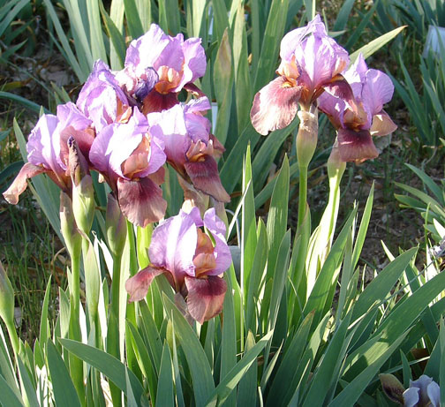
Calypso Clown OGB
Increase is normally heavier than in TB’s. The increase is more like the rebloomers. You may need to divide every two years.
Aril List
CALYPSO CLOWN
(L. Rich, R. 1977), OGB
Notes:
CALYPSO CLOWN
(L. Rich, R. 1977), OGB

Slide 19
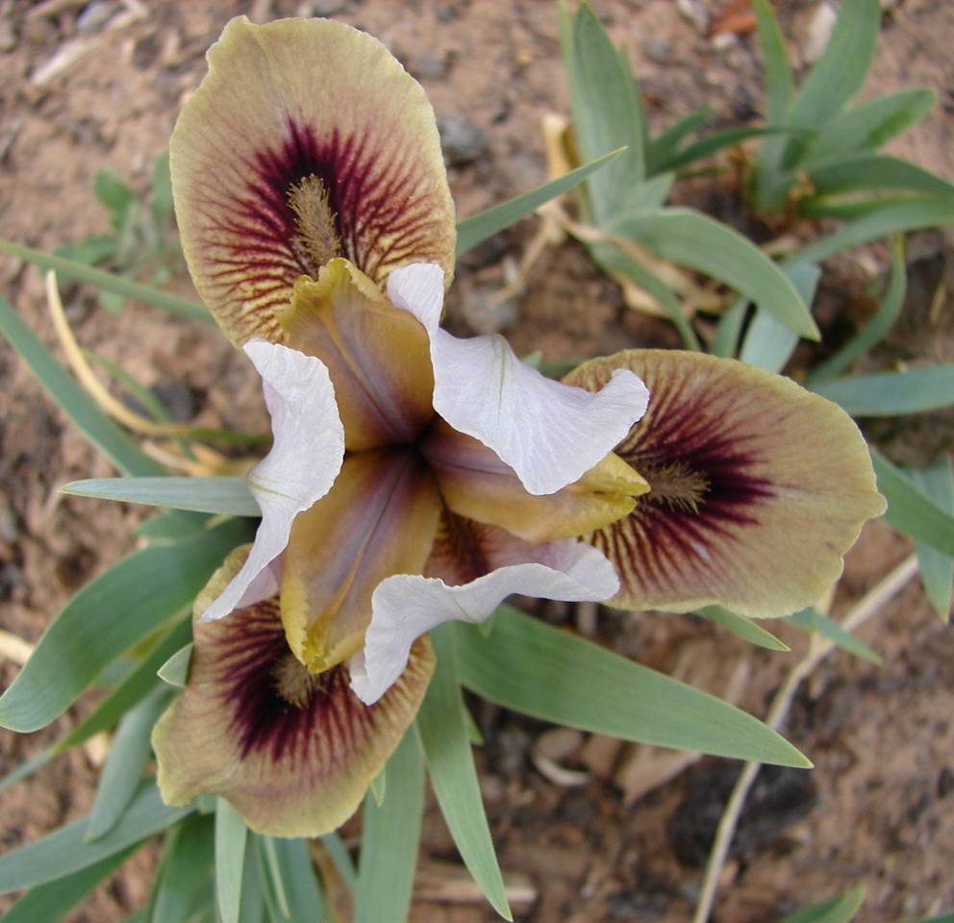
Canasta OGB
Size is important to gardeners, and it unhelpful to classify a 5” Arilbred dwarf together with a 40” tall Arilbred. Many growers recognize the public’s need for size classification, and use a term for the smaller arilbreds like AB-MED, ABM, or ABD. The terminology is not uniform and can vary widely since there is no “official” category for these smaller arilbreds.
Aril List
CANASTA
(L. Rich, R. 1975), OGB. AB-MED
Notes:
CANASTA
(L. Rich, R. 1975), OGB. AB-MED
The Smaller Arilbreds Tom Tadfor Little, http://www.telp.com/irises/The%20Smaller%20Arilbreds.pdf

Slide 20
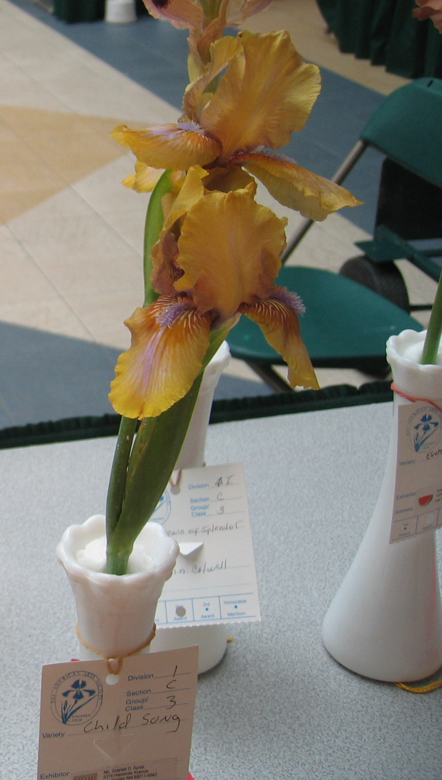
Child Song RB-
Arilbreds are the only irises in the judge’s handbook in which there is a description of the vase in which the iris should be displayed in a show.
The vase should be transparent. The judge may ask the clerk to pull the Arilbred from the vase if the vase is not transparent so they can examine the stem.
Child Song is a tetraploid designated as APTT. (Aril, I. Pumila and two sets of Bearded chromosomes )
Aril List
Child Song
( Elm Jensen, R. 1983), RB-
Notes:
The notation used is as follows: A represents a set of 10 or 11 aril chromosomes (oncocyclus or regelia) H represents a set of 11 psammiris chromosomes (from I. humilis or related species) P represents a set of 8 dwarf bearded chromosomes (usually from I. pumila) T represents a set of 12 bearded chromosomes (typically tall bearded) In some cases, chromosome counts are available and are given after the configuration, following a colon. Thus APT:30 represents one set each of aril, pumila, and TB chromosomes, verified by an actual count of 30 chromosomes.

Slide 21
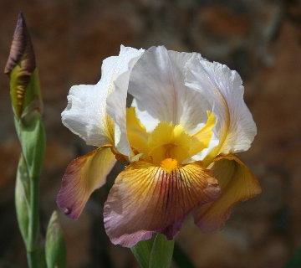
Depending on the amount of aril content, the rhizomes may be rounder is shape and smaller than the elongated rhizomes of the TBs. This does not indicate size of bloom.
Cup Runneth Over OGB-
Aril List
CUP RUNNETH OVER
(Sharon McAllister, R. 2005), OGB-
Notes:
CUP RUNNETH OVER
(Sharon McAllister, R. 2005), OGB-
Picture by Howie Dash

Slide 22
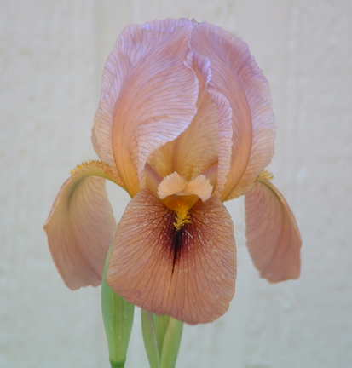
Damfino OGB
Sharon McAllister is a well known Arilbred hybridizer in Las Cruces, NM. Say this iris name out loud to hear her thoughts about this irises’ heritage.
Aril List
DAMFINO
(Sharon McAllister, R. 1998), OGB
Notes:
DAMFINO
(Sharon McAllister, R. 1998), OGB

Slide 23
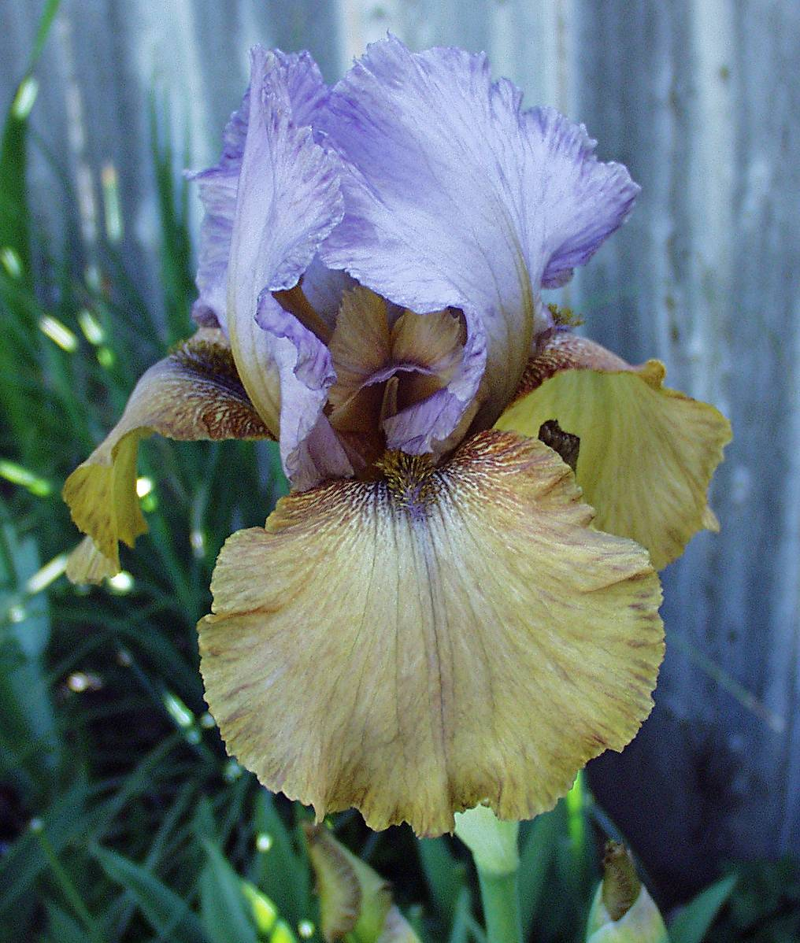
Desert Celebration OGB-
Arilbred irises can look very Onco-like, very Regelia-like or very TB-like.
Aril List
DESERT CELEBRATION
(Lin Flanagan, R. 1994), OGB-
Notes:
DESERT CELEBRATION
(Lin Flanagan, R. 1994), Sdlg. 90018-1. AB OGB-

Slide 24
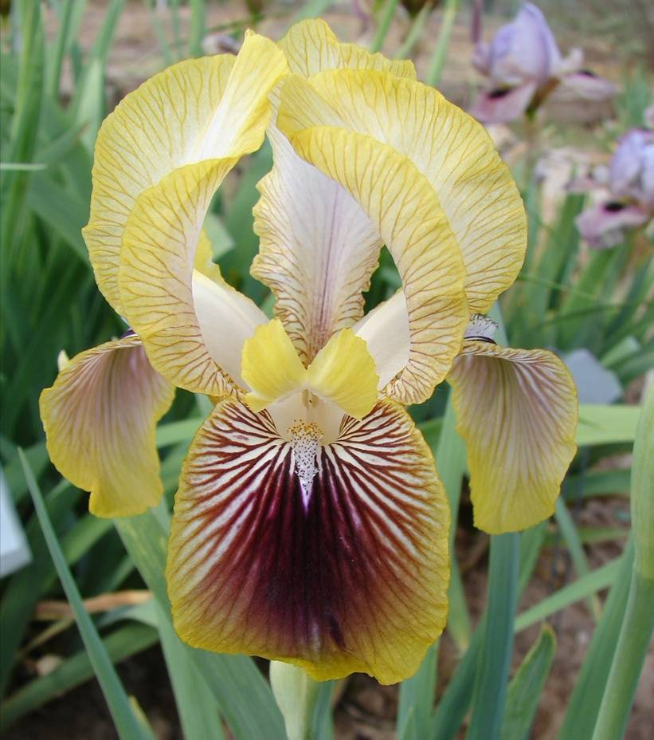
Desert Fire OGB+
Ask people in your area which arilbreds are easier to grow. Some pluses (more aril content) may be easier to grow than some of the minuses (less aril content).
Aril List
DESERT FIRE
(H. Shockey, R. 1975), OGB+
Notes:
DESERT FIRE
(H. Shockey, R. 1975), OGB+

Slide 25
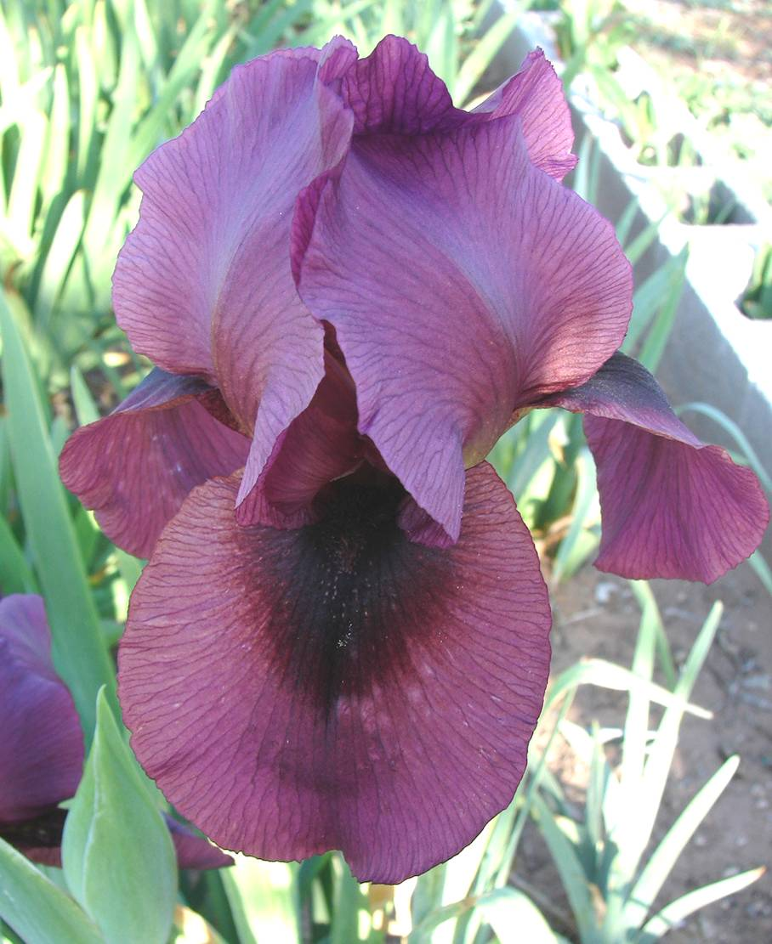
Desert Fury OGB
The signal on an Arilbred is not the same as a color spot. The signal has elongated cells that are raised from the petal and have a velvet texture.
In a color spot, the texture is not different. Arilbreds can have both signals and color spots
Regelia can have V-shaped color spot on falls.
Aril List
DESERT FURY
(Howard Shockey, R. 1994), OGB
Clarence G. White Medal, 2001
2001
Notes:
DESERT FURY
(Howard Shockey, R. 1994), OGB

Slide 26
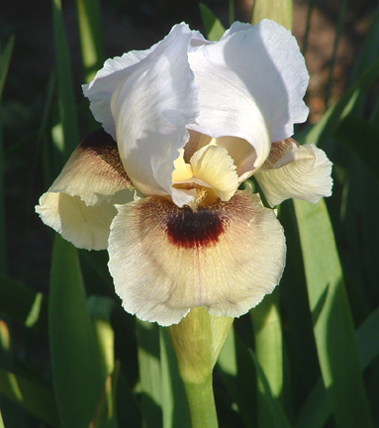
Dreamkeeper OGB
Current hybridizing advancements are resulting in ½ Arilbred irises that are more aril-like than many pluses.
Larger signals
Aril-looking forms
Aril-looking beards
Aril List
DREAM KEEPER
(Vernon & Dana Brown, R. 2005) OGB
Notes:
DREAM KEEPER
(Vernon & Dana Brown, R. 2005), Sdlg. 98-107-1. AB (OGB

Slide 27
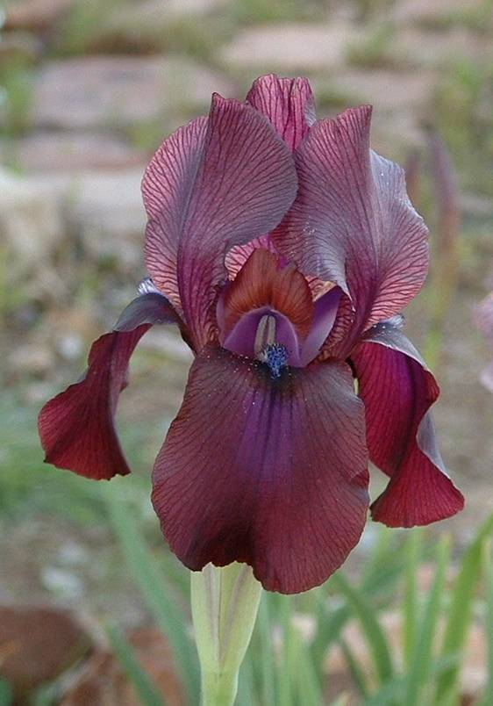
Dunshanbe RC
RC Regeliocyclus (pure aril that is a cross between Regelia and Oncocyclus). It is more Regelia-like than Oncocyclus-like
Regelia and Oncocyclus are the two major sections in the Aril world recognized by the Aril International Society (AIS).
Regelia grow more in the mountains while Oncocyclus (aka as Oncos) grow more in the desert.
Aril List
DUNSHANBE
(T. Wilkes, R. 1977), RC
Notes:
DUNSHANBE
(T. Wilkes, R. 1977), RC

Slide 28
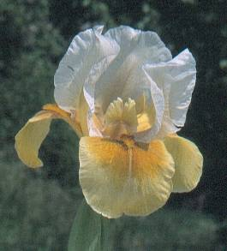
Ear Falas OGB-
In the modern catalogs you will probably see something like AB OGB-. AB tells you it is an Arilbred. The Aril Society International further subdivides the arilbreds into nine categories, based on the relative content of oncocyclus, regelia, and bearded ancestry (RB+, RB, RB-, OB+, OB, OB-, OGB+, OGB, OGB-)
Aril List
EAR FALAS
(Jean Peyrard, R. 2005), OGB-
Notes:
EAR FALAS
(Jean Peyrard, R. 2005), OGB-

Slide 29
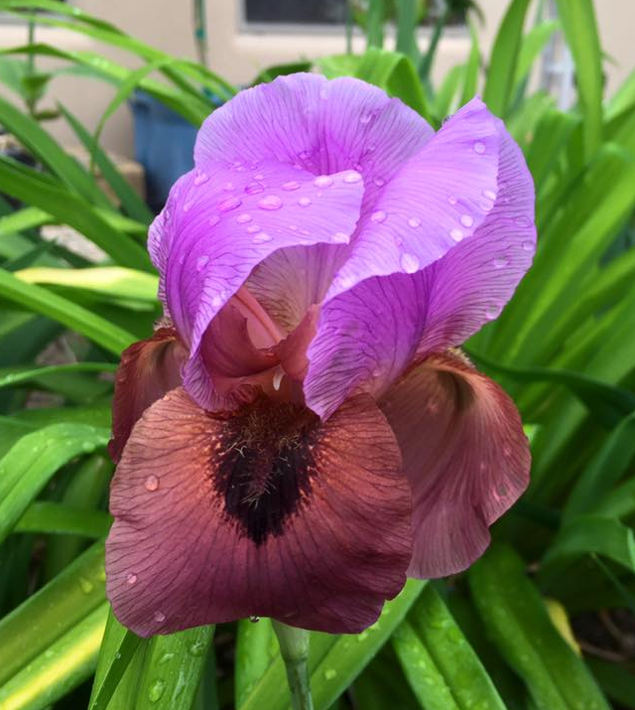
Enchanter’s Spell OGB
More than 50 species have been found in the literature for the Oncos. While more than 8 species have been found for the Regelias.
Some may be local varieties and others may be hybrids.
Aril List
Enchanter’s Spell
Rick Tasco, 2013, OGB
Notes:
Picture by Howie Dash

Slide 30
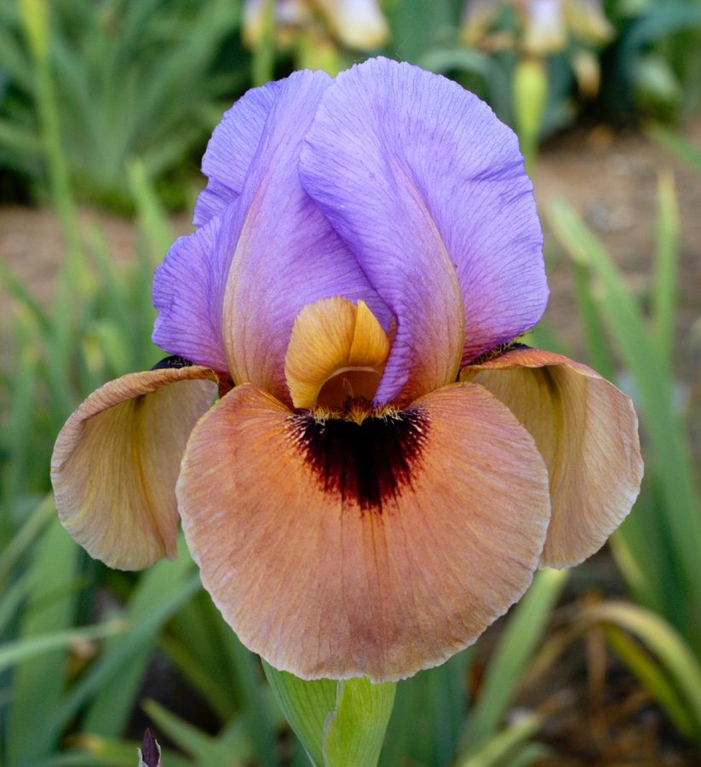
Fiesta Skirt OGB
The Arilbreds are judged to the standards under which they are registered. The classification can sometime be surprisingly hard to determine since they can be diploids, triploids, tetraploids or more.
Aril List
FIESTA SKIRT
(Howard & Irene Shockey, R. 2003), OGB
Notes:
FIESTA SKIRT
(Howard & Irene Shockey, R. 2003), OGB

Slide 31
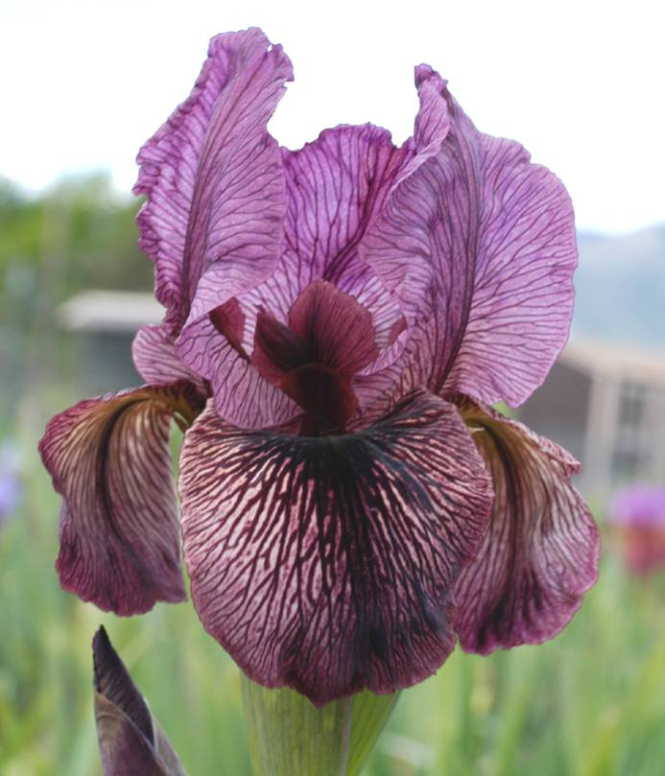
Frank Rice OGB+
Arilbred is the only class in the judge's handbook that discusses the tag used for seedlings at an iris show. It says that the tag should only bear the type and aril content of the seedling, i.e. Oncobred seedling – ½ aril content. Seedling numbers may accidently reveal to the judge the hybridizer.
Aril List
FRANK RICE
(Frank Rice, R. 2002), OGB+
Notes:
FRANK RICE
(Frank Rice, R. 2002 OGB+

Slide 32
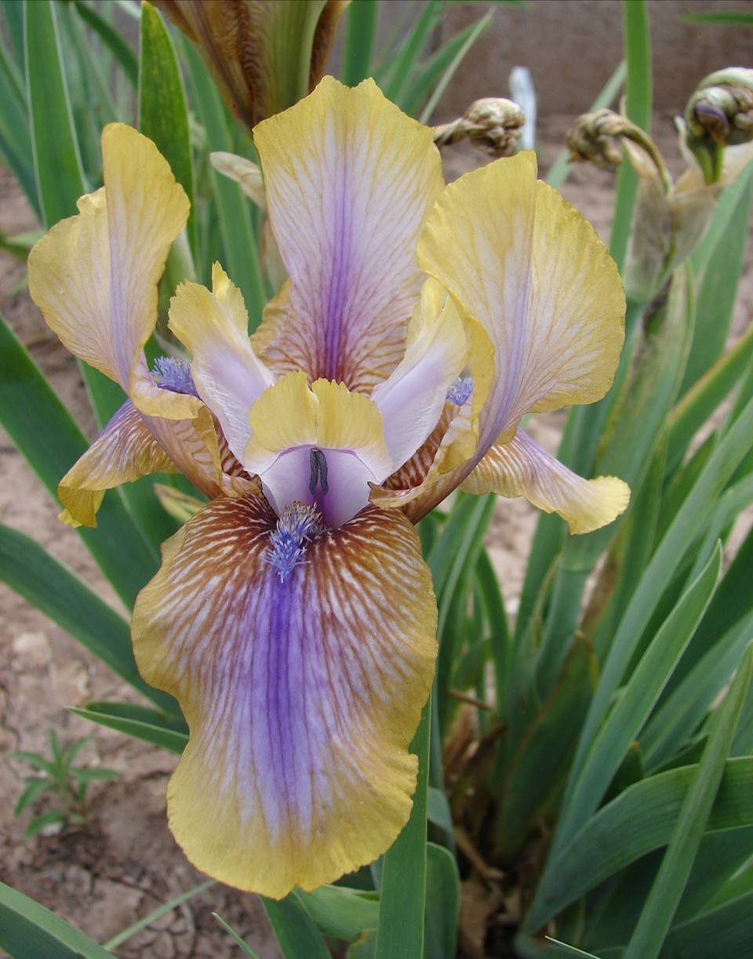
Genetic Artist RB
Regelias is one of two major sections in the Aril world.
Tolerate more water during the summer than the oncocyclus.
More tailored form, with elongated standards or falls and long slender stems
Linear Beards
Aril List
GENETIC ARTIST
(H. Danielson, R. 1971), RB
Notes:
GENETIC ARTIST
(H. Danielson, R. 1971), RB

Slide 33
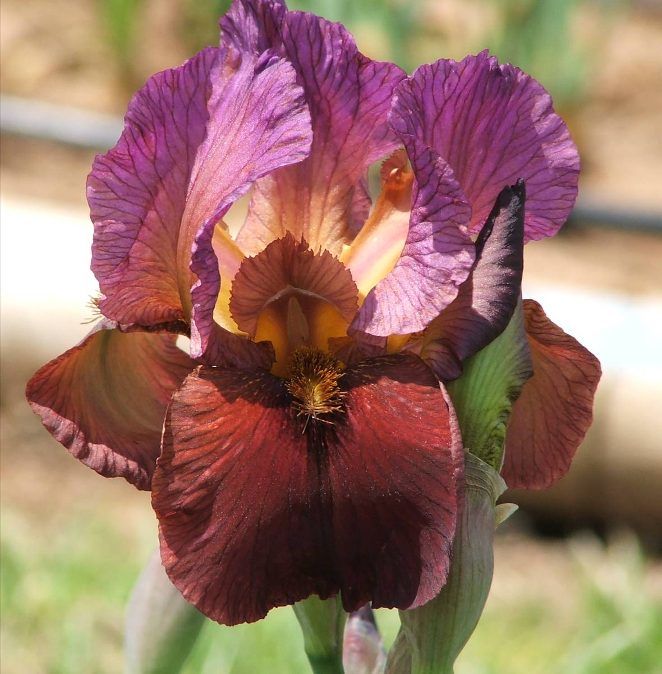
Go Big Red OGB
A little regelia in the heritage often brings out the onco characteristics in the OGB.
Aril List
Go Big Red
Sharon McAllister OGB 2006
Notes:
Go Big Red
Sharon McAllister OGB 2006

Slide 34
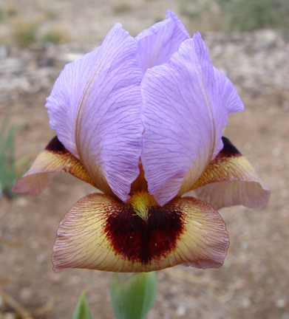
Golden Halo
The falls can be recurved (curl under). However, it is considered a fault if the signal is not showing because the falls recurve too much.
Aril List
Golden Halo
Pete McGrath
Notes:
Golden Halo , Pete McGrath

Slide 35
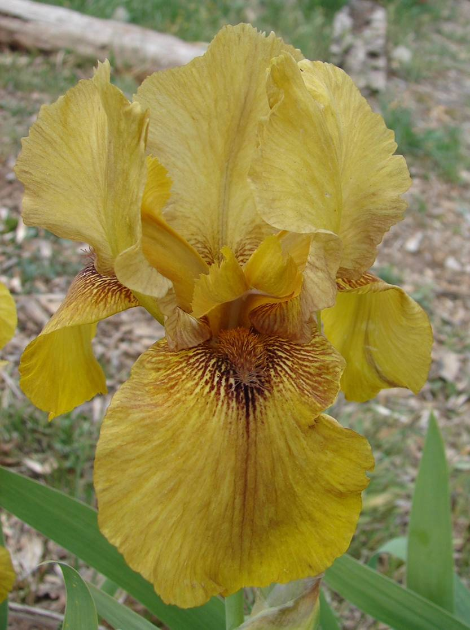
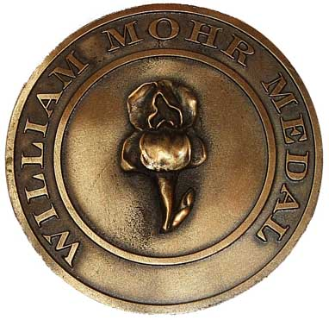
Hakuna Matata OGB-
Since 1993, the William Mohr Memorial Medal has been awarded to the best Arilbred with more than ¼ and less than ½ aril ancestry. (Before 1993, the William Mohr award was equivalent to an Award of Merit (AM). Arilbreds must now earn an AM before they can qualify for the William Mohr medal.)
Aril List
HAKUNA MATATA
(A. & D. Cadd, R. 1999), OGB-
William Mohr Medal, 2011
2011
Notes:
HAKUNA MATATA
(A. & D. Cadd, R. 1999), OGB-

Slide 36
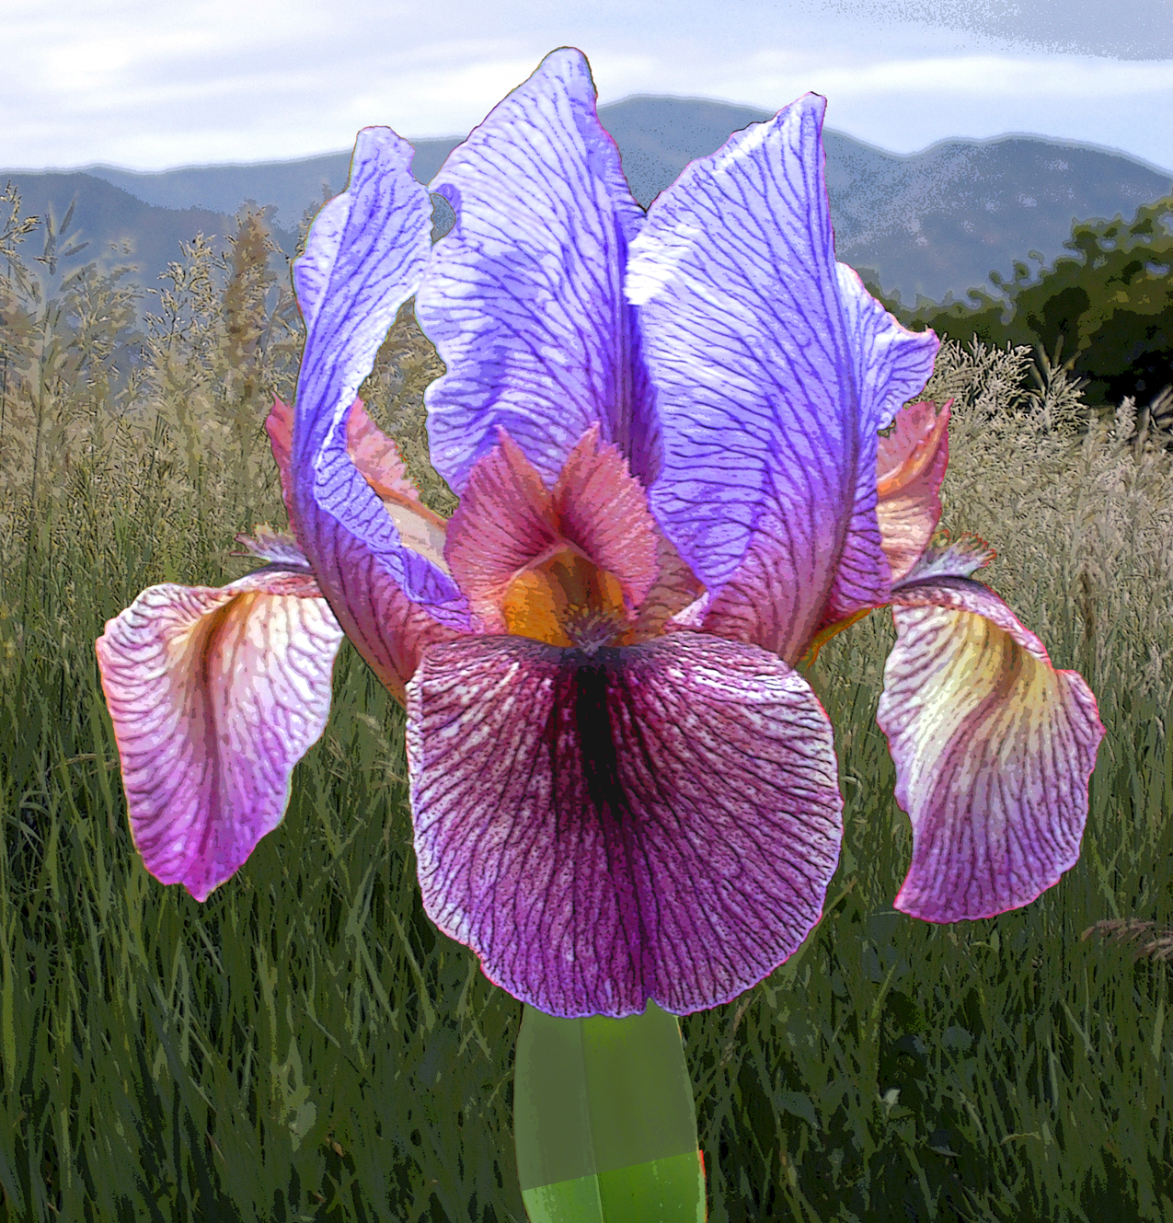
Hammurabi OGB
This is a diploid (AT). One set of chromosomes is from an aril parent (A) and one set is from a bearded parent (T). It is sometimes referred to as an ABM because its stature is short like a median. ABM is not an official ASI designation
Aril List
HAMMURABI
(Lowell Baumunk, R. 2004), OGB
Clarence G. White Medal, 2011
2011
Notes:
HAMMURABI
(Lowell Baumunk, R. 2004), OGB

Slide 37
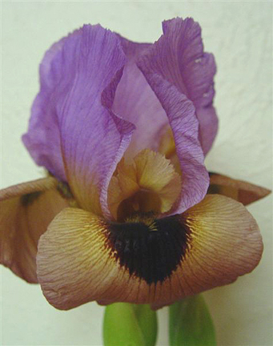
Hannah’s Prayer OGB
Aril irises are referred to in the bible as Lilies.
Song of Solomon 6:3
“I am my beloved's and my beloved is mine, He who pastures his flock among the lilies.”
Matthew 6:28 “And why take ye thought for raiment? Consider the lilies of the field, how they grow; they toil not, neither do they spin.”
Aril List
HANNAH'S PRAYER
(Pete McGrath, R. 2004), OGB
Notes:
HANNAH'S PRAYER
(Pete McGrath, R. 2004), OGB

Slide 38
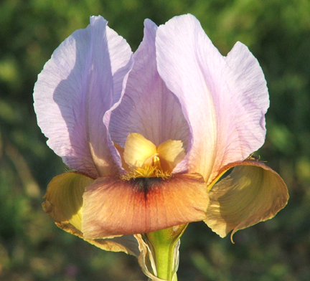
Honey Not Tonight OGB
Arilbreds are heavy feeders and benefit from regular fertilizing from a balanced fertilizer. As always, avoid fertilizer high in Nitrogen.
Aril List
Honey Not Tonight
Sharon McAllister, OGB, 2007
Notes:
Honey Not Tonight
Sharon McAllister, OGB, 2007

Slide 39
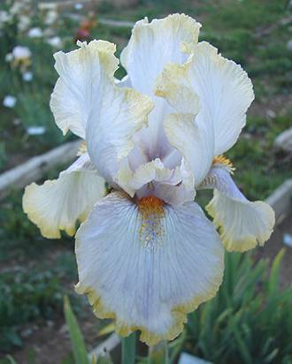
Hoopla OGB+
Arilbreds require a minimum of 6 hours of sun.
Light mid-day/afternoon shade can help
Require well drained bed.
Add pebbles to the soil to improve drainage.
Space about 18 inches to 24 inches apart. They increase rapidly.
Aril List
HOOPLA
(L. Danielson, R. 1987), OGB+
Notes:
HOOPLA
(L. Danielson, R. 1987), OGB+

Slide 40
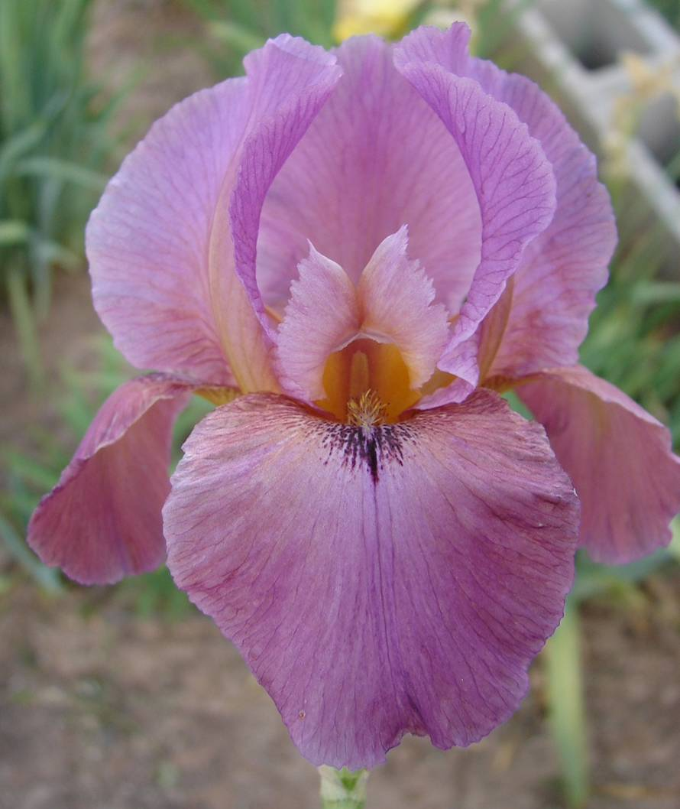
Hot Ice OGB
Plant in early fall when they start to come out of summer-induced dormancy
If acquired in the heat of the summer, plant in pots and keep in shade.
Aril List
HOT ICE
(Lois Rich by James Whitely, R. 1994), OGB
Notes:
HOT ICE
(Lois Rich by James Whitely, R. 1994), OGB

Slide 41
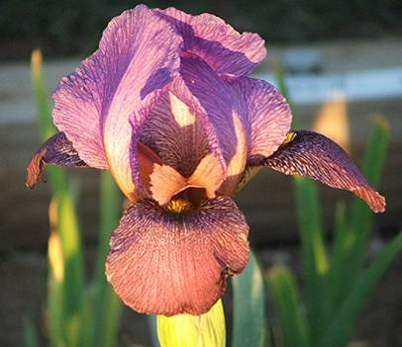
Hunt’s Dorcom OGB
Aril and Arilbred rhizomes like to be planted a little deeper so they don’t dry out.
Arilbred irises are subject to the same diseases and insects as the TBs in your area.
Aril List
HUNT'S DORCOM
Sharon McAllister, OGB, 2007
Notes:
HUNT'S DORCOM
Sharon McAllister, OGB, 2007

Slide 42
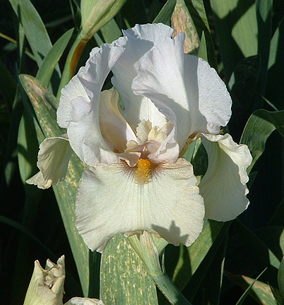
I’m Still Here OGB-
Keep weeds to a minimum. Arilbreds (like most irises) need air-circulation around the rhizomes so they can still be here next spring. Also, sun on the rhizome in the spring triggers bloom.
Aril List
I’m Still Here
Sharon McAllister, OGB-, 2006
Notes:
I’m Still Here
Sharon McAllister, OGB-, 2006

Slide 43
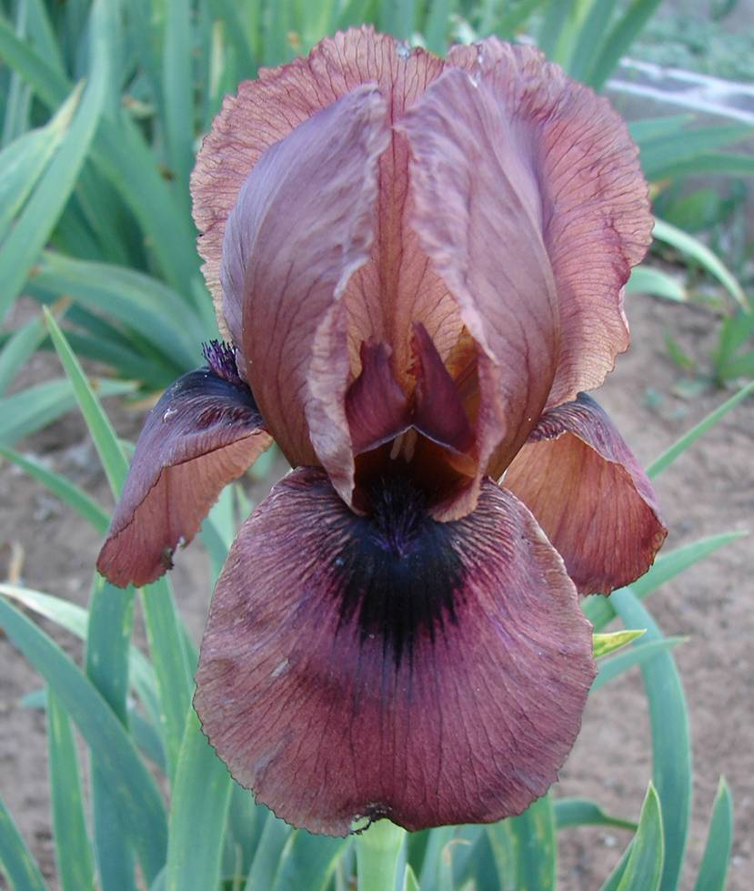
Invention OGB
This iris is an attempt to develop a fully fertile Arilbred dwarf by developing amphidiploid crosses. Dwarf and median bearded irises whose chromosomes come in sets of 12, (I. aphylla, I. reichenbachii, and I. suaveolens) crossed with arilbreds may produce small, amphidiploid arilbreds. This work was pioneered by Harald Mathes of Germany in the 1990’s.
Aril List
INVENTION
(Harald Mathes, R. 1994), OGB
Notes:
INVENTION
(Harald Mathes, R. 1994), OGB
From http://www.telp.com/irises/The%20Smaller%20Arilbreds.pdf
Amphidploid = a plant having the sum of the chromosome numbers of two parental species, owing to the doubling of the chromosomes in a hybrid of two species.

Slide 44
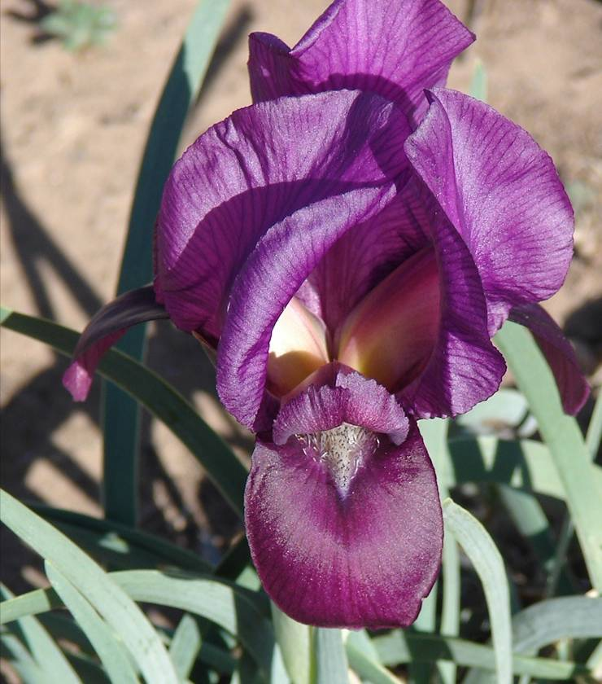
I. barnumae
Extensive variation exists within the oncocyclus section, not only from one species to another, but among clones of a given species. However, all Oncos bloom on single flower stems that can be quite short as to make the plant true dwarfs.
Aril List
I. Barnumae, ONCO
Notes:
Barnumae ONCO
From World of Irises, edited by Bee Warburton, 1995, pg 180

Slide 45
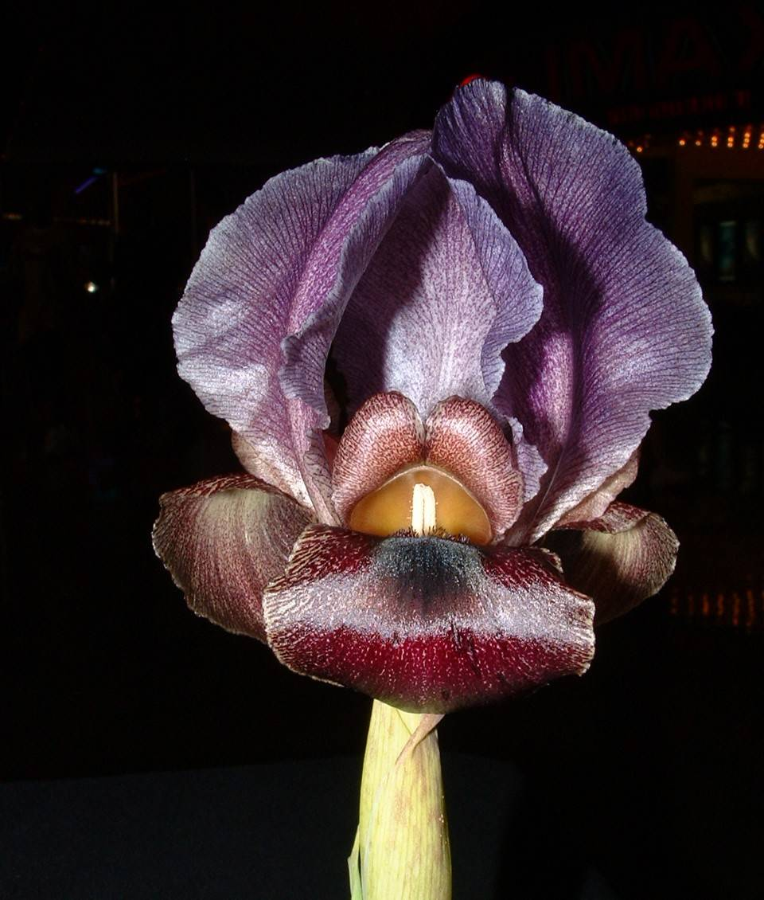
I. hayneii
Arils are some of the most extravagantly colored flowers in the plant world. Unfortunately they are difficult to grow in all but the warmest and driest regions of the US. They can rot if they receive rain in the summer time. However people have invented ways to keep the rain off of the Arils
Aril List
I. hayneii, onco
Notes:
I. hayneii, onco

Slide 46
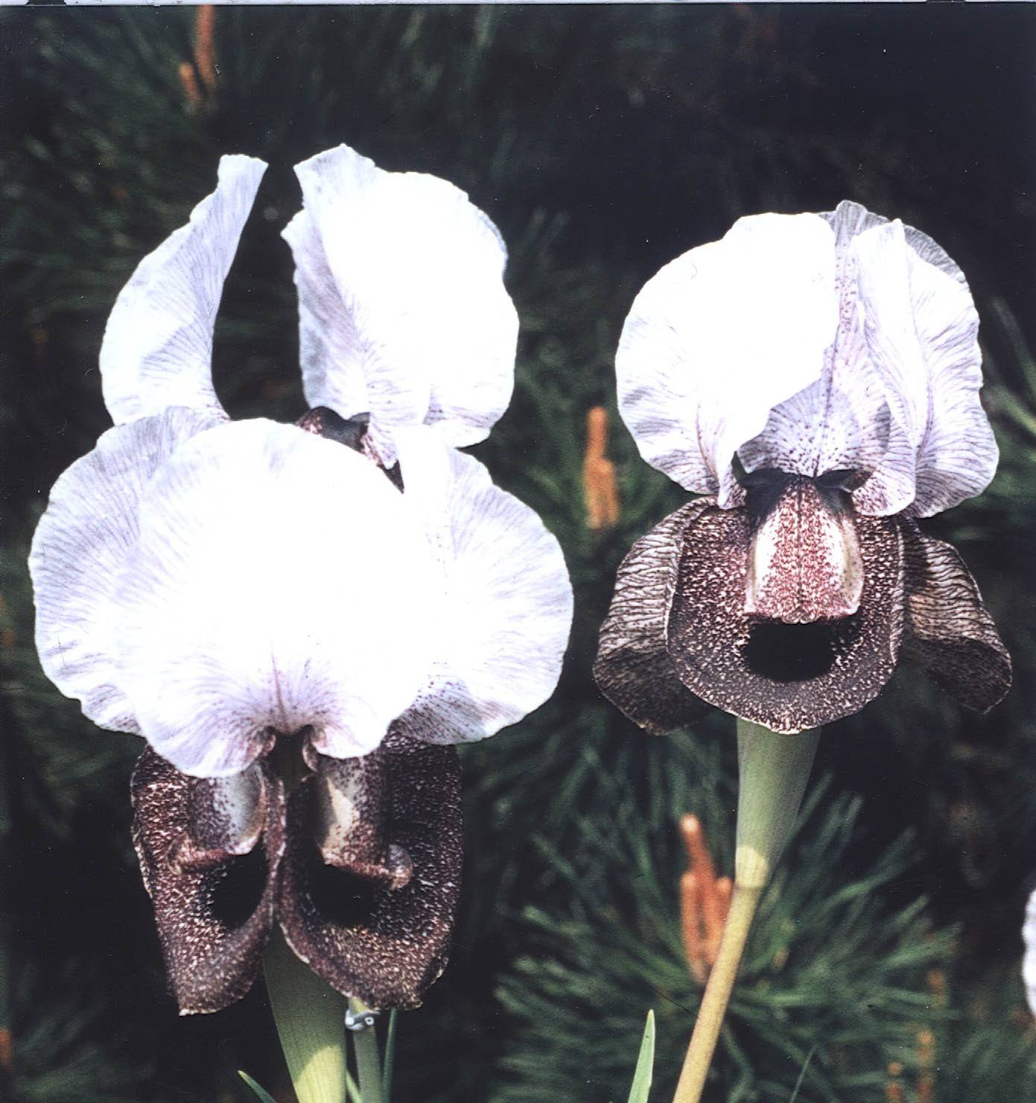
I. iberica
This is a native species of the Oncocyclus section. It has dwarf habit but a gigantic flower. Note the exaggerated style arms that stick out past the standards. It is a native of the Iberian provinces of the Caucasus inhabiting mountains 6500 feet high.
Aril List
I. Iberica, Onco
Notes:
I. iberica onco

Slide 47
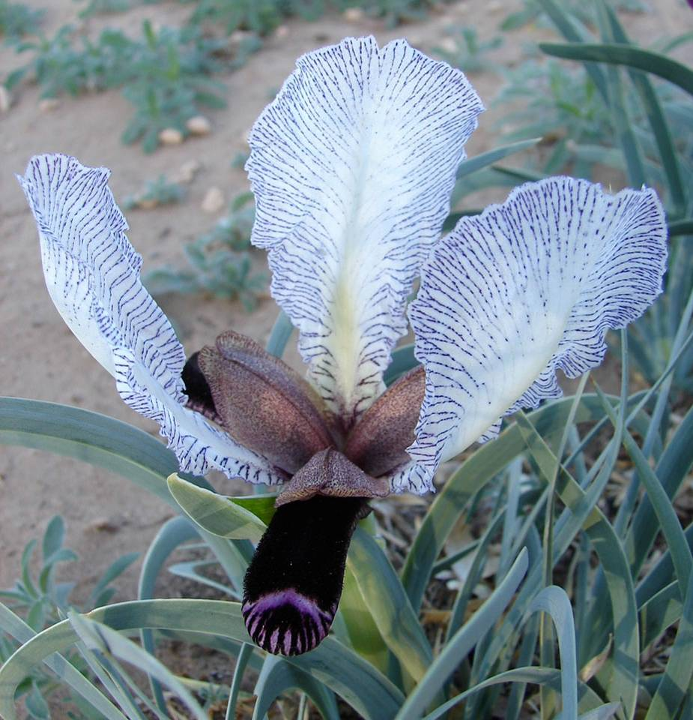
I. paradoxa var. Choschab
The disproportion between the standards and the falls found in many oncocycli reaches its extreme here. It occurs in a region where the winters are long and severe. Found in Russian Armenia, and in the Iranian province Aderleidsjan
Aril List
I. Paradoxa var. Choschab, ONCO
Notes:
paradoxa var. Choschab ONCO
From The World of Irises edited by Bee Warburton, 1995

Slide 48
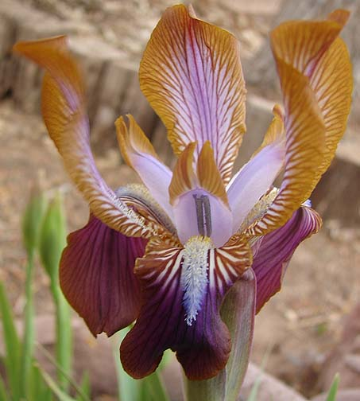
I. Stolonifera
This is of the Regelia section. Stolons, aka runners, are horizontal stems that grow just below ground level.
This aril is so named because of its habit of producing inches long stolons from the rhizomes. New plants form at the end. In the wild, it occurs in Soviet Central Asia in the Pamir-Alai range in a dry rocky environment.
Aril List
I. Stolonifera, Regelia

Slide 49
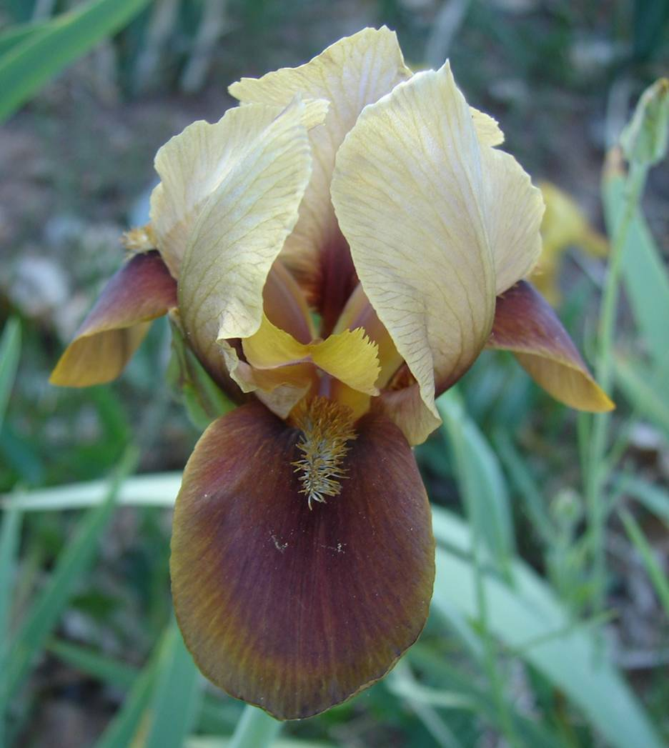
Jacobs Well OGB-
Aril species are native to the Middle East, ranging from near-desert climates to mountainous ones. Their flowers have patterns, forms and color combinations not found in the more common TBs
Aril List
JACOB'S WELL
(M. Brizendine by J. & L. Fry, R. 1986), OGB-
Notes:
JACOB'S WELL
(M. Brizendine by J. & L. Fry, R. 1986), OGB-

Slide 50
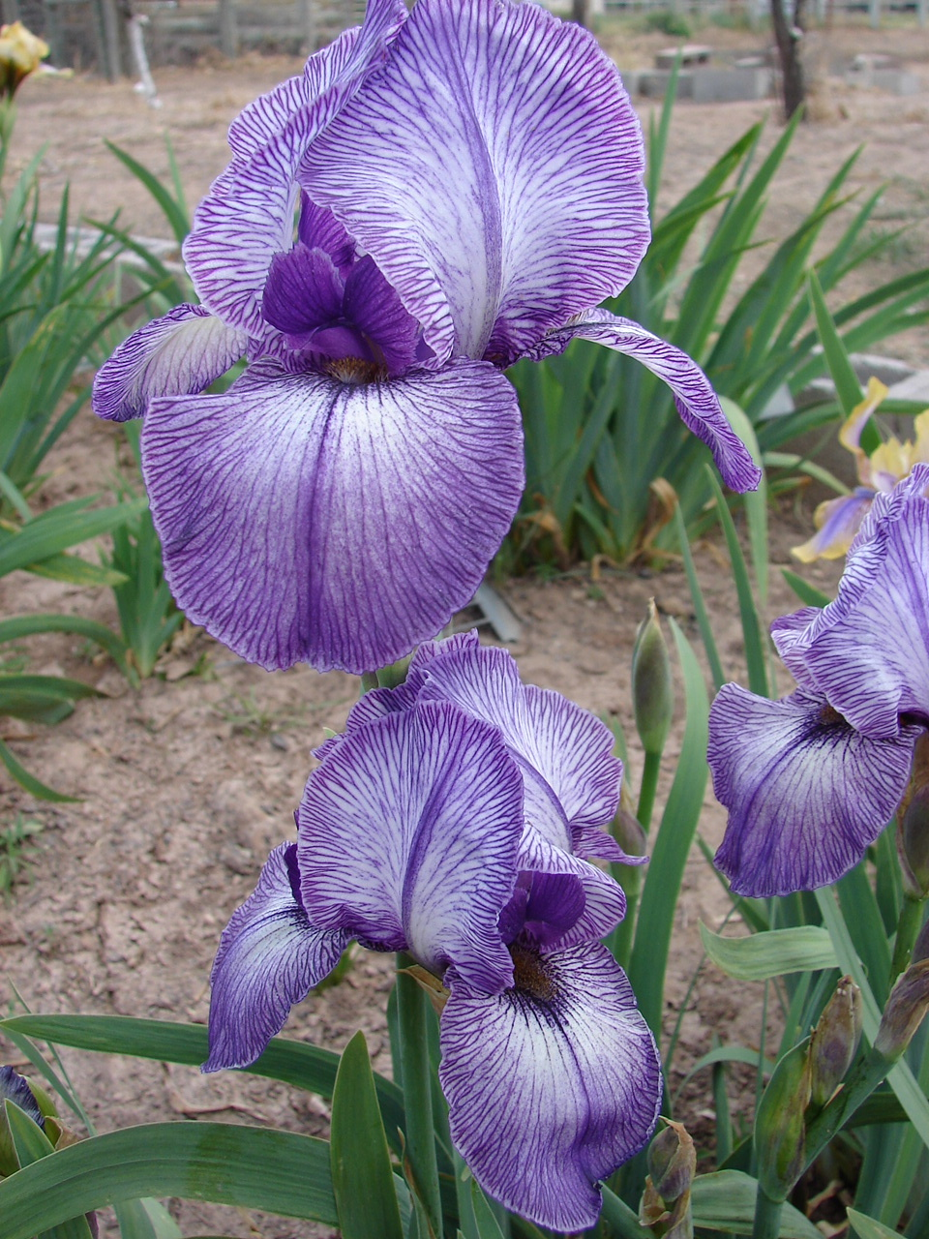
Jonneye’s Magic OGB
OGB Oncogeliobred
Half aril content needs 3 aril traits. The traits include:
Signal at the end of beard
Exotic veining, dotting
Recurved falls
Globular form
Aril shape with elongate upright standards
Wide variety in form
Unusual colors and combinations
Aril List
JONNYE'S MAGIC
(Lois Rich by James Whitely, R. 1992), OGB
Notes:
JONNYE'S MAGIC
(Lois Rich by James Whitely, R. 1992), OGB

Slide 51
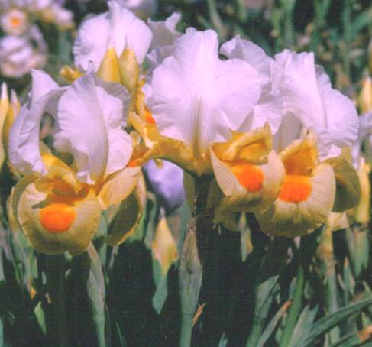
Judean Magic OG
OG-Oncogelia Contains both Regelia and Oncocyclus in its heritage. Onco is listed first means that it more oncocyclus in appearance or is the first-generation pod parent.
Aril List
JUDEAN MAGIC
(H. Shockey, R. 1986), OG
Notes:
JUDEAN MAGIC
(H. Shockey, R. 1986), OG

Slide 52
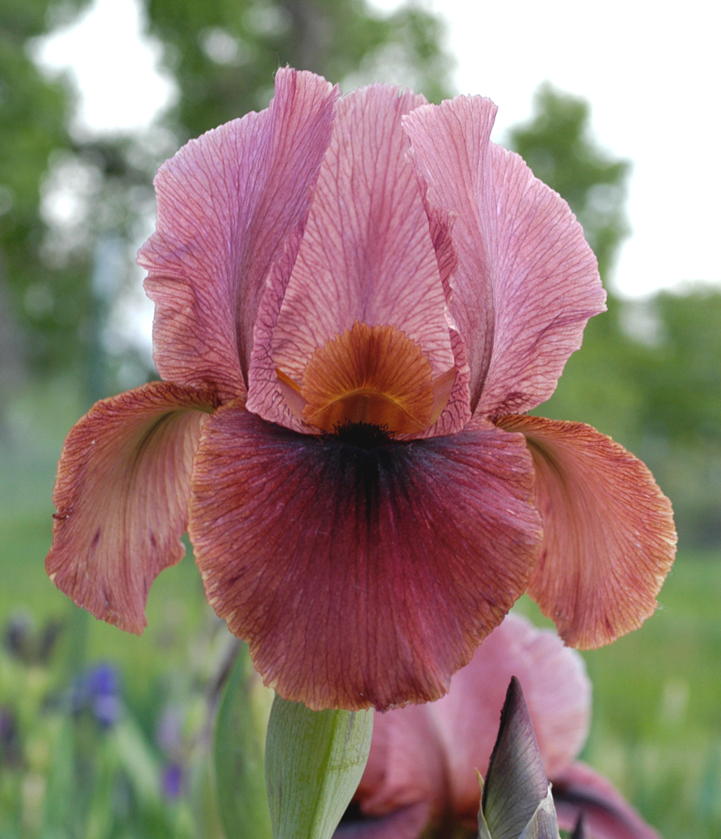

Kalifa’s Cape OGB+
Aril seeds like to be planted 4-6 inches deep. Aril irises get their name from the white collar (or "aril") on the seeds which contains nutrition that ants like. The ants pull the seeds into their colony and eat the aril collar. The seed then germinates!
Aril List
KALIFA'S CAPE
(Robert Annand, R. 2003), OGB+
Notes:
KALIFA'S CAPE
(Robert Annand, R. 2003), OGB+

Slide 53

Kedesh OGB
Depending on their growing conditions, half-breds can remain green-dormant in the summer or go completely dormant like their aril ancestors in order to conserve strength
Aril List
KEDESH
(James Whitely, R. 2001), OGB
Notes:
KEDESH
(James Whitely, R. 2001), (OGB tet.),

Slide 54

Khyber Pass OGB
Before 1993, the Clarence. G. White award was equivalent to an award of merit (AM). Arilbreds must now earn an AM before they can qualify for the Clarence G. White medal. This medal is awarded to irises with equal or greater aril content. William Mohr medal is awarded for less aril content. Remember Mohr is less.
Aril List
KHYBER PASS
(K. Kidd, R. 1983), OGB
Clarence G. White Medal, 1986
1986
Notes:
KHYBER PASS
(K. Kidd, R. 1983), OGB

Slide 55

Kiosk OGB
Although, Arils have beards, they are not classified with the bearded irises because they are so different. Aril beards are rather sparse, being long and straggly on the Regelias, and nothing more than a wide "fuzzy" patch on the Oncos. The arils show dark signal spots below the beards with much veining and speckling, in a large range of colors.
Aril List
KIOSK
(Ben Hager, R. 1985), OGB
Notes:
KIOSK
(Ben Hager, R. 1985), OGB

Slide 56

Kuza-Nama OGB-
A flower has to have at least ¼ aril heritage in order to be classified as an Arilbred. The heritage has to be from the Oncocyclus and/or Regelia sections of the iris world. The greater the content of the bearded (eupogon) irises the more the likelihood of increased branching and bud counts.
Aril List
KUZA-NAMA
(Ben Hager, R. 1982), OGB-
Notes:
KUZA-NAMA
(Ben Hager, R. 1982), OGB-

Slide 57

Lancer OGB
Howard Shockey was a well-known Arilbred hybridizer from Albuquerque, NM who specialized in producing beautiful clear-colored arilbreds with amazing signals. Howard Shockey was honored by the American Iris Society with the Hybridizer Award in 2000.
Aril List
LANCER
(Howard Shockey, R. 1994), OGB
Clarence G. White Medal, 2002
2002
Notes:
LANCER
(Howard Shockey, R. 1994), OGB

Slide 58

Little Brown Jug OGB-
The minuses are easier to grow. Then work upwards to the half Arilbred (no “+” or “-”). Then try the pluses. If you are successful with the pluses then move to the pure arils.
Aril List
LITTLE BROWN JUG
(D. Meek, R. 1988), OGB
Notes:
LITTLE BROWN JUG
(D. Meek, R. 1988), OGB-

Slide 59

Loudmouth OB
Arilbreds can be diploids, tetraploids or triploids. This triploid (APT) has one set of chromosomes from the aril parent, one set from a dwarf bearded (probably I. pumila) and one set of chromosomes from the bearded iris (probably TB). This makes it 1/3 aril by chromosome count, even if a parent is pure aril.
Aril List
LOUDMOUTH
(J. Rich, R. 1970), OB
Clarence G. White Medal, 1976
Triploid APT
1976
Notes:
likely chromosome configuration of the iris, usually inferred from the published parentage. The notation used is as follows:
A represents a set of 10 or 11 aril chromosomes (oncocyclus or regelia)
H represents a set of 11 psammiris chromosomes (from I. humilis or related species)
P represents a set of 8 dwarf bearded chromosomes (usually from I. pumila)
T represents a set of 12 bearded chromosomes (typically tall bearded)
In some cases, chromosome counts are available and are given after the configuration, following a colon. Thus APT:30 represents one set each of aril, pumila, and TB chromosomes, verified by an actual count of 30 chromosomes.
References http://www.telp.com/irises/checklist.pdf

Slide 60

Masada’s Glory OGB+
Pluses (> ½ aril heritage) tend to go completely dormant in the summer, dropping all of its leaves like its aril ancestors
Aril List
MASADA'S GLORY
(James Whitely, R. 2001), OGB+
Notes:
MASADA'S GLORY
(James Whitely, R. 2001), OGB+

Slide 61

Mean Mr. Mustard OGB+
The best time to show an Arilbred bloom is 8-24 hours after it first opens for maximum points at a show. When it first opens, their may be extensive swirling of standards and it needs time to relax a bit.
Aril List
Mean Mr. Mustard
Pete McGrath, 2010, OGB+
Notes:
2010, Pete McGrath, OGB+

Slide 62

Mixed Messages OGB+
When judging an Arilbred of over ½ Aril that do not normally have branching, the point scale for Arils should be used and not the point scale for Arilbreds.
FLOWER
Form 20 15
Color 25 15
Size 10 10
Substance 10 10
STEM
Height and Straightness…………….…..10
Branches and bud placement 10 10
Typical Number of buds…………………5
Aril List
Mixed Messages
Sharon McAllister, OGB+, 2007
Notes:
Mixed Messages
Sharon McAllister, OGB+, 2007
Picture by Howie Dash

Slide 63

Old Fashioned Girl OGB-
Iris enthusiasts in the late nineteenth century wanted to cross an aril with bearded iris to create a more gardenable iris that had the beauty and unusual traits of the arils. Without knowledge of genetics, early hybridizers used an experimental approach. Early attempts to improve the arilbreds were plagued by hybrid sterility and poor germination.
Aril List
OLD FASHIONED GIRL
(Sharon McAllister, R. 1993), OGB-
Notes:
OLD FASHIONED GIRL
(Sharon McAllister, R. 1993), OGB-

Slide 64

Omar’s Eye OGB
Omar’s Eye is a triploid ((I. atropurpurea x (I. mariae x Judean Cream)) x (I. stolonifera x ((I. lortetii x I. susiana) x I. nazarena))). It chromozone designation is APT where A means Aril, P usually mean Pumila and T means any of the bearded irises (probably TB)
Aril List
OMAR'S EYE
(Carl Boswell, R. 1995), OGB
Clarence G. White Medal, 2007
Triploid (APT)
2007
Notes:
OMAR'S EYE
(Carl Boswell, R. 1995), OGB,

Slide 65

Omar’s Gold OGB-
The American Iris Society (AIS) has a Encyclopedia that provides info and pictures of irises (including arils and arilbreds). Here is the link to Omar’s Gold:
http://wiki.irises.org/bin/view/Ab/AbOmarsGold
Aril List
OMAR'S Gold
(Carl Boswell, R. 1995), OGB-
William Mohr Medal, 2002
Tetraploid A?TT
2002
Notes:
OMAR'S EYE
(Carl Boswell, R. 1995), OGB

Slide 66

Omar’s Stitchery OGB
Once an iris has won the Clarence G. White medal, it is eligible for 3 years to win the Dykes medal ( iris superbowl).
Aril List
OMAR'S STITCHERY
(Carl Boswell, R. 2000), OGB
Clarence G. White Medal, 2006
Triploid (APT)
2006
Notes:
OMAR'S STITCHERY
(Carl Boswell, R. 2000),OGB

Slide 67

On Bended Knee OGB
The largest of the Arilbred classes is the Oncogeliabreds (OGB)
Aril List
ON BENDED KNEE
(Sharon McAllister, R. 1998), OGB
Notes:
ON BENDED KNEE
(Sharon McAllister, R. 1998), OGB

Slide 68

Patriot’s Gem OGB-
William Mohr was tragically killed in 1923 in an auto accident. He never knew the fame his irises would ultimately achieve. His wonderful new irises could have been lost had it not been for his friend, Professor Sydney B. Mitchell. The two greatest achievements of William Mohr's hybridizing programs are probably his plicatas and his innovative and beautiful arilbreds.
PATRIOT'S GEM
(F. Gadd, R. 1988), OGB-
William Mohr Medal, 1999
Tetraploid (APTT)
Aril List
1999
Notes:
PATRIOT'S GEM
(F. Gadd, R. 1988), OGB-
William Mohr Medal, 1999
William Mohr and his wife were killed in 1923, when an express train hit their car.
Picture by Howie Dash

Slide 69

Penninah’s Provocation OGB
You can tell this is an arilbred from the following characteristics (needs 3 for half or more):
Delicate veining
Large pronounced signal and color spot
Globular form
Recurved falls
Size of the falls wrt the standards.
Aril List
PENNINAH'S PROVOCATION
(Pete McGrath, R. 2004), OGB
Notes:
PENNINAH'S PROVOCATION
(Pete McGrath, R. 2004), OGB

Slide 70

Persian Lass OH
OH Oncocyclus Hybrids can have extremely varied forms
Globular falls
Extremely broad falls
Recurved falls
Lancelate and flaring falls
Almost no falls
Domed standards
Relaxed standards
Aril List
PERSIAN LASS
(H. Shockey, R. 1979), OH
Notes:
PERSIAN LASS
(H. Shockey, R. 1979), OH

Slide 71

Persian Padishah OGB+
Note that the flower appears too large for the stalk. This is typical of the onco heritage and should not be counted as a fault when judging the iris in a show or garden. Note that this stalk won Best in Show in 2003 defeating many multi-branched, multi-flowered TBs.
Aril List
PERSIAN PADISHAH
(H. Shockey, R. 1987), OGB+
Honorable Mention 1990; Award of Merit 1993 Clarence G. White Medal 1995.
1995
Notes:
c

Slide 72

Persian Sapphire OGB-
This a tetraploid (4 sets of chromosomes) APPT. One set is Aril, one set is from the bearded iris and two sets are probably from I. pumula making this a short iris sometimes referred to as an Arilmed.
PERSIAN SAPPHIRE
(Lowell Baumunk, R. 2005), OGB-
William Mohr Medal 2011
Tetraploid (APPT)
Aril List
2011
Notes:
PERSIAN SAPPHIRE
(Lowell Baumunk, R. 2005), OGB-
William Mohr Medal 2011

Slide 73

Pink Marble OB-
The Oncocyclus are true desert dwellers, found in the mountain ranges of Turkey, Iran, and the Caucasus or in the deserts of the Middle East and Asia Minor.
Aril List
PINK MARBLE
(Lloyd Austin, R. 1955), OB-
Notes:
PINK MARBLE
(Lloyd Austin, R. 1955), OB-

Slide 74

Prairie Thunder OB-
Arilbreds often grow more clumpy than that of TBs which tend to spread out.
Aril List
PRAIRIE THUNDER
(Paul Black, R. 1990), AB (OB-)
Tetraploid APTT
Notes:
PRAIRIE THUNDER
(Paul Black, R. 1990), Sdlg. 86407A. AB (OB-)

Slide 75

Refiner’s Fire OGB
Pure Arils can rot with too much moisture. Adequate drainage is key!
Arilbreds are more hardy but still require adequate drainage.
Arils and arilbreds prefer a more alkaline soil than do bearded iris.
Aril List
Refiner’s Fire
McGrath, 2006, OGB
Clarence G. White Medal, 2013
2013
Notes:
Refiner’s Fire
McGrath, 2006, OGB

Slide 76

Rivers of Babylon OGB
The Aril Society International is a group of iris enthusiasts that are devoted to promoting the Aril and Arilbred irises. Members have access to their annual sale. Visit their web site for more information including links to sources of arilbreds.
RIVERS OF BABYLON
(Lowell Baumunk, R. 2004), OGB
Clarence G. White Medal, 2010
Aril List
http://www.arilsociety.org
2010
Notes:
RIVERS OF BABYLON
(Lowell Baumunk, R. 2004), OGB

Slide 77

Sand Dancer OGB
Rick Tasco was honored by the American Iris Society with the Hybridizer Award in 2010 for his work with all types of irises including arilbreds.
Aril List
Sand Dancer
Rick Tasco, 2010, OGB
Honorable Mention 2012, Award of Merit 2014.

Slide 78

Scarlet Butterfly Less than 1/4
NOTE: This iris has not been accepted as an Arilbred by the Aril Society International because it does not exhibit the aril characteristics necessary for ASI acceptance. However, it is listed in both the TB and AB registries.
Aril List
Scarlet Butterfly
Austin 1959, Onco per Austi
Notes:
Scarlet Butterfly
Austin 1959, Onco per Austin

Slide 79

She Devil OB-
Onco standards are:
Usually larger than the falls (can be a lot bigger).
Usually globular or broadly oval
May be domed, overlapping slightly or open but erect
May be lightly ruffled
May be reflexed outward on the sides.
Aril List
SHE DEVIL
(Paul Black, R. 1996), OB-
William Mohr Medal, 2003
Tetraploid APTT
2003
Notes:
SHE DEVIL
(Paul Black, R. 1996), (OB-)

Slide 80

Sharina OGB
The oncocyclus irises have beautiful and exotic markings and often have a broad, globular form and large, dark, velvety signal patches on the falls. They have only one flower per stalk, but the bloom is usually large and spectacular. It often appears too large for the stem
The striking signal is a well known Aril trait.
Aril List
SHARINA
(H. Shockey, R. 1986), OGB+
Notes:
SHARINA
(H. Shockey, R. 1986), OGB+

Slide 81

Skies Always Blue OGB+
Sharon McAllister is a well known AB hybridizer from Fairacres, NM. The 9” annual rainfall makes it a good place to grow Arils and Arilbreds. However, much of that rain comes in late summer which can cause rot. So even in the desert, good drainage is key.
Aril List
SKIES ALWAYS BLUE
(Sharon McAllister, R. 1998), OGB+
Notes:
SKIES ALWAYS BLUE
(Sharon McAllister, R. 1998), OGB+

Slide 82

Sky Signal OGB+
Many people think that because the arils grow in the desert, that they are vulnerable to winter’s cold weather. However, the desert can get quite cold during a winter night and many regelia survive under a winter snow cover.
Aril List
SKY SIGNAL
(H. Shockey, R. 1979), OGB+
Notes:
SKY SIGNAL
(H. Shockey, R. 1979), OGB+

Slide 83

Silent Tears OGB-
Silent Tears won Honorable Mention 1993; Award of Merit 1996; and the William Mohr Medal in 2000. It was eligible to win the Dykes for the next 3 years
Aril List
SILENT TEARS
(Les Peterson by Ardi Kary, R. 1991), OGB-
Honorable Mention 1993; Award of Merit 1996
William Mohr Medal in 2000.
2000
Notes:
SILENT TEARS
(Les Peterson by Ardi Kary, R. 1991), OGB-

Slide 84

Spirit of Caleb OGB
The Clarence G. White medal is awarded yearly to irises of ½ or more aril content that clearly exhibit at least three recognizable aril flower characteristics as defined and approved by the Aril Society International (ASI).
Aril List
SPIRIT OF CALEB
(Pete McGrath, R. 2002), OGB
Clarence G. White 2009
2009
Notes:
SPIRIT OF CALEB
(Pete McGrath, R. 2002), OGB

Slide 85

Stars Over Chicago RB
Arilbred’s terminal bud must be blooming for judging in a show. Otherwise it appears out of balance and will lose the full 10 points for branching and bud placement.
Aril List
STARS OVER Chicago
(H. Danielson, R. 1973), OGB
Honorable Mention 1974
Clarence G. White Award 1978.
1978
Notes:
STARS OVER Chicago
(H. Danielson, R. 1973), OGB
Honorable Mention 1974; White Award 1978.

Slide 86

Stars Over Lpaso OGB
Henry and Luella Danielson are well known hybridizers from Chaparral, New Mexico. Henry received the American Iris Society Hybridizer Award in 1983.
Aril List
STARS OVER LPASO
(L. Danielson, R. 1985), OGB
Tetraploid AATT
Notes:
STARS OVER LPASO
(L. Danielson, R. 1985), OGB

Slide 87

Stolen Heart OGB
Substance should be adequate to retain the cultivar’s particular form. It may be starchy or of a more resilient nature.
Aril List
STOLEN HEART
(Howard & Irene Shockey, R. 2003), OGB
Notes:
STOLEN HEART
(Howard & Irene Shockey, R. 2003), OGB

Slide 88

Sunflight RB-
RB- Less than ½ Regelia content. The regelia irises are typically more tailored in form, with narrow petals and long, slender stems. Some are veined, others have smooth, solid coloring. Pure Regelias usually have two flowers per stalk.
Aril List
SUNFLIGHT
(E. Jensen, R. 1988), RB-
Notes:
SUNFLIGHT
(E. Jensen, R. 1988), RB-

Slide 89

Surpassing Yellow OGB
Open standards should not exceed the vertical plane. Standards should be domed rather than paddle shaped. Some flagging is allowed, excessive flagging is undesirable.
Aril List
SURPASSING YELLOW
(Harald Mathes, R. 2001), OGB
Tetraploid AATT
Notes:
SURPASSING YELLOW
(Harald Mathes, R. 2001), OGB

Slide 90

Sylphide RC
RC Regeliocyclus is a cross between a Regelia and an Oncocyclus that is more Regelia than Onco (or pod parent is Regelia).
The color palette of the arils has often been compared to Oriental rugs and may have been an inspiration to the artisans since they both originate in the same parts of the world such as Turkey, Iran, Afghanistan, etc.
Aril List
Sylphide RC

Slide 91

Tcha’Deetch OGB
Flower form is of prime importance, but there are so many forms in the Arilbred world and one form should not take precedence over another in judging.
Consistent petal size and symmetry of form are most important.
Aril List
TCHA'DEETCH
(Rob Stetson, R. 2003), OGB
Notes:
TCHA'DEETCH
(Rob Stetson, R. 2003), OGB

Slide 92

Thabor OGB+
Arilbreds are not classified by height like the eupogon irises TB, IB, SDB, MDB, BB, MTB. Many arilbreds are as tall as TBs but they can range in height from 3” upwards. They usually bloom earlier than the TBs, with the SDBs and the IBs.
Aril List
THABOR
(John Holden by Jean Peyrard, OGB+, R. 1989
Notes:
THABOR
(John Holden by Jean Peyrard, OGB+, R. 1989

Slide 93

Tuff Stuff OGB
Treat half or ¼-bred Arilbreds like the Tall Bearded irises except allow for better drainage. Today, even irises of half aril content grow quite easily throughout the US
Aril List
Tuff Stuff
McAllister, 2006, OGB
Notes:
Tuff Stuff
McAllister, 2006, OGB

Slide 94

Turkish Pendant OGB
OGB – Oncogeliabred, an iris that contains both Oncocyclus and Regelia in its background as well as a bearded (eupogon) iris .
Most arilbreds have both the Oncocyclus and Regelia in their heritage.
Aril List
TURKISH PENDANT
(Howard Shockey, R. 1989), OGB
Notes:
TURKISH PENDANT
(Howard Shockey, R. 1989), OGB

Slide 95

Turkish Topaz RH
RH - Regelia Hybrid
More tailored form, with elongated standards of falls and long slender stems
The Regelia are more tolerant of moisture than the Oncos.
Not as well adapted to the desert
Standards are often pointed and touching. This is seen in Arab architecture in the doorways silhouettes.
Aril List
TURKISH TOPAZ
(Lloyd Austin, R. 1976), RH
Notes:
TURKISH TOPAZ
(Lloyd Austin, R. 1976), RH

Slide 96

Vera RH
RH Regelia Hybrid - Contains only Regelias in its heritage.
Regelias and may be found in mountain valleys in southwest and central Asia such as the mountains of Afghanistan and the western slopes of the Himalayans. The Aril stem will be almost straight.
Aril List
Vera RH

Slide 97

Vera-Anne RB
RB - Regelia crossed with a bearded (eupogon) iris. No sign (“+” or “-”) = ½ aril heritage.
In close selections for higher awards, a show judge should evaluate the degree of accomplishment and skill required by the respective exhibitor in growing an Aril or Arilbred that demanded tremendous horticultural skill.
Aril List
VERA-ANNE
(Lawrence Ransom, R. 1995), RB
Tetraploid AAPT
Notes:
VERA-ANNE
(Lawrence Ransom, R. 1995)., RB

Slide 98

Werckmeister’s Clone #2 RC
Note that the Aril Society International presently restricts the designation "aril" to the Oncocyclus and Regelia sections only, and to hybrids involving only these two sections like this Regeliocyclus (RC).
The highest award for this class is the Clarence G. White Medal.
Aril List
Not Registered sib to Werckmeister’s Beauty
Notes:
Not Registered sib to Werckmeister’s Beauty

Slide 99

Windrider OGB
Alas, the modern arilbreds, which are not much different from bearded irises in their cultural requirements are often lumped with pure Arils as being difficult to grow. Arils, indeed, are frustrating to grow in most climates, but arilbreds are not.
Aril List
Windrider, AB, OGB, Wilson, 1994
Notes:
Windrider, AB, OGB, Wilson, 1994

Slide 100

Zizah OGB+
Arilbreds of more than half aril content (pluses) should receive some preferential treatment. However, they should not require the full-blown summer protection preparations demanded by the pure arils but will still appreciate a well drained location
Aril List
ZIZAH
(L. Rich, R. 1982)., OGB
Notes:
ZIZAH
(L. Rich, R. 1982)., OGB

Slide 101

Zwanenburg Beauty RH
Pure Arils go almost completely dormant in the summer. You will think they have died off. Have faith and wait another growing season.
Many Arilbreds don’t sell well because in dormancy they are often leafless by the time of the sale to the uninformed public.
Aril List
ZWANENBURG BEAUTY RH

Slide 102
That’s All Folks!
No, not the iris That’s All Folks. This is the end of the presentation.
Notes:
From http://en.wikipedia.org/wiki/Codominant#Simple_dominance_or_complete_dominance
An allele (pronounced /əˈliːl/ (US), /ˈæliːl/ (UK)) is a viable DNA (deoxyribonucleic acid) coding that occupies a given locus (position) on a chromosome. Usually alleles are sequences that code for a gene, but sometimes the term is used to refer to a non-gene sequence. An individual's genotype for that gene is the set of alleles it happens to possess. In a diploid organism, one that has two copies of each chromosome, two alleles make up the individual's genotype. The word came from Greek αλληλος = "each other".
An example is the gene for blossom colour in many species of flower — a single gene controls the colour of the petals, but there may be several different versions (or alleles) of the gene. One version might result in red petals, while another might result in white petals. The resulting colour of an individual flower will depend on which two alleles it possesses for the gene and how the two interact.

Slide 103
THANKS!
COPYRIGHT
We appreciate the permission to use the images shown in this presentation.
Images cannot be sold or published or used for any and all commercial purposes without obtaining written permission from the legal copyright holder (usually the photographer).
AUTHOR
Software cannot be sold or published or used for any and all commercial purposes without obtaining written permission from the software developer Scarlett Ayres at sdayres@aol.com. Feel free to download for your club’s entertainment.

Slide 104
Aril Society International
You are invited to join the Aril Society International, a non-profit organization of aril enthusiasts.
The ASI encourages the cultivation, appreciation and improvement of this lovely and unusual group of plants through education, exhibitions, field explorations and gardening activities featuring arils.
Visit the web at http://www.arilsociety.org

Slide 105
Afrosiab | Desert Fury | I. barnumae | Old Fashion Girl | Sky Signal
Aladdin’s Gem | Dreamkeeper | I. hayneii | Omar's Eye | Silent Tears
Andromache | Dunshanbe | I. iberica | Omar's Gold | Stars Over Lpaso
Aril Reverie | Enchanter’s Spell | I. paradoxa | Omar's Stitchery | Stolen Heart
Back in Fashion | Ear Falas | I. stolonifera | On Bended Knee | Sunflight
Betty McPherson | Fiesta Skirt | Jacobs Well | Patriot's Gem | Surpassing Yellow
Blue Arts | Frank Rice | Jonneye's Magic | Penninah's Provocation | Sylphide
Bozrah | Genetic Artist | Judean Magic | Persian Lass | Tcha'Deetch
Bronze Age | Go Big Red | Kalifa's Cape | Persian Padishah | Thabor
Burnished Star | Golden Halo | Kedesh | Persian Sapphire | Tuff Stuff
Buttered Berries | Hakuna Matata | Khyber Pass | Pink Marble | Turkish Pendant
Butterfly Wings | Hammurabi | Kiosk | Prairie Thunder | Turkish Topaz
Bysantine Art | Hannah's Prayer | Kuza-Nama | Refiner's Fire | Vera
Calypso Clown | Honey Not Tonight | Lancer | Rivers of Babylon | Vera-Ann
Canasta | Hoopla | Little Brown Jug | Scarlet Butterfly | Werckmeister's Clone
Cup Runneth Over | Hot Ice | Loudmouth | She Devil | Zizah
Damfino | Hunt's Dorcom | Masada's Glory | Sharina | Zwanenburg Beauty
Desert Celebration | I'm Still Here | Mixed Messages | Skies Always Blue
Desert Fire | Invention | Mohric Mystery

