Slide 1
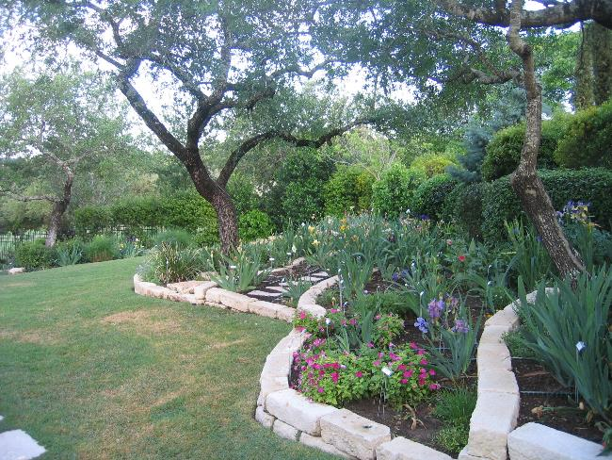
American Iris Society AIS
The American Iris Society is a nonprofit institution incorporated 1927 and exists for the sole purpose of promoting the culture and improvement of the Iris.
Visit the AIS web site at
http://www.irises.org
Austin, Texas

Slide 2
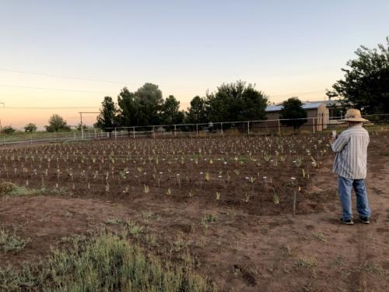
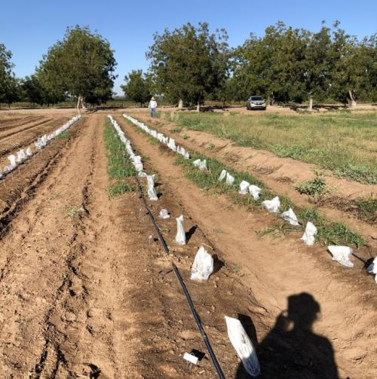
Outline
Regions
Sections
Cooperating Societies
Activities
Improving the Iris
Heirloom Preservation
Conservation of Native Irises
Providing information
Education, Library
Membership Benefits
National Conventions
Display Gardens
Official Registry for the World
Joining
Notes:
Blue J Irises, Vado, NM
Calhouns Flower Farm, Vado, NM (protecting from spraying for nut grass)

Slide 3
24 Regions
The AIS is the parent organization for 24 regional organizations in the US and Canada.
16
11
13
1
11
8
2
21
14
3
19
12
9
6
20
18
4
7
15
22
23
23
17
24
5
10
13
14
Notes:
http://www.irises.org/about-ais/regions-affiliated-societies/

Slide 4
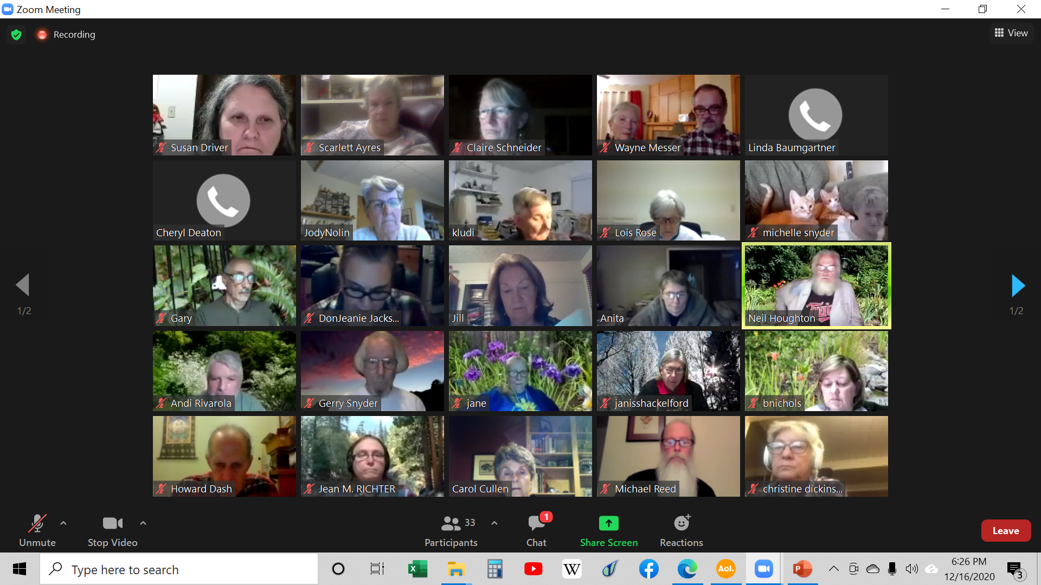
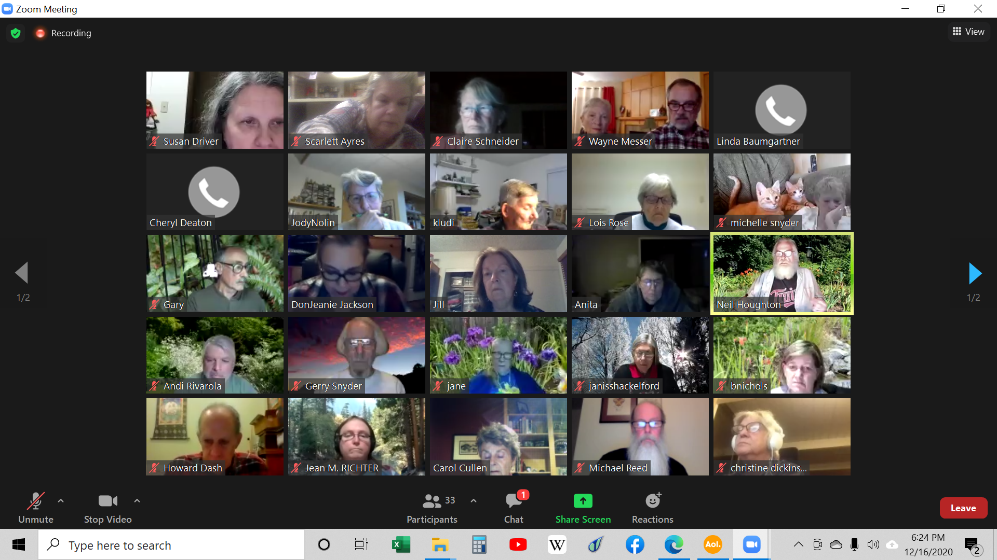
Zoom Meetings

Slide 5
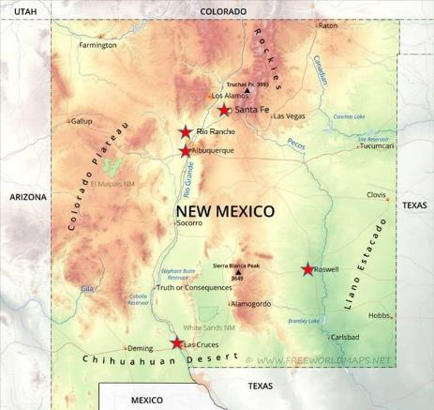
Local Iris Societies
Region 23 - New Mexico
Each regional affiliate is the parent organization of local iris societies.
Many local clubs exist in most states.
You don’t have to participate in the AIS to belong to a local club.
http://www.irises.org/about-ais/regions-affiliated-societies/

Slide 6
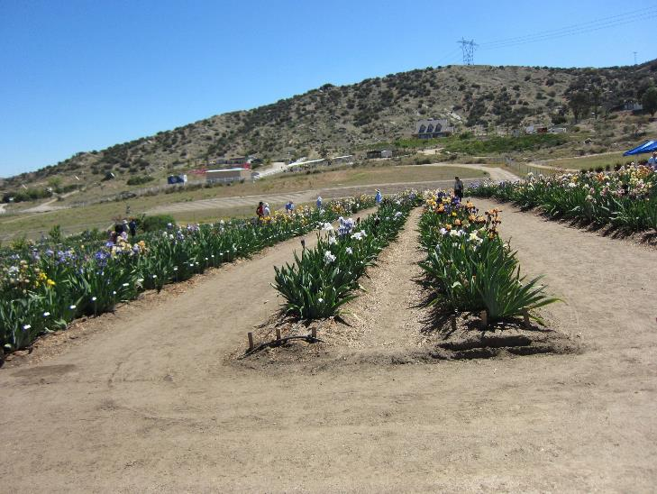
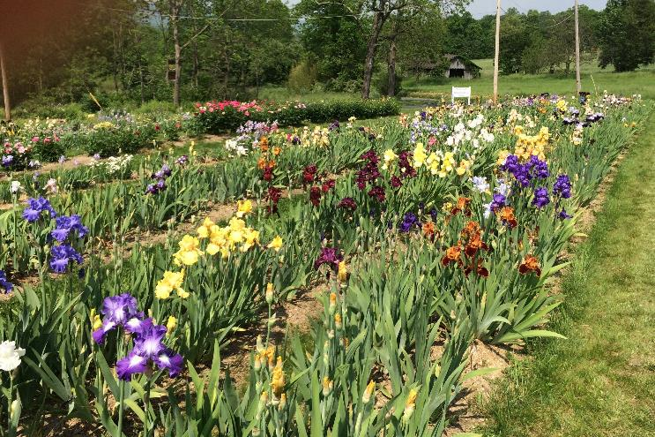
AIS Sections and Cooperating Societies
AIS Sections and AIS Cooperating Societies are special interest groups that deal with information on specific classifications of iris.
Benefits include informative newsletters with a focus on specific types of irises.
Many of these groups also hold events such as mini-conventions on an annual or semi-annual basis.
Membership in these groups is in addition to AIS membership.
Be sure to check out their Facebook pages and websites!
Mystic Lake Irises, Ontario, California
Hildenbrandt Iris Gardens, NJ

Slide 7
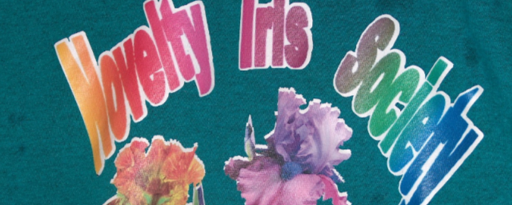
AIS Sections
AIS members interested in a particular group of irises may establish a separate organization which may be chartered by the AIS as a Section. Membership in the AIS shall be a prerequisite for all elected officers and directors.
Median Iris Society
Society for Siberian Irises
Spuria Iris Society
Society for Japanese Irises
Reblooming Iris Society
Dwarf Iris Society
Society for Pacific Coast Native Irises
Species Iris Group of North America
Historic Iris Preservation Society
Society for Louisiana Irises
Novelty Iris Society

Slide 8
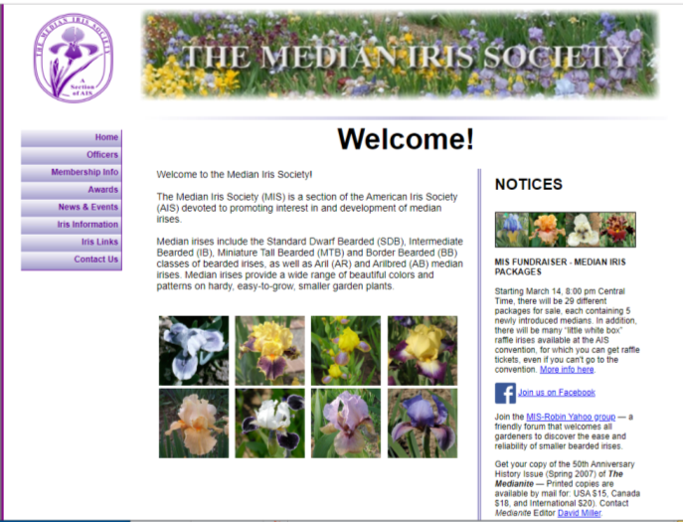
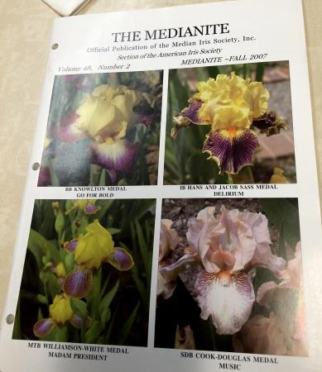
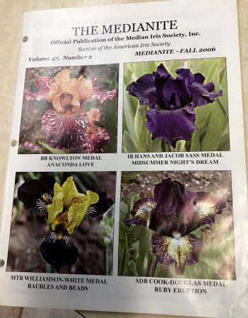
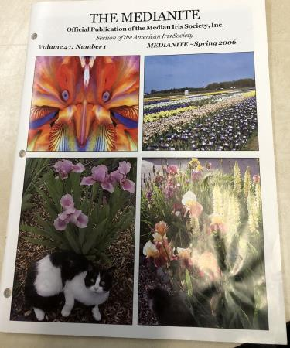
Median Iris Society
Median Iris Society (MIS) President: Hooker Nichols, email: bjnhtn@aol.com Membership: Judy Eckhoff, email: judy67543@gmail.com website: www.medianiris.com
Notes:
Others are:
Society for Siberian Irises (SSI) President: Dr. E. Roy Epperson, 1115 Delk Drive, High Point, NC 27262 e-mail: kirklee@triad.rr.com Membership: Susan Grigg, 105 Trotters Ridge Drive, Raleigh, NC 27614 e-mail: smgrigg@bellsouth.net website: www.socsib.org Society for Japanese Irises President: Jill Copeland, 78118 M40, Lawton, MI 49065 e-mail: jandjcope@aol.com Membership: Catherine Button, 70 Sharpless Blvd., Westhampton, NJ 08060 e-mail: ridingthewind@gmail.com website: www.socji.org Dwarf Iris Society President: Hugh Thurman, 521 Kickapoo Trail, Frankfort, KY 40601 Membership: Kathie Kasperek, 9130 North 5200 West, Elwood, UT 84337-8640 e-mail: zebrairis1@aol.com website: N/A Society for Pacific Coast Native Irises President: Richard C. Richards, 5885 Cowles Mt. Blvd., La Mesa, CA 91942 e-mail: mongo2u@cox.net Membership: Terry Hudson, 33450 Little Valley Road, Fort Bragg, CA 95437 e-mail: irishud@earthlink.net website: www.pacificcoastiris.org Species Iris Group of North America (SIGNA) President: Will Plotner, PO Box 250, Molalla, OR 97038-0250 e-mail: gardens@molalla.net Membership: Rodney Barton, 3 Wolters Street, Hickory Creek, TX 75065 e-mail: rbarton@hsc.unt.edu website: www.signa.org Historic Iris Preservation Society (HIPS) President: Donna James, 887 County Route 3, Hannibal, NY 13074 e-mail: ron2don@alltel.net Membership: Judy Eckhoff, 7911 South Yoder Rd., Haven, KS 67543 e-mail: judye@msinter.net website: www.hips-roots.com
Aril Society International (ASI) President: Patricia Toolan, P.O. Box 568, Angaston, S.A. 5353 Australia e-mail: pattoolan1@bigpond.com Membership: Reita Jordan, 3500 Avenida Charada Ave. NW, Albuquerque, NM 87107 e-mail: sjordan@unm.edu website: www.arilsociety.org Society for Louisiana Irises President: Paul W. Gossett, 129 East 33rd Place, Tulsa, OK 74105-2542 e-mail: pwgossett@juno.com Membership: Richard Sloan, 118 East Walnut, Alma, AR 72921 e-mail: rjsloan@mynewroads.com website: www.louisianas.org

Slide 9
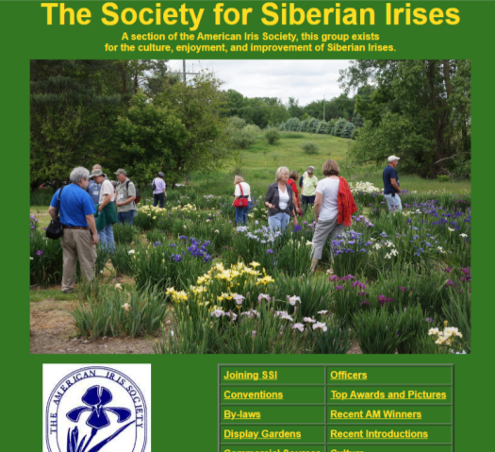
Society for Siberian Irises (SSI)
President: Patrick Spence, e-mail: Patrick@CascadiaIrisGardens.com Membership: Bob Bauer, email: ensata@aol.com website: www.siberianirises.org
Notes:
Others are:
Society for Siberian Irises (SSI) President: Dr. E. Roy Epperson, 1115 Delk Drive, High Point, NC 27262 e-mail: kirklee@triad.rr.com Membership: Susan Grigg, 105 Trotters Ridge Drive, Raleigh, NC 27614 e-mail: smgrigg@bellsouth.net website: www.socsib.org Society for Japanese Irises President: Jill Copeland, 78118 M40, Lawton, MI 49065 e-mail: jandjcope@aol.com Membership: Catherine Button, 70 Sharpless Blvd., Westhampton, NJ 08060 e-mail: ridingthewind@gmail.com website: www.socji.org Dwarf Iris Society President: Hugh Thurman, 521 Kickapoo Trail, Frankfort, KY 40601 Membership: Kathie Kasperek, 9130 North 5200 West, Elwood, UT 84337-8640 e-mail: zebrairis1@aol.com website: N/A Society for Pacific Coast Native Irises President: Richard C. Richards, 5885 Cowles Mt. Blvd., La Mesa, CA 91942 e-mail: mongo2u@cox.net Membership: Terry Hudson, 33450 Little Valley Road, Fort Bragg, CA 95437 e-mail: irishud@earthlink.net website: www.pacificcoastiris.org Species Iris Group of North America (SIGNA) President: Will Plotner, PO Box 250, Molalla, OR 97038-0250 e-mail: gardens@molalla.net Membership: Rodney Barton, 3 Wolters Street, Hickory Creek, TX 75065 e-mail: rbarton@hsc.unt.edu website: www.signa.org Historic Iris Preservation Society (HIPS) President: Donna James, 887 County Route 3, Hannibal, NY 13074 e-mail: ron2don@alltel.net Membership: Judy Eckhoff, 7911 South Yoder Rd., Haven, KS 67543 e-mail: judye@msinter.net website: www.hips-roots.com
Aril Society International (ASI) President: Patricia Toolan, P.O. Box 568, Angaston, S.A. 5353 Australia e-mail: pattoolan1@bigpond.com Membership: Reita Jordan, 3500 Avenida Charada Ave. NW, Albuquerque, NM 87107 e-mail: sjordan@unm.edu website: www.arilsociety.org Society for Louisiana Irises President: Paul W. Gossett, 129 East 33rd Place, Tulsa, OK 74105-2542 e-mail: pwgossett@juno.com Membership: Richard Sloan, 118 East Walnut, Alma, AR 72921 e-mail: rjsloan@mynewroads.com website: www.louisianas.org

Slide 10
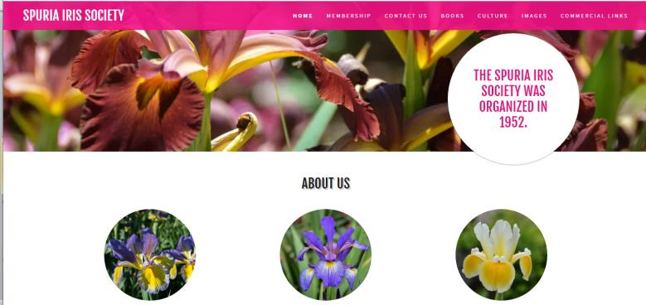
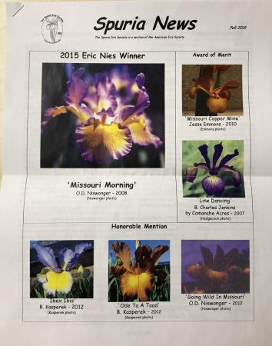
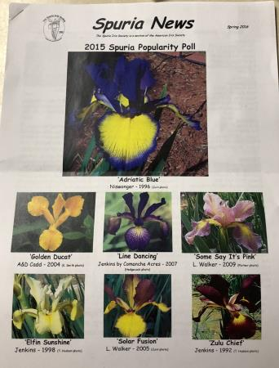
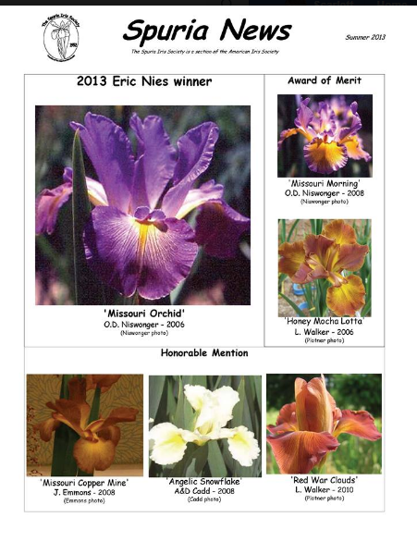
Spuria Iris Society
President: Andi Rivarola, email: andinsky@gmail.com Membership:Cheryl Deaton, email: Region15kids@hotmail.com website:www.spuriairissociety.org
Notes:
Others are:
Society for Siberian Irises (SSI) President: Dr. E. Roy Epperson, 1115 Delk Drive, High Point, NC 27262 e-mail: kirklee@triad.rr.com Membership: Susan Grigg, 105 Trotters Ridge Drive, Raleigh, NC 27614 e-mail: smgrigg@bellsouth.net website: www.socsib.org Society for Japanese Irises President: Jill Copeland, 78118 M40, Lawton, MI 49065 e-mail: jandjcope@aol.com Membership: Catherine Button, 70 Sharpless Blvd., Westhampton, NJ 08060 e-mail: ridingthewind@gmail.com website: www.socji.org Dwarf Iris Society President: Hugh Thurman, 521 Kickapoo Trail, Frankfort, KY 40601 Membership: Kathie Kasperek, 9130 North 5200 West, Elwood, UT 84337-8640 e-mail: zebrairis1@aol.com website: N/A Society for Pacific Coast Native Irises President: Richard C. Richards, 5885 Cowles Mt. Blvd., La Mesa, CA 91942 e-mail: mongo2u@cox.net Membership: Terry Hudson, 33450 Little Valley Road, Fort Bragg, CA 95437 e-mail: irishud@earthlink.net website: www.pacificcoastiris.org Species Iris Group of North America (SIGNA) President: Will Plotner, PO Box 250, Molalla, OR 97038-0250 e-mail: gardens@molalla.net Membership: Rodney Barton, 3 Wolters Street, Hickory Creek, TX 75065 e-mail: rbarton@hsc.unt.edu website: www.signa.org Historic Iris Preservation Society (HIPS) President: Donna James, 887 County Route 3, Hannibal, NY 13074 e-mail: ron2don@alltel.net Membership: Judy Eckhoff, 7911 South Yoder Rd., Haven, KS 67543 e-mail: judye@msinter.net website: www.hips-roots.com
Aril Society International (ASI) President: Patricia Toolan, P.O. Box 568, Angaston, S.A. 5353 Australia e-mail: pattoolan1@bigpond.com Membership: Reita Jordan, 3500 Avenida Charada Ave. NW, Albuquerque, NM 87107 e-mail: sjordan@unm.edu website: www.arilsociety.org Society for Louisiana Irises President: Paul W. Gossett, 129 East 33rd Place, Tulsa, OK 74105-2542 e-mail: pwgossett@juno.com Membership: Richard Sloan, 118 East Walnut, Alma, AR 72921 e-mail: rjsloan@mynewroads.com website: www.louisianas.org

Slide 11
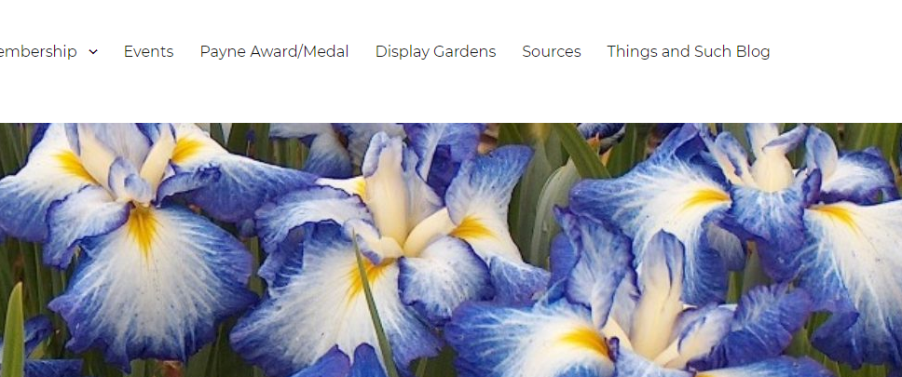
Society for Japanese Irises
President: Patrick Spence, email: patrick@cascadiairisgardens.com Membership: Jody Nolin, email: jody.nolin@gmail.com website: www.socji.org
Notes:
Others are:
Society for Siberian Irises (SSI) President: Dr. E. Roy Epperson, 1115 Delk Drive, High Point, NC 27262 e-mail: kirklee@triad.rr.com Membership: Susan Grigg, 105 Trotters Ridge Drive, Raleigh, NC 27614 e-mail: smgrigg@bellsouth.net website: www.socsib.org Society for Japanese Irises President: Jill Copeland, 78118 M40, Lawton, MI 49065 e-mail: jandjcope@aol.com Membership: Catherine Button, 70 Sharpless Blvd., Westhampton, NJ 08060 e-mail: ridingthewind@gmail.com website: www.socji.org Dwarf Iris Society President: Hugh Thurman, 521 Kickapoo Trail, Frankfort, KY 40601 Membership: Kathie Kasperek, 9130 North 5200 West, Elwood, UT 84337-8640 e-mail: zebrairis1@aol.com website: N/A Society for Pacific Coast Native Irises President: Richard C. Richards, 5885 Cowles Mt. Blvd., La Mesa, CA 91942 e-mail: mongo2u@cox.net Membership: Terry Hudson, 33450 Little Valley Road, Fort Bragg, CA 95437 e-mail: irishud@earthlink.net website: www.pacificcoastiris.org Species Iris Group of North America (SIGNA) President: Will Plotner, PO Box 250, Molalla, OR 97038-0250 e-mail: gardens@molalla.net Membership: Rodney Barton, 3 Wolters Street, Hickory Creek, TX 75065 e-mail: rbarton@hsc.unt.edu website: www.signa.org Historic Iris Preservation Society (HIPS) President: Donna James, 887 County Route 3, Hannibal, NY 13074 e-mail: ron2don@alltel.net Membership: Judy Eckhoff, 7911 South Yoder Rd., Haven, KS 67543 e-mail: judye@msinter.net website: www.hips-roots.com
Aril Society International (ASI) President: Patricia Toolan, P.O. Box 568, Angaston, S.A. 5353 Australia e-mail: pattoolan1@bigpond.com Membership: Reita Jordan, 3500 Avenida Charada Ave. NW, Albuquerque, NM 87107 e-mail: sjordan@unm.edu website: www.arilsociety.org Society for Louisiana Irises President: Paul W. Gossett, 129 East 33rd Place, Tulsa, OK 74105-2542 e-mail: pwgossett@juno.com Membership: Richard Sloan, 118 East Walnut, Alma, AR 72921 e-mail: rjsloan@mynewroads.com website: www.louisianas.org

Slide 12
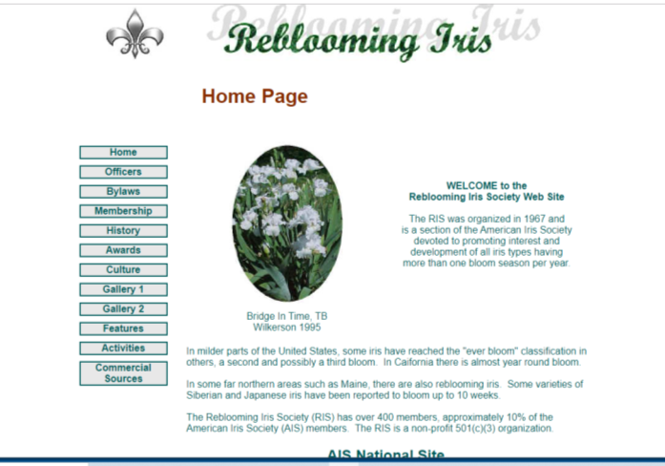
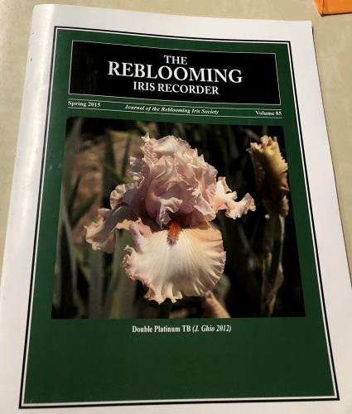
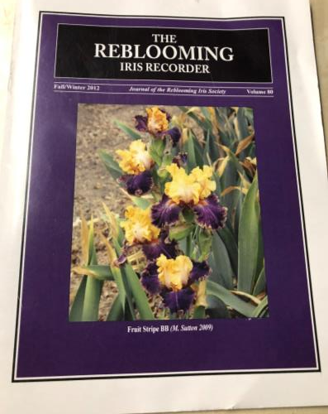
Reblooming Iris Society
President: Riley Probst
e-mail: rprobst02@earthlink.net Membership: Rose Kinnard, email: rkinnard@minesmo.org website: www.rebloomingiris.com
Notes:
Others are:
Society for Siberian Irises (SSI) President: Dr. E. Roy Epperson, 1115 Delk Drive, High Point, NC 27262 e-mail: kirklee@triad.rr.com Membership: Susan Grigg, 105 Trotters Ridge Drive, Raleigh, NC 27614 e-mail: smgrigg@bellsouth.net website: www.socsib.org Society for Japanese Irises President: Jill Copeland, 78118 M40, Lawton, MI 49065 e-mail: jandjcope@aol.com Membership: Catherine Button, 70 Sharpless Blvd., Westhampton, NJ 08060 e-mail: ridingthewind@gmail.com website: www.socji.org Dwarf Iris Society President: Hugh Thurman, 521 Kickapoo Trail, Frankfort, KY 40601 Membership: Kathie Kasperek, 9130 North 5200 West, Elwood, UT 84337-8640 e-mail: zebrairis1@aol.com website: N/A Society for Pacific Coast Native Irises President: Richard C. Richards, 5885 Cowles Mt. Blvd., La Mesa, CA 91942 e-mail: mongo2u@cox.net Membership: Terry Hudson, 33450 Little Valley Road, Fort Bragg, CA 95437 e-mail: irishud@earthlink.net website: www.pacificcoastiris.org Species Iris Group of North America (SIGNA) President: Will Plotner, PO Box 250, Molalla, OR 97038-0250 e-mail: gardens@molalla.net Membership: Rodney Barton, 3 Wolters Street, Hickory Creek, TX 75065 e-mail: rbarton@hsc.unt.edu website: www.signa.org Historic Iris Preservation Society (HIPS) President: Donna James, 887 County Route 3, Hannibal, NY 13074 e-mail: ron2don@alltel.net Membership: Judy Eckhoff, 7911 South Yoder Rd., Haven, KS 67543 e-mail: judye@msinter.net website: www.hips-roots.com
Aril Society International (ASI) President: Patricia Toolan, P.O. Box 568, Angaston, S.A. 5353 Australia e-mail: pattoolan1@bigpond.com Membership: Reita Jordan, 3500 Avenida Charada Ave. NW, Albuquerque, NM 87107 e-mail: sjordan@unm.edu website: www.arilsociety.org Society for Louisiana Irises President: Paul W. Gossett, 129 East 33rd Place, Tulsa, OK 74105-2542 e-mail: pwgossett@juno.com Membership: Richard Sloan, 118 East Walnut, Alma, AR 72921 e-mail: rjsloan@mynewroads.com website: www.louisianas.org

Slide 13
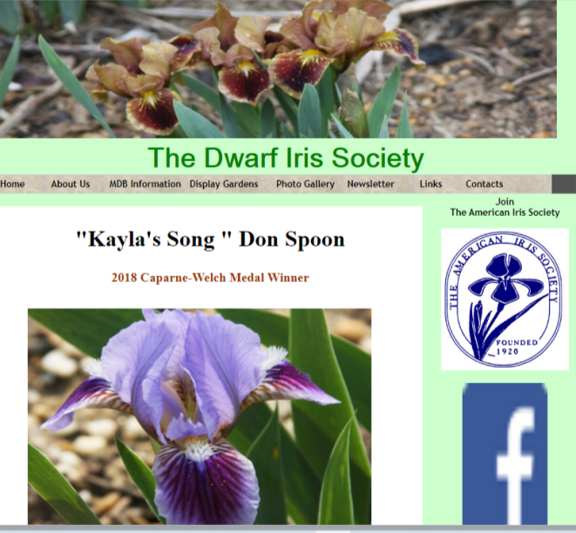
Dwarf Iris Society
President: Bob Pries, email: robertpries@embarqmail.com Membership: Dave and Debra Miller, email: miller42@aol.com website:www.dwarfiris.org
Notes:
Others are:
Society for Siberian Irises (SSI) President: Dr. E. Roy Epperson, 1115 Delk Drive, High Point, NC 27262 e-mail: kirklee@triad.rr.com Membership: Susan Grigg, 105 Trotters Ridge Drive, Raleigh, NC 27614 e-mail: smgrigg@bellsouth.net website: www.socsib.org Society for Japanese Irises President: Jill Copeland, 78118 M40, Lawton, MI 49065 e-mail: jandjcope@aol.com Membership: Catherine Button, 70 Sharpless Blvd., Westhampton, NJ 08060 e-mail: ridingthewind@gmail.com website: www.socji.org Dwarf Iris Society President: Hugh Thurman, 521 Kickapoo Trail, Frankfort, KY 40601 Membership: Kathie Kasperek, 9130 North 5200 West, Elwood, UT 84337-8640 e-mail: zebrairis1@aol.com website: N/A Society for Pacific Coast Native Irises President: Richard C. Richards, 5885 Cowles Mt. Blvd., La Mesa, CA 91942 e-mail: mongo2u@cox.net Membership: Terry Hudson, 33450 Little Valley Road, Fort Bragg, CA 95437 e-mail: irishud@earthlink.net website: www.pacificcoastiris.org Species Iris Group of North America (SIGNA) President: Will Plotner, PO Box 250, Molalla, OR 97038-0250 e-mail: gardens@molalla.net Membership: Rodney Barton, 3 Wolters Street, Hickory Creek, TX 75065 e-mail: rbarton@hsc.unt.edu website: www.signa.org Historic Iris Preservation Society (HIPS) President: Donna James, 887 County Route 3, Hannibal, NY 13074 e-mail: ron2don@alltel.net Membership: Judy Eckhoff, 7911 South Yoder Rd., Haven, KS 67543 e-mail: judye@msinter.net website: www.hips-roots.com
Aril Society International (ASI) President: Patricia Toolan, P.O. Box 568, Angaston, S.A. 5353 Australia e-mail: pattoolan1@bigpond.com Membership: Reita Jordan, 3500 Avenida Charada Ave. NW, Albuquerque, NM 87107 e-mail: sjordan@unm.edu website: www.arilsociety.org Society for Louisiana Irises President: Paul W. Gossett, 129 East 33rd Place, Tulsa, OK 74105-2542 e-mail: pwgossett@juno.com Membership: Richard Sloan, 118 East Walnut, Alma, AR 72921 e-mail: rjsloan@mynewroads.com website: www.louisianas.org

Slide 14
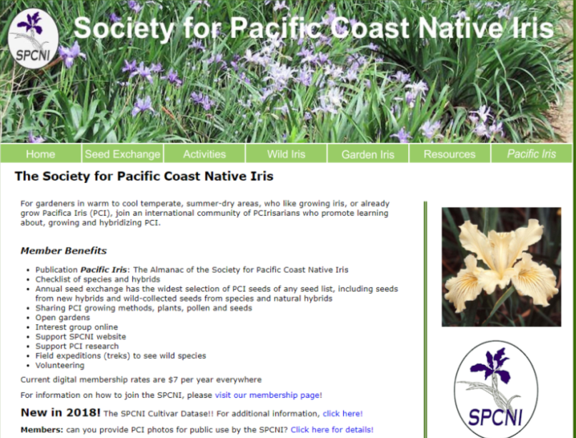
Society for Pacific Coast Native Irises (SPCNI)
President: Bob Sussman, email: matilija@gte.net Membership: Kathleen Sayce, email: ksayce@willapabay.org website: www.pacificcoastiris.org
Notes:
Others are:
Society for Siberian Irises (SSI) President: Dr. E. Roy Epperson, 1115 Delk Drive, High Point, NC 27262 e-mail: kirklee@triad.rr.com Membership: Susan Grigg, 105 Trotters Ridge Drive, Raleigh, NC 27614 e-mail: smgrigg@bellsouth.net website: www.socsib.org Society for Japanese Irises President: Jill Copeland, 78118 M40, Lawton, MI 49065 e-mail: jandjcope@aol.com Membership: Catherine Button, 70 Sharpless Blvd., Westhampton, NJ 08060 e-mail: ridingthewind@gmail.com website: www.socji.org Dwarf Iris Society President: Hugh Thurman, 521 Kickapoo Trail, Frankfort, KY 40601 Membership: Kathie Kasperek, 9130 North 5200 West, Elwood, UT 84337-8640 e-mail: zebrairis1@aol.com website: N/A Society for Pacific Coast Native Irises President: Richard C. Richards, 5885 Cowles Mt. Blvd., La Mesa, CA 91942 e-mail: mongo2u@cox.net Membership: Terry Hudson, 33450 Little Valley Road, Fort Bragg, CA 95437 e-mail: irishud@earthlink.net website: www.pacificcoastiris.org Species Iris Group of North America (SIGNA) President: Will Plotner, PO Box 250, Molalla, OR 97038-0250 e-mail: gardens@molalla.net Membership: Rodney Barton, 3 Wolters Street, Hickory Creek, TX 75065 e-mail: rbarton@hsc.unt.edu website: www.signa.org Historic Iris Preservation Society (HIPS) President: Donna James, 887 County Route 3, Hannibal, NY 13074 e-mail: ron2don@alltel.net Membership: Judy Eckhoff, 7911 South Yoder Rd., Haven, KS 67543 e-mail: judye@msinter.net website: www.hips-roots.com
Aril Society International (ASI) President: Patricia Toolan, P.O. Box 568, Angaston, S.A. 5353 Australia e-mail: pattoolan1@bigpond.com Membership: Reita Jordan, 3500 Avenida Charada Ave. NW, Albuquerque, NM 87107 e-mail: sjordan@unm.edu website: www.arilsociety.org Society for Louisiana Irises President: Paul W. Gossett, 129 East 33rd Place, Tulsa, OK 74105-2542 e-mail: pwgossett@juno.com Membership: Richard Sloan, 118 East Walnut, Alma, AR 72921 e-mail: rjsloan@mynewroads.com website: www.louisianas.org

Slide 15
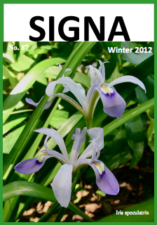
Species Iris Group of North America (SIGNA)
President: Will Plotner, email: gardens@molalla.net Membership: Rodney Barton, email: rbartontx@yahoo.com website: www.signa.org
Notes:
Others are:
Society for Siberian Irises (SSI) President: Dr. E. Roy Epperson, 1115 Delk Drive, High Point, NC 27262 e-mail: kirklee@triad.rr.com Membership: Susan Grigg, 105 Trotters Ridge Drive, Raleigh, NC 27614 e-mail: smgrigg@bellsouth.net website: www.socsib.org Society for Japanese Irises President: Jill Copeland, 78118 M40, Lawton, MI 49065 e-mail: jandjcope@aol.com Membership: Catherine Button, 70 Sharpless Blvd., Westhampton, NJ 08060 e-mail: ridingthewind@gmail.com website: www.socji.org Dwarf Iris Society President: Hugh Thurman, 521 Kickapoo Trail, Frankfort, KY 40601 Membership: Kathie Kasperek, 9130 North 5200 West, Elwood, UT 84337-8640 e-mail: zebrairis1@aol.com website: N/A Society for Pacific Coast Native Irises President: Richard C. Richards, 5885 Cowles Mt. Blvd., La Mesa, CA 91942 e-mail: mongo2u@cox.net Membership: Terry Hudson, 33450 Little Valley Road, Fort Bragg, CA 95437 e-mail: irishud@earthlink.net website: www.pacificcoastiris.org Species Iris Group of North America (SIGNA) President: Will Plotner, PO Box 250, Molalla, OR 97038-0250 e-mail: gardens@molalla.net Membership: Rodney Barton, 3 Wolters Street, Hickory Creek, TX 75065 e-mail: rbarton@hsc.unt.edu website: www.signa.org Historic Iris Preservation Society (HIPS) President: Donna James, 887 County Route 3, Hannibal, NY 13074 e-mail: ron2don@alltel.net Membership: Judy Eckhoff, 7911 South Yoder Rd., Haven, KS 67543 e-mail: judye@msinter.net website: www.hips-roots.com
Aril Society International (ASI) President: Patricia Toolan, P.O. Box 568, Angaston, S.A. 5353 Australia e-mail: pattoolan1@bigpond.com Membership: Reita Jordan, 3500 Avenida Charada Ave. NW, Albuquerque, NM 87107 e-mail: sjordan@unm.edu website: www.arilsociety.org Society for Louisiana Irises President: Paul W. Gossett, 129 East 33rd Place, Tulsa, OK 74105-2542 e-mail: pwgossett@juno.com Membership: Richard Sloan, 118 East Walnut, Alma, AR 72921 e-mail: rjsloan@mynewroads.com website: www.louisianas.org

Slide 16
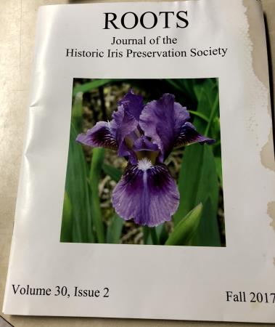
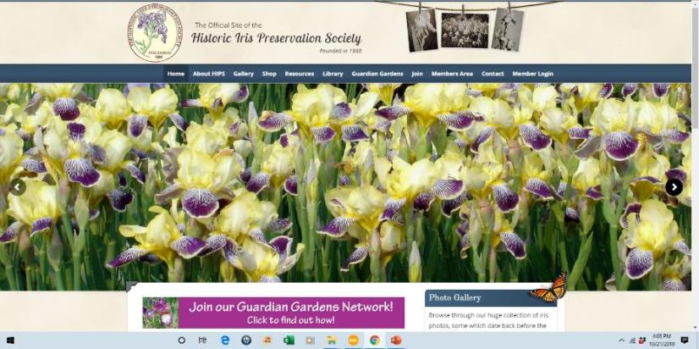
Historic Iris Preservation Society (HIPS)
President: Cathy Egerer, PO Box 456, Grand Marais, MI 49839 phone: 989-513-2614 | e-mail: plover12@gmail.com Membership: Judy Eckhoff, 7911 South Yoder Rd., Haven, KS 67543 email: judy67543@gmail.com website: http://www.historiciris.org
Notes:
Others are:
Society for Siberian Irises (SSI) President: Dr. E. Roy Epperson, 1115 Delk Drive, High Point, NC 27262 e-mail: kirklee@triad.rr.com Membership: Susan Grigg, 105 Trotters Ridge Drive, Raleigh, NC 27614 e-mail: smgrigg@bellsouth.net website: www.socsib.org Society for Japanese Irises President: Jill Copeland, 78118 M40, Lawton, MI 49065 e-mail: jandjcope@aol.com Membership: Catherine Button, 70 Sharpless Blvd., Westhampton, NJ 08060 e-mail: ridingthewind@gmail.com website: www.socji.org Dwarf Iris Society President: Hugh Thurman, 521 Kickapoo Trail, Frankfort, KY 40601 Membership: Kathie Kasperek, 9130 North 5200 West, Elwood, UT 84337-8640 e-mail: zebrairis1@aol.com website: N/A Society for Pacific Coast Native Irises President: Richard C. Richards, 5885 Cowles Mt. Blvd., La Mesa, CA 91942 e-mail: mongo2u@cox.net Membership: Terry Hudson, 33450 Little Valley Road, Fort Bragg, CA 95437 e-mail: irishud@earthlink.net website: www.pacificcoastiris.org Species Iris Group of North America (SIGNA) President: Will Plotner, PO Box 250, Molalla, OR 97038-0250 e-mail: gardens@molalla.net Membership: Rodney Barton, 3 Wolters Street, Hickory Creek, TX 75065 e-mail: rbarton@hsc.unt.edu website: www.signa.org Historic Iris Preservation Society (HIPS) President: Donna James, 887 County Route 3, Hannibal, NY 13074 e-mail: ron2don@alltel.net Membership: Judy Eckhoff, 7911 South Yoder Rd., Haven, KS 67543 e-mail: judye@msinter.net website: www.hips-roots.com
Aril Society International (ASI) President: Patricia Toolan, P.O. Box 568, Angaston, S.A. 5353 Australia e-mail: pattoolan1@bigpond.com Membership: Reita Jordan, 3500 Avenida Charada Ave. NW, Albuquerque, NM 87107 e-mail: sjordan@unm.edu website: www.arilsociety.org Society for Louisiana Irises President: Paul W. Gossett, 129 East 33rd Place, Tulsa, OK 74105-2542 e-mail: pwgossett@juno.com Membership: Richard Sloan, 118 East Walnut, Alma, AR 72921 e-mail: rjsloan@mynewroads.com website: www.louisianas.org

Slide 17
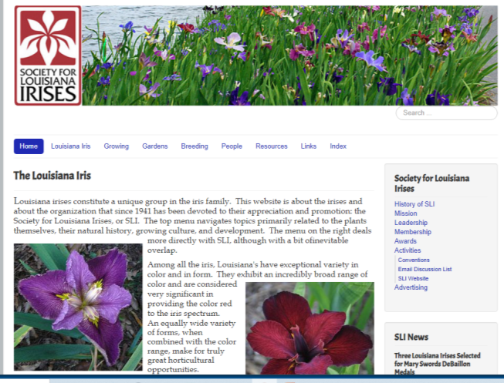
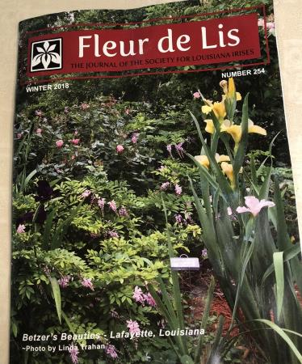
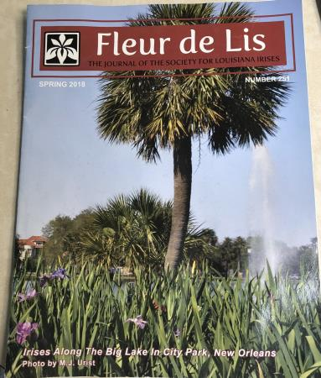
Society for Louisiana Irises (SLI)
President: Robert Treadway, phone:(870) 854-456 | email: robertt01@earthlink.net Membership: Ron Killingsworth, website: www.louisianas.org
Notes:
Others are:
Society for Siberian Irises (SSI) President: Dr. E. Roy Epperson, 1115 Delk Drive, High Point, NC 27262 e-mail: kirklee@triad.rr.com Membership: Susan Grigg, 105 Trotters Ridge Drive, Raleigh, NC 27614 e-mail: smgrigg@bellsouth.net website: www.socsib.org Society for Japanese Irises President: Jill Copeland, 78118 M40, Lawton, MI 49065 e-mail: jandjcope@aol.com Membership: Catherine Button, 70 Sharpless Blvd., Westhampton, NJ 08060 e-mail: ridingthewind@gmail.com website: www.socji.org Dwarf Iris Society President: Hugh Thurman, 521 Kickapoo Trail, Frankfort, KY 40601 Membership: Kathie Kasperek, 9130 North 5200 West, Elwood, UT 84337-8640 e-mail: zebrairis1@aol.com website: N/A Society for Pacific Coast Native Irises President: Richard C. Richards, 5885 Cowles Mt. Blvd., La Mesa, CA 91942 e-mail: mongo2u@cox.net Membership: Terry Hudson, 33450 Little Valley Road, Fort Bragg, CA 95437 e-mail: irishud@earthlink.net website: www.pacificcoastiris.org Species Iris Group of North America (SIGNA) President: Will Plotner, PO Box 250, Molalla, OR 97038-0250 e-mail: gardens@molalla.net Membership: Rodney Barton, 3 Wolters Street, Hickory Creek, TX 75065 e-mail: rbarton@hsc.unt.edu website: www.signa.org Historic Iris Preservation Society (HIPS) President: Donna James, 887 County Route 3, Hannibal, NY 13074 e-mail: ron2don@alltel.net Membership: Judy Eckhoff, 7911 South Yoder Rd., Haven, KS 67543 e-mail: judye@msinter.net website: www.hips-roots.com
Aril Society International (ASI) President: Patricia Toolan, P.O. Box 568, Angaston, S.A. 5353 Australia e-mail: pattoolan1@bigpond.com Membership: Reita Jordan, 3500 Avenida Charada Ave. NW, Albuquerque, NM 87107 e-mail: sjordan@unm.edu website: www.arilsociety.org Society for Louisiana Irises President: Paul W. Gossett, 129 East 33rd Place, Tulsa, OK 74105-2542 e-mail: pwgossett@juno.com Membership: Richard Sloan, 118 East Walnut, Alma, AR 72921 e-mail: rjsloan@mynewroads.com website: www.louisianas.org

Slide 18
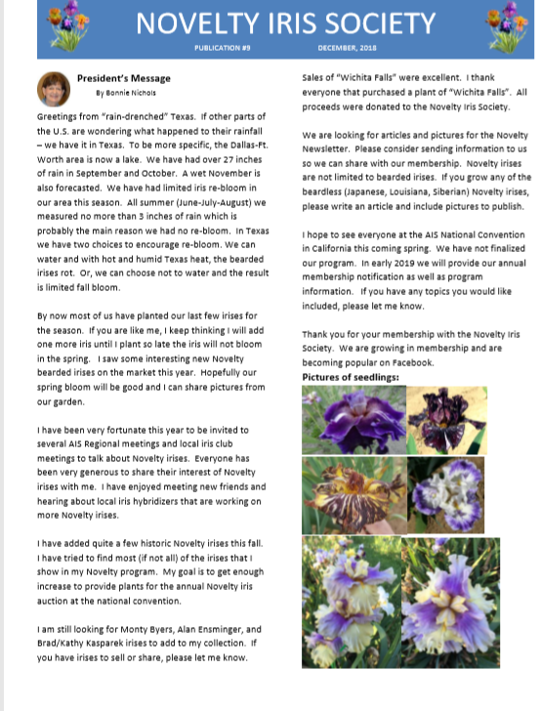
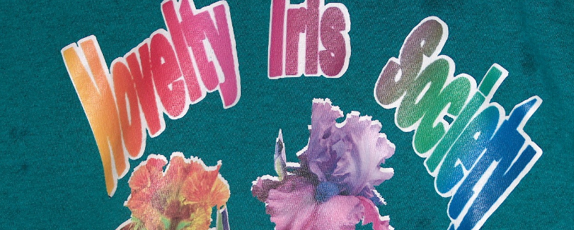
Novelty Iris Society
President: Bonnie Nichols, email: bjnhtn@aol.com Membership: Kathy Wade, email: nisnewsletter@yahoo.com
Notes:
Others are:
Society for Siberian Irises (SSI) President: Dr. E. Roy Epperson, 1115 Delk Drive, High Point, NC 27262 e-mail: kirklee@triad.rr.com Membership: Susan Grigg, 105 Trotters Ridge Drive, Raleigh, NC 27614 e-mail: smgrigg@bellsouth.net website: www.socsib.org Society for Japanese Irises President: Jill Copeland, 78118 M40, Lawton, MI 49065 e-mail: jandjcope@aol.com Membership: Catherine Button, 70 Sharpless Blvd., Westhampton, NJ 08060 e-mail: ridingthewind@gmail.com website: www.socji.org Dwarf Iris Society President: Hugh Thurman, 521 Kickapoo Trail, Frankfort, KY 40601 Membership: Kathie Kasperek, 9130 North 5200 West, Elwood, UT 84337-8640 e-mail: zebrairis1@aol.com website: N/A Society for Pacific Coast Native Irises President: Richard C. Richards, 5885 Cowles Mt. Blvd., La Mesa, CA 91942 e-mail: mongo2u@cox.net Membership: Terry Hudson, 33450 Little Valley Road, Fort Bragg, CA 95437 e-mail: irishud@earthlink.net website: www.pacificcoastiris.org Species Iris Group of North America (SIGNA) President: Will Plotner, PO Box 250, Molalla, OR 97038-0250 e-mail: gardens@molalla.net Membership: Rodney Barton, 3 Wolters Street, Hickory Creek, TX 75065 e-mail: rbarton@hsc.unt.edu website: www.signa.org Historic Iris Preservation Society (HIPS) President: Donna James, 887 County Route 3, Hannibal, NY 13074 e-mail: ron2don@alltel.net Membership: Judy Eckhoff, 7911 South Yoder Rd., Haven, KS 67543 e-mail: judye@msinter.net website: www.hips-roots.com
Aril Society International (ASI) President: Patricia Toolan, P.O. Box 568, Angaston, S.A. 5353 Australia e-mail: pattoolan1@bigpond.com Membership: Reita Jordan, 3500 Avenida Charada Ave. NW, Albuquerque, NM 87107 e-mail: sjordan@unm.edu website: www.arilsociety.org Society for Louisiana Irises President: Paul W. Gossett, 129 East 33rd Place, Tulsa, OK 74105-2542 e-mail: pwgossett@juno.com Membership: Richard Sloan, 118 East Walnut, Alma, AR 72921 e-mail: rjsloan@mynewroads.com website: www.louisianas.org

Slide 19
Cooperating Societies
Established national or international organizations whose primary purposes are consistent with those of the AIS, may be recognized as Cooperating Societies of the AIS.
Aril Society International
Tall Bearded Iris Society

Slide 20
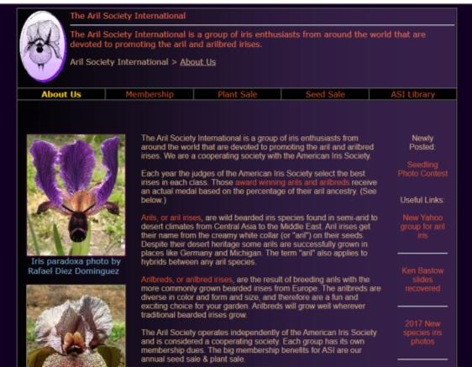
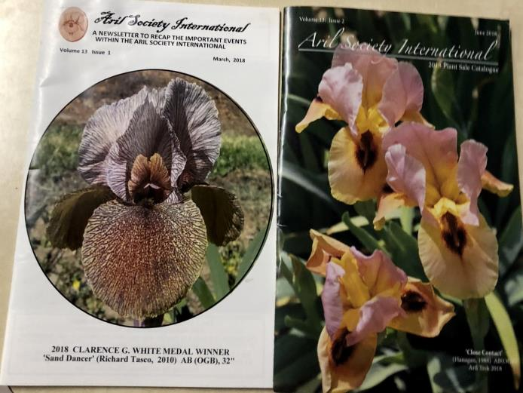
Aril Society International (ASI)
President: Howie Dash, email: howie@aol.com Membership: Dell Perry, email: seandelirises@yahoo.com
website: www.arilsociety.org
Notes:
Others are:
Society for Siberian Irises (SSI) President: Dr. E. Roy Epperson, 1115 Delk Drive, High Point, NC 27262 e-mail: kirklee@triad.rr.com Membership: Susan Grigg, 105 Trotters Ridge Drive, Raleigh, NC 27614 e-mail: smgrigg@bellsouth.net website: www.socsib.org Society for Japanese Irises President: Jill Copeland, 78118 M40, Lawton, MI 49065 e-mail: jandjcope@aol.com Membership: Catherine Button, 70 Sharpless Blvd., Westhampton, NJ 08060 e-mail: ridingthewind@gmail.com website: www.socji.org Dwarf Iris Society President: Hugh Thurman, 521 Kickapoo Trail, Frankfort, KY 40601 Membership: Kathie Kasperek, 9130 North 5200 West, Elwood, UT 84337-8640 e-mail: zebrairis1@aol.com website: N/A Society for Pacific Coast Native Irises President: Richard C. Richards, 5885 Cowles Mt. Blvd., La Mesa, CA 91942 e-mail: mongo2u@cox.net Membership: Terry Hudson, 33450 Little Valley Road, Fort Bragg, CA 95437 e-mail: irishud@earthlink.net website: www.pacificcoastiris.org Species Iris Group of North America (SIGNA) President: Will Plotner, PO Box 250, Molalla, OR 97038-0250 e-mail: gardens@molalla.net Membership: Rodney Barton, 3 Wolters Street, Hickory Creek, TX 75065 e-mail: rbarton@hsc.unt.edu website: www.signa.org Historic Iris Preservation Society (HIPS) President: Donna James, 887 County Route 3, Hannibal, NY 13074 e-mail: ron2don@alltel.net Membership: Judy Eckhoff, 7911 South Yoder Rd., Haven, KS 67543 e-mail: judye@msinter.net website: www.hips-roots.com
Aril Society International (ASI) President: Patricia Toolan, P.O. Box 568, Angaston, S.A. 5353 Australia e-mail: pattoolan1@bigpond.com Membership: Reita Jordan, 3500 Avenida Charada Ave. NW, Albuquerque, NM 87107 e-mail: sjordan@unm.edu website: www.arilsociety.org Society for Louisiana Irises President: Paul W. Gossett, 129 East 33rd Place, Tulsa, OK 74105-2542 e-mail: pwgossett@juno.com Membership: Richard Sloan, 118 East Walnut, Alma, AR 72921 e-mail: rjsloan@mynewroads.com website: www.louisianas.org

Slide 21
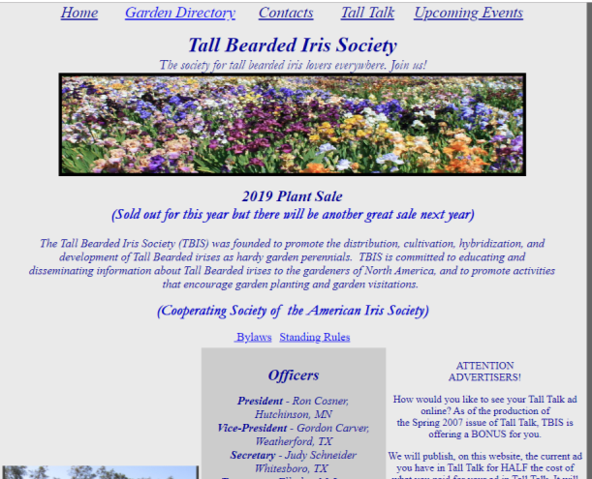
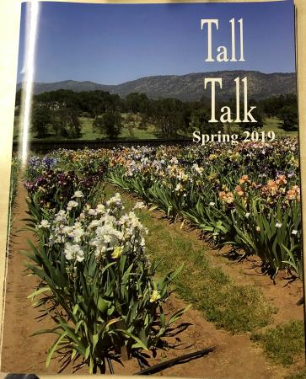
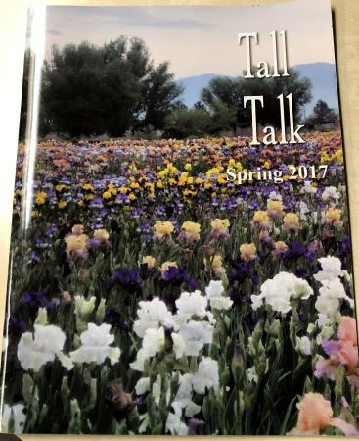
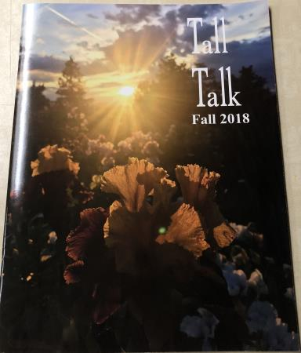
Tall Bearded Iris Society (TBIS)
President: Ron Cosner, e-mail: keighley15@msn.com Membership: Phyllis Wilburn, email: abirder@aol.com website: www.tbisonline.com
Notes:
Others are:
Society for Siberian Irises (SSI) President: Dr. E. Roy Epperson, 1115 Delk Drive, High Point, NC 27262 e-mail: kirklee@triad.rr.com Membership: Susan Grigg, 105 Trotters Ridge Drive, Raleigh, NC 27614 e-mail: smgrigg@bellsouth.net website: www.socsib.org Society for Japanese Irises President: Jill Copeland, 78118 M40, Lawton, MI 49065 e-mail: jandjcope@aol.com Membership: Catherine Button, 70 Sharpless Blvd., Westhampton, NJ 08060 e-mail: ridingthewind@gmail.com website: www.socji.org Dwarf Iris Society President: Hugh Thurman, 521 Kickapoo Trail, Frankfort, KY 40601 Membership: Kathie Kasperek, 9130 North 5200 West, Elwood, UT 84337-8640 e-mail: zebrairis1@aol.com website: N/A Society for Pacific Coast Native Irises President: Richard C. Richards, 5885 Cowles Mt. Blvd., La Mesa, CA 91942 e-mail: mongo2u@cox.net Membership: Terry Hudson, 33450 Little Valley Road, Fort Bragg, CA 95437 e-mail: irishud@earthlink.net website: www.pacificcoastiris.org Species Iris Group of North America (SIGNA) President: Will Plotner, PO Box 250, Molalla, OR 97038-0250 e-mail: gardens@molalla.net Membership: Rodney Barton, 3 Wolters Street, Hickory Creek, TX 75065 e-mail: rbarton@hsc.unt.edu website: www.signa.org Historic Iris Preservation Society (HIPS) President: Donna James, 887 County Route 3, Hannibal, NY 13074 e-mail: ron2don@alltel.net Membership: Judy Eckhoff, 7911 South Yoder Rd., Haven, KS 67543 e-mail: judye@msinter.net website: www.hips-roots.com
Aril Society International (ASI) President: Patricia Toolan, P.O. Box 568, Angaston, S.A. 5353 Australia e-mail: pattoolan1@bigpond.com Membership: Reita Jordan, 3500 Avenida Charada Ave. NW, Albuquerque, NM 87107 e-mail: sjordan@unm.edu website: www.arilsociety.org Society for Louisiana Irises President: Paul W. Gossett, 129 East 33rd Place, Tulsa, OK 74105-2542 e-mail: pwgossett@juno.com Membership: Richard Sloan, 118 East Walnut, Alma, AR 72921 e-mail: rjsloan@mynewroads.com website: www.louisianas.org

Slide 22
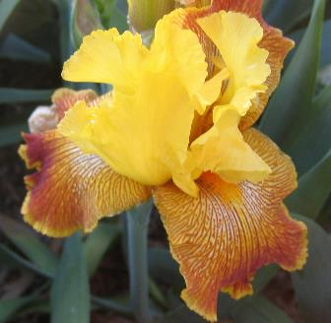
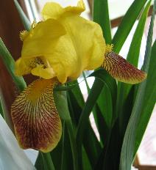
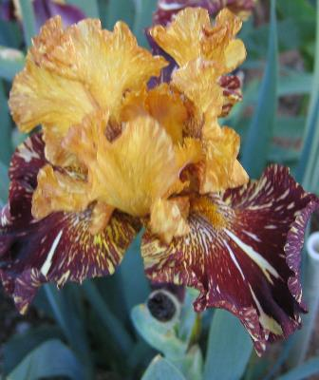
AIS Activities
1981
Improving the Iris
Form
Substance
Color
Size
New Features
Quantity of Blooms
Resistance to diseases
Resistance to insects
1840
Bengal Tiger, Maryott
1996
Honorabile, Barr
Spiced Tiger, Kasperek

Slide 23
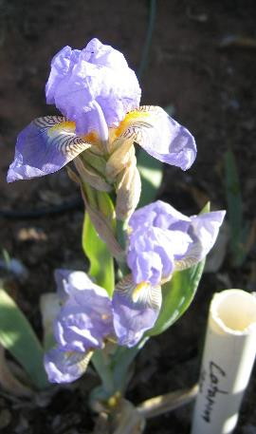
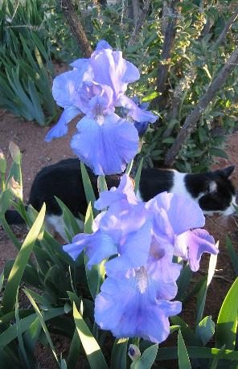
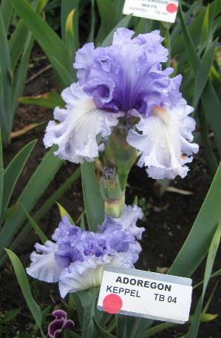
Changes Over The Years
1909
1977
2004
Victorian Falls,
Schreiners
Catarina, Foster

Slide 24
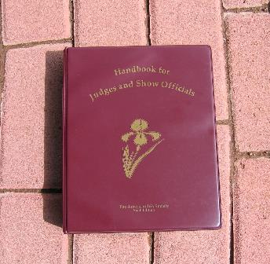
How does the AIS Improve the Iris?
…branches cannot hold flowers
too tightly against the stalk
…Color alone is insufficient
justification for an award
Encourages discussion on the merits of individual cultivars (i.e. AIS bulletin)
Develop guidelines (Judges Handbook) for what constitutes a good iris form. Yet, allow flexibility in the interpretation of that form.
…should produce 3-5
increases per rhizome
…strong midribs are vital assets
…remain in bloom over two weeks
…must maintains its form for 3 days
…plicata patterns should be distinct
and not appear as stains.
…color that fades rapidly
is unacceptable
…muddy dull colors…are
lacking in good color clarity
…should possess individuality
and exhibit unique qualities
…standards may be erect
or domed, open or closed,
touched or overlapping.
…be observed over two
consecutive bloom seasons

Slide 25
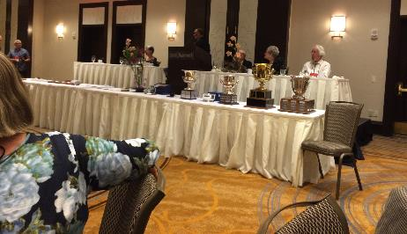
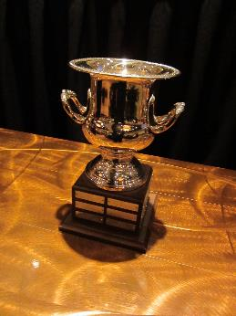
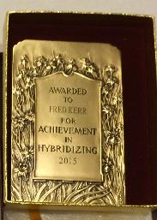
How does the AIS Improve the Iris?
John C. Wister Medal
Tall Bearded
Hans and Jacob Sass Medal
Intermediate Bearded
Sponsors awards for the “best” iris in each section and for the top iris overall.
These awards encourage the hybridizers to produce top quality irises.
Williamson-White Medal
Miniature Tall Bearded
J.A. Payne Medal
Japanese
Knowlton Medal
Border Bearded
Mary Swords DeBaillon Medal Louisiana
Caparne-Welch Medal
Miniature Dwarf Bearded
Cook-Douglas Medal
Standard Dwarf Bearded

Slide 26
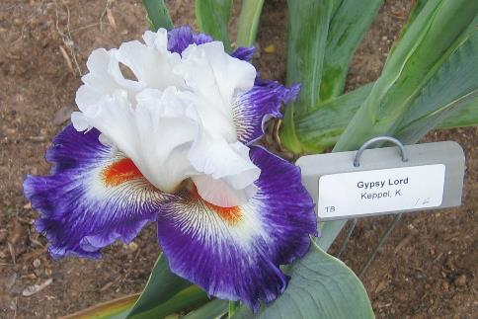
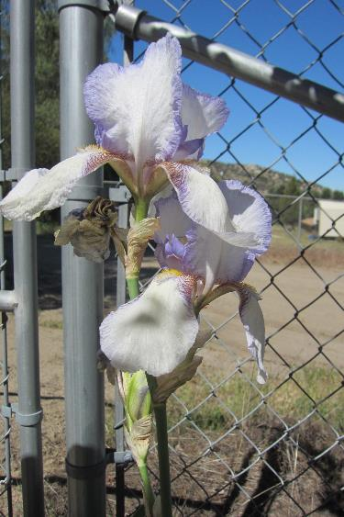
Dykes Memorial Medal
The Dykes Medal is the highest award of the AIS. Awarded to no more than one iris per year. Irises are eligible as a Dykes Medal candidate for three years following winning a classification medal. Only AIS registered judges may vote.
Gypsy Lord, 2015
Dykes
San Francisco, 1927
Everything Plus, 1991
Notes:
The American Dykes Memorial Medal
This is one of the highest awards judged by the American Iris Society Judges. It is awarded by the British Iris Society in honor of William Rickatson Dykes to the best Iris developed by an American hybridizer. The candidates are chosen from the AIS Medal winners that have been bred by American (US & Canadian) Hybridizers. The Medal winners are the best irises in their class. So this is the best of the best. The British Iris Society also presents Dykes Medals to Great Britain, Australia, New Zealand and previously France.

Slide 27
Dykes Display Gardens

Slide 28
Changes in Dykes Medal Winners Throughout the Years
Montmartre, 2017
Coralie, 1933

Slide 29
Changes in Dykes Medal Winners Throughout the Years
That’s All Folks, 2013
New Moon, 1973
Truly Yours, 1953

Slide 30
Changes in Dykes Medal Winners Throughout the Years
Golden Panther, 2009
Copper Lustre, 1938
Argus Pheasant, 1952
Notes:
All brown are blends, deriving their color from the visual mingling of two different pigments. Many are uniform in color but some will show graduations of other color.
Brown seems like an unusual color for a flower called the rainbow flower. However, hybridizers have always strived for colors beyond the rainbow.

Slide 31
How does AIS improve the iris?
Trains and accredits judges for garden judging
The most important responsibility of a judge is voting the annual AIS ballot for the AIS awards and medals.
To vote the ballot knowledgeably a judge must grow a selection of newer varieties.
He/she must also tour gardens to observe as many irises as possible. This takes a commitment of time and money.

Slide 32
Display Gardens Nation-wide
Some are display gardens dedicated to a particulate type of iris, or heirloom irises or native irises.
AIS Display gardens exist across the nation. Many are open to the public 24/7. Others are private gardens, open by appointment.
Corey Garden in
Reading, MA, 1950s
Chadwicks, Oregon
Collier, Washington
Mid America, Oregon

Slide 33
Additional Activities
Photo Contests
Preserving heirloom irises
Conservation of native iris species
Collection, compilation, and publication of data concerning the history, classification, breeding and cultivation of irises
Promoting the Iris (AIS bulletins, iris display gardens, iris shows, websites)
Educating the public
On-line Library
On-line Iris Encyclopedia
Popularity symposia
Tectorcorus
Spec Red Dazzler
Notes:
Ally Oops
Spec Red Dazzler
Tectorcorus blue

Slide 34
How does the AIS Preserve Heirloom Irises?
Through the volunteer efforts of the Historic Iris Preservation Society
Display gardens in 20 regions throughout the country
Provides contacts and opportunities for people to find and grow heirloom irises.
Provides commercial source listing.
Through the HIPS bulletin ROOTS and the HIPS website to share interests, deepen enjoyment, and help disseminate varieties
Aitkens
Evanston, IL, 1950s
Concord, MA 1950s
Notes:
Some folks concentrate on specific hybridizers, others on specific eras
The three vintage photos are from 1950's era Cooley's Gardens catalogs. The Steadman Buttrick garden in Concord, MA, The Franklin Cook garden in Evanston, IL, and the Corey garden in Reading, MA.

Slide 35
Historic Iris Preservation Society Activities
Grows, exchanges information and irises
Sponsors a yearly historic iris sale with donated irises made available for purchase
Writes chronicles of past hybridizers or of a single topic or era.
Commercial Source Chairman advises potential buyers on where they may find particular varieties
Maintains a database, voluntarily reported, of who grows what and who is willing to share
Aitkens
Notes:
For instance, HIPS just assisted in redistributing a large collection of 1960 & 70's varieties when Lorraines Iris Patch closed its doors. Most would probably have been lost to time without the work our members are doing to ensure they are sent to good homes.

Slide 36
Historic Iris Display Gardens
Many historic iris display gardens exist throughout the nation. Check out the HIPS web site. Some may be dedicated to an era or to a hybridizer.
Reberts, Westminster, MD
Unser Garden
Shelton, WA
Schreiners, Oregon
Notes:
The Reberts garden is in Westminster, MD. photo is by Laetitia Munro The Unser garden is in Shelton, WA. And the Schreiners Is in Oregon. Both photos by Mike Unser

Slide 37
Presby Historic Iris Display Garden, NJ

Slide 38
Historic Iris Display Gardens
Lanesfield Historic School Site, Kansas City

Slide 39
How Does AIS Conserve Native Irises?
Through the volunteer efforts of the AIS Section Species Iris Group of North America (SIGNA)
Display gardens
Seed Exchange
Through the SIGNA bulletin and the SIGNA website. Back issues of SIGNA are still in demand due to the relevance of their information.
Dietes sp. Photo by Ken Walker
Iris Tingitana, Photo by Ken Walker
Notes:
Blue clump is Fresh Notes
Darker blue clump is Chinese Blue by Niswonger SPEC-X 02

Slide 40
SIGNA Activities
Research wild species and irises in the wild
Study the range of habitat
Promote a wider appreciation of these irises and their hybrids for use as gardens ornamentals.
Support iris conservation in the wild
Finance research grants and germplasm collection
Pseudacorus Varigata
Notes:
Mt Pleasant Gardens
Pseudacorus Varigata

Slide 41
SIGNA Seed Exchange
60-80 donors from all over the United States and seven foreign countries contributed 500-700 types of iris seed.
In December the seed list is sent to SIGNA members.
The orders are processed on a first ordered first served basis and many people go to great lengths to send in their orders immediately. Thousands of packages are sent.
Many offerings are rare and unusual, and often in very short supply.
Only members of SIGNA may participate in The Seed Exchange. (Non-members may join by including the cost of a membership with their seed order).
SIGNA has also helped sponsor several trips to collect species iris plants and seed. One trip went to China in 1983.
Neomerica Flumiensis
Photo by Rodney Barton

Slide 42
Seed Exchange
Ferraria crispa
Babiana Augustifolia
Neomarica eximia
Photos by Rodney Barton

Slide 43
How Does AIS Conserve Native Irises?
Through the volunteer efforts of the AIS Section Society for Pacific Coast Native Iris (SPCNI)
Display gardens
Preserving and encouraging dissemination of wild-growing irises native to California, Oregon and Washington.
Through the ALMANAC, with reports describing members' experiences as they discover wild iris populations, raise "Pacificas" in their gardens, or cross different varieties to produce new hybrids The Almanac provide sources of seed, seedlings and plants
Professor Neil
Notes:
Red iris is Professor Neil. Photos taken at Aitkens

Slide 44
SPCNI Activities
Evaluate introduced varieties and research wild species
Provide articles on growing iris from seed, planting mixes, fungus and disease control
Provide articles on transplanting, and hybridizing methods
Encourage commercial use of “Pacificas” by providing tips in landscape design
Provide growing tips for eastern states and other countries
Sponsor guided field trips to see wild “Pacificas” iris, and to gardens that use the various species in landscaping projects.
Exchange plants and seeds of species and hybrids

Slide 45
How Does AIS Conserve Native Irises?
Through the volunteer efforts of the Society for Louisiana Irises (SLI). The founders of SLI came together in 1941 with the intention of preserving and promoting interest in Louisiana irises since the wetland habitat was threatened.
Promote the use of Louisiana irises both in the garden and the landscape and the preservation of the native species in their natural habitat.
Support scientific research, including those pertaining to the solution of diseases related to, but not necessarily exclusive to the Louisiana iris
Display gardens
http://www.louisianas.org/

Slide 46
Louisianas Species Preservation Project
Through the volunteer efforts of the Society for Louisiana Irises (SLI), many native species from Louisiana to Florida to Texas to even Ohio are being collected. Over 100 varieties are now being safe-guarded as their natural habitat diminishes. Many Louisianas we collected just before their habitat were bull-dozed!
Part of the preservation project is to establish and maintain colonies on lands protected from development.
Their ultimate goal is to have the diversity of the species available for public viewing in every state where they once grew.
http://www.louisianas.org/
Notes:
Information from Fleur de Lis, Summer 2018

Slide 47
Louisiana’s Display Garden

Slide 48
How does the AIS Provide Information About Irises?
http://wiki.irises.org/
The AIS Iris on-line Encyclopedia provides information and pictures of all registered irises.

Slide 49
How does the AIS promote the iris?
National Conventions, regional and local meetings (open to the public)
Conventions for specific classification of iris
Twitter, Facebook, Instagram
Encourage E-mail lists, robins and on-line interactive discussion groups devoted to the iris.
http://www.irises.org/resources/links/

Slide 50
How does the AIS educate the public?
Exhibitions, i.e. shows (judged by accredited judges)
AIS web site ( www.irises.org )
Presentations available for free to AIS members
(http://www.irises.org/members/presentations/)
Youth and school programs
Educational Materials

Slide 51
How does the AIS educate the public?
By showing that irises can grow in many climates, in many types of soils. By showing what types of irises can grow where.
Las Cruces, NM, desert conditions, alkaline soils. Grow bearded irises including Arilbreds. Cannot grow Siberians or Japanese Irises.
Victoria, Canada, moist loamy soil. Grow bearded irises, Siberians and Japanese irises. Can grow Arilbreds with difficulty

Slide 52
How does AIS educate youth?
Through youth artistic programs, essays and coloring contests
Through local clubs providing rhizomes to schools and teaching students how to grow irises
Through activities to help learning about iris culture
Providing AIS membership to the youth at reduced prices
Through the website http://www.aisyouth.com/
Notes:
TO SET UP A CLASSROOM IRIS PROGRAM (C.I.P.) Get the names and birthdates of the youth members
Send in $5 w/o AIS Bulletin or $9 w/ Bulletin dues for each youth to AIS (Note: to receive the $5.00 rate, someone in the household must already be an AIS member. Many local clubs pay the AIS dues for their youths who participate in some way -- either in shows, at meetings, or in sales/auctions.)
Send the name of the adult in charge (teacher/leader) and
The school's address (most CIPs are done this way, but some send the youth address)
Send the information to Tom Gormley, National AIS membership secretary (see the membership page of this web site.)

Slide 53
How does the AIS educate the public?
http://wiki.irises.org/Hist/ArticlesOnHistoricIris
For the reference, research, and education of horticultural, scientific, and general audiences, the AIS Hager/DuBois Memorial Iris Library collects and makes available published literature, archives, and visual records pertaining to the genus Iris. It includes Articles, Books, Catalogs, Presentations, and Videos. It both online and physical.
Notes:
Quick Response (QR) codes allow a mobile device to read a code and send someone to a URL (webpage).

Slide 54
Facebook
The AIS, it’s sections, cooperating societies and many regions and local clubs have Facebook pages. These pages discuss upcoming events, show photos of the latest seedlings and introductions and give hybridizers an opportunity to gather opinions about their latest creations from the iris community.

Slide 55
AIS Hager/DuBois Memorial Iris Library

Slide 56
AIS Hager/DuBois Memorial Iris Library

Slide 57
AIS Research
Encourages or supports Iris research on:
Native or species irises
Iris taxonomy
Genetic markers
Iris diseases and insects
Fertility Tests
History of early cultivars
Kansas State Research Garden

Slide 58
AIS Membership Benefits
A subscription to the AIS Bulletin (4/year)
News and Notes (on-line AIS news magazine)
You can choose to participate in the annual AIS National Convention.
Be a part of Iris popularity polls (don’t have to be a judge). It is also open to the public
Contacts with the community devoted to the iris.
Some commercial growers will even pay your AIS membership fee if you buy so many irises

Slide 59
AIS Membership Benefits
A subscription to the AIS Bulletin (4/year)
News and Notes (on-line AIS news magazine)
You can choose to participate in the annual AIS National Convention.
Be a part of Iris popularity polls (don’t have to be a judge). It is also open to the public
Contacts with the community devoted to the iris.
Some commercial growers will even pay your AIS membership fee if you buy so many irises

Slide 60
Bulletin
Color-illustrated
Articles on iris culture and hybridizers
Discussion on the merits of various cultivars
Reports on the activities of the AIS, its sections and the regional affiliates
Directory of commercial growers.
Articles of a historic nature.

Slide 61
News and Notes
On-line news magazine provided to members that contains the latest happenings from the AIS

Slide 62
AIS National Convention
The convention is held in a different city each year. Hybridizers all over the country the world come to talk about the latest Iris happenings. Close to 1000 iris fans attended the 2006 convention in Portland, OR.

Slide 63
Convention Events
The national convention is the main event for the American Iris Society.
The activities include:
Bus tours of convention gardens
Judges training
Meetings for Regional Vice Presidents (RVPs), AIS Sections and Board
Gift shop of hand-crafted iris paraphernalia

Slide 64
Events (cont)
Briefings by the world’s most influential iris hybridizers
Socializing with iris fanciers from all over the world
Banquets
Awards dinner
Sharing/Learning knowledge

Slide 65
Iris Nurseries
Schreiner’s
You can visit the Convention city’s local iris nurseries.

Slide 66
AIS National Convention Display Gardens
Hybridizers send their latest creations to the Display Gardens created especially for the national convention. These irises have been recently introduced or are seedlings.
Wildwind, Oregon, 2006
Schreiners

Slide 67
Opportunity to See the Latest Seedlings

Slide 68
AIS is the Official Registry For The Entire World
AIS is the Official Registry For The Entire World

Slide 69
Official World Registry
Each iris variety is first "Registered" with the AIS and later "Introduced“ when it is first offered for sale to the general public.
This was done to provide a “one-stop” location for registry and to prevent confusion of irises that would arise if an iris was registered in two different countries under different names
http://www.irises.org/hybridizers-growers/iris-registration/#forms
Does not include bulbous irises. These irises are handled by an organization in Holland
The year of registration and introduction are usually different

Slide 70
AIS Membership

Slide 71
You Too Can Join
Register online at
http://www.irises.org/joining-on-line/
Or mail a check made out to the American Iris Society at:
Tom Gormley-AIS Membership Secretary P.O. Box 177
DeLeon Springs, FL 32130
Phone and fax: 386-277-2057
E-mail: aismemsec@irises.org
Note the above link will allow you to join the various cooperating societies including the AIS

Slide 72
E-Membership
AIS Electronic Membership: AIS eMembership is separate from the normal AIS membership. eMembers do not receive printed copies of the AIS Bulletins. Instead, they have access to online AIS Bulletins using an easy to use viewer. eMembers also have access to online viewing of The Basic Iris Culture booklet and access to irisregister.com, the online database of iris registrations and introductions.

Slide 73
$25 Voucher for Joining or Upgrading
A $25.00 VOUCHER MAY BE YOURS! The AIS Voucher Program continues in 2019; now available for any new member of AIS, any new E-Member, or for any current member who upgrades membership; that is, upgrades from a single membership to a triennial or to a dual, or an E-Member who upgrades to multiple years of E-Membership. Please follow this link to read the full program details and a listing of participating nurseries: http://www.irises.org/pdf/2016_Voucher_Program_rev_1.pdf

Slide 74
Membership Fees

Slide 75
The End
End This Presentation

